Slide 1
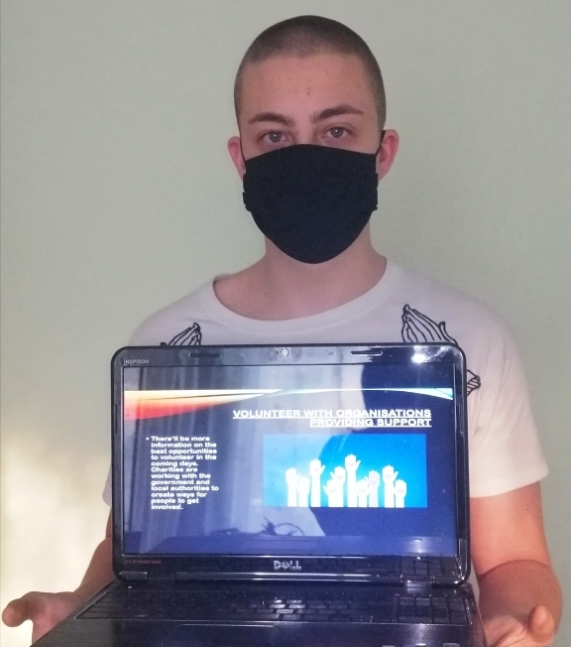
Uplifting our world through volunteering in the time of COVID-19
Nikolai Atanasov -9-th grade
Foreign Language School
Pleven, Bulgaria

Slide 2
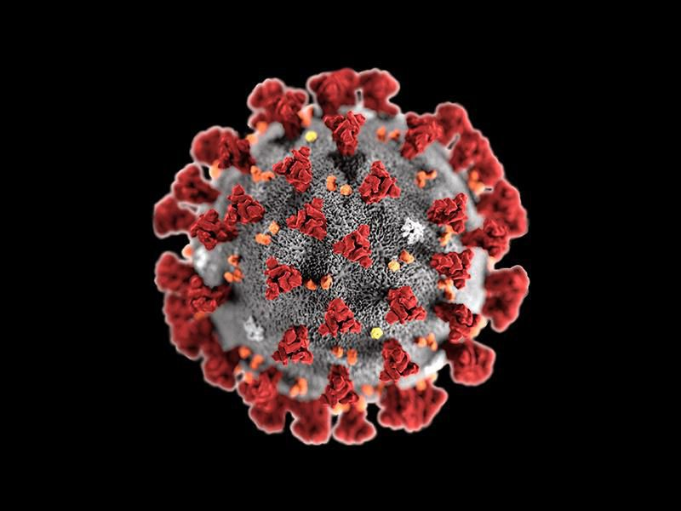
What is COVID-19?
Coronavirus disease (COVID-19) is an infectious disease caused by a newly discovered coronavirus.
Most people infected with the COVID-19 virus will experience mild to moderate respiratory illness and recover without requiring special treatment. Older people, and those with underlying medical problems like cardiovascular disease, diabetes, chronic respiratory disease, and cancer are more likely to develop serious illness.

Slide 3
HOW TO PREVENT FROM THE VIRUS?
The best way to prevent and slow down transmission is be well informed about the COVID-19 virus, the disease it causes and how it spreads. Protect yourself and others from infection by washing your hands or using an alcohol based rub frequently and not touching your face.

Slide 4
VOLUNTEERING - HOW CAN YOU HELP?
Look out for your neighbours
The simplest thing everyone can do right now is look out for their neighbours and offer help with shopping and other errands. If you must stay at home but feel well enough to help, you can volunteer remotely, for example to befriend people who are isolated people or share official information.

Slide 5
Stay safe when supporting others
Only volunteer if you feel well enough and are not shielding, self-isolating or in a high-risk group.
Keep washing your hands often for 20 seconds.
Stay at least two metres - about three steps - away from people you’re helping.
If you’re trying to help someone with very serious issues – don’t be afraid to flag with appropriate statutory services.
Support family, friends and neighbours by phone or video call.
Offer to run errands for people but stay outside of people’s homes.
Let family and friends know what you’re doing.
Don’t take on too much - it's often better not to offer at all than to let someone down.

Slide 6
Volunteer with organisations providing support
There’ll be more information on the best opportunities to volunteer in the coming days. Charities are working with the government and local authorities to create ways for people to get involved.

Slide 7
Other ways to help charities
All charities are going to be stretched. Lots of fundraising events that would’ve taken place have been cancelled. At the same time, many people who volunteer may not be able to - especially if they’re being advised to stay at home.

Slide 8
Be a volunteer in the time of COVID-19! Help other people! #ResponsibleTogether #EuropeAgainstcovid-19

