Slide 1
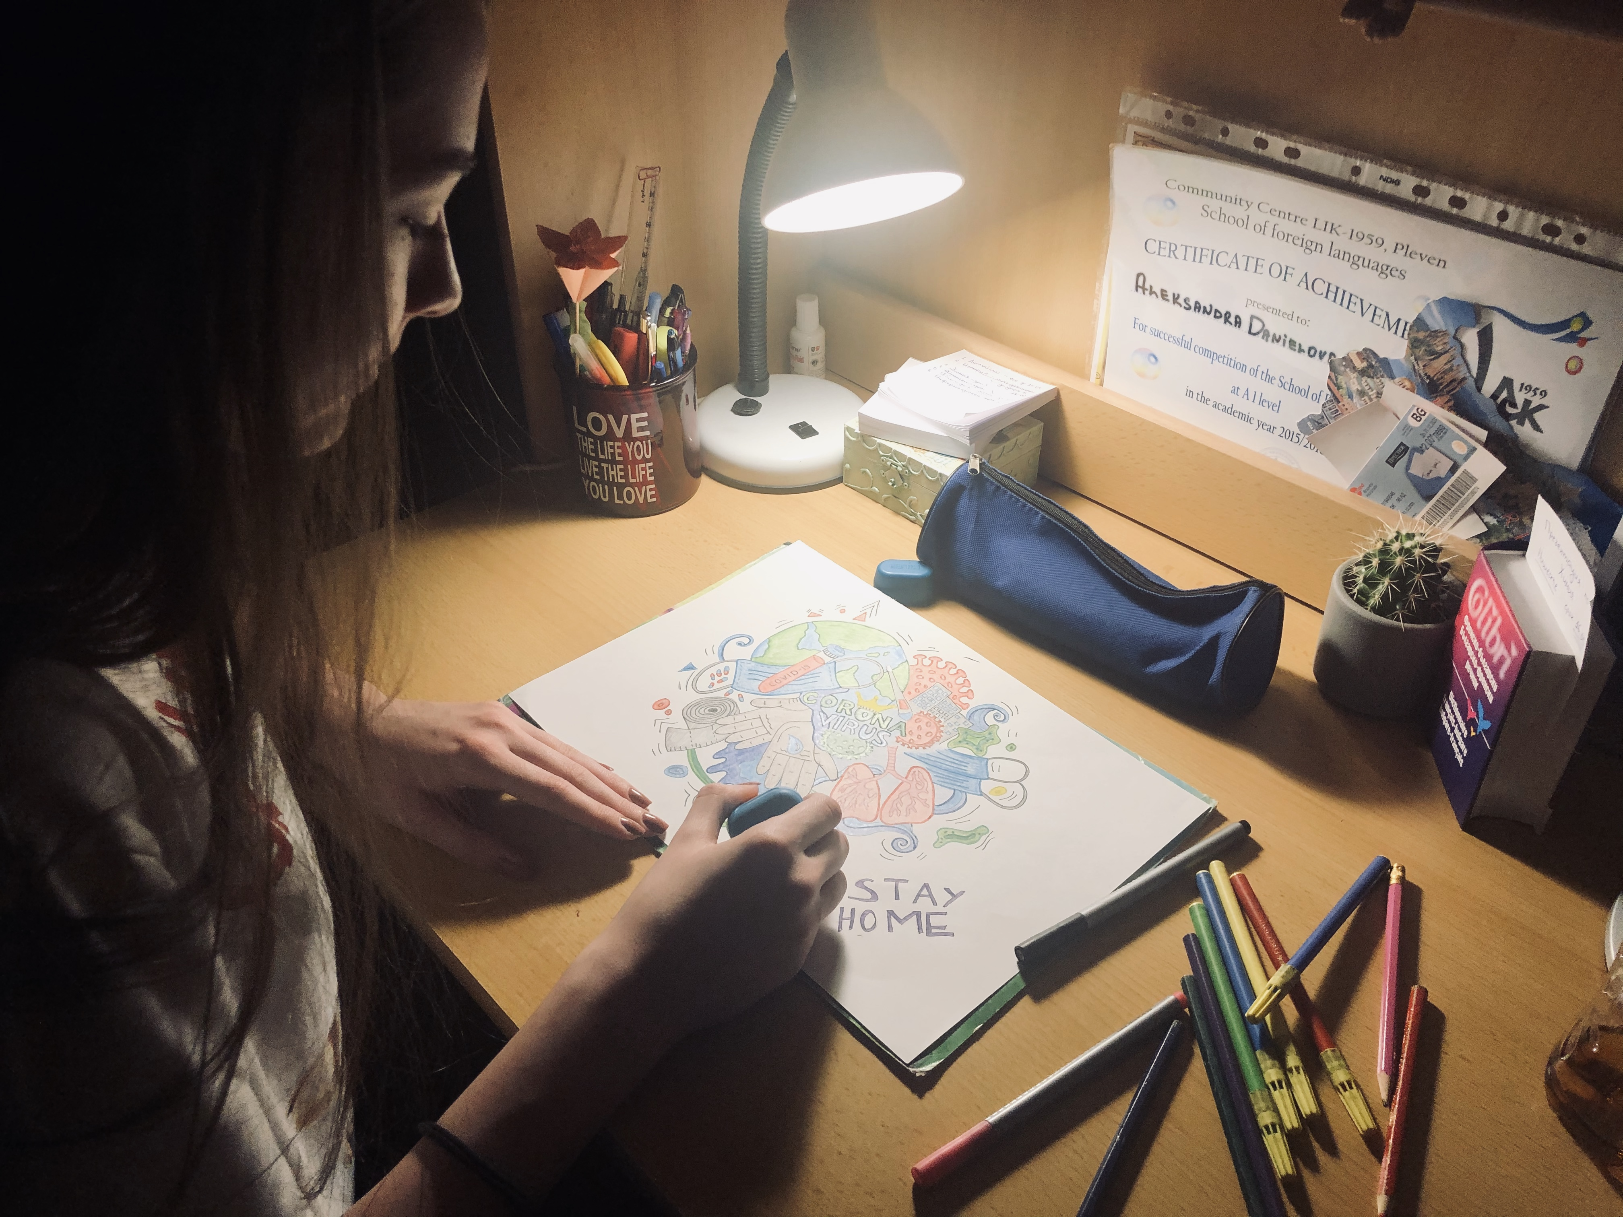
10 simple ways to care for each other during the COVID-19
Alexandra Genova – 9-th grade
Foreign Language School – Pleven, bulgaria

Slide 2
#1) Look after yourself, to look after us all – flatten the curve!
If we all do our best to stop the spread, we can flatten the curve!
Use simple social distancing tactics like replacing hugs and handshakes with alternatives …

Slide 3
#2) Check in on elderly neighbors
Although necessary, social isolation can be lonely. Text, phone call, email or, if needed, in person (taking the proper safety measures), especially if they live alone.

Slide 4
#3) Reach out to people in self isolation
Send them funny memes or GIFs to cheer them up. Call them. Video chat them. Don’t forget about them. Make sure they feel less alone and have social support. Offer them help. Some communities have started to use these cards to help neighbors who are in self-isolation.

Slide 5
#4) Volunteer your time.
Know someone in self isolation or who needs to limit their public interactions ?
Offer to pick up and deliver their shopping, treats or other things they might need, while taking precautions to keep yourself safe. Your time and labor could be a big help to someone needing support.

Slide 6
#5) Counter racist fears and xenophobia
Diseases can make anyone sick regardless of their origin or ethnicity. Yet because the virus originated in China, people of Chinese descent have faced a wave of racism . Help stop the fear and abuse by educating people and correcting racist comments or behavior when you hear or see them.

Slide 7
#6) Combat misinformation online
Unfortunately, if not unexpected, misinformation on COVID-19 is floating around online. If you see it, report it to your platform and let anyone posting/sharing it know

Slide 8
#7) A radical idea: rent payment relief for self-isolated people without paid sick leave?
If you’re a landlord and have the extra income, you could consider freezing rent payments and ensuring no evictions occur for any tenants struggling financially due to the pandemic. What do you think?

Slide 9
#8) Fundraise for people financially impacted by quarantine measures
Fundraising platforms can help you organize, but word of mouth, email and text are also tried and true ways to do some grassroots fundraising in support of someone affected by things like missing work, paying for childcare because of school closures, or extra medical costs.

Slide 10
#9) Make social distancing fun with video chat
Social distancing doesn’t mean we can’t feel close to our loved ones. Get creative. Have a video chat to get together and celebrate birthdays or other occasions using everyday tools like Skype, Hangouts or Zoom.

Slide 11
#10) Share positive news and acts of kindness with your community
There are so many examples out there of people helping one another. Share those. Talk about those. Together we can prevent getting caught in a bad news hopelessness spiral. Spread the word about how you’re making a difference.

Slide 12
Thank you for your attention!

