Slide 1
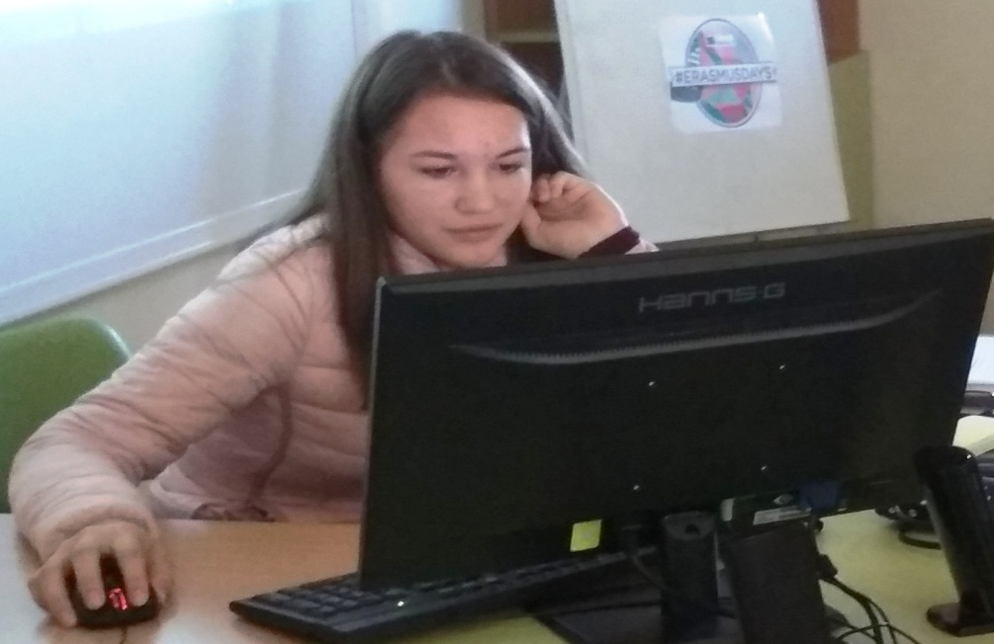
Viktoria Dobreva – 9-th grade Foreign Language School Pleven, Bulgaria
We believe in Europe

Slide 2
Europe Day
Europe Day is a day celebrating "peace and unity in Europe"^{[1][2]} celebrated on 5 May by the Council of Europe and on 9 May by the European Union.
The first recognition of Europe Day was by the Council of Europe, introduced in 1964.^{[3]} The European Union later started to celebrate its own European Day^{[4]} in commemoration of the 1950 Schuman Declaration, leading it to be referred to by some as "Schuman Day" or "Day of the united Europe".^{[5]} Both days are celebrated by displaying the Flag of Europe.^{[6}

Slide 3
History
The Council of Europe was founded on 5 May 1949, and hence it chose that day for its celebrations when it established the holiday in 1964.[
The "Europe Day" of the EU was introduced in 1985 by the European Communities (the predecessor organisation of the EU). The date commemorates the Schuman Declaration of 9 May 1950, put forward by Robert Schuman, which proposed the pooling of French and West German coal and steel industries. This led to the creation of the European Coal and Steel Community, the first European Community, established on 18 April 1951.

Slide 4
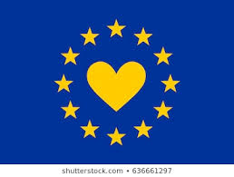
History
A "raft of cultural icons" was launched by the European Commission in 1985, in reaction to the report by the ad hoc commission "for a People's Europe" chaired by Pietro Adonnino. The aim was to facilitate European integration by fostering a Pan-European identity among the populations of the EC member states. The European Council adopted "Europe Day" along with the flag of Europe and other items on 29 June 1985 in Milan.[

Slide 5
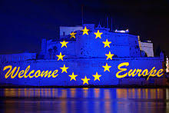
History
Following the foundation of the European Union in 1993, observance of Europe Day by national and regional authorities increased significantly. Germany in particular has gone beyond celebrating just the day, since 1995 extending the observance to an entire "Europe Week" (Europawoche [de]) centered on 9 May. In Poland, the Schuman Foundation [pl], a Polish organisation advocating European integration established in 1991, first organised its Warsaw Schuman Parade [pl] on Europe Day 1999, at the time advocating the accession of Poland to the EU.

Slide 6
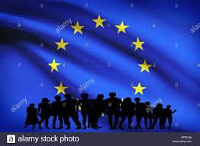
History
Observance of 9 May as "Europe Day" was reported "across Europe" as of 2008 In 2019, 9 May became an official public holiday in Luxembourg each year, to mark Europe Day.^{[14]} The EU's choice of the date of foundation of the European Coal and Steel Community rather than that of the EU itself established a narrative in which Schuman's speech, concerned with inducing economic growth and cementing peace between France and Germany, is presented as anticipating a "vocation of the European Union to be the main institutional framework" for the much.

Slide 7
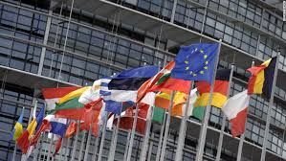
History
The European Constitution would have legally enshrined all the European symbols in the EU treaties, however the treaty failed to be ratified in 2005, and usage would continue only in the present de facto manner. The Constitution's replacement, the Treaty of Lisbon, contains a declaration by sixteen members supporting the symbols.^{[16]} The European Parliament "formally recognised" Europe Day in October 2008. further-reaching European integration of later decades.

Slide 8
Legal recognition
Europe Day is a public holiday for employees of European Union institutions. In 2019, it was declared a public holiday in Luxembourg for all citizens and is also a public holiday in Kosovo, according to the disputed government there. It is a "memorial day" in Croatia, which is a legally-recognised day, but is not a public holiday; a legally-recognised commemorative day in Lithuania and a "flag day" (German: Beflaggungstage) in Germany, where flags are ordered to be shown by federal decree.

Slide 9
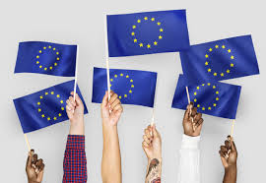
Europe day in Bulgaria
On 14 December 1995, the Bulgarian parliament voted a resolution under which the Republic of Bulgaria should submit an official application for full membership of the European Union. A long process of negotiations began.
On 25 April 2005 at ceremony in Luxembourg, Bulgaria and Romania signed treaties of accession to the European Union on 1 January 2007.

Slide 10
Europe day in Bulgaria
Bulgaria 's accession to EU was expected with great enthusiasm across the country. Millions of viewers watched live the ceremony on 25 April 2005, as the event offered a moving national nuance – the Anthem of Europe from Beethoven's Symphony No. 9 was performed in Bulgarian by the incredible singers from the choir Le Mystere Des Voix Bulgares .

Slide 11
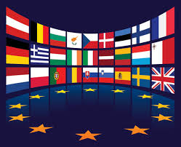
Europe day in Bulgaria
For Bulgarians the European Union was more of a social alliance working for the cause of security and prosperity in the most important spheres of life – economy, employment, standards of living, human rights, social benefits and opportunities for study.

Slide 12
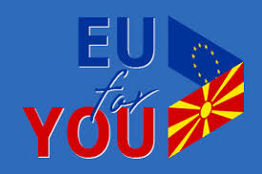
Europe day in Bulgaria
With time enthusiasm switched to a more realistic attitude and overtones of Euroscepticism could also be heard. Most Bulgarians are aware that being part of the European Union is not a panacea; that apart from a social community the EU is also a liberal space where personal success is a priority. As a whole the support of Bulgarians for EU membership remains high – 55% and is six percentage points higher than in 2016, Eurobarometer suggests.

Slide 13
Europe day in Bulgaria
The main priority areas where Bulgarians want to see more results on the part of the European Union include combating terrorism (61%); poverty and social inclusion (40%); and uncontrolled migration (38%). These are followed by the problems of unemployment (33%), religious radicalism (26%) and organized crime (24%).

Slide 14
Europe day in Bulgaria
Without doubt stronger support for EU at the end of 2017 is linked to the Bulgarian Presidency of the Council of the European Union but also to the European policy of combating terrorism and uncontrolled migration.

Slide 15
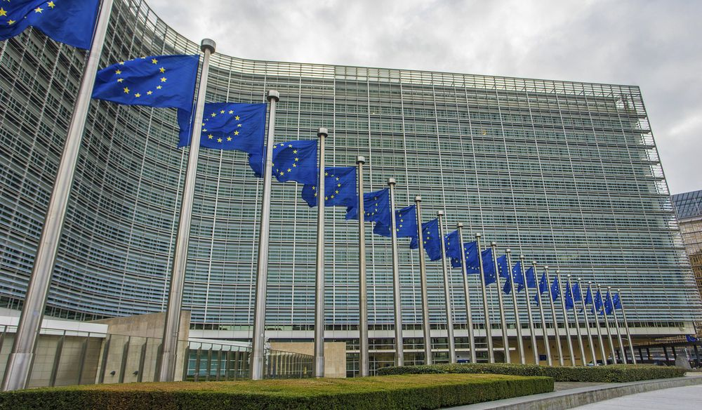
Europe day in Bulgaria
This year is the year of the first Bulgarian Presidency of the Council of EU. The atmosphere on 9 May, Europe Day, is festive in Sofia and across the country. Tonight starting from 9:30 p. m. Sofia is hosting a 3D mapping show on the façade of the Council of Ministers. „This is an unconventional way to mark Europe Day”, commented Teodor Stoychev, head of the information office of the European Parliament in Sofia.

Slide 16
Europe day in Bulgaria
The highlight will be the European Year of Cultural Heritage. A Literature Night is on the program in Sofia. The event is organized jointly with the cultural institutes of the EU Member States and seeks to popularize European culture. Other 11 cities will also host European Literature Nights including Plovdiv, Varna, Rousse and Veliko Tarnovo.

Slide 17
European celebrations are due on 12 and 13 May when the South Park in Sofia is hosting the festival Famillathlon featuring a stand of the European Commission. It is part of the French movement Famillathlonand has been organized for a tenth year running by Roditeli (Parents) Association. The event is dedicated to the family, sports and healthy lifestyles and offers a diverse program of activities for children and parents. One of them is the entertaining game The Little Europe in which every family can learn interesting facts about the European Union member countries.

