Slide 1
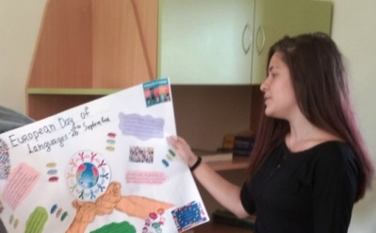
A message from the future
Tsvetina Tsvetanova – 9-th grade
Foreign Language School
Pleven, Bulgaria

Slide 2
You are all aware of the coronavirus in the world.You must be wondering what will happen when it all goes away.This is the moment you will find out.You are reading a MESSAGE FROM THE FUTURE.

Slide 3
Yes, it will pass.But not so fast.Mankind must learn this way of life-strict measures, prohibitions, compliance with rules.
The year I come from is a little different. People do not underestimate hygiene, sightseers go on vacations in their own countries to support the economy.

Slide 4
Our worlds have contracted to the confines of our homes, and yet in some ways we’re more connected than ever to one another. We feel fear and boredom, anger and gratitude, frustration and strange peace. Uncertainty drives us to find metaphors and images that will let us wrap our minds around what is happening.

Slide 5
COVID 19 IN THE WORLD
They will find a cure for the virus. The virus still exists, but the pandemic and the peak of the disease are gone.

Slide 6
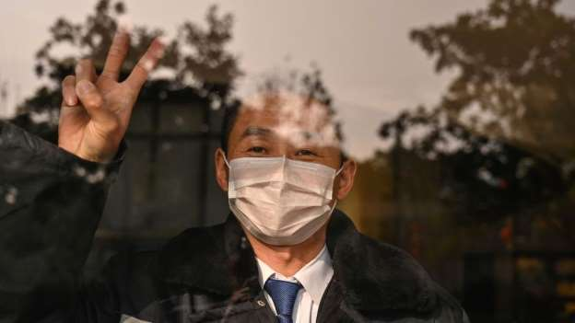
STAY STRONG

Slide 7
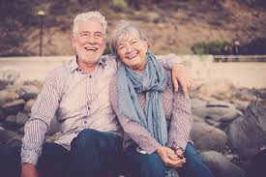
AFTER COVID 19

