Slide 1
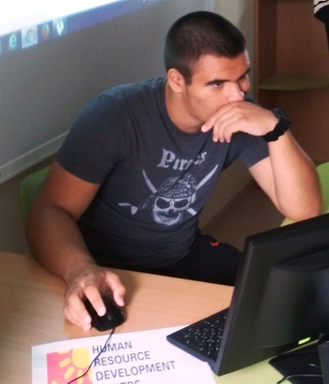
Messages of hopes to other people during COVID-19
Borislav Stefanov – 9-th grade
Foreign Language School
Pleven, Bulgaria

Slide 2
Messages from India
Indian artist Sudarsan Pattnaik puts some final touches as he makes a sand sculpture depicting doctors
wearing protective facemasks with a message reading "We are For You", "Stay Home Stay Safe" at Puri beach in Puri.

Slide 3
Messages from England
People walk past a message on a billboard in West London, as the spread of the coronavirus disease (COVID-19) continues, London, Britain.

Slide 4
Messages from Switzerland
Swiss army soldier Arthur, waves next to a big heart made with flowers with the message for you (pour vous) to thank medical workers at the bottom of the hospital building of the HiB Hospital (Hopital intercantonal de la Broye) because of the coronavirus outbreak, in Payerne, Switzerland.

Slide 5
Messages from South Africa
A man walks beneath a billboard during the 21-day nationwide lockdown aimed at limiting the spread of coronavirus disease (COVID-19) in central Cape Town, South Africa.

Slide 6
Messages from USA
A person walks by a sign on a freeway overpass during the global outbreak of the coronavirus disease (COVID-19), in Los Angeles, California, U.S.

Slide 7
THANK YOU FOR YOUR ATTENTION!

