Slide 1
”Get in shape for Europe” (GISE)
2018-1-RO01-KA229-049580
Let’s Act Against Gender Violence!

Slide 2
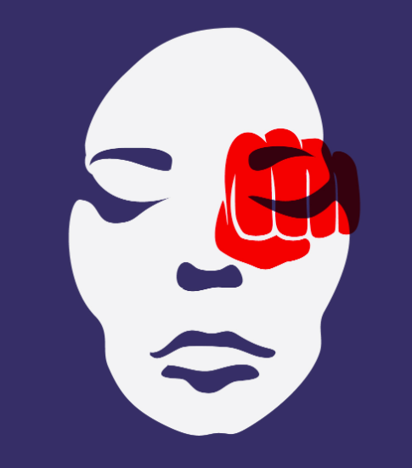
Did you know that, according to statistics, gender-based violence kills as many women as cancer? Far from being a marginal, banal and unimportant phenomenon, gender violence is a widespread reality in Romania, as well as in the European Union. Considering these aspects, we developed the project entitled "Act against gender violence" which won first prize in an important competition organized by the Vaslui School Inspectorate.

Slide 3
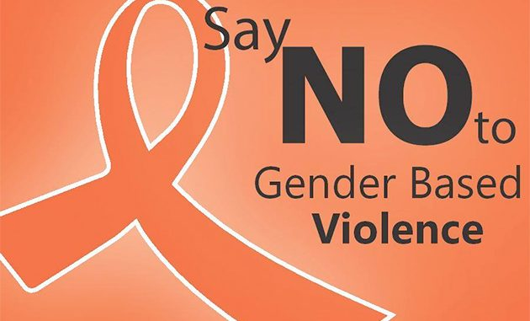
The specific objectives of the project were:
awareness by participants that gender-based violence is a current social problem and a violation of human rights;
improving participants' knowledge of the causes, forms and consequences of gender-based violence;
improving participants' skills to propose solutions to reduce gender-based violence.

Slide 4
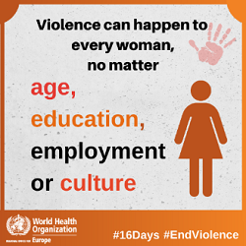
The 22 students in the target group participated in five training sessions on gender violence.
The applied methods were interactive: case studies, debates, group work, storytelling, brainstorming.

Slide 5
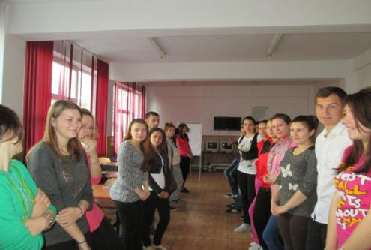
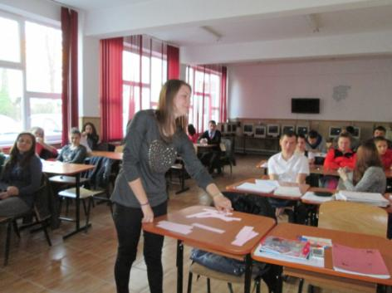
During the first training session, participants understood the difference between gender and sex, learned to distinguish biological differences from stereotypes, established what gender violence and domestic violence mean, realized that gender violence is not a quarrel between lovers, establishing the differences between these two types of violence, they expressed their opinion on various statements about gender violence, establishing myths and realities.

Slide 6
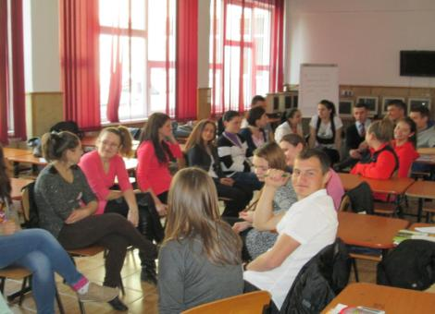
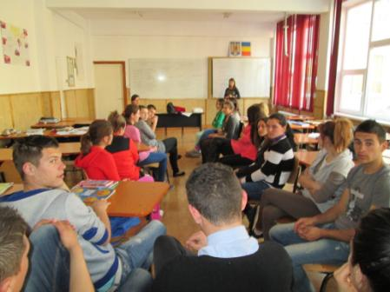
During the second training session, the participants identified the causes of gender violence, the forms of manifestation and its consequences. The students were divided into 8 groups, each receiving the task of identifying abusive behaviors that, in their opinion, could fall into the 8 segments of the wheel: intimidation, emotional abuse, isolation, minimization, denial and blame, the use children, economic abuse, male privileges, coercion and threat. The conclusion we reached is that the aggressor, using the mentioned behaviors, gains control and power. The "Wheel of Equality!", the alternative to violence between partners, was also completed.

Slide 7
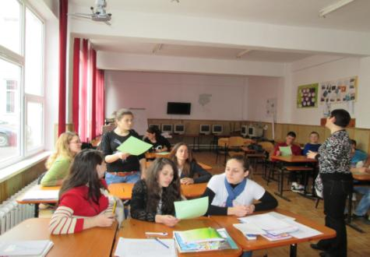
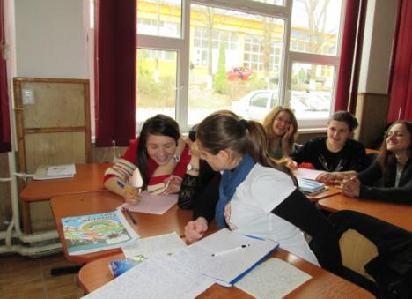
During the third training session, the students, divided into groups, identified elements that, from their point of view,are characteristic of a healthy relationship between a woman and a man, they discussed the ways in which culture contributes to the production, dissemination and perpetuation of gender violence. Also, through a group exercise, students came to the conclusion that language is not gender neutral and often contributes to manifestations of gender violence.

Slide 8
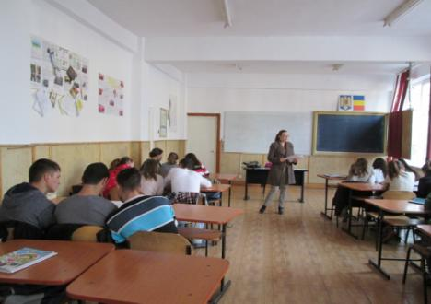
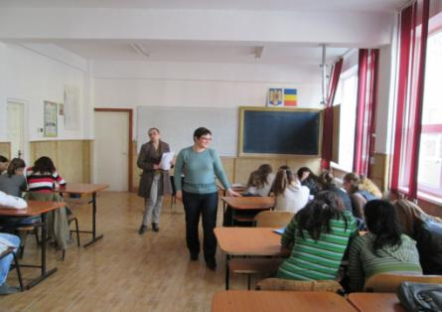
On the occasion of the fourth training session, starting from a case study, they identified the elements of danger in the aggressor's behavior, elements of vulnerability related to the victim, elements that increase the risks and identified ways to act against gender violence. at the level of the state, the educational system, the media, the family, the church, the civic sector, the economic sector.

Slide 9
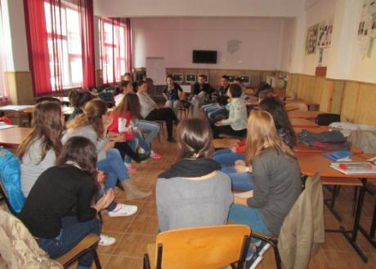
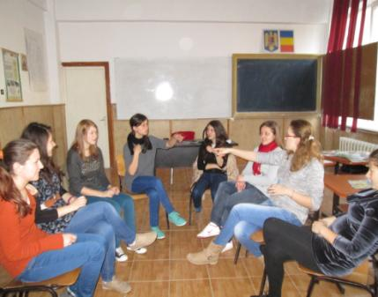
On the occasion of the fifth working session, the students, using the “art of storytelling” method, shared their stories regarding street harassment and drafted the manifesto “Let's act against street violence”.

Slide 10
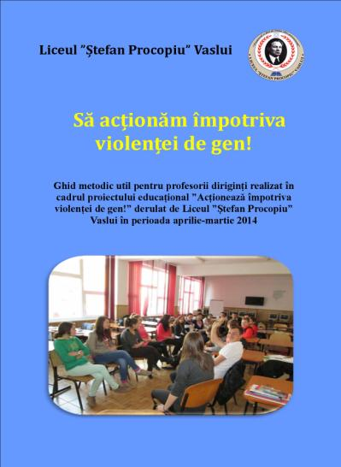
The final product of this project is the guide "Let's act together against gender violence" which presents a training model structured on 5 training sessions.

Slide 11
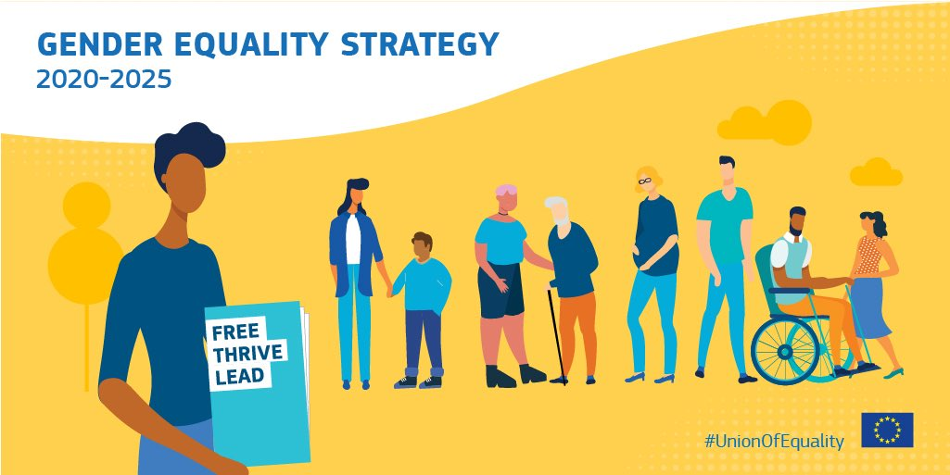
What is the EU doing regarding gender based violence?
The EU protects women and children from gender-based and domestic violence through legislation and practical measures. The EU Gender Equality Strategy 2020-2025 confirms that the European Commission will do all it can to prevent and combat gender-based violence, support and protect victims, and hold perpetrators accountable. The Gender Equality Strategy provides for an ambitious set of measures for ending gender-based violence.

Slide 12
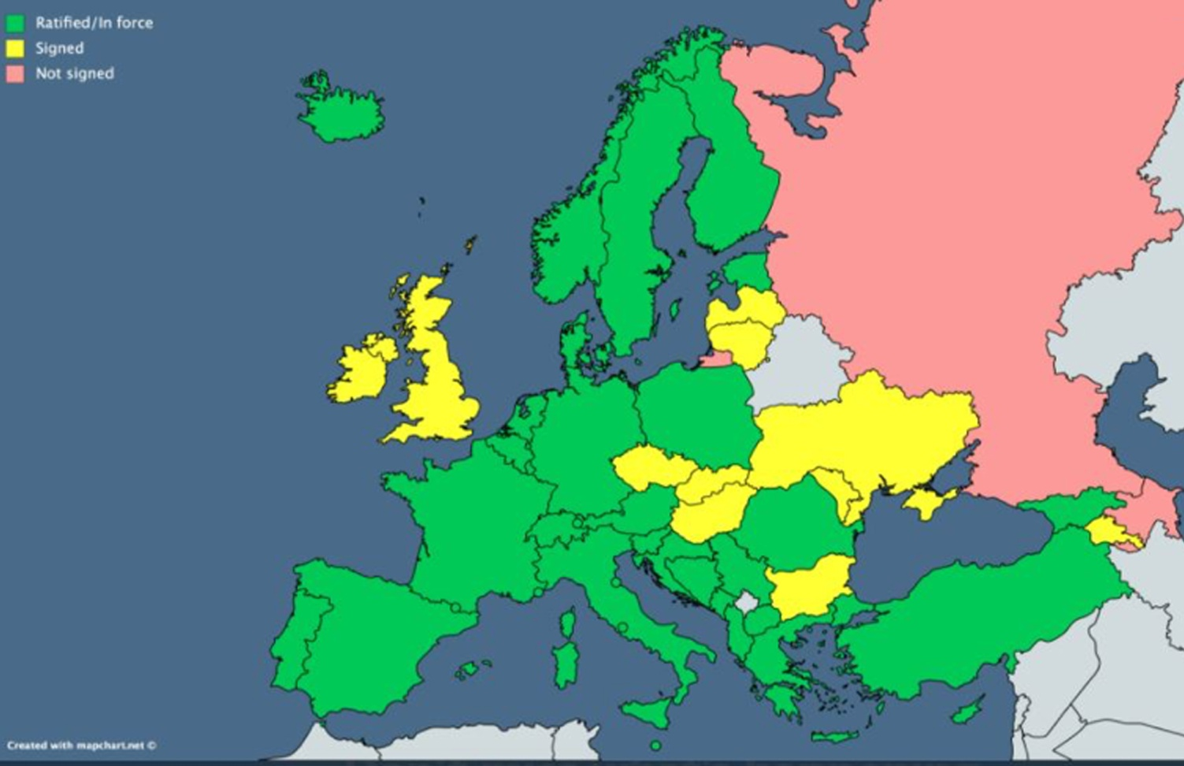
What is the EU doing regarding gender based violence?
The Council of Europe Convention on preventing and combating violence against women and domestic violence – the ‘Istanbul Convention’ – is the benchmark for international standards in this field. The EU signed the Convention in 2017, signaling the intention to become a party to this most advanced human rights agreement on protecting women from violence. Concluding the EU’s accession is a key priority for the Commission.

Slide 13
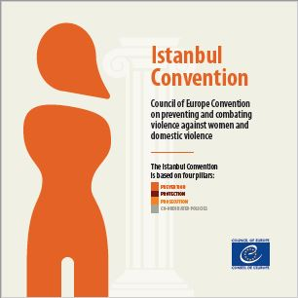
The Council of Europe Istanbul Convention is the most comprehensive international human rights treaty on violence against women and domestic violence.
This legally binding instrument explicitly defines violence against women as a human rights violation and a form of gender-based discrimination and includes a strong emphasis on prevention and survivors’ rights.
In addition to Council of Europe Member States, it can be ratified by the European Union and is open for accession by any State in the world.

Slide 14
What is the EU doing regarding gender based violence?
As announced in the Commission Work Programme 2021, the Commission intends to make a new legislative proposal to prevent and combat gender-based violence against women and domestic violence. The proposal will aim to strengthen the actions taken by the Member States by ensuring a minimum level of protection across the EU, both online and offline.

