Slide 1
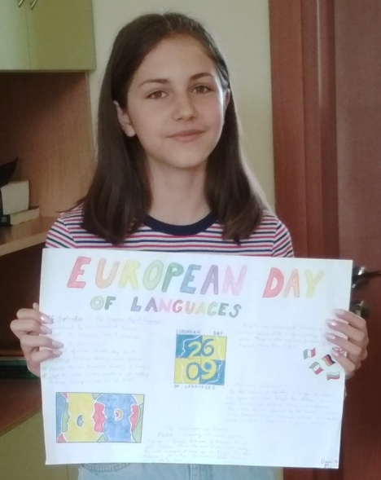
STRUCTURES OF THE EUROPEAN UNION
Elena Zorkova – 9-th grade
Foreign Language School
Pleven, Bulgaria

Slide 2
INSTITUTIONS
OF THE
EUROPEAN
UNION
The institutions of the European Union are the seven principal decision-making bodies of the European Union(EU). They are, as listed in Article 13 of the Treaty on European Union:
the European Parliament,
the European Council (of Heads of Government),
the Council of the European Union (of national Ministers, a Council for each area of responsibility),
the European Commission,
the Court of Justice of the European Union,
the European Central Bank and
the Court of Auditors

Slide 3
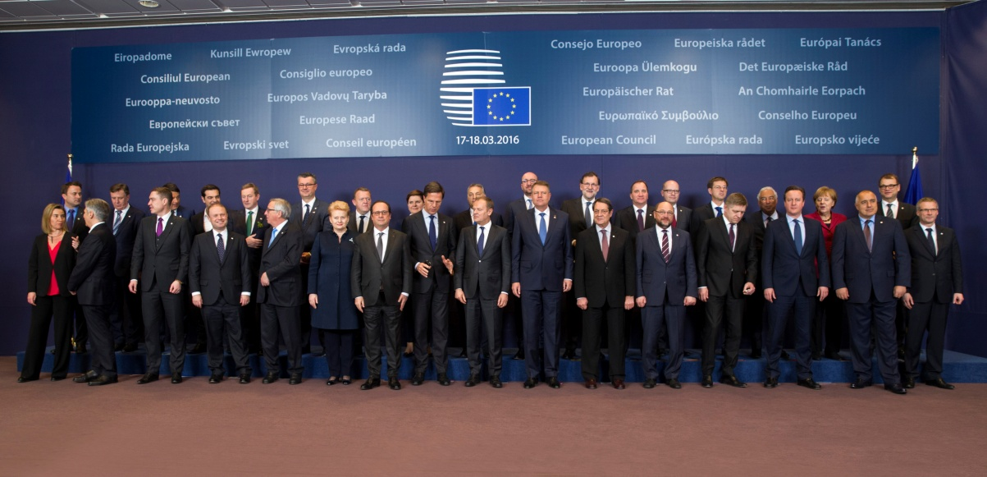
European Council
- Provides impetus and direction -
Summit of the Heads of state or government, the President of the European Council and the President of the European Commission.
Gives the necessary political impetus for the development of the Union and sets its general objectives and priorities
Does not legislate
Based in Brussels

Slide 4
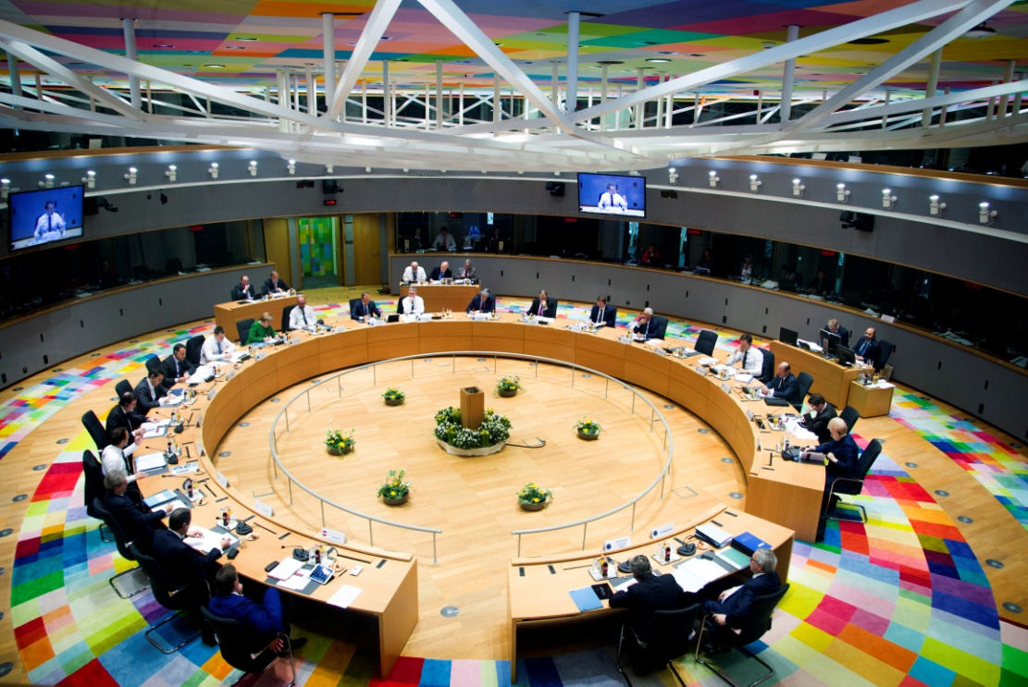
Council of the European Union
- Legislature -
composed of twenty-eight national ministers (one per state)
informally known as the "Council of Ministers" or just "the Council"
acts together with the Parliament as a legislature
shares with the Parliament the budgetary power
ensures coordination of the broad economic and social policy and sets out guidelines for the Common Foreign and Security Policy (CFSP)
concludes international agreements
based in Brussels

Slide 5
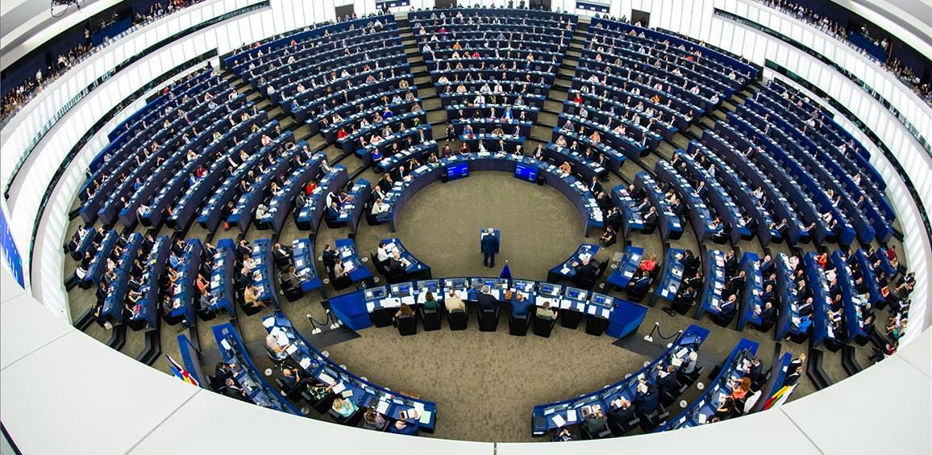
European Parliament
- Legislature -
acts together with the Council (of the European Union) as a legislature
shares with the Council (of the European Union) the budgetary power
exerts the democratic control over the institutions including the European Commission and approves the Commission members
based in and plenary sessions in Strasbourg, primarily meets in Brussels

Slide 6
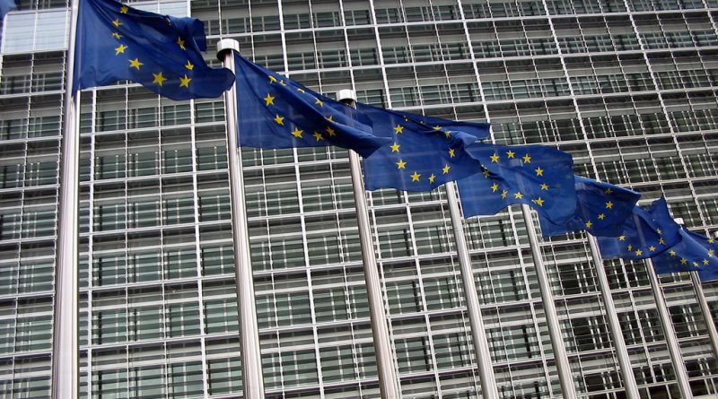
European Commission
- Executive -
is the executive
submits proposals for new legislation to the Parliament and Council (of the European Union)
implements policies
administers the budget
ensures compliance with European law ("guardian of the treaties")
negotiates international agreements
based in Brussels

Slide 7
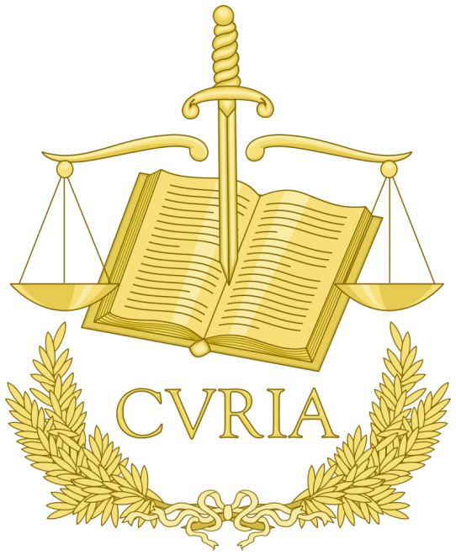
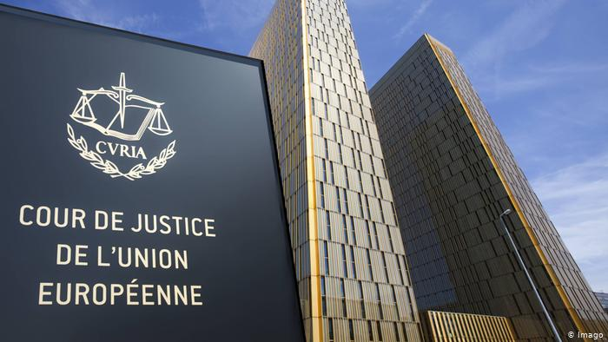
Court of Justice of
the European Union
- Judiciary -
ensures the uniform application and interpretation of European law
has the power to decide legal disputes between member states, the institutions, businesses and individuals
based in Luxembourg

Slide 8
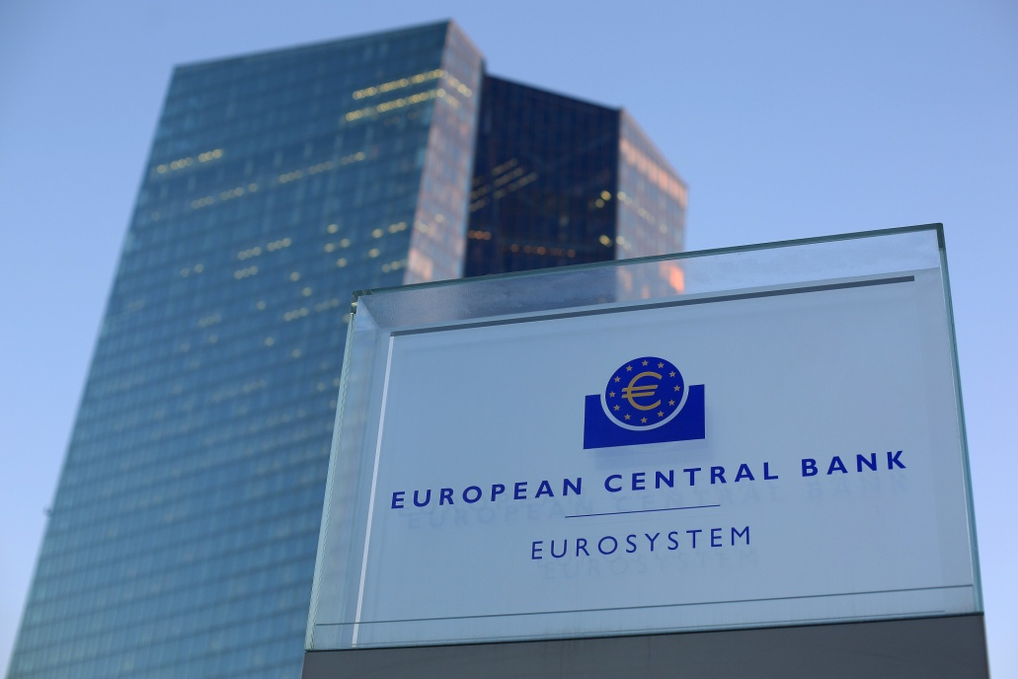
European Central Bank
- Central bank -
forms together with the national central banks the European System of Central Banks and thereby determines the monetary policy of the eurozone
ensures price stability in the eurozone by controlling the money supply
based in Frankfurt

Slide 9
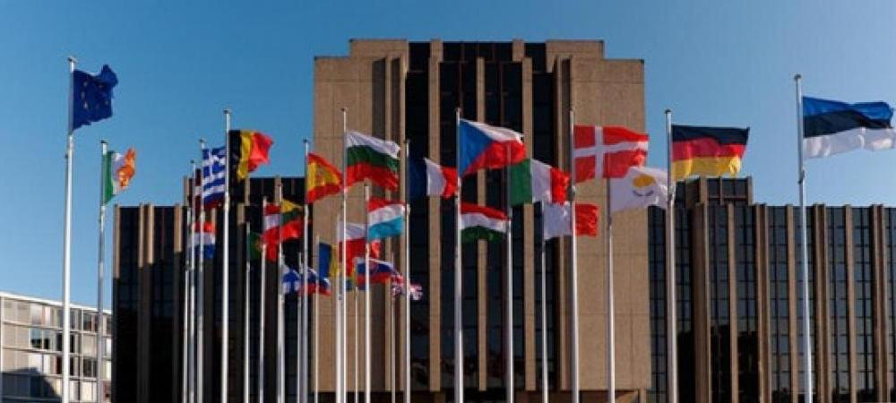
European Court of Auditors
- Financial auditor -
checks the proper implementation of the budget
based in Luxembourg

Slide 10
THANK YOU
FOR YOUR ATTENTION!

