Slide 1
European Union Member States
Victoria Agusheva-9-th grade
Foreign Language School
Pleven, Bulgaria

Slide 2
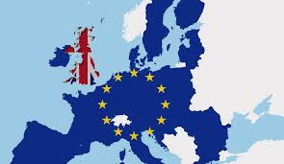
When did it first start?
The EU was not always as big as it is today. When European countries started to cooperate economically in 1951, only Belgium, Germany, France, Italy, Luxembourg and the Netherlands participated.Over time, more and more countries decided to join. The Union currently counts 27 EU countries. The United Kingdom withdrew from the European Union on 31 January 2020.

Slide 3
Members of the Schengen border-free area
The Schengen Area is one of the greatest achievements of the EU. It is an area without internal borders, an area within which citizens, many non-EU nationals, business people and tourists can freely circulate without being subjected to border checks. Since 1985, it has gradually grown and encompasses today almost all EU countries and a few associated non-EU countries.

Slide 4
Members of the Schengen border-free area
While having abolished their internal borders, Schengen States have also tightened controls at their common external border on the basis of Schengen rules to ensure the security of those living or travelling in the Schengen Area.

Slide 5
Joining the European Union
Becoming a member of the EU is a complex procedure which does not happen overnight. Once an applicant country meets the conditions for membership, it must implement EU rules and regulations in all areas.
Any country that satisfies the conditions for membership can apply. These conditions are known as the ‘Copenhagen criteria’ and include a free-market economy, a stable democracy and the rule of law, and the acceptance of all EU legislation, including of the euro.

Slide 6
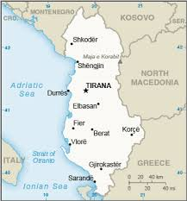
Candidate countries
Montenegro
These countries are in the process of 'transposing' (or integrating) EU legislation into national law:
Albania
Montenegro
North Macedonia
Serbia
Turkey
Albania

Slide 7
The 27 member countries of the
European
Union and year of entry
Year of entry Countries
01/01/1958 Belgium/ France/ Germany/ Italy/ Luxembourg/ Netherlands
01/01/1973 Denmark/ Ireland/ United Kingdom (left on 31 January 2020)
01/01/1981 Greece
01/01/1986 Portugal /Spain
01/01/1995 Austria/Finland/ Sweden
01/05/2004 Cyprus/ Czechia/ Estonia/ Hungary/ Latvia/ Lithuania/ Malta/ Poland/ Slovakia/Slovenia
01/01/2007 Bulgaria/ Romania
01/07/2013 Croatia

Slide 8
Thank you for your attention!

