Slide 1
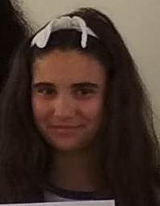
Tips for how to stay happy in troubling times of Covid-19
Vassilena Nankova 9e class,6

Slide 2
CONTENT:
1. Distract yourself
2. Don’t obsess over being positive or happy
3. Focus on the small things
4. Clean up – maybe
5. Get out of town
6.Catch up on books, podcasts, movies, or TV shows
7. Take care of your body
8. Keep moving
9. Connect with friends and family, and reach out to people who might feel isolated.

Slide 3
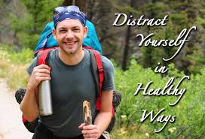
Distract yourself
It’s easy to run over and over the topic that’s stressing us out, whether that’s the new coronavirus outbreak, the state of the climate or something else.

Slide 4
Don’t obsess over being positive or happy
This one may seem counterintuitive: it can be a bad idea to chase positive emotions. Actively pursuing happiness can lead to the reverse effect.

Slide 5
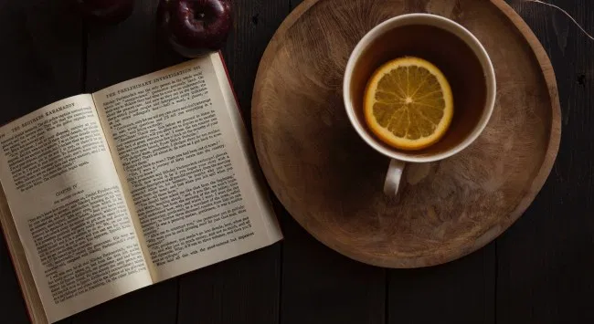
And again, if you’re focused on an outcome like “I must feel happy”, you may feel worse about yourself if you don’t succeed – even though it’s perfectly natural to have a more difficult time feeling happy in stressful times.

Slide 6
Focus on the small things
It may be wise, then, to spend less time trying to become happy, and focus more on the little things that make us happy.

Slide 7
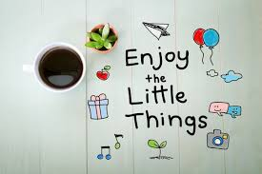
It may be wise, then, to spend less time trying to become happy, and focus more on the little things that make us happy.

Slide 8
Clean up – maybe
Should you find yourself quarantined, take this opportunity to clean your house. "Kondo-ing" your home has been shown to carry many benefits.

Slide 9
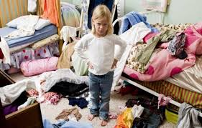
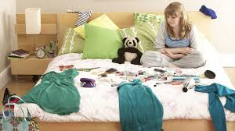
However, de-cluttering is not for everyone. Hoarders use physical objects to reinforce feelings of comfort and security. For those people, tidying up activates the brain’s pain-processing regions.

Slide 10
Get out of town
If you live in a city, another option might be to leave it behind for a short while – only if you can do so while maintaining safe social distancing and safeguarding your, and others’, health.

Slide 11
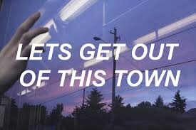
Interestingly, the effect is not seen with green space, so the seaside will be better for you than the country.

Slide 12
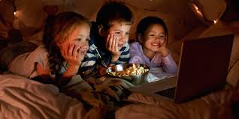
Catch up on books, podcasts, movies, or TV shows
Is there something ambitious you've been wanting to tackle? Maybe instead of the Summer of Woolf I should have the Spring of Woolf.

Slide 13
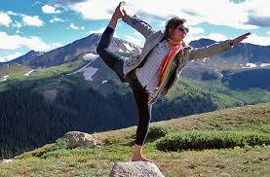
Take care of your body
This is important for health and also for mood. Get enough sleep, wake up at a normal hour, eat healthy food, don't drink too much, stick to a regular routine of personal hygiene and dress, and in particular...

Slide 14
Keep moving
This may be tough if your normal exercise routine is disrupted. Figure out how to keep active.

Slide 15
Drag those dusty hand-weights out from under the bed. And remember to stand up and walk around frequently. In everyday life, we have to move from Point A to Point B, and it may take more effort to get yourself on your feet. Find a way to keep up with.

Slide 16
Connect with friends and family, and reach out to people who might feel isolated
This is a time when technology can really come to our aid! Call, text, do video calls, send funny videos of your dog...we all want to feel connected and cared for.

