Slide 1
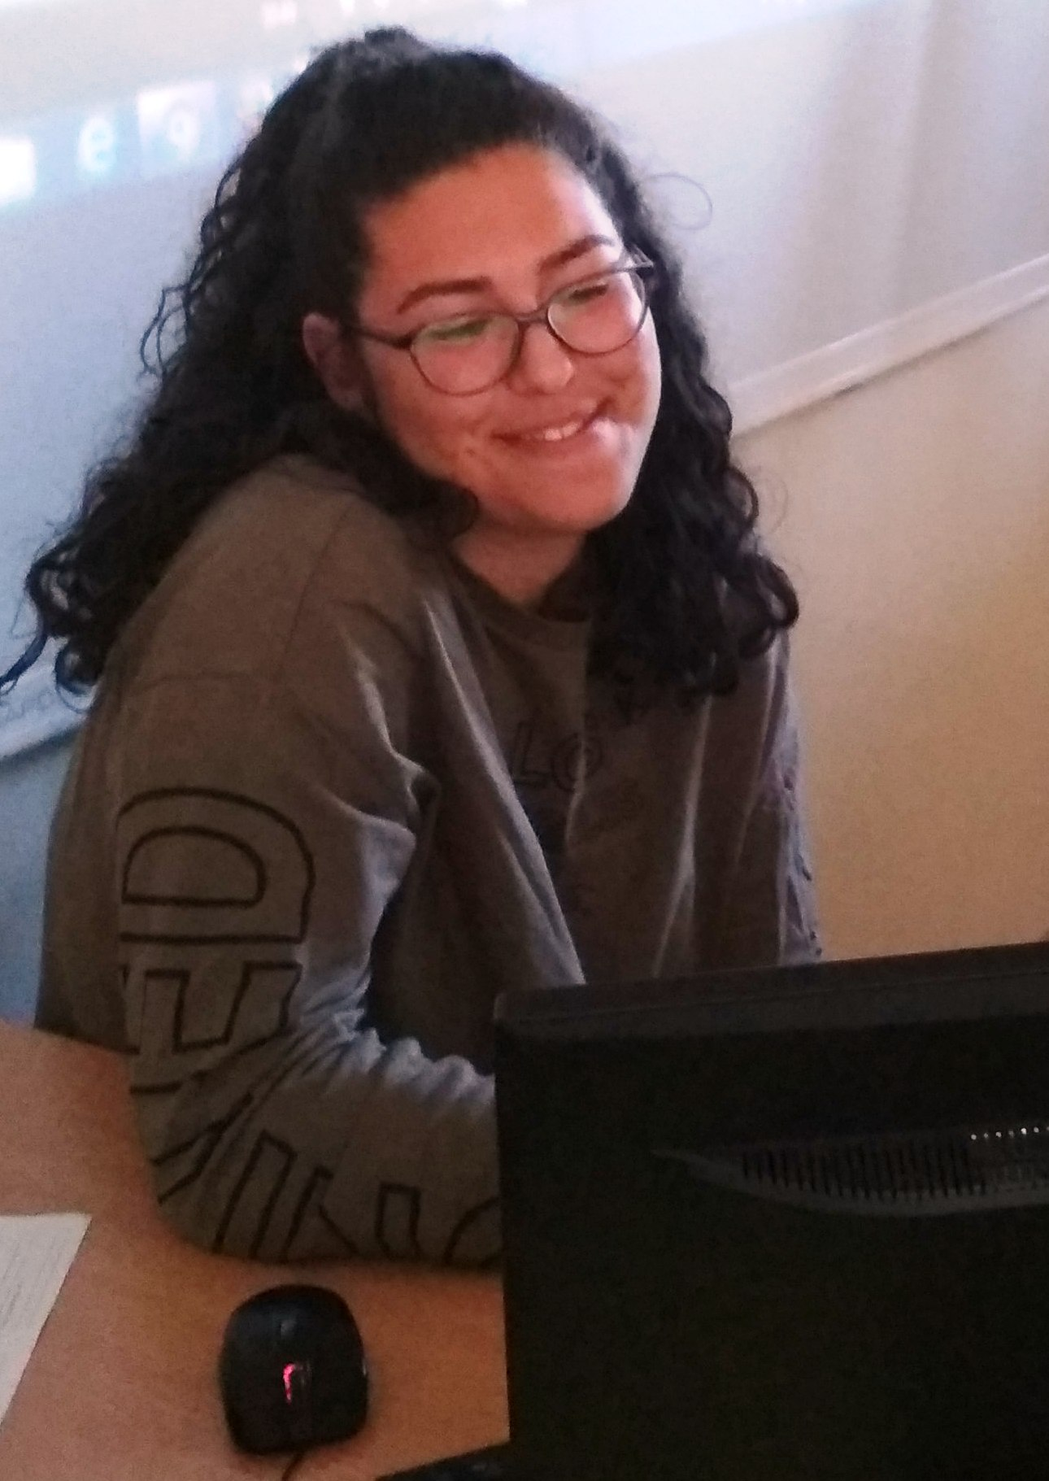
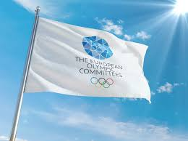
HOW OLYMPIC ATHLETES SHARE THEIR PERSONAL BATTLES WITH COVID-19
Victoria Agusheva – 9-th grade
Foreign Language School
Pleven, Bulgaria

Slide 2
Even the best get sick
While the whole world is dealing with the COVID-19 pandemic, some in the sports community have found themselves in the middle of the crisis having tested positive for the the virus.

Slide 3
Messages of hope
Boglarka Kapas, the Hungarian swimmer and bronze medallist in the Rio Olympics 800m freestyle, has sent a message of encouragement despite testing positive, saying: "Be careful, stay home, and stay healthy.
Chinese footballer Wu Lei, who plays for RCD Espanyol in La Liga, also took to his social media platforms to announce his positive test results for COVID-19. He has since recovered strongly, even started training again this week. The left-winger said in a recent blog post: "Since today, I've started to do some basic training... There are a lot of things that can't wait. The only way to grow without regrets is to keep moving forward.

Slide 4
Some of the athlets are alredy better
Patrick McEnroe, captain of the USA men's tennis team at Athens 2004, seemed to be in high spirits while speaking from his basement after contracting COVID-19. He shared an update video on twitter, saying "The bad news is I tested positive. The good news is the symptoms have passed, and I feel 100%. I'm an example of someone who's been able to fight through it."

Slide 5
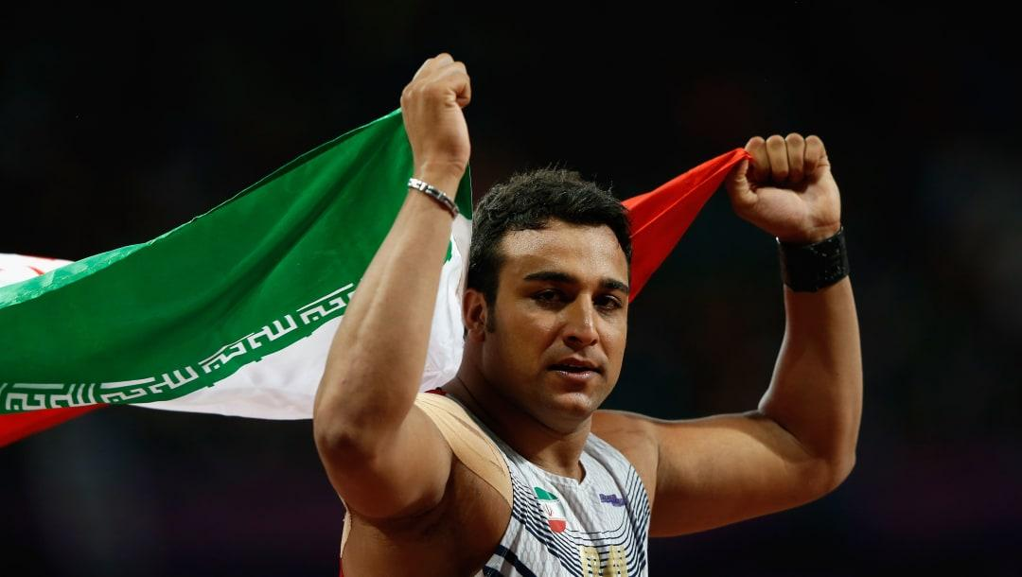
Everyone is supporting each other
Ehsan Hadadi, Iran's first ever Olympic track and field medallist,
tested positive for COVID-19 earlier this year.
At the end of March, World Athletics announced
that the London 2012 silver medalist did
indeed have the virus, and wished him
"a full and speedy recovery."

Slide 6
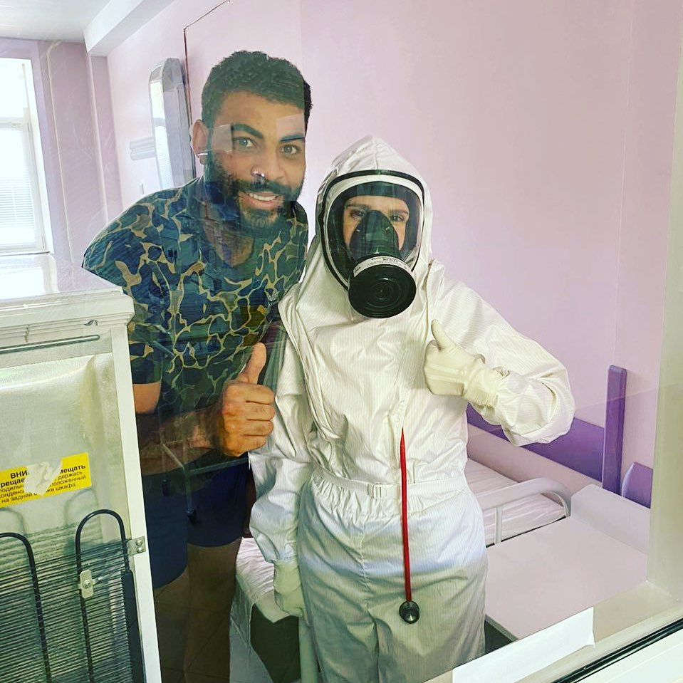
Gratitude towards the medical workers
French volleyball player Earvin N'Gapeth has now returned home safe and sound after contracting the virus, but not without thanking the selfless doctors who helped him through. Sharing a powerful photo on his Instagram, he said, "It’s time to go home after 15 days in quarantine in the A. F. Agafonov hospital in Kazan. From the bottom of my heart, thanks to all the medical staff. Nurses, doctors, cleaning people, cooks and all of those I’m forgetting."

Slide 7
Please stay Safe!
Please stay safe! It’s really important and even the smallest things can make the impact! We are in this fight together! The Olympic games got cancelled because of this virus. It’s not just a virus anymore. We can all save the world by just staying at home. People are dying not just because the virus makes big impacts but because there isn’t enough places in the hospitals to be cured all this people that are getting sick at the same time. We can make all better and to have the Olympic games the other year if we follow the rules the governments are setting! And be safe! You and your family. I think this is the most important thing.

Slide 8
Thank you for your attention and be safe!

