Slide 1
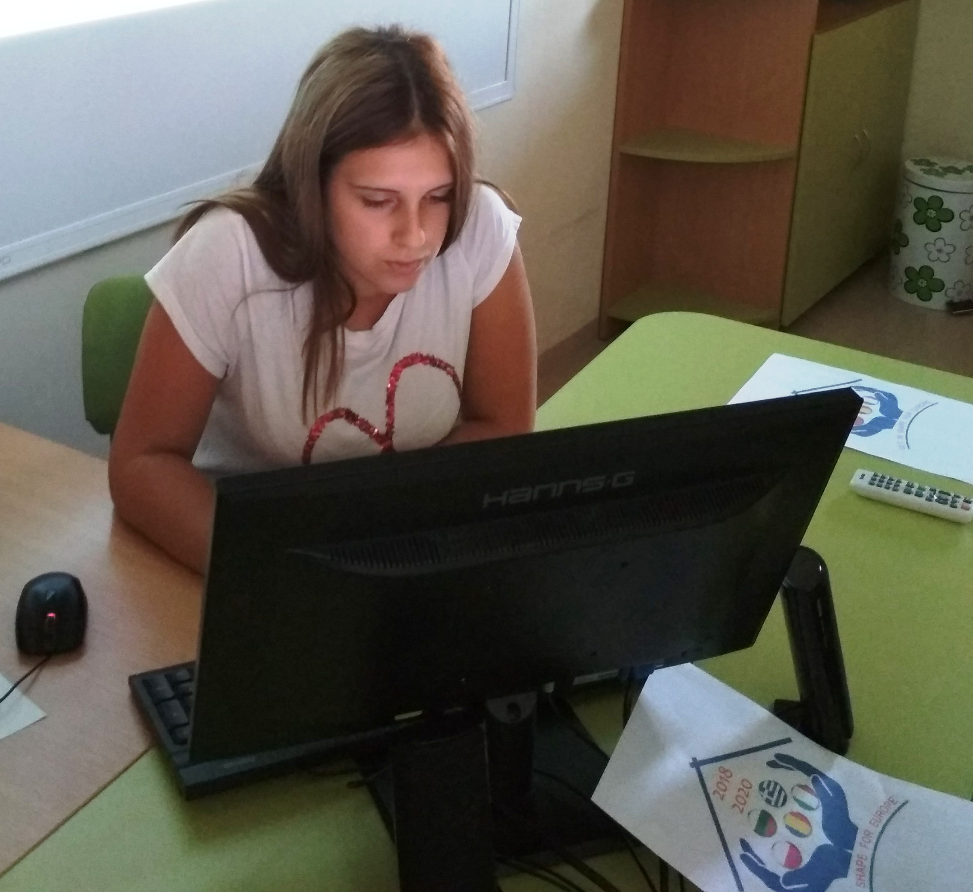
solidarity and hope-the response against the covid 19
Daria Nikolova – 9-th grade
Foreign Language School
Pleven, Bulgaria

Slide 2
solidarity and hope-the response against the covid 19
As public fear and insecurity increase around the COVID-19 pandemic, more than ever we need solidarity, hope and political will to survive this crisis together

Slide 3
Solidarity
Member States most affected by the coronavirus will receive access to up to EUR 800 million in 2020. Funding decisions will be examined on a case-by-case basis.

Slide 4
HOPE
Attachment hope serves to build and maintain relationships of trust, to achieve a sense of connection with others, and very good survival skills.
Mastery hope helps one become strong and successful, receive support for their efforts, and be inspired by good role models.
Hope for survival helps keep calm and find ways to cope with troubles or difficult situations. It allows you to manage your own fears.
Spiritual hope allows us to feel close to nature and to all human beings and to gain additional strength and protection.

Slide 5
COVID-19

Slide 6
Thank you for your attention!

