Slide 1
”Everybody can do it!” (ECDI)

Slide 2
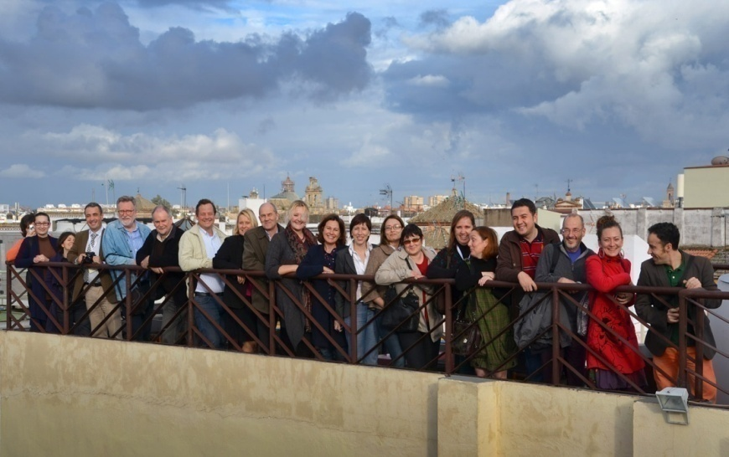
Some years ago, "Ştefan Procopiu" High School Vaslui was partner in the Grundtvig Learning Partnership "Everybody can do it" (ECDI) in collaboration with another 7 European institutions (Spain, Portugal, UK, France, Estonia, Turkey, Finland).
The goals of this Partnership were:
Promote gender equality between men and women in public and private life, emphasizing the importance of autonomy, in contrast to the traditional gender division of tasks in private life;
Promote social integration and self-esteem by reinforcing learners’ awareness of their own skills and potential to be an active part of society.

Slide 3
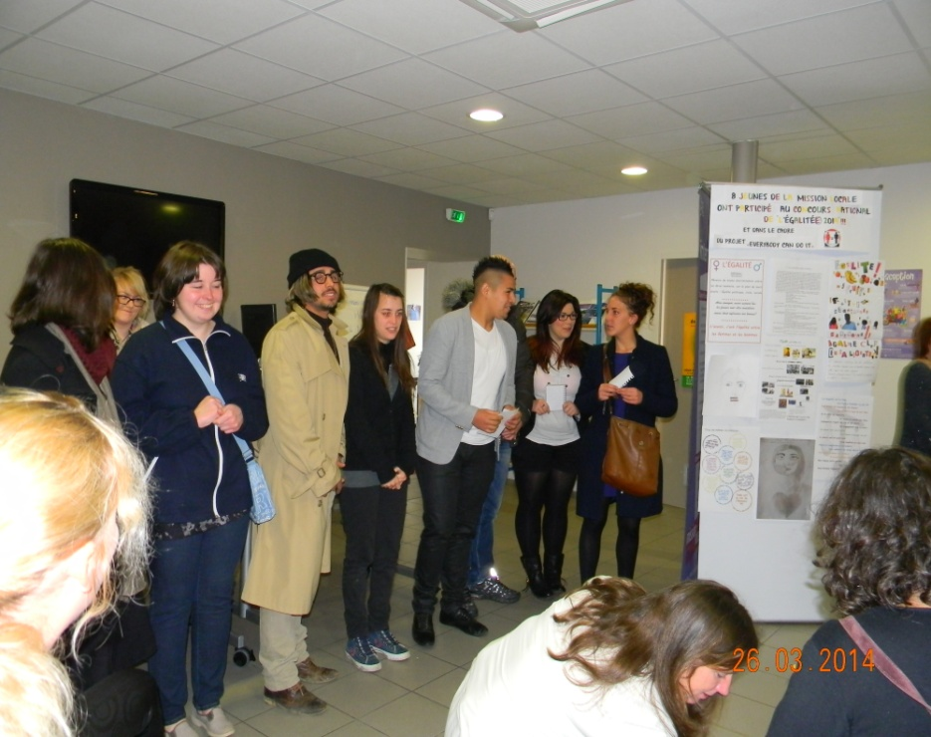
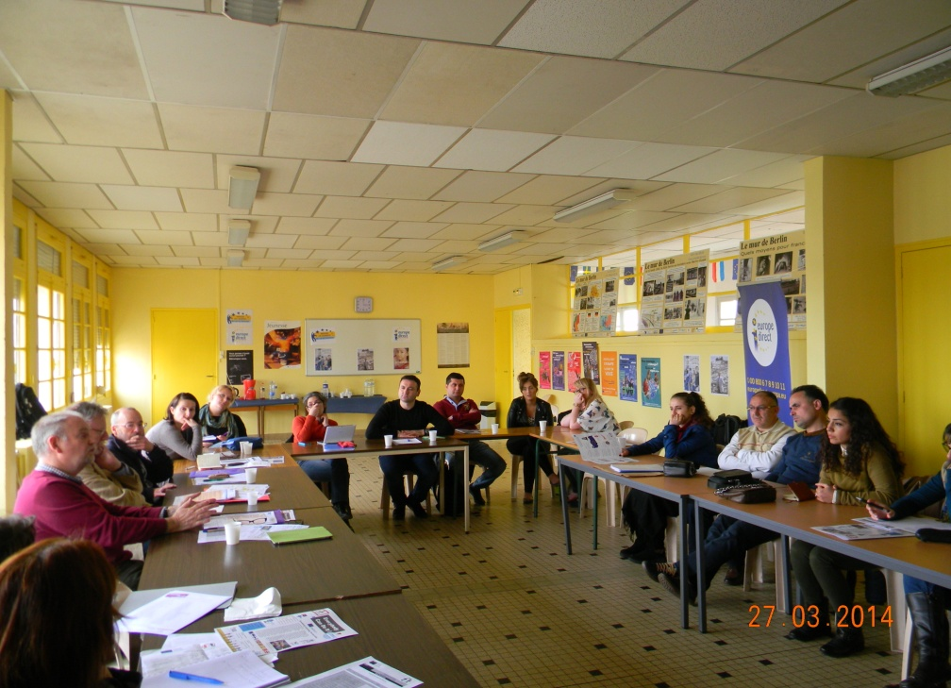
Partnership products
The questionnaire: "Women and Men – European Realities of Today"
The questionnaire "Women and Men-European Realities of Today" was produced, applied and interpreted at the partnership level. Each partner presented the results of the questionnaire at a project meeting in Turkey thus highlighting the similarities and differences among the answers of the eight partner institutions.

Slide 4
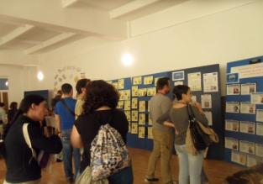
Partnership products
The brochure
”Women who inspire Europe”
The project teams from 8 institutions colaborate to produce the "Women who inspire Europe“ brochure, which were used for the exhibition during the project meeting hosted by "Ştefan Procopiu" High School.

Slide 5
Partnership products
Books and Videos Database on Gender Equality
At partnership level, a database of books and films titles has been created taking into account the concepts of the "Everybody can do it!" Partnership (ECDI), such as: gender equality, equal opportunities, gender violence, stereotypes, discrimination, feminist movement, the role of women in science, army, etc.

Slide 6
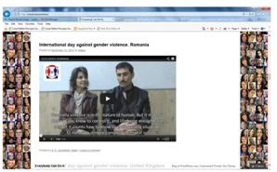
Partnership products
Video materials marking 25th November - "International Day for the Elimination of Violence against Women" One of the activities organized was the one marking November 25th - "International Day for the Elimination of Violence against Women". On this occasion, the partners make video messages on violence against women. The learners from the project were involved in making these videos.

Slide 7
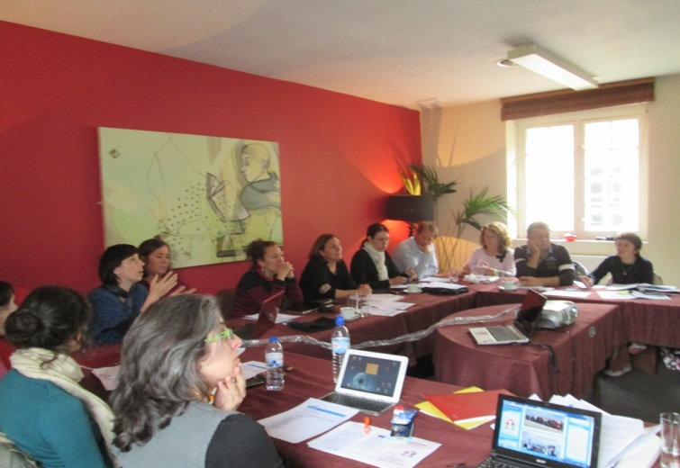
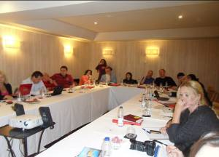
Partnership products
Gender legislation database
Another outcome of the partnership is the database on gender equality legislation in the 8 partner countries.

Slide 8
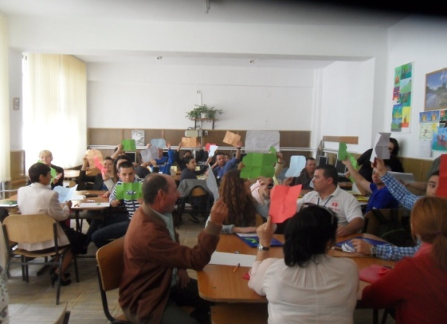
Partnership products
The brochure: "We are equal!
Good Practice Guide on Gender Equality!"
This brochure is the main product of the Everybody can do it! (ECDI) Partnership. During the two years of the project, each partner developed 4 workshops. Their description can be found in the brochure "We Are Equal! Good Practice Guideline on Gender Equality ".

Slide 9
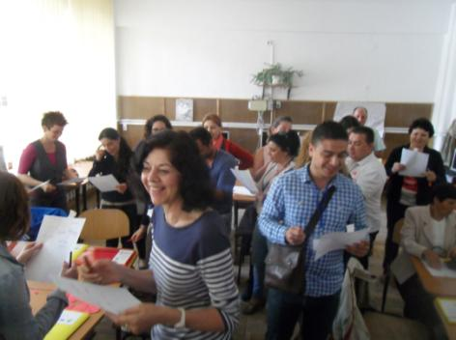
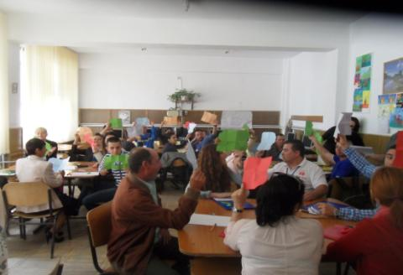
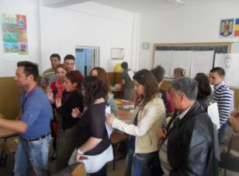
Partnership products
Over 40 workshops about gender equality with the learners enrolled in the target group

Slide 10
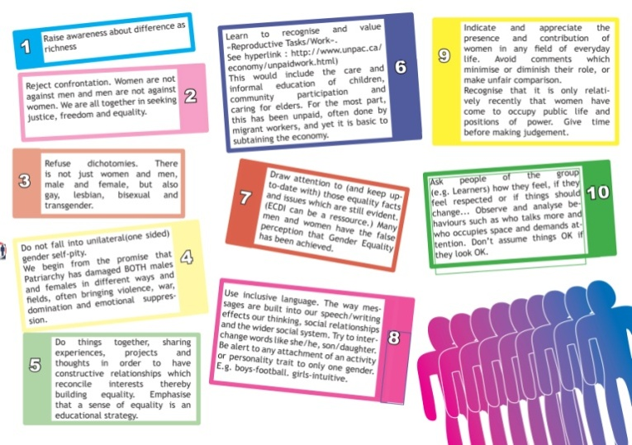
Partnership products
The Decalogue of Good Practice on Gender Equality

Slide 11
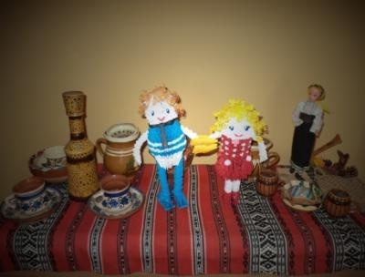
Partnership products
The Romanian Mascot made by 2 learners from the project

