Slide 1
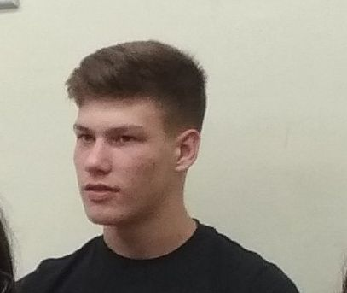
BE A STRONG LEADER DURING COVID-19
Alexander Alexandrov – 9-th grade
Foreign Language School – Pleven, Bulgaria

Slide 2
4 Actions to Be a Strong Leader During COVID-19 Disruption

Slide 3
No. 1: Create a central and clear list of priorities
Centrally set out a clear set of priorities, and locally implement them with a high degree of local manager autonomy. In a dynamic situation, overly centralizing decision making hobbles the organization’s ability to respond quickly and effectively

Slide 4
No. 2: Pursue a nonbinary approach to problem solving
There are almost always more options besides “do it/don’t do it” if teams can be creative about how they solve problems. For example, many leaders will be faced with the decision of whether to fire people and risk losing talent (not to mention further disrupting lives), or keep their people and risk their margins. But what if there were more options?

Slide 5
No. 3: Be honest, empathetic, clear and simple
Hone a clear, honest, empathetic and simple approach to communication as the COVID-19 situation evolves. This is obvious, I know. Yet I include it because it is so important and also because we live in an era of rapid dissemination of information that is of questionable veracity, from multiple sources.

Slide 6
No. 4: Write down the stories
Collect stories of teams coming together to overcome the adversity caused by COVID-19. People are capable of amazing things in a time of crisis. Capture the detail of these stories; don’t summarize them too much.

Slide 7
Thank you for your attention!
Alexander 9e presentation

