Slide 1
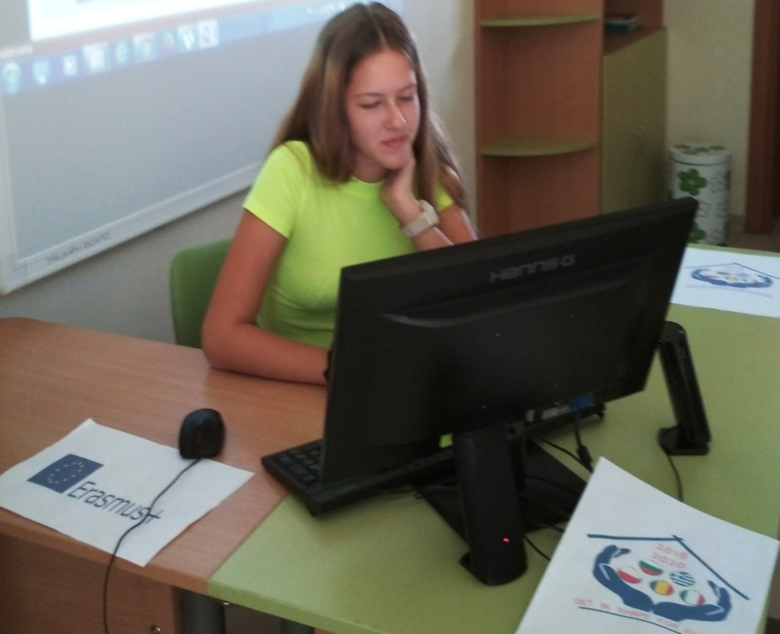
KEY MESSAGES DURING COVID-19
Viktoria Betova – 9-th grade
Foreign Language School – Pleven, Bulgaria

Slide 2
Key messages: Ensure Dignity, Access, Participation and Safety
• Prepare and share public communication to address and prevent stigma and discrimination that can prevent people from seeking healthcare. Messaging about “high risk groups” should be sensitive to minimize negative impact on those groups.
• Remind staff and volunteers to ensure dignity in all services: screening, surveillance, isolation, treatment, etc. Regularly review these services.
• Support governments, through guidance and advocacy, to ensure human dignity is respected in all responses at all times.

Slide 3
Key messages: Ensure Dignity, Access, Participation and Safety
Design services, treatment and communication to be accessible to all, especially those who are marginalised.
Older people may not have easy access to information on websites & social media - use adapted communications methods like phone calls & pamphlets.
Provide communications in the languages of ethnic minorities and migrants, in plain language, and adapted for visual / auditory impairments.
Ensure where possible gender-balanced teams especially if providing treatment or support, even if online or by phone.

Slide 4
Key messages: Ensure Dignity, Access, Participation and Safety
•Gather feedback on activities and services from all members of the community (all genders, ages, abilities and other groups).
Use online or phone methods to gather feedback and suggestions on activities and services from the people supported.
Provide opportunities for people to provide feedback on services in person where applicable - e.g. during treatment or distribution of food/medicine

Slide 5
Key messages: Ensure Dignity, Access, Participation and Safety
• Address the increased risk of violence in the home and of self-harm during isolation and stressful situations
Embed support and guidance on domestic violence in existing services – e.g. equip volunteers providing other services with information about where to get help in the case of violence in the home.
Set up or strengthen dedicated support and assistance – e.g. phoneline or online support for people at risk of inter-personal and self-directed violence.
Be especially vigilant of the risk of violence towards higher risk groups –older people (especially older women), people with disabilities (including intellectually disabled) and those with limited social networks such as migrants, homeless people

Slide 6
Considerations for key groups at risk of exclusion, violence and discrimination

Slide 7
Older people
Older people are at higher risk and have specific communication needs as they may not have easy access to online communications, and some may have difficulty seeing, hearing or understanding. Normal support mechanisms may no-longer be available. Older people in assisted-living facilities live close to each other and social distancing can be difficult
• Develop specific messages on the risk for older people and how to care for them, especially in homecare. Use communication channels used by older people, and communicate also with family members, health care providers and caregivers.
• Scale up telephone / online support wherever and whenever possible and provide (additional) care services / home visits if possible.
• Prioritise continued support to older people and be especially vigilant for signs of violence.
• Ensure that all staff and volunteers working on telephone helplines or providing services can refer to specialist services to support people experiencing violence, including the police services

Slide 8
People with disabilities
Some people with disabilities (physical and intellectual) may have specific communication needs, be at higher risk because of pre-existing conditions, lose access to their regular support mechanisms.
• Prioritise continuity of services supporting people with disabilities, and scale up if possible, including phone /online support.
• Ensure as much as possible that assistive devices remain available.
• Offer multiple forms of accessible communication, such as text captioning or signed videos, text captioning for people who use assistive technology.
• Provide tailored approach to meet individual needs, work with personal carers and support networks

Slide 9
Refugees and Migrants, including irregular migrants and those in informal settings
May not be included in the national strategies and may be difficult to reach as they move. Access to services and information may be limited by legal status, discrimination and language barriers. Therefore:
• Plan for services and communication to include migrant communities, including for psychosocial support and referral.
• Make material available in common languages of migrant communities, and engage their active participation to ensure it is accessible.
• Advocate on their behalf, including for access to public health service
• Monitor incidents of violence and discrimination.

Slide 10
Women
Women are the majority of front-line health workforce and caregivers. Cultural factors may restrict women’s access to information and services. Some women may be particularly affected, e.g. older women living alone, migrant women in an irregular situation. Isolation may lead to an increased risk of violence in the home.
• Provide specific advice for women caring for children and others in isolation and quarantine, and may not be able to avoid close contact.
• Ensure communications, treatment, support and services are culturally and gender sensitive to ensure access for women. Where possible ensure that medical teams are gender-balanced.
• Ensure measures are in place to mitigate risks of sexual and gender-based violence against women in quarantine facilities, isolation processes and procedures.
• Ensure that all staff and volunteers working on telephone helplines or providing services are trained in responding to reports of SGBV, (especially intimate-partner violence) and can refer to specialists.

Slide 11
Children and Youth
Children have specific information and emotional needs, cannot access many services and support mechanisms if schools are closed. Isolation may lead to an increased risk of violence in the home.
1
• Ensure that measures are in place to mitigate the risk of all forms of violence against children in quarantine facilities, isolation processes and procedures.
2
• Design information and communication materials in a child-friendly manner, on physical and mental health issues (including emotional unrest) related to the outbreak.
3
• Provide information to care givers and institutions about children’s psychosocial issues including skills to handle children’s anxieties as well as their own.
4
• Provide counselling and support services for affected families, by phone and online.
5

Slide 12
Men
Men appear to be more likely to get sick and die from COVID-19, tend to wash their hands less frequently than women and have a lower immune response. Isolation may lead to an increased risk of violence in the home.
• Community engagement and health service teams should be gender-balanced and provide targeted messaging from other men on hand washing.
• Ensure measures are in place to mitigate risks of sexual and gender-based violence against men in quarantine facilities, isolation processes and procedures.

Slide 13
Sexual and gender minorities including LGBTIQ people
May face challenges in accessing healthcare systems due to stigma and discrimination, especially in contexts where they are criminalized. Older LGBTIQ people are more likely to be isolated
• Include existing LGBTIQ groups, communities, and centres in engagement and outreach as they have key roles in prevention and supporting access to medical care.
• Ensure measures are in place to mitigate risks of sexual and gender-based violence in quarantine facilities, isolation processes and procedures.

