Slide 1
UNITED IN EUROPE VS COVID-19
hristiyan hristoV – 9-th grade
Foreign Language school – Pleven, Bulgaria

Slide 2
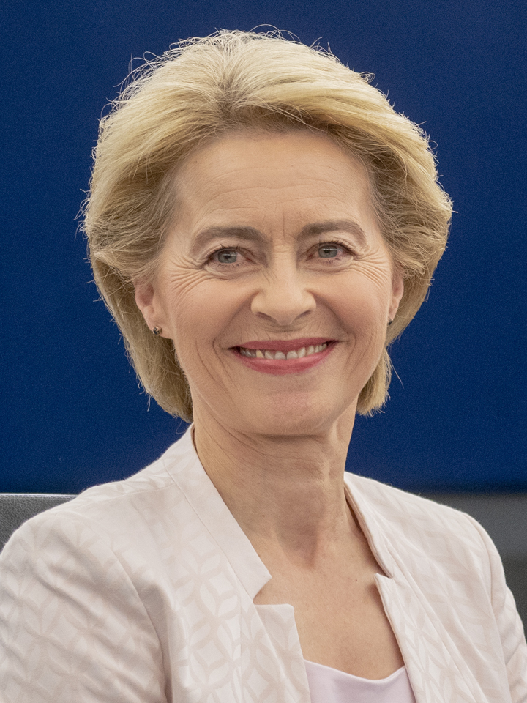
Measures taken
The European Commission coordinates common European measures in response to the COVID-19 pandemic.

Slide 3
Delay in the spread of the virus
To help reduce the spread of the virus in Europe and beyond, the European Union has closed its external borders for non-essential travel.

Slide 4
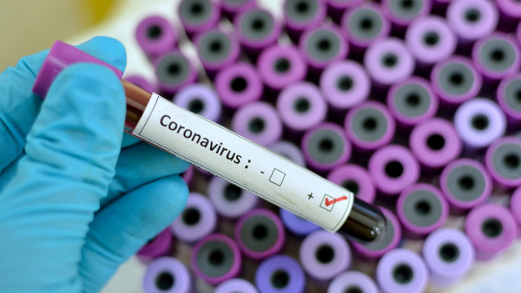
Provision of medical equipment
All EU countries will have quick access to the first stock of medical equipment under the RescEU program established under the Civil Protection Mechanism to provide the EU with crisis response equipment.

Slide 5
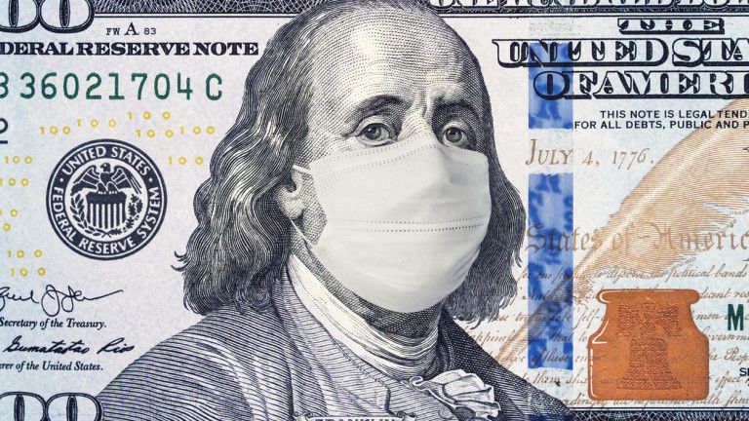
Accelerating economic recovery
New proposal for a long-term EU budget for 2021-2027, including a package of measures to stimulate the economy.

Slide 6
Support for the economics
The European Central Bank has said it will buy € 750bn in crisis relief, in addition to another € 120bn quantitative easing program.

Slide 7
European solidarity
The European Parliament has endorsed rules that allow Member States to request financial assistance from the EU Solidarity Fund for health crises.

Slide 8
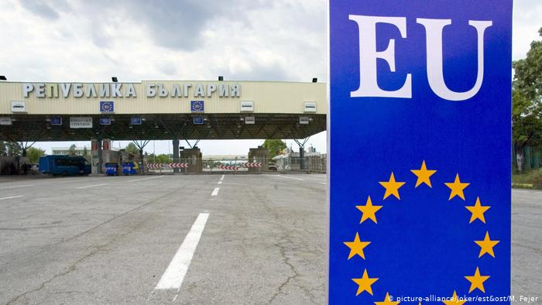
Return of people to the EU
More than 20,000 Europeans have been returned to the EU

