Slide 1
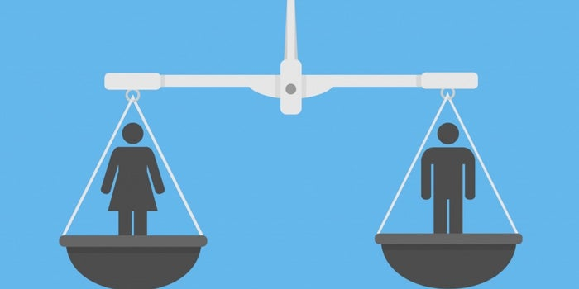
”Get in shape for Europe” (GISE)
GENDER EQUALITY

Slide 2
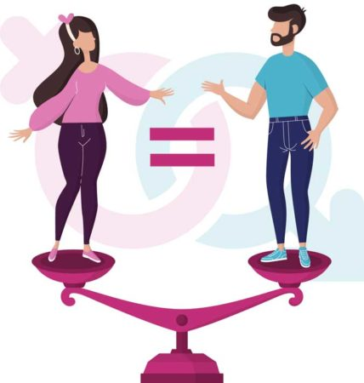
Contents
I.GENDER: A SOCIAL CONSTRUCTION
II. GENDER AND LABOR MARKET
III. STATISTICAL INDICATORS

Slide 3
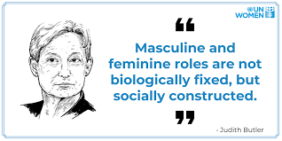
Although societies have evolved over the years, gender socialization and social expectations of men and women, boys and girls are still deeply rooted. Family, colleagues, the media, culture and religion inspire various messages about how each gender should look and behave, affecting or "shaping" the beliefs, attitudes, perceptions and behaviors of young people.

Slide 4
It may be difficult for boys and girls to accept that there are inequalities between women and men, because I think it is "natural" for women and men to be treated differently. It is important to challenge these beliefs, helping young people to understand the notions of social privilege and social power.

Slide 5
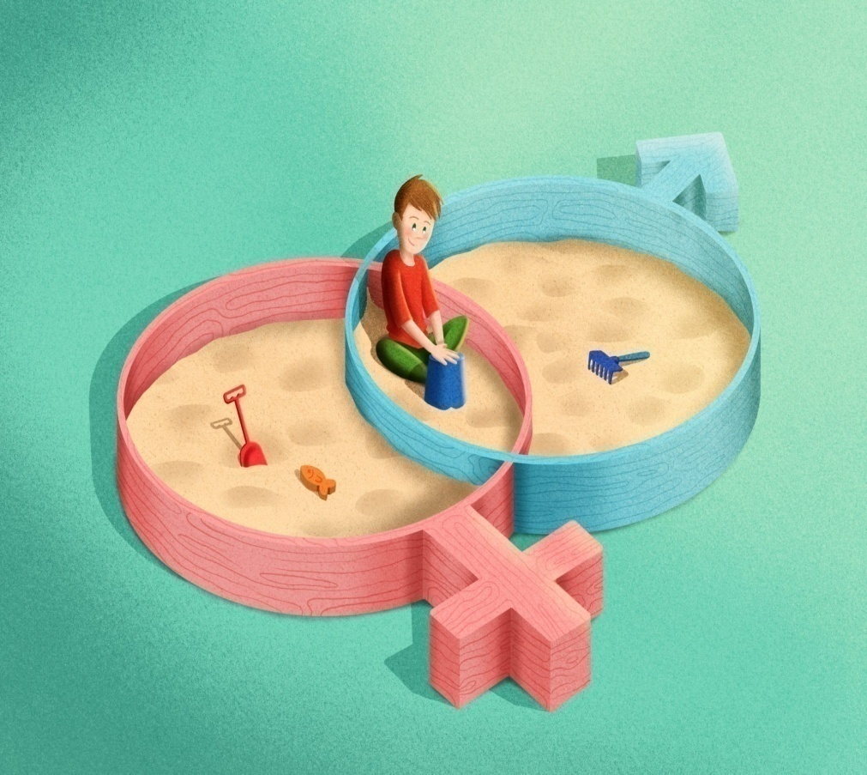
The family plays the main role in the construction of gender, and the other factors (school, entourage, social environment, etc.) contribute to the maintaining and enhancing attitudes and behaviours towards gender learned in the family. According to studies, parents treat their children differently depending also on their gender.

Slide 6
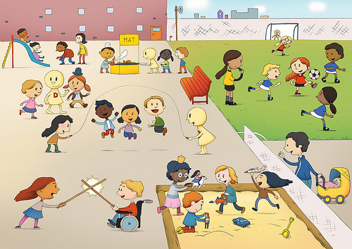
Some Expectations and messages with which boys grow up
Boys' rooms are usually decorated with jungle animals, dinosaurs, superheroes: elements that indicate strength. In addition, their toys include trucks, cars, tools, dinosaurs, action heroes; in general, toys that teach them that they need to be strong, wilder, tough, and that they need to fight and defend themselves and others.
We assume that all boys like sports and that they prefer to play outside, in nature, to get dirty.

Slide 7
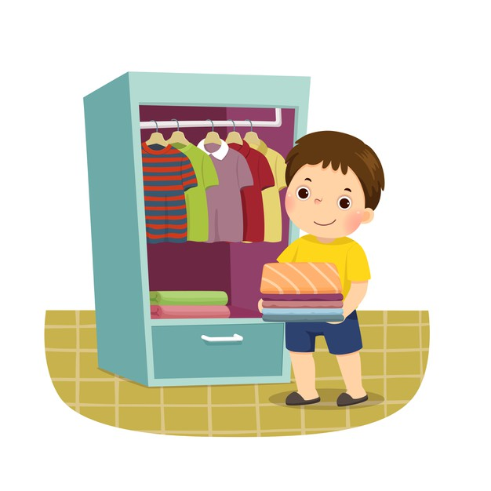
Some Expectations and messages with which boys grow up
We push them more easily to group sports (eg football) and other sports. We also encourage them to get involved in activities related to construction, engineering, robotics and martial arts, rather than arts, dance, theater and expression.
Most parents admit that they do not teach their boys to do household chores, but to fix various things.

Slide 8
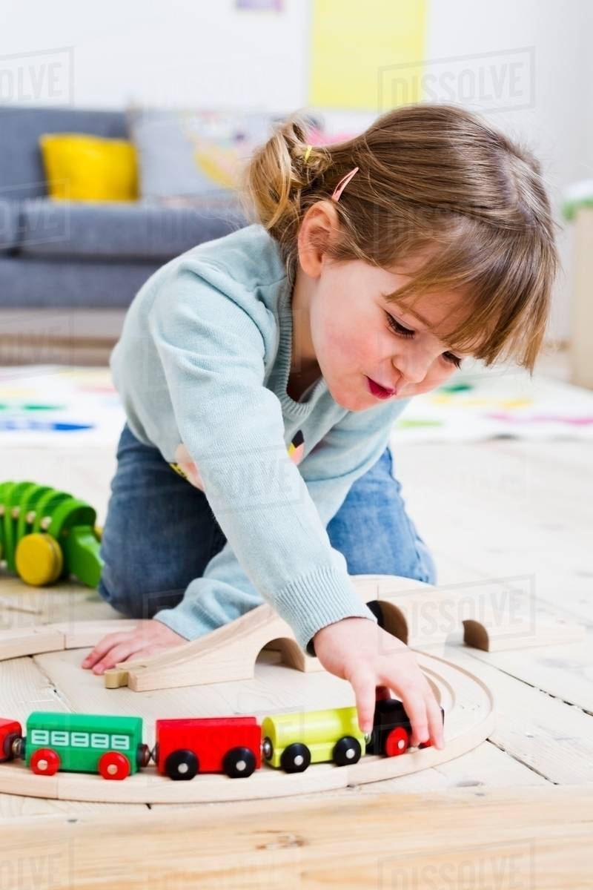
Some Expectations and messages with which girls grow up
Their toys usually include dolls, dollhouses, tea sets, kitchens, jewelry sets, care sets (mirrors, combs, hair dryers, makeup kits) and other household items (e.g., washing machines, irons, vacuum cleaners, etc.).
As a result, girls are told that they are expected to be cared for, to serve food, to help with household chores and to take care of younger children. This is the most common stereotype that society imposes on women.

Slide 9
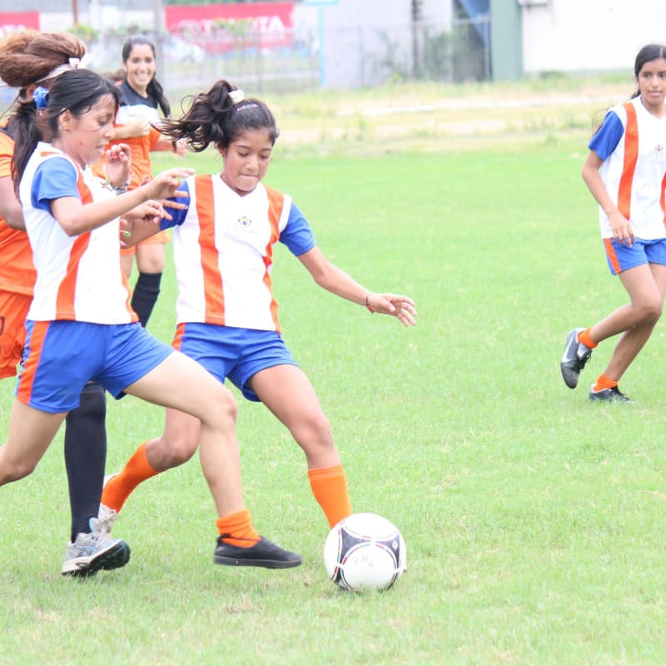
Some Expectations and messages with which girls grow up
We tend to assume that girls need more help, support and protection
We expect them to be more emotional and easier to express.
Parents encourage them to get involved in activities such as dance, ballet, artistic gymnastics, art, artistic activities, theater and expression, rather than team sports and martial arts.

Slide 10
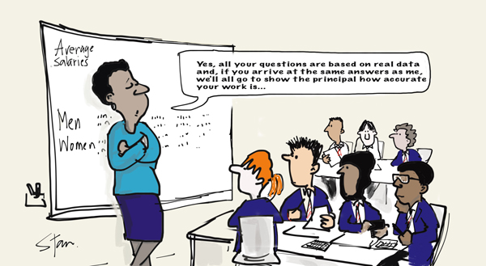
Schools and the education system in general are not immune to discrimination and prejudice. The perceptions, attitudes and expectations of students, but also of teachers include gender stereotypes. In addition, stereotypical perceptions of gender roles are presented, directly or indirectly, through the school curriculum, textbooks, the way language is used and the general discourse in educational institutions, as well as through the “hidden” curriculum (daily activities in schools, carried out outside the official program). It is believed that boys and girls have different traits, skills and abilities; therefore, they are assigned different tasks.

Slide 11
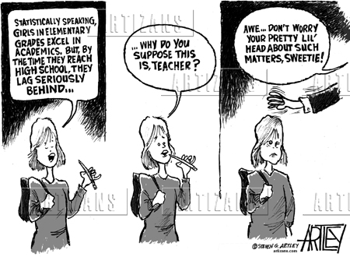
Attitudes, perceptions and stereotypical expectations of teachers
Research involving teachers and students from schools in Romania showed the following:
Teachers think that girls are calmer and, therefore, often ignore their disruptive behavior in class, rarely reprimanding them. On the other hand, the tendency is for boys to be considered restless in class, being scolded faster and punished more severely. Boys are also "service suspects" when something is broken or stolen.

Slide 12
Attitudes, perceptions and stereotypical expectations of teachers (in Romania)
Outside the program, girls are usually given "light" tasks, namely cleaning or decorating a room or accompanying guests during school events. In comparison, boys are given tasks that involve moving objects (whether heavy or not) and other tasks in the field of construction, repair or technology.

Slide 13
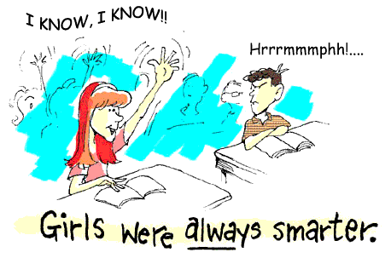
Attitudes, perceptions and stereotypical expectations of teachers (in Romania)
It seems that teachers 'expectations related to girls' school performance are higher. Although they realize that girls have higher grades, they interpret boys' success differently: they believe that, in the case of boys, their school performance reflects their intelligence, while in the case of girls, they are the result of diligence and effort.

Slide 14
Attitudes, perceptions and stereotypical expectations of teachers (in Romania)
Although they are aware that girls and boys have similar results in science and mathematics, teachers still consider that boys have "innate" skills for these subjects.

Slide 15
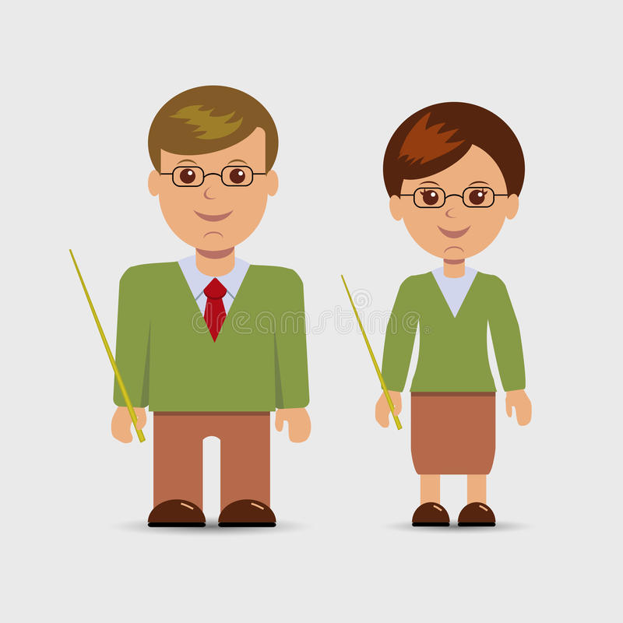
Attitudes, perceptions and stereotypical expectations of teachers (in Romania)
Male/female teachers recognize social expectations and stereotypes about the roles they play. For example, there is a perception that male teachers are stricter and can impose classroom discipline better than female teachers. Many teachers are "stuck in this role", while, by extension, female teachers will seek the help of a colleague to manage a very disobedient class. On the other hand, female teachers are expected to assume a rather "maternal" role towards students, to be more patient and approachable, to show empathy and to support those who face a personal problem.

Slide 16
Stereotypes in the school textbooks
in Romania
In general, textbooks represent women and men in stereotypical roles. Men are statesmen in public office, while women are mostly portrayed as wives, mothers, or housewives.

Slide 17
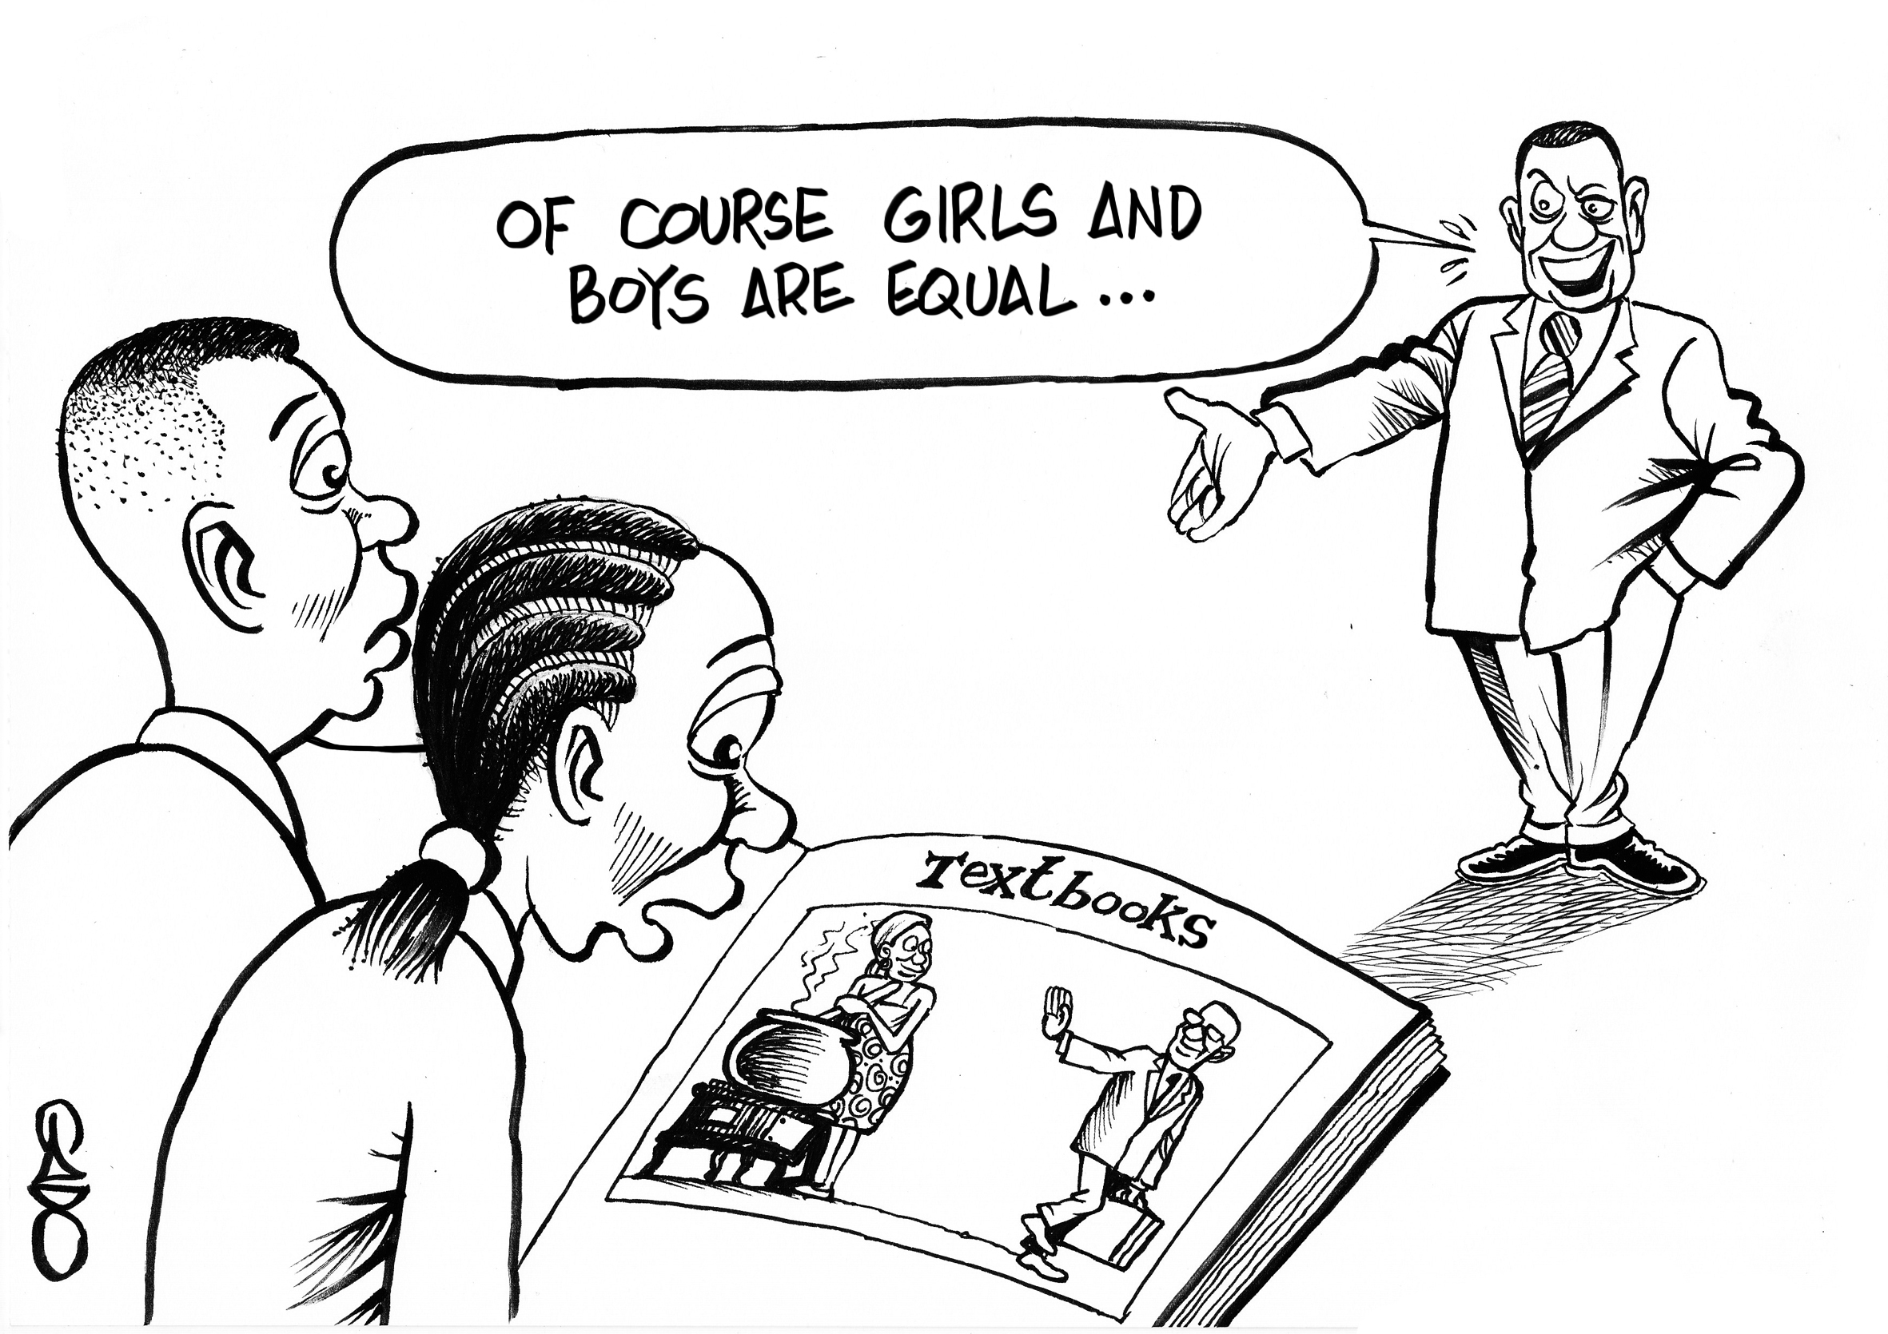
Stereotypes in the school textbooks
in Romania
The male gender dominates both quantitatively and qualitatively. In the stories in the textbooks, the male protagonists predominate, and in the history books most of the outstanding personalities presented are men.
Women appear in school literature rarely in important roles, most often being presented in terms of the relationship they have with a man.

Slide 18
Stereotypes in the school textbooks
in Romania
Men predominate in images that illustrate textbooks
The quotes in the textbook mostly belong to men.

Slide 19
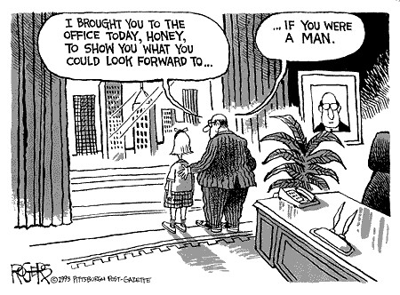
Occupational segregation
Gender-based occupational segregation refers to the concentration of women and men in different economic sectors and in different positions in the same sector:
humanities, social work, education, health and services are sectors dominated mainly by women
technology, engineering and natural sciences are considered rather "masculine" fields.

Slide 20
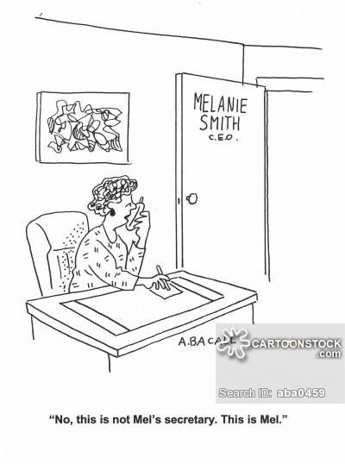
Occupational segregation
The focus of women and men on the "feminine" and "masculine" sectors seems to be a clear consequence of gender socialization and stereotypical ideals about masculinity and femininity. We can hardly imagine a male educator, a female Formula 1 driver or an aviation engineer, being still totally surprised when we realize that the flight captain's voice is a woman's voice or when we are carefully cared for by a male nurse.

Slide 21
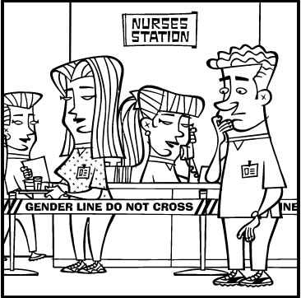
Occupational segregation
Occupational segregation is so deeply rooted that women and men who "cross the border" and choose professions that do not conform to their gender face major obstacles, both in terms of access to a position and its preservation in an environment that can be considered "hostile" to them.

Slide 22
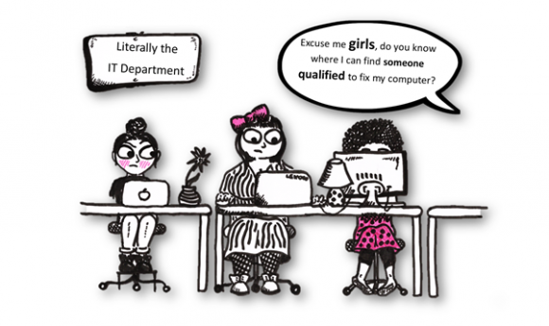
Occupational segregation
Occupational segregation can lead to choices that may not reflect the person's skills, interests or aspirations, preventing both genders from reaching their full potential.

Slide 23
Occupational segregation
Occupational segregation can lead to choices that may not reflect the person's skills, interests or aspirations, preventing both genders from reaching their full potential.

Slide 24
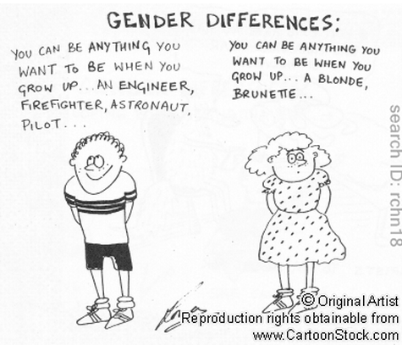
Occupational segregation
Occupational segregation gives rise to major inequalities in the labor market, with significant negative effects on women. There is a tendency for a large number of women to choose low-paid jobs or professions with little chance of promotion. On the other hand, well-paid jobs and leadership positions or leadership are dominated by men.

Slide 25
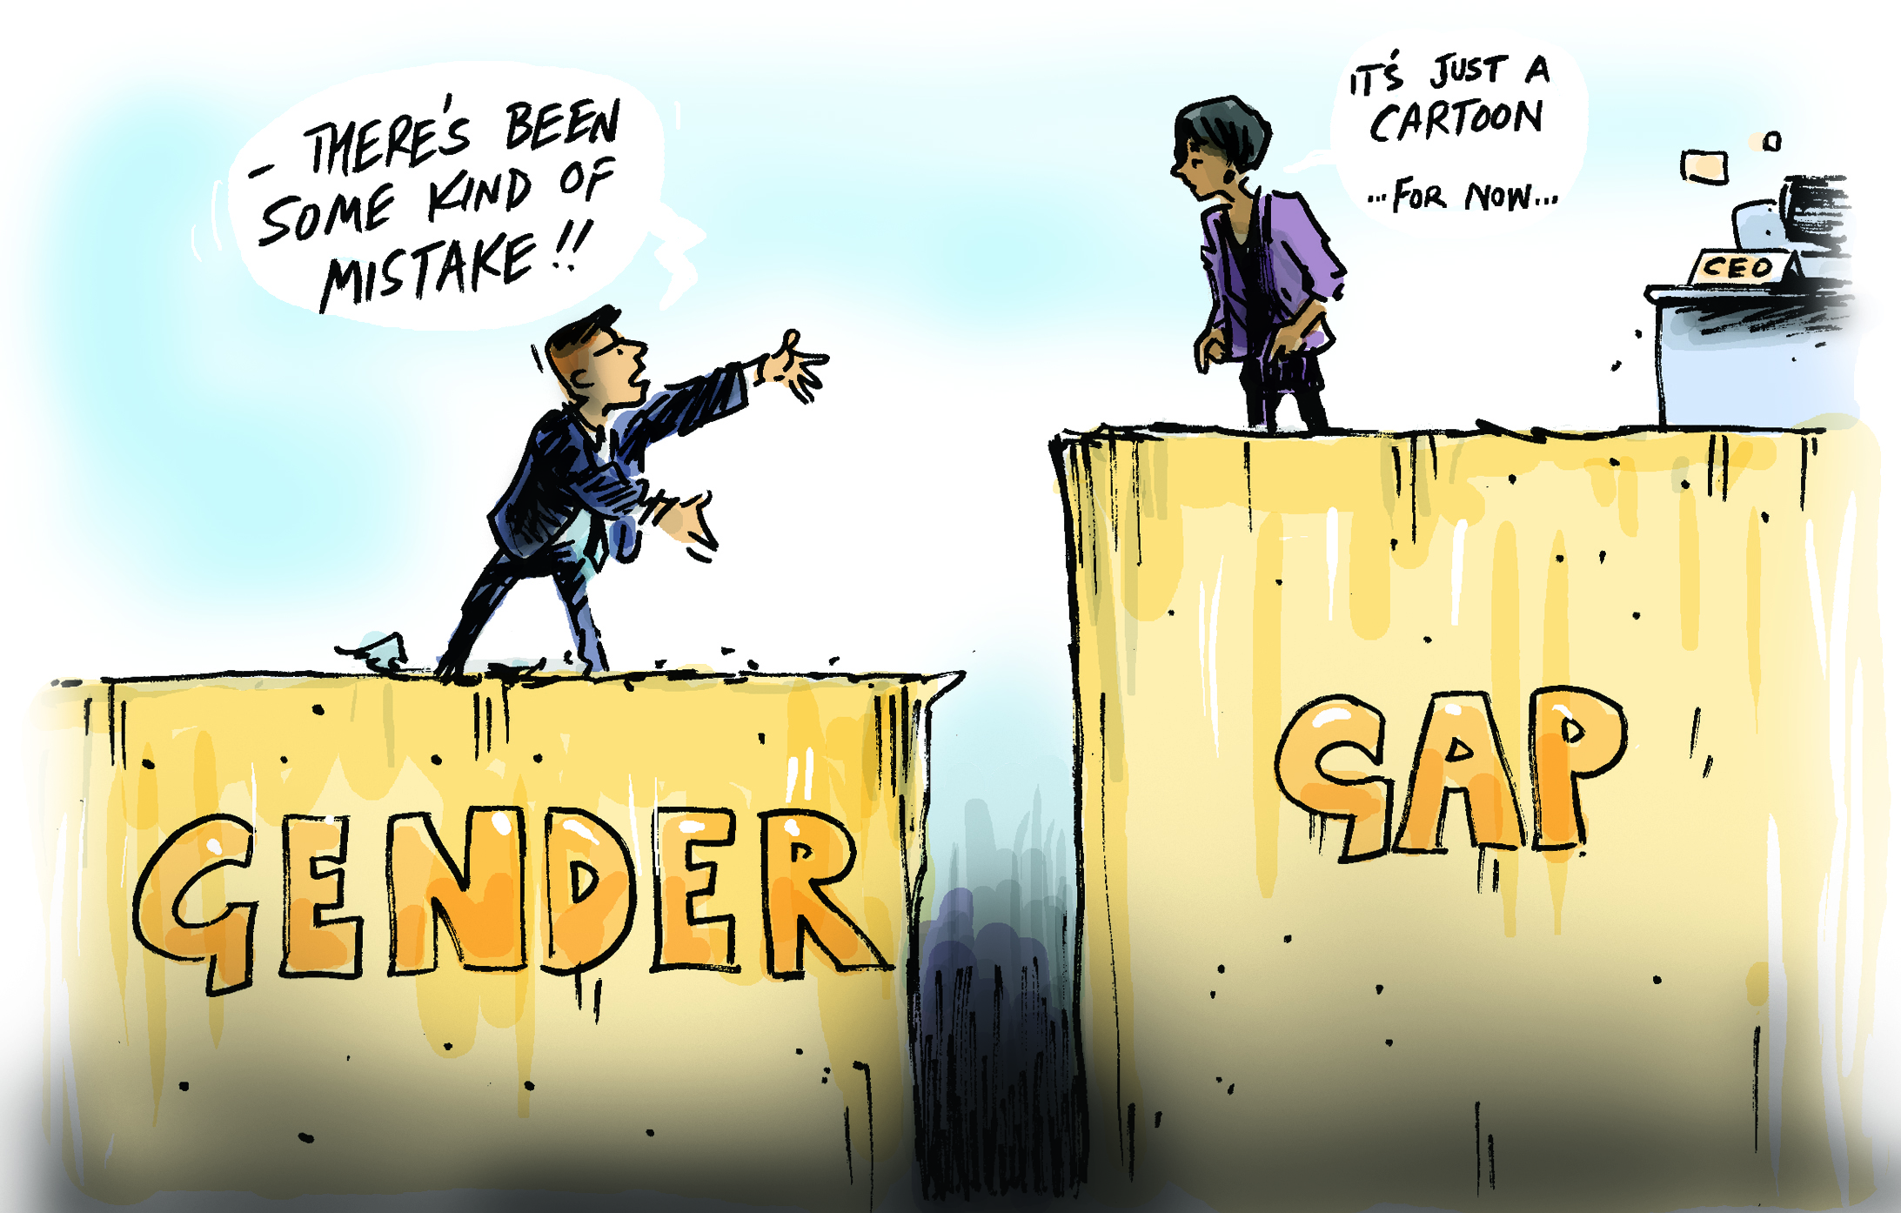
Occupational segregation
Occupational segregation is also the main cause of the pay gap between women and men, with women receiving lower wages than men for the same work. As a result, women are less financially independent, have lower pensions, more limited access to social services and face a higher risk of poverty.

Slide 26
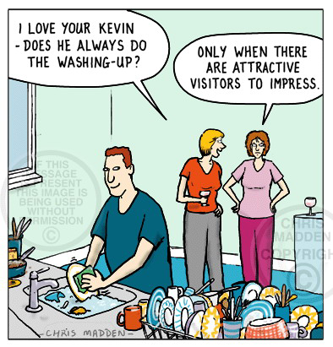
The balance between personal and professional life
A great challenge for women: achieving a balance between personal and professional life, between family responsibilities and professional responsibilities. According to statistics, at EU level, women continue to provide care to the family, children and the elderly, to a much greater extent than men.

Slide 27
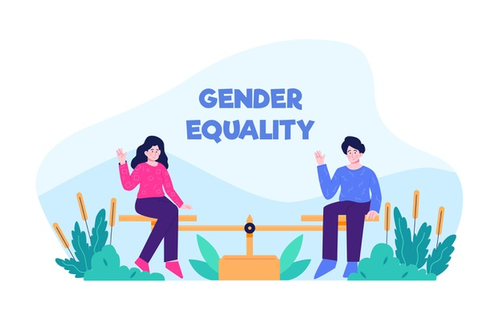
The balance between personal and professional life
On the one hand, women are expected to be economically and professionally successful, but at the same time, there is also the expectation or "unwritten obligation" that they put motherhood and family care above professional choices.

Slide 28
The balance between personal and professional life
The difficulty for women to find a balance between family and professional responsibilities is all the greater, given the lack of adequate support measures, such as strategies, policies, programs, flexible programs, accessible day care services for children and the elderly, the opportunity to work from home, etc.

Slide 29
The balance between personal and professional life
Reconciling family and professional life is an important goal of the EU. As a result, in 2019, the EU proposed several measures in this regard:
Division of childcare leave between women and men
Childcare services
Elderly care services

Slide 30
The balance between personal and professional life
Regarding ”Division of childcare leave between women and men ”- The European Commission has introduced a package of measures to extend childcare leave from three to four months, of which at least one month cannot be transferred to the other parent, encouraging so that fathers can take leave.

Slide 31
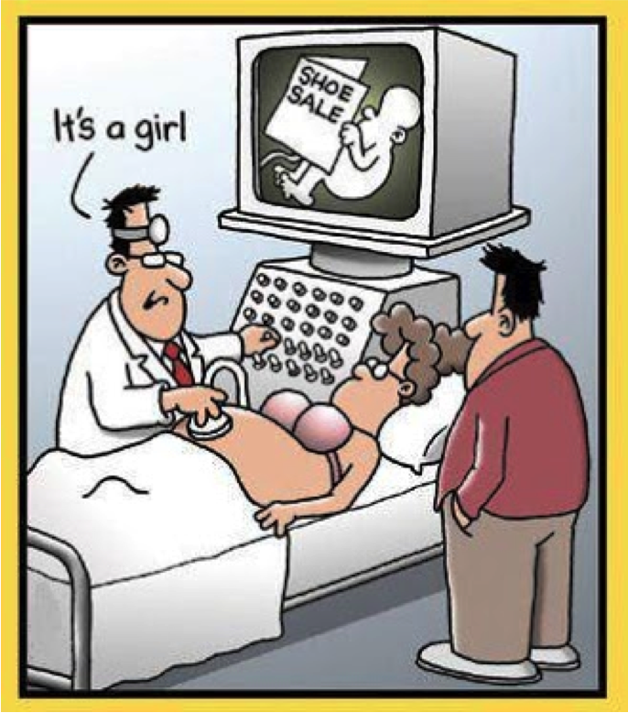
STATISTICAL INDICATORS - Demography
The population of the European Union is balanced by sex, with a slightly higher share of women (51.1%).
On January 1, 2018, the resident population of Romania was 19.52 million inhabitants (48.9% - men and 51.1% - women).

Slide 32
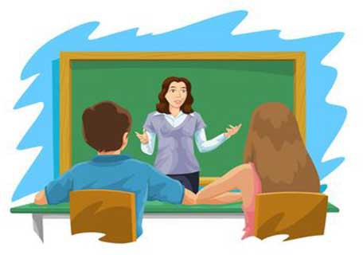
STATISTICAL INDICATORS
Teaching staff in Romania
In Romania, as in almost all European countries, the profession of teacher in pre-university education is mostly held by women (77.3%).
As the level of education increases, the share of female teachers decreases.
Thus, in pre-school and pre-school education, the share of women is 99.7%, in primary and secondary school, 80.1%, and for high school it was 71.5%.
Higher education is notable for a balance in terms of gender teaching staff (51.3%).

Slide 33
STATISTICAL INDICATORS
The level of education of the population in Romania
In terms of gender gaps, there are differences between the adult male and female population (25-64 years), in terms of structure by level of education, especially for lower levels. While men with an average level of education have a higher share than women (63.3%, compared to 57.4%), in the case of people with at most a higher level of education, women have a higher frequency.

Slide 34
STATISTICAL INDICATORS
Gender differences in the field of health
The chances of a longer life are higher in all EU countries for women. European statistics show that women in the European Union live, on average, 83.6 years, while the average life expectancy of men is 78.2 years.
The researchers say that this difference is largely explained by the different lifestyles and occupations of the two sexes.

Slide 35
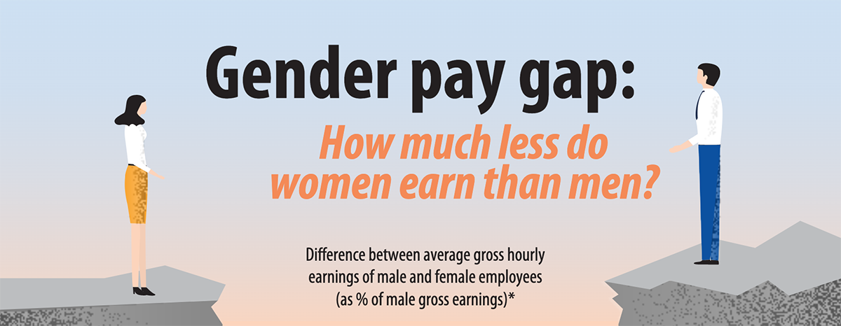
Women earn on average 15% less than men
In the EU in 2018, women earned 14.8 % less than men when comparing their average gross hourly earnings. On average, women earned less than men in all Member States, however this gender pay gap varies.
The largest differences were observed in Estonia (22.7 %), Germany (20.9 %), Czechia (20.1 %), Austria (19.6 %) and Slovakia (19.4 %). On the other hand, the smallest differences in earnings between women and men were found in Romania (3.0 %), Luxembourg (4.6 %), Italy (5.0 % in 2017) and Belgium (6.0 %).

Slide 36
For more information about such statistics,
we recommend you 2 resources
The Gender Equality Index, developed by EIGE, is a comprehensive tool for measuring gender equality in all EU Member States. The index identifies gender differences in six main sectors: education, employment, finance, time, health and power).
This digital publication The life of women and men in Europe – a statistical portrait aims at comparing women and men in their daily lives. This digital publication containing short texts, interactive visualisation tools, infographics, photos, etc. has been developed by Eurostat in collaboration with the National Statistical Institutes of the EU Member States.

Slide 37
Material made with the financial support of the European Commission.
The content of this material represents the exclusive responsibility of the authors and the National Agency and the European Commission are not responsible for the way in which the content of the information will be used.

