Slide 1
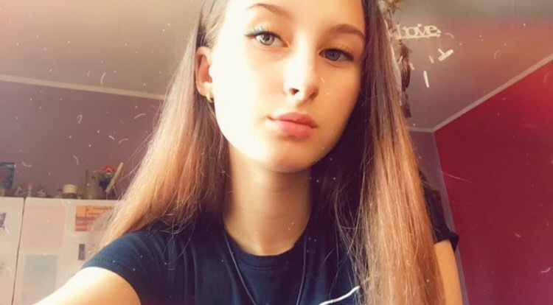
How people worldwide adjust to new life amid COVID-19
Vladislava Lazarova
9-th grade
Foreign Language Scnool
Pleven, Bulgaria

Slide 2
The life with covid-19
Stories

Slide 3
As the coronavirus grows to more than 191 000 cases acoss the worls and the death toll climbs to 7 800 plus, people are sharing their stories of fear, resiliency and recovery.

Slide 4
Dr. Jalal Baig said.
“Having parents that fall in the high-risk category and being a health provider yourself isn’t easy at all, and my wife feels the same way and exposing her parents,”

Slide 5
Park - 47
While hospitalized, Park said he had difficulty breathing that ‘’ would come and go ‘’ and dealt with side effects from medication, but said the advice from his doctor to stay positive helped him focus on his recovery.

Slide 6
Roberta Politi Italy
Roberta Politi’s family ownsa supermarket in a small Italian town. Since the pandemic, the number of shoppers allowed in the store at one time has been reduced to prevent lines.

Slide 7
I decided to add a few touching pictures that prove that good in people, love and support will be able to beat the virus!

Slide 8
Stay home and be safe!
We will all deal with this virus!

Slide 9
Thank you for the attention, stay healthy!
Prepared by : Vladislava Lazarova
9e grade

