Slide 1
5th GENERAL SENIOR HIGH SCHOOL OF AIGALEO

Slide 2
“GET IN SHAPE FOR EUROPE” (GISE)

Slide 3
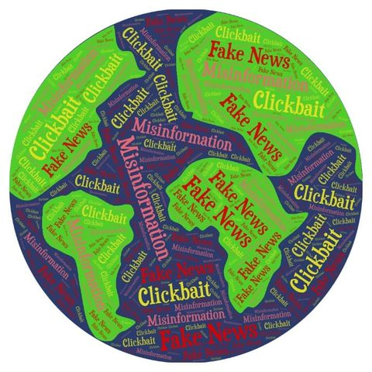
October 16 – 2020
FAKE NEWS
5th GENERAL SENIOR HIGH SCHOOL OF AIGALEO
School education
Conferences, presentations, round tables
Exhibition, Online conferences, meetings
and webinar
In the framework of the Erasmusplus project "GET IN SHAPE FOR EUROPE” (GISE), the members of the European Club of the 5th General Senior High School of Aigaleo will present the activities on fake news that took place during the 3rd transnational teaching and learning activities in Athens in November 2019, entitled: “Democratic competences in the Digital Era”.
This presentation along with the exhibition will occur at the premises of our school on Friday the 16th October 2020, at 12.00 pm, taking into consideration the Covid19 measures.
https://www.erasmusdays.eu/event/fake-news/

Slide 4
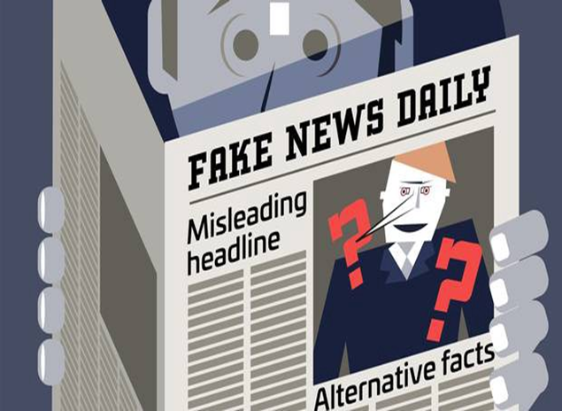
WHAT IS FAKE NEWS?
TYPES OF FAKE NEWS
CONSEQUENCES

Slide 5
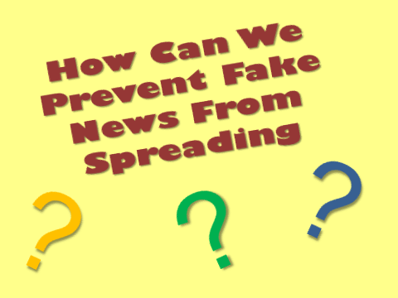
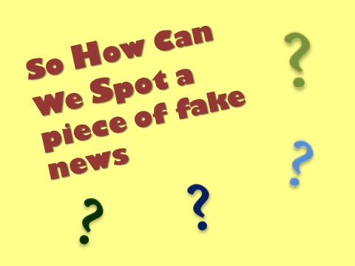
A POWERPOINT PRESENTATION ON FAKE NEWS
Hello, I'm Dimitris and my role is to inform you about the powerpoint presentation on fake news.
To be more specific, we chose that topic in order to raise people’s awareness, as it is one of the most important issues you can face while surfing the net. Therefore, we wanted to inform, not only our classmates, but also the whole school about it.
Aside from the presentation, we also created a quiz so that we could make the audience come alive and make it more fun.
Our main goal was to show that we should not believe what we see online as , in the main, nothing is what it seems!

Slide 6
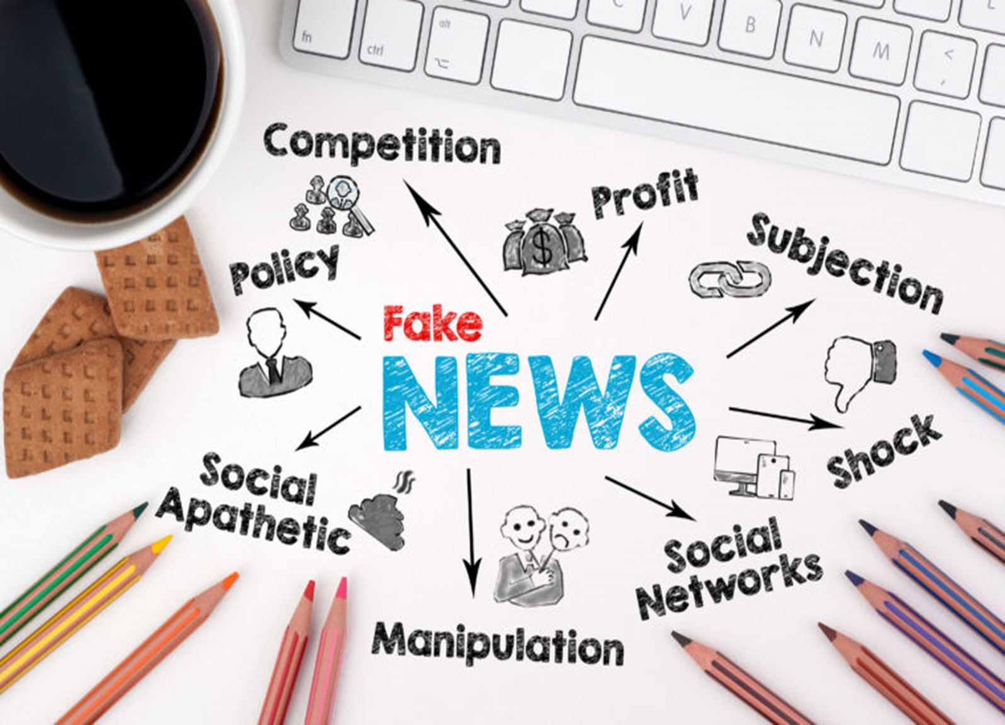

Slide 7
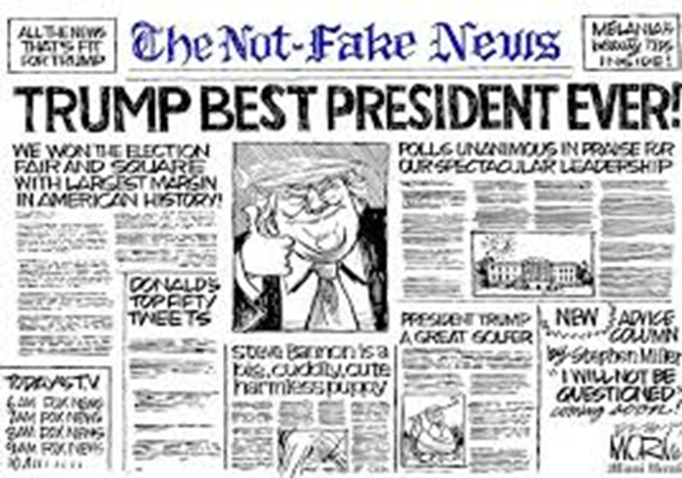
DESIGNED LESSONS ON FAKE NEWS
Hi, my name is Spiros and I will present you with one of the activities that took place at our school, thanks to the Erasmus program.
Two years ago, some classmates and I, members of the European club of our school, composed a quiz about fake news.
The quiz contained 20 article titles; some of them were real while others were fake. Our classmates were asked to find which were fake news. After that, we made a presentation about some smart and easy ways to find out whether an article is fake or not.
Through this whole process, we believe that we achieved our goal and improved the ability of some of our classmates to detect fake news .

Slide 8
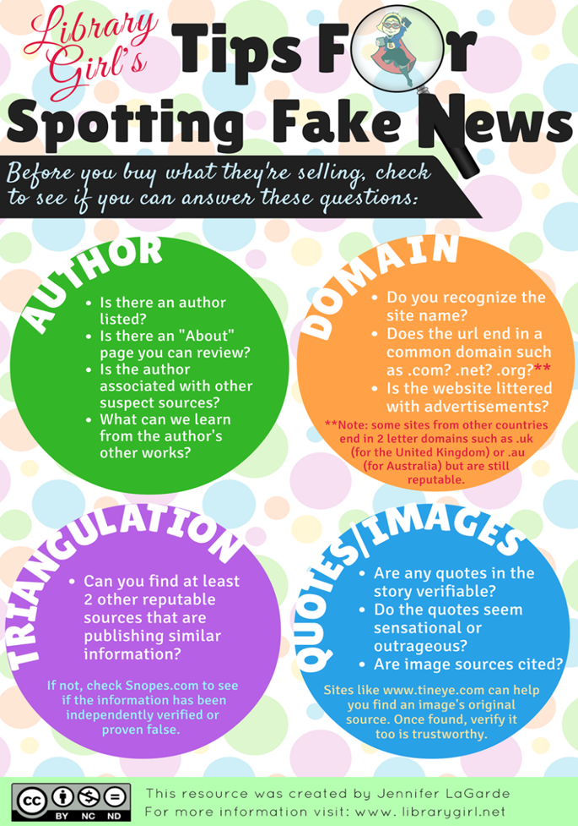

Slide 9
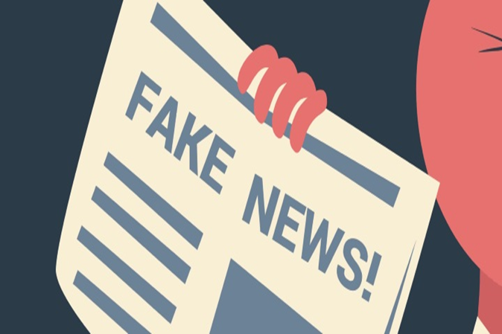
A QUESTIONNAIRE ABOUT FAKE NEWS
A questionnaire about fake news was created by three students through the use of google forms.
Young people were invited to answer questions regarding their social media accounts and their relationship with misinformation on the internet.
For instance, some of the questions where whether they have a social media account or not and considering that, if they are aware of fake news and their risks.
The students' goal was to provide their peers with statistics and information regarding this issue in order to browse the internet safely, highlighting the great value of critical thinking every time we come across an article, an essay or any other post in cyberspace.

Slide 10
FAKE NEWS QUESTIONNAIRE
1. Do you have a social media account?
YES
NO
2.How long (on average) do you spend on social networks per day?
3. Do you know about fake news on social media?
YES
NO
4.Do you know how to identify fake news?
YES
NO
5. Do you think it's easy to tell if a news item is fake or not?
YES
NO
6.If an article was known to be false, would you read it?
YES
NO
7.If you knew that a news item was false, would you notify it?
YES
NO
8. How often do you think an article falls into the category of fake news?
ALMOST NEVER
OFTEN
VERY OFTEN
ALMOST ALWAYS
9. Which of the following news do you think is true?
A little girl was assigned by Kim Jong Un to threaten the US1
"In Flames" Paris after serious episodes
A former employee destroys the aircraft of the company that fired him
The measles vaccine is harmful to the human body
We mourn the loss of Kostas Gavras
10. Who do you think should be responsible for finding out which of the news is false?
A government agency
Social media
Each person separately
All of the above
None of the above
Another agent
11. Do you know the various tactics used by some agencies to combat fake news?
YES
NO
12.Why do you think fake news is created?
Financial interests
Political interests
For satire or parody
To manipulate the people
All the above
None of the above

Slide 11
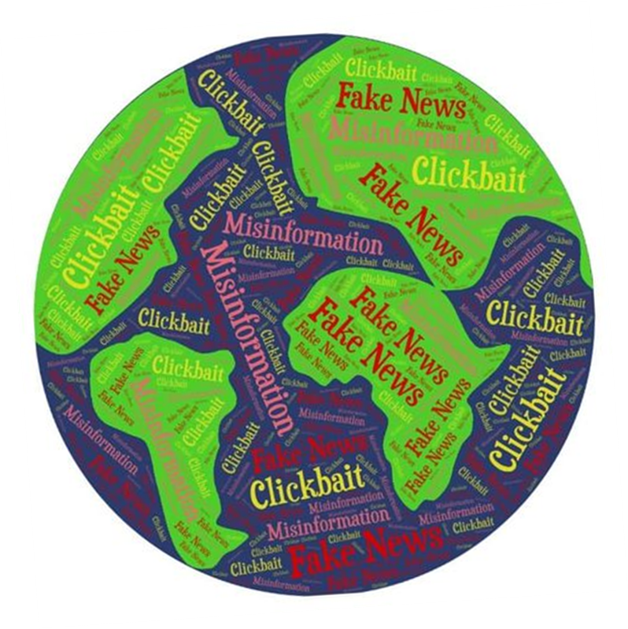

Slide 12
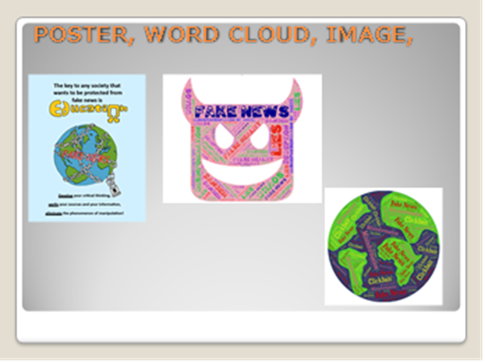
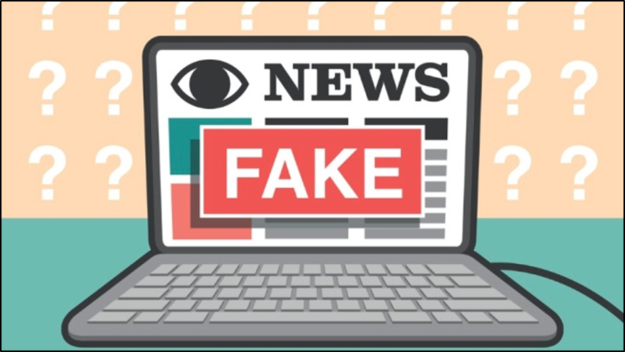
Α POSTER, A WORD CLOUD AND AN IMAGE
Hello, my name is Ariadni and I will talk to you about one of the many activities regarding fake news we did during the second year of the project. More specifically, some students, including me, created posters about this topic.
We used key phrases to summarise the issue of fake news and then we put them together to make the posters. One of them was a drawing and the other one was a word cloud.
Our goal was to raise awareness and inform our fellow classmates and teachers about this serious matter.

Slide 13
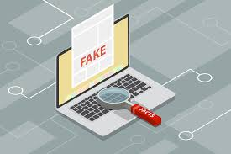
Interactive activity A game on fake news “Spread the news’’

Slide 14
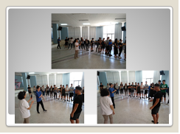
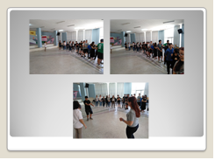
INTERACTIVE ACTIVITY: “SPREAD THE NEWS’’
The students took part in a game - activity to see the effects of disinformation.
The students, being in a row, had to copy the movement that the first student had performed and then present it to the others in the row.
Another variation of that was also presented with the students whispering a short sentence to the next student, the outcome of which was very different from the original one.
For me, these processes were very interesting because I realized how easily a word or an action can be falsely interpreted by someone, intentionally or not, leading to miscommunication and disinformation .

Slide 15
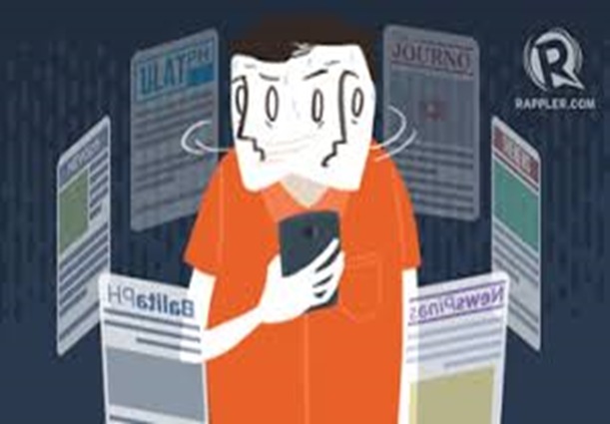
Μisleading content ("misleading use of information to frame an issue or an individual")

Slide 16
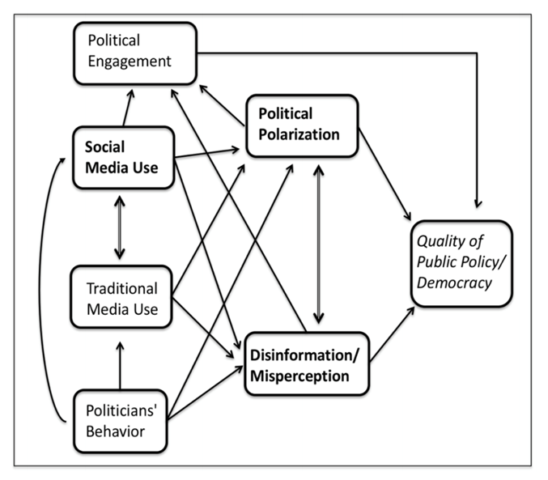
Democracy

Slide 17
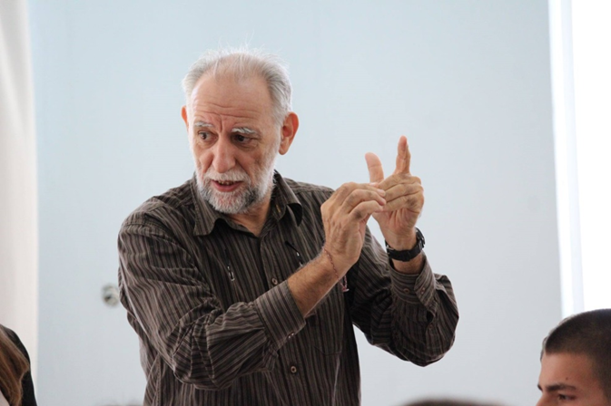
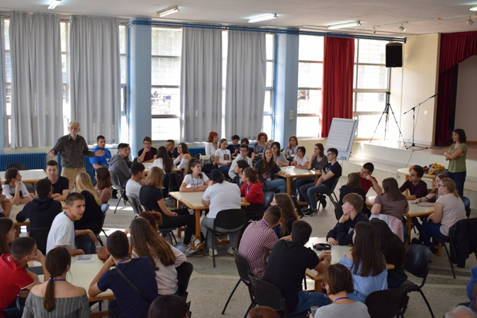
“REAL OR FAKE? DISINFORMATION ΑND DEMOCRACY”
Mr George Moschos and Ms Matoula Papadimitriou, founding members of Initiative for Article 12, did the presentation “Real or Fake? Disinformation and democracy” in our school during the third mobility.

Slide 18
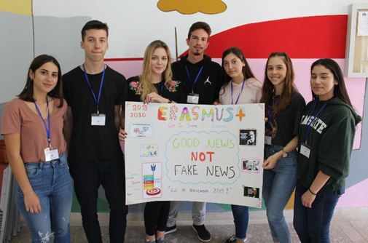
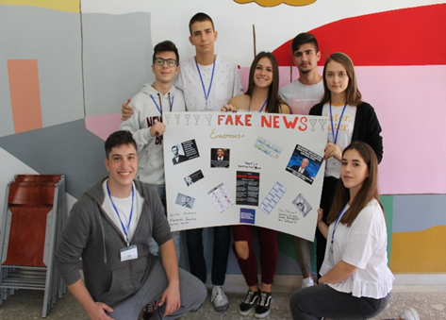
First of all, the participating students from different countries were divided into mixed groups. After that, we were asked questions about fake news and we tried to find some examples as a team.
Also, we produced posters about the things that we should be careful of on the internet. The posters on fake news were produced by the teams of students so that there is dissemination of the results of the meeting and all the students have a clear idea of the activities conducted.

Slide 19
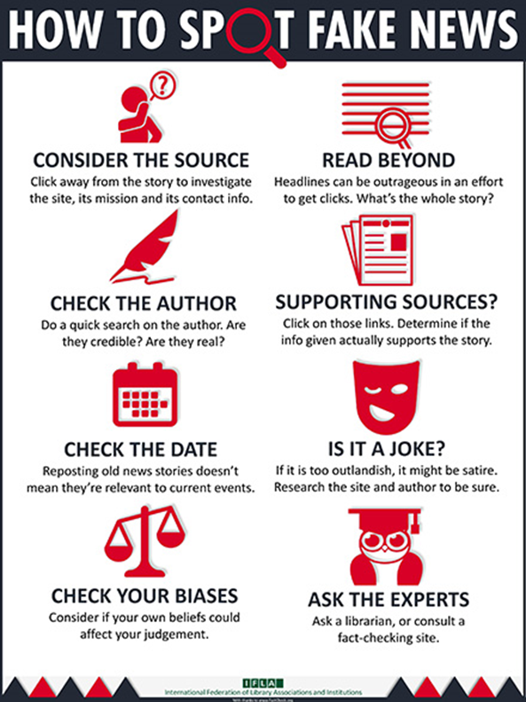

Slide 20
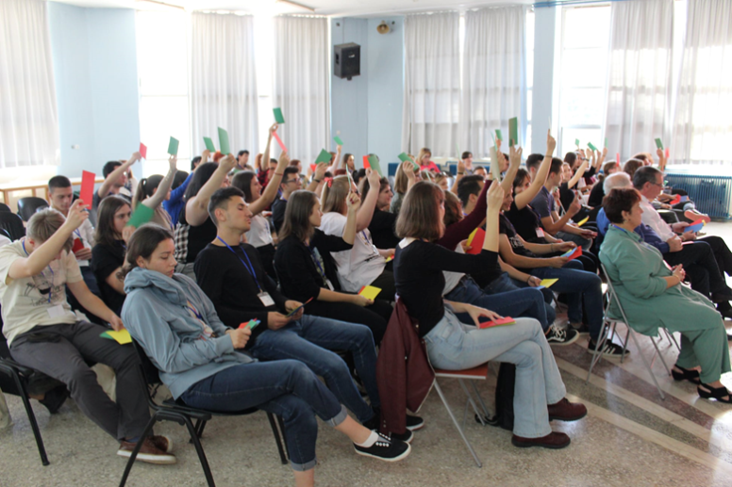
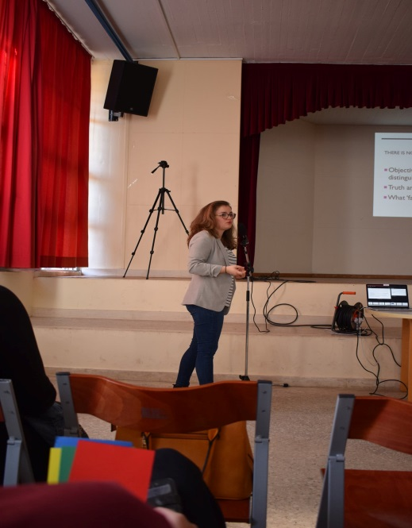
MS OLGA GKOTSOPOULOU’S, PRESENTATION ,
PhD candidate at the Faculty of Law and Criminology of Vrije Universiteit, Brussels, : 'How well do you know your digital self? Let's find out how your online footprint affects your democratic competences”.
Our Erasmus+ team had the honor to watch a presentation by Miss Olga Gkotsopoulou about our digital profile on the internet and the risks it entails.
Through the interactive presentation with many questions and our participation, we considered how safe we are on social media with the information we give about ourselves.
We learned whether we are our digital self or not, what is the relationship of our online self with our identity offline and now we pay attention to our posts and privacy settings in order to stay on the right track!

Slide 21
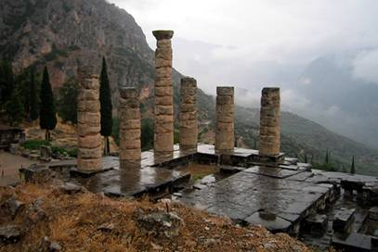
“PYTHIA ORACLES GIVING” GAME IN DELPHI
To demonstrate the oracle ritual that took place in ancient Delphi, we decided to play a role game in which students would pose questions to Pythia and then she would give her answers.
We prepared the act at the school library by choosing roles, making up the questions and thinking about how to present the act to all Erasmusplus students during the trip to the archaeological site of Delphi.

Slide 22
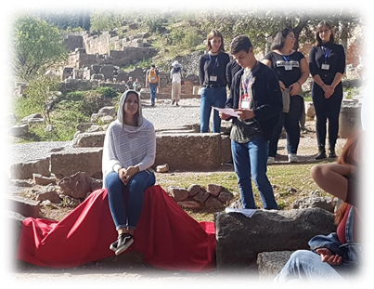
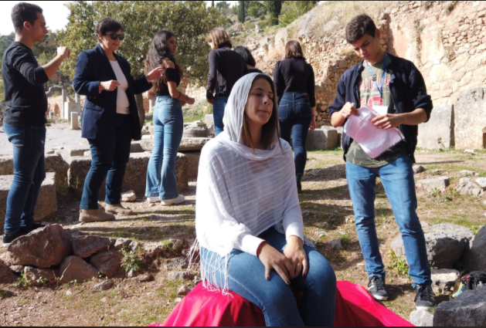
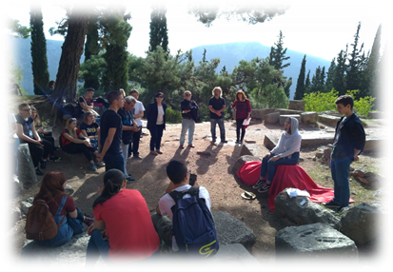
“ BE PYTHIA” IN DELPHI
During the third mobility in Athens, the Erasmus+ teams visited Delphi.
There, the Greek team organized a theatrical event which was about Pythia and her ambiguous prophecies uttered under divine possession (enthusiasmos) by Apollo.
The activity was entitled : “Be Pythia” and I played the role of Pythia .
The aim was to find out the connection between the oracles of antiquity and the fake news of our time.
All of us gained interesting knowledge from this event and I hope it will be an unforgettable experience for Erasmus + teams.

