Slide 1
THE ECONOMICS IN THE TIME OF COVID 19
Kaili Kraucher – 9-th grade
Foreign Language School – Pleven, Bulgaria

Slide 2
As countries close shops, borders and beg their citizens to stay at home, the global economy is looking less healthy by the day.

Slide 3
Experts believe that the tourism, transport, leisure, and export-oriented industries will be hit hardest.

Slide 4
Businesses exist to make a profit. If they can’t produce, they can’t sell things. This means they won’t make profits, which means they are less able to employ you.
Many people lose their jobs or fear losing their jobs. So they buy less.
And the whole cycle starts again.

Slide 5
The entertainment industry suffers from the restriction of mass public events - sports, music, theatre, cinema, and all cultural events.
The transport sector is also at risk because of the shrinking trade and the decline in travel.
The restaurant and hotel industry suffer damage as well.
Factories close.

Slide 6
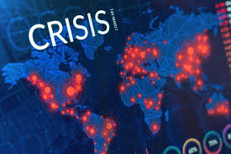
There is no way to tell exactly what the economic damage from the global COVID-19 coronavirus pandemic will be, but it might bring confusion in the economics and in the countries as a whole.

