Slide 1
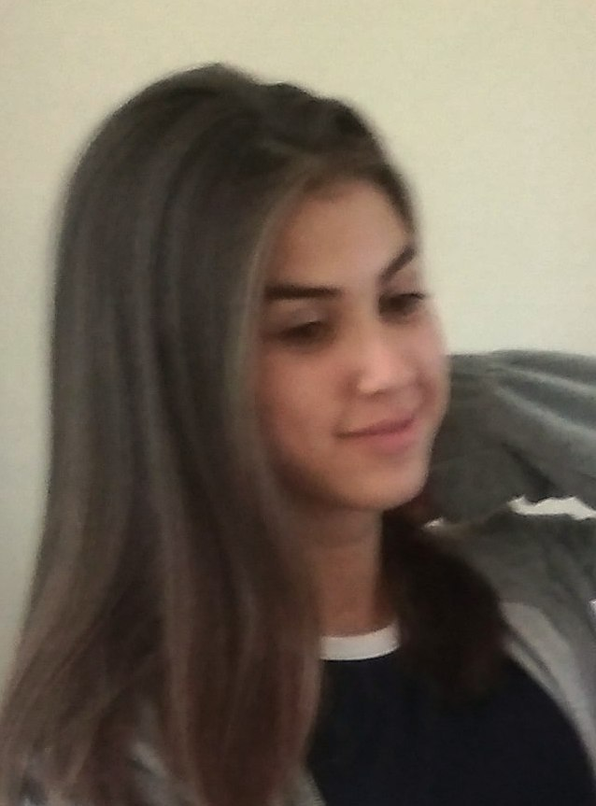
How to Stay strong during COVID-19
Alexandra Ivanova – 9-th grade
Foreign Language School
Pleven, Bulgaria

Slide 2
1. Mental Health
Support your loved ones
Social distanting doesn’t mean social isolation!
Create and follow daily routine
Get enough sleep

Slide 3
2. Stay physically strong during COVID-19
Do exercises at home
Dance!
Give your pets the attention they need
Just do something that keeps your mind busy

Slide 4
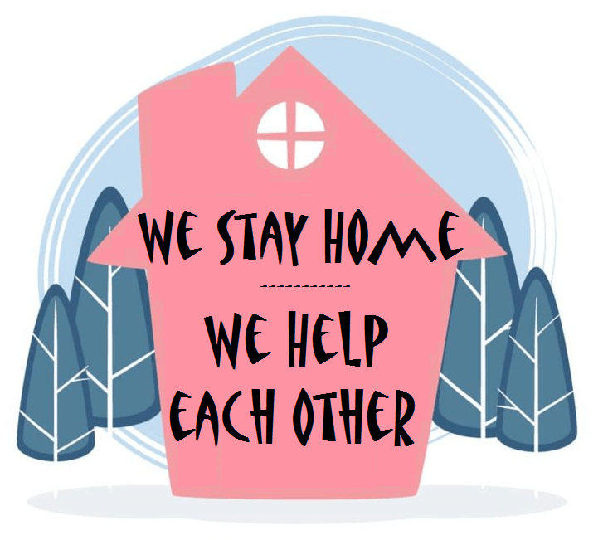
3. Follow the imposed measures!
We all want the quarantine to end soon, so please respect the restrictions and measures!
stay home, save live!

