Slide 1
Partnership “Get in shape for Europe” (GISE) C9-Short-term joint staff training Events – “Inclusive school practices” (11-13 May 2021) Host: Zespół Szkół Ekonomiczno-Gastronomicznych, Tarnów, Poland
5th GENERAL SENIOR HIGH SCHOOL OF AIGALEO, GREECE
Project funded by the Erasmus+ Programme of the European Union

Slide 2
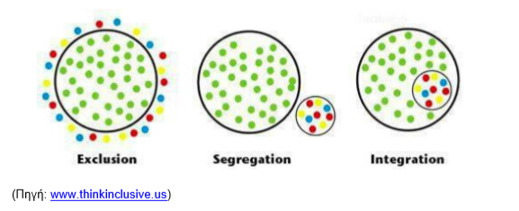
What is inclusion?
A good question! Inclusion is a concept difficult to define.
Initially, it would be easier to consider what is not inclusion, rather than what it is, mostly regarding education:
Ιnclusion is not one of the following:

Slide 3
Exclusion: some children and young people are excluded from access to quality education.
Segregation: some children and young people receive education separately from other children, for example
in different classrooms but in the same school or
with a continuous 'creation' or 'management' of groups throughout the curriculum.
Integration: children and young people seem to be all involved in the learning process, but in reality receive their education separately. For example, a child attends classes in the same room as the other children but receives separate, individual help from an adult and does not interact with other children. The student participates, but is not included.

Slide 4
Inclusive education aims to maximize
acceptance and participation,
the psychosocial development and personal success of children and
to minimize discrimination.“
Inclusive education describes the process
by which a school strives to respond
to all students by treating them as
autonomous individuals.

Slide 5
Inclusive education aims at equality,
social justice,
participation and
an active role in the community.
It is based on a positive view of diversity.
Priority is given to the struggle for change, with emphasis on the importance of familiarisation with the concept of coexistence and the recognition of our common human nature.

Slide 6
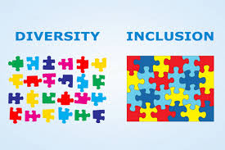
Inclusion focuses
on all students and not just some
Historically, inclusion is considered the education of children with sensory and / or physical disabilities or of children referred to as "children with special learning disabilities".
Nowadays inclusion is linked to a much wider range of differences that are found in all individuals in the school community, including adults,such as:
• ways of acquiring knowledge
• ways of communicating or interacting
• sensory or physical factors
• social, emotional factors
or factors related to mental health
• socio-economic conditions
• marital status
• cultural beliefs or expectations
• language spoken at home
• gender
• sexuality……………

Slide 7
​​Goals of an inclusive school could be, according to its needs :
• Practically applying the values ​​of inclusion.
• Supporting all people in order to feel they belong to the community.
• Enhancing participation in learning and teaching activities, relationships and local school communities.
• Improving schools for staff and parents / guardians, as well as for children.
• Reducing exclusion, discrimination, barriers to learning and participation.
• Sharing experience from lifting barriers for some
children so that even more children can benefit.
Restructuring the culture, policies and practice so that
they embrace diversity and treat everyone equally.
• Recognizing that inclusion in education
is an aspect of inclusion in society.

Slide 8
Values of inclusion

Slide 9
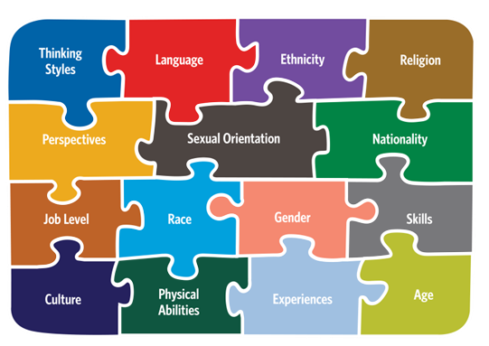
Does our school community recognize the value of inclusion and diversity?
practices aimed at actively engaging and challenging their school community.
We are trying to play an important role in shaping future educational practices through the Inclusive Schools program.
The Inclusive Schools program will encourage schools across Europe to develop inclusive education practices aimed at actively engaging and challenging their school community.

Slide 10
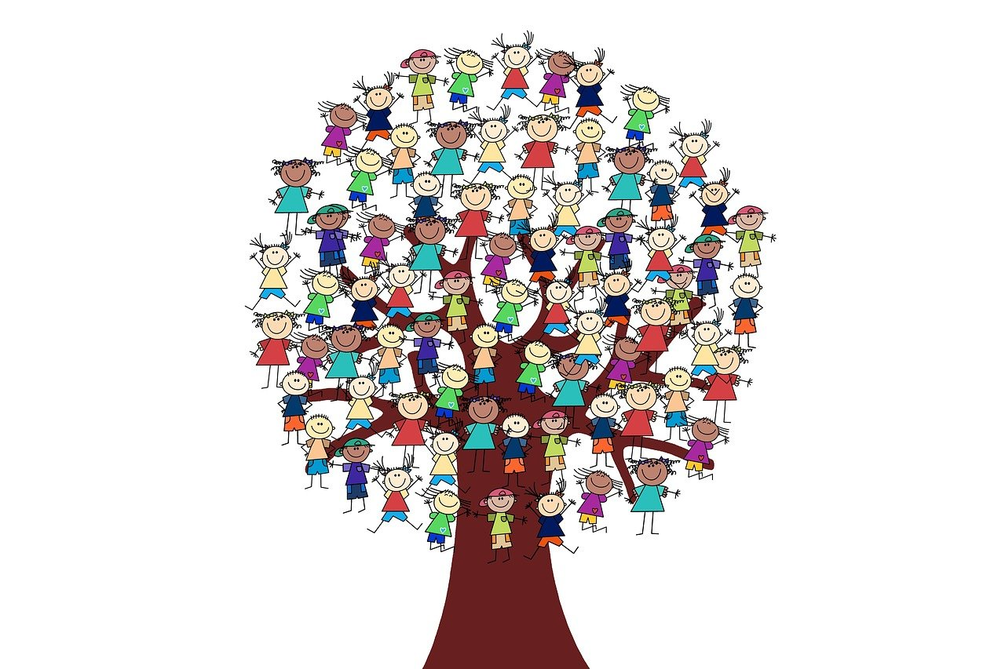
Within the Inclusive Schools program, the following activities will be implemented in which schools will play an important role.
Development of diversity research and mapping tools as well as strategy planning
Creation of practical guidelines
Training of teachers and
Establishment of a school
certification system

Slide 11
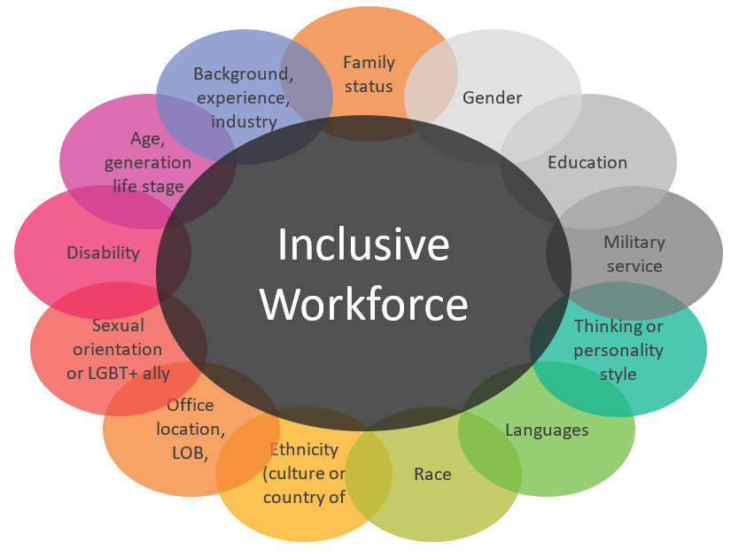
The program includes an innovative information campaign, a plan to create a communication channel between the school community and policy makers, thereby creating a dialogue channel between the two sides on inclusion and diversity .

Slide 12
SEMINARS ON INCLUSION
The members of the pedagogical team of Erasmusplus of our school participated in a seminar organised by the third Directorate of Secondary education through the Environmental Education, Health Education and Cultural Affairs Officers in collaboration with the British Council to inform School Teachers and Principals of the "Participation Schools" program and educational material.
SUBJECT: Experiential seminar "Inclusive schools: practices of inclusive education"
(https://www.britishcouncil.gr/programmes/education/schools/inclusive-schools)

Slide 13
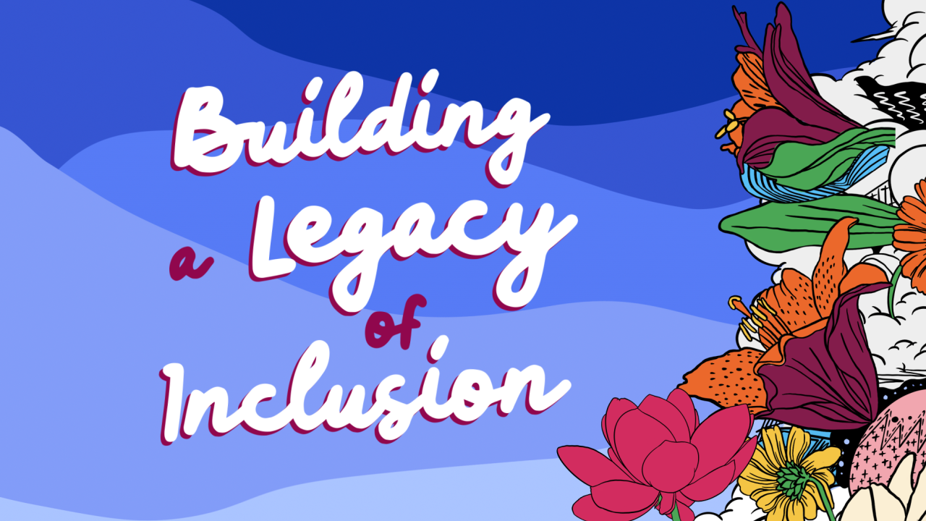
The program supports the creation of a school environment where teachers and young people embrace and accept the challenges and benefits of diversity.
Adopting an inclusive approach involves developing a learning environment where every student has equal opportunities to succeed.

Slide 14
The "Inclusive Schools" educational program (https://www.britishcouncil.gr/programmes/education/schools/inclusive-schools) is aimed at thousands of students and young people from Greece and other partner countries, coming from different backgrounds - irrespective of gender, learning needs, socio-economic status, religion and ethnic origin and its aim is to support their integration into the school community

Slide 15
