Slide 1
Partnership “Get in shape for Europe” (GISE) C9-Short-term joint staff training Events – “Inclusive school practices” (11-13 May 2021) Host: Zespół Szkół Ekonomiczno-Gastronomicznych, Tarnów, Poland
5th GENERAL SENIOR HIGH SCHOOL OF AIGALEO, GREECE
Project funded by the Erasmus+ Programme of the European Union

Slide 2
SCHOOL ACTIVITIES ON INCLUSION 1ST ACTIVITY
SHALL WE PUT OURSELVES INTO THE OTHERS’ SHOES?
On Wednesday, February 12th 2020, the students of the Erasmus+ Program put themselves in the place of people experiencing difficulties due to ethnicity or disability.
The students had to follow simple instructions to perform certain tasks. Initially the instructions were read in Spanish, so no one knew what to do (for example, being in the position of a refugee in a foreign country, not knowing the language of the host country).

Slide 3
The instructions were then given again in Spanish.
During this phase, students understood what they had to do better, making use of more facts
(eg the intonation , having knowledge of other languages, body language).
Then they followed the same instructions with their eyes closed (as if they were blind) and with one hand behind their backs (as if they were disabled ).
At each stage, students discussed how they felt being excluded from a group.

Slide 4
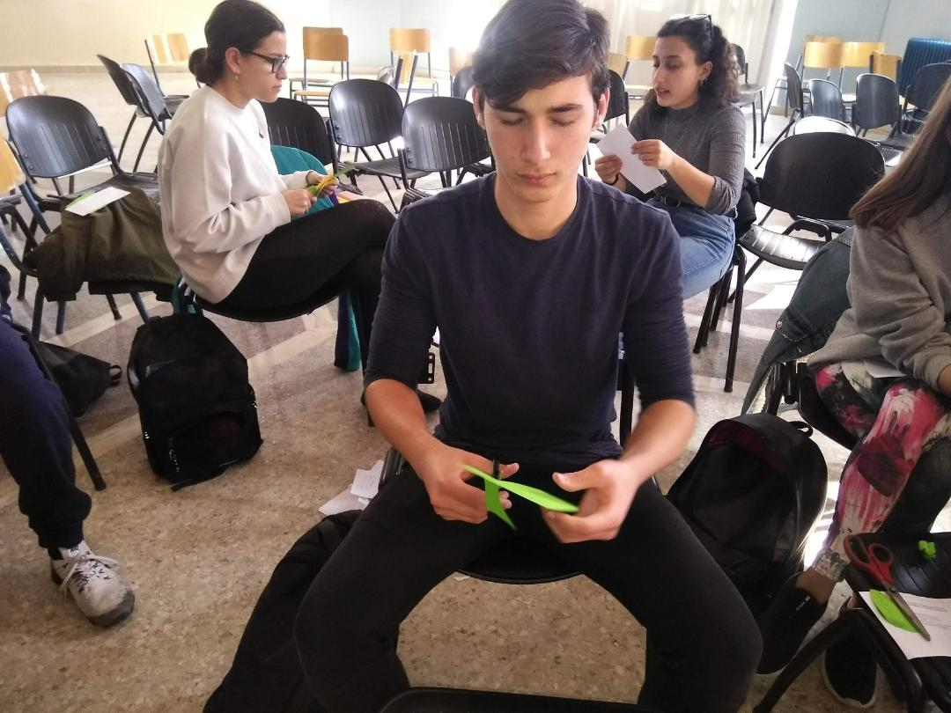
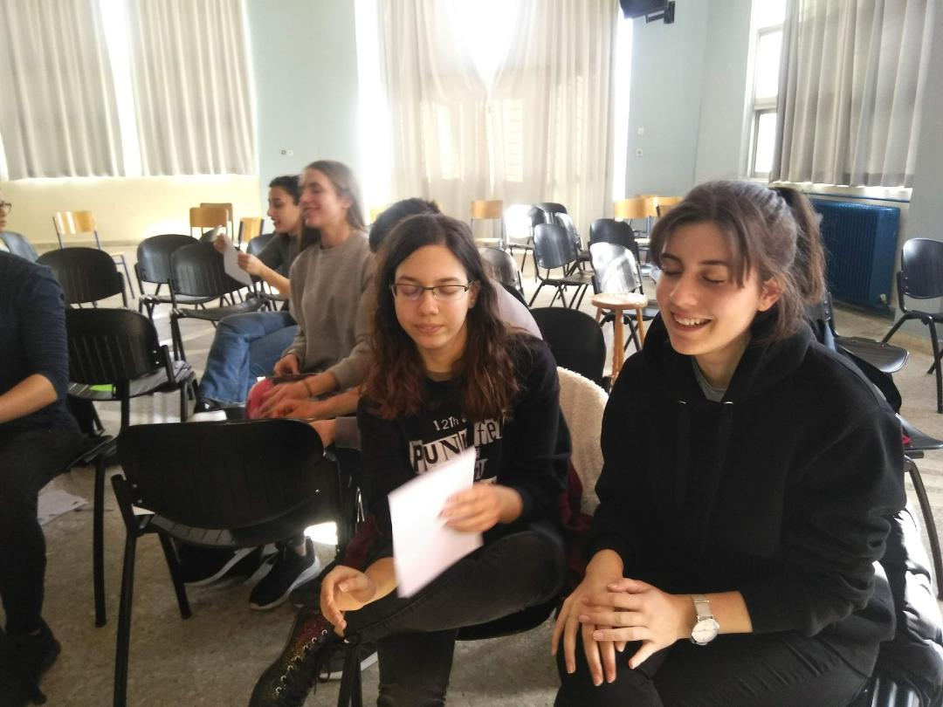

Slide 5
The purpose of the action was for the students to realize the negative feelings that exclusion generates, so as to address inclusion.
Students actively participate in the activity and follow the instructions given to them:
1. Take the blue paper and fold it in half.
2. Take the yellow paper and cut a circle.
3. Stick the circle on the blue paper.
4. Use the marker to write "We love school »on the circle.
5. Write your name on the back of the blue paper.
(The British Council Educational INCLUSIVE SCHOOLS program gave the occasion for the action)

Slide 6
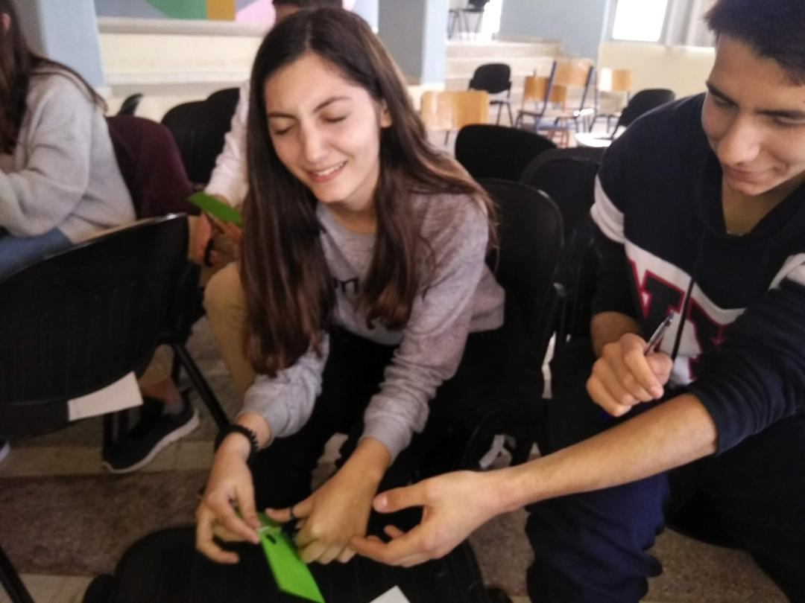
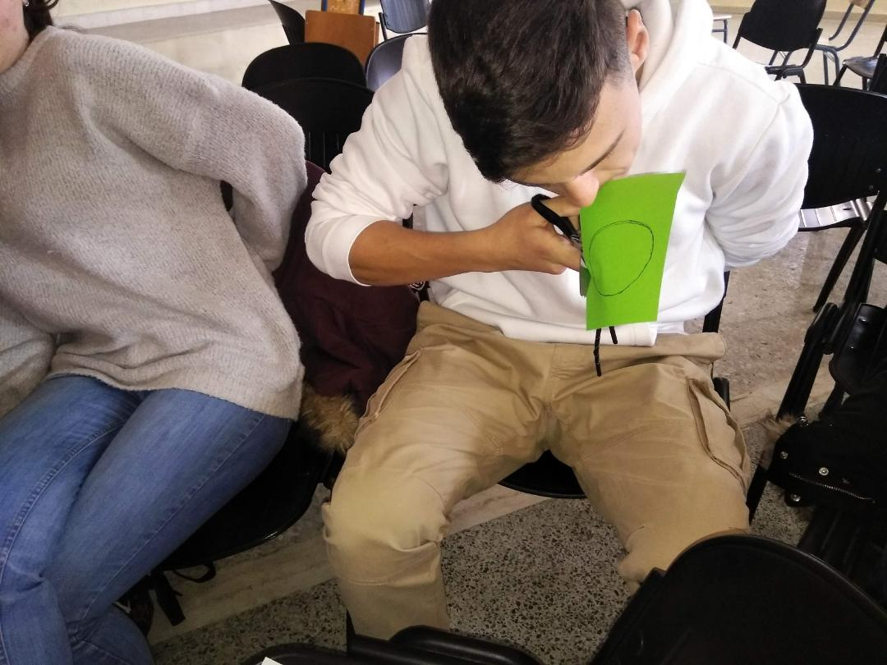

Slide 7
SOME OF OUR STUDENTS’ THOUGHTS
“It was a great opportunity to experience the same difficulties as disabled people. However, it was a simple simulation that helped us realize some things. But in the end we all regained our sight or hearing and we continue to live with the same ease as before. For some the conditions are different: When the curtain closes, they do not continue to live normally. These difficulties are part of their lives”
“Modern societies in our eyes often seem democratic and open to all. They create the impression that they accept all people without discrimination. In reality, however, certain population groups are excluded from social life. How do these people, who experience exclusion every day, feel?”

Slide 8
the creation OF a POSTER “The Hand of Solidarity “

Slide 9
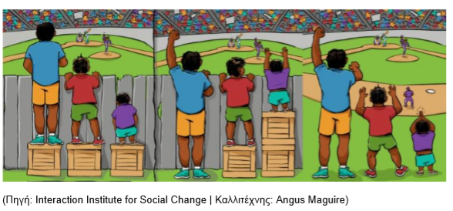
2nd ACTIVITY
One picture, a thousand thoughts
On Wednesday 4/3/2020, our students discussed diversity and inclusion, expressing their opinions freely regarding the following picture:

Slide 10
They concluded that:
The upper left image shows equality of opportunity: providing the same help to each individual to achieve the same result. This sounds fair, but if you look closely you will see that it fails to provide people with what they really need.
The middle image above presents an equal opportunity: each person receives what is needed to achieve the same result. The help is different for each person, but the result is the same.Focusing on equivalence rather than equality can be an important change that individuals need to make as part of their path to inclusion.
The last image presents the goal of inclusive education policies: to remove as many obstacles as possible for all students to learn. As students and circumstances change, removing barriers to learning is an ongoing endeavour and may also require changing perceptions.

Slide 11
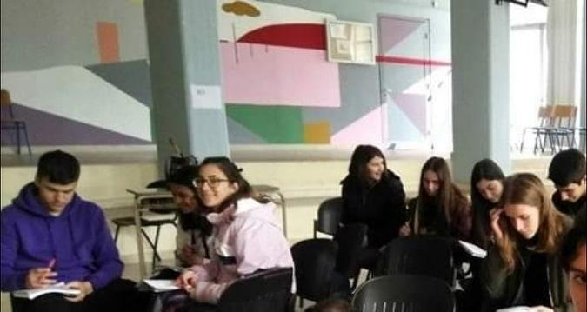

Slide 12
Equal opportunity differs from equality of opportunity.
Afterwards, some of our students wrote short articles addressing this issue .
One of them, entitled “Fight for differentiation”, emphasized the importance of action, in order to change attitudes and behaviours against exclusion.

Slide 13
Some of our students' thoughts:
Different means for equal opportunities.
Freedom without restrictions.
We are equal, though different.
Equality: Equality sometimes leads to injustice if the needs of individuals are not taken into account.
.
Equity: Effortless inclusion means sharing your box of opportunities with other people.
Liberation: In our society we are used to obstacles, problems, difficulties, in order to appreciate something.
The third image is life with equality, freedom, inclusion.
It is up to us to ensure equality with our perceptions and actions.

Slide 14
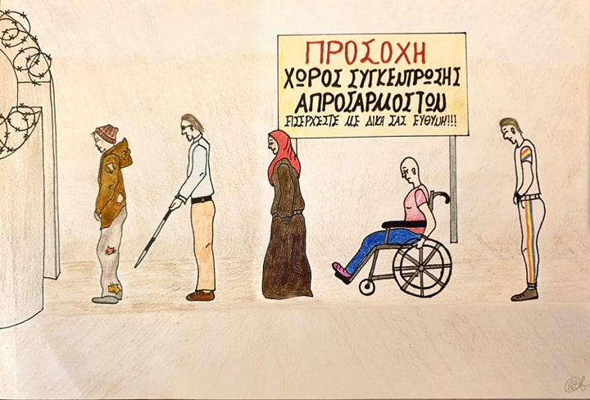
Then a student created this painting inspired by this activity.
“A painting about the excluded”

Slide 15
PARTICIPATION IN CULTURAL ACTIVITIES
Participation of students through collaboration and student-centered approach in:
Theatrical performances
Projects
Sports activities and athletic competitions
Educational programmes (eg Erasmusplus, European Parliament Ambassador Schools, Model United Nations simulations)

Slide 16
Why is it important to apply inclusion techniques in our school curriculum?
As experience has shown us, it is of paramount significance that we provide our students with a great repertoire of educational opportunities so that they are able to be involved actively in the tasks they are interested in.
In this way, by doing an activity they mostly enjoy, relevant to their interests and inclinations, and through cooperation with the other students in pairs or groups, they will feel accepted as a part of the community, in order to become active citizens who will consciously contribute to the well-being of the society.

Slide 17
https://www.youtube.com/watch?v=keyjlqixq9c
The commitment of Sustainable Development Goal 4 (SDG 4) to ensure ‘inclusive and equitable quality education’ and promote ‘lifelong learning for all’ is part of the United Nations (UN) 2030 Agenda for Sustainable Development pledge to leave no one behind. The agenda promises a ‘just, equitable, tolerant, open and socially inclusive world in which the needs of the most vulnerable are met’.

