Slide 1
Partnership “Get in shape for Europe” (GISE) C9-Short-term joint staff training Events – “European Values: Gender Equality and Equal Opportunities” (20-22 April 2021) Host: “Stefan Procopiu” High School, Vaslui, Romania
5th GENERAL SENIOR HIGH SCHOOL OF AIGALEO, GREECE
Project funded by the Erasmus+ Programme of the European Union

Slide 2
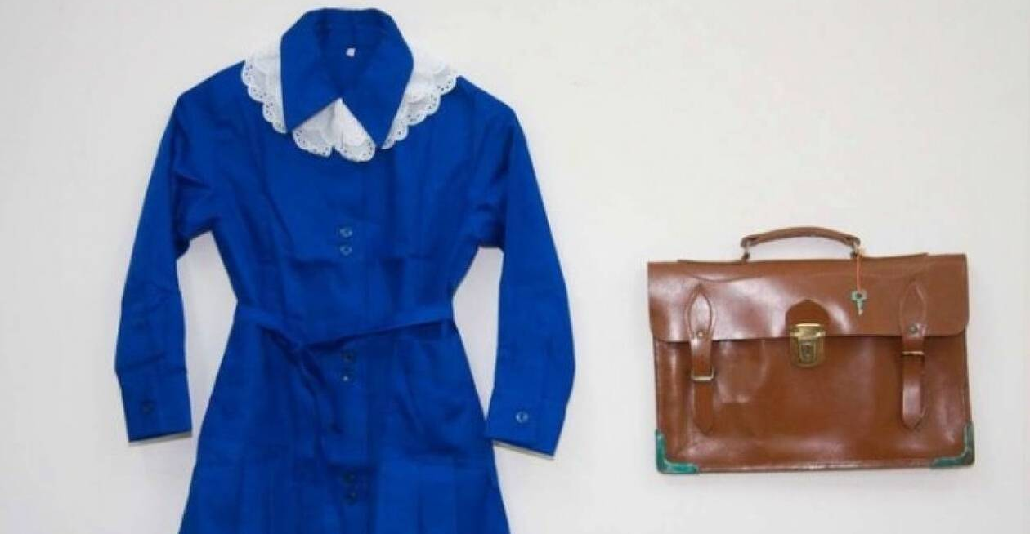
GENDER DISCRIMINATION AND SCHOOL
Some historical facts
1834 Both boys and girls obtain the right to attend Primary School, though most girls are not allowed to go to school or it is not considered necessary for them to know to read and write.
1836 Only boys obtain the right to attend Secondary School
1837 Boys can pursue University Studies
1879 93% of Greek women are estimated to be illiterate
1890 The first woman is accepted in University
1914 Girls have to wait almost a century to be able to attend public Secondary education
Till 1970 boys and girls used to go to different schools.
1982 Abolition of the blue uniform students (mostly girls) had to wear at school.
Even nowadays, women are faced with difficulties when they try to achieve higher status at work (glass ceiling)

Slide 3
SCHOOL BOOKS AND GENDER
School has always been the place where ideas, either conservative or revolutionary, are disseminated. As students tend to accept whatever they are taught without questioning, especially when it is consistent to their families’ values, stereotypes regarding gender are intensified at school.
School books play a very important role to the stabilization of these stereotypes. They reflect social norms and present role models with which students are identified. In this way, they form their attitudes regarding men and women and learn what is acceptable or not for them according to their gender
So, if the content of school books changes, we can expect relevant changes to people’s attitudes towards gender.
This change has been realized during the last 40 years in Greek educational system. Texts provide relevant information and the accompanying pictures, which make school books more interesting and attractive, but implicitly(and often unintentioally) propagate stereotypes aiming at the cognitive and sentimental aspects of children’s personality.

Slide 4
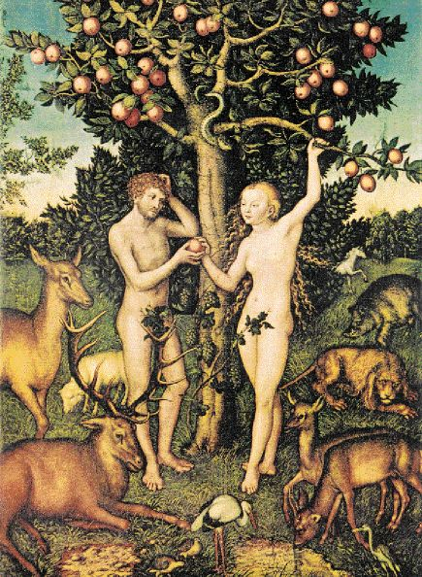
RELIGION BOOKS
Most religious communities are deeply patriarchic and so is church. Men are always the main heroes, while women are mostly dependent on men. Men appear in social occasions, while house is the woman’s place. Men are clever, brave, sociable, rational, while women are humble, fragile, sentimental, and coward. Even Adam was the first to be created by God, while Eva is responsible for the loss of Paradise.

Slide 5
HISTORY BOOKS
Women are almost absent in history books. This is mostly because for centuries they were not even considered as individuals equal to men. Women are mentioned only when they break gender stereotypes and behave like men.
For example, there are some women who have contributed significantly to the Greek Revolution of 1821, and it should be a great occasion to refer to these women, since here in Greece we celebrate the 200th Anniversary of this crucial event of Modern Greek history

Slide 6
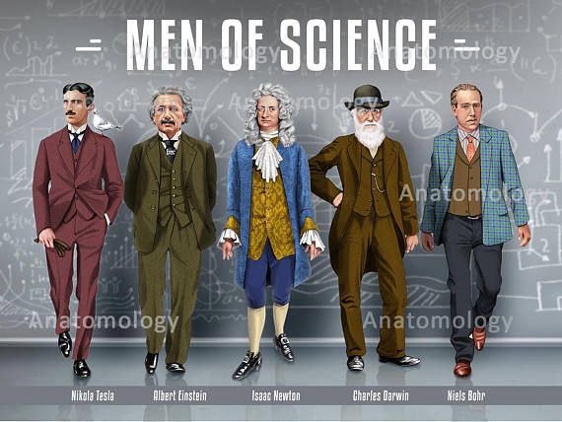
SCIENCE BOOKS
Men are considered more capable of understanding science, most teachers of science are men, while girls tend to accept their “inherent” inability to understand Science.

Slide 7
MATHS BOOKS
While during Primary school boys and girls show almost the same ability to understand Maths, later on girls tend to give up.
Most Maths problems follow social stereotypes, for example : girls usually buy clothes, books and cosmetics, boys buy gadgets.
Mostly women are housewives or assistants and buy food for the family, while men are businessmen or shop owners and buy newspapers or more “important” and expensive goods.

Slide 8
SOCIAL STUDIES
Women are usually presented as housewives, who stay at home, while men usually stay and entertain themselves outdoors. Though, the feminist movement is depicted as a very special chapter in the History of Human Rights.

Slide 9
TEXTBOOKS
Older language books used to present boys and girls in a stereotypical way, but there has been a change in this representation during the last 20 years. Literature offers examples of women that are revolutionary for their time and age, unmarried mothers, housewives who defy their husbands’ authority, etc

Slide 10
STEREOTYPES ABOUT THE ROLE OF EACH GENDER
Though things are a lot better compared to the past, we can still find oversimplified and preoccupied social beliefs about the behavior, abilities, roles and professions of people, just because of their gender. These preoccupations define how people should be according to their gender, and this way they limit and direct young students to pre-defined roles, which affect their gender identity and lead to sexism and sometimes to gender discrimination.
As far as professions are concerned, we still describe jobs as masculine and feminine, women usually work in lower rank positions and are worse paid than men.
World Health Organisation: ”People are born female or male but learn to be girls and boys who grow into women and men. This learned behaviour makes up gender identity and determines gender roles.”

Slide 11
SUGGESTIONS
The authors of school books should be fully aware of the impact that school books have to the souls of young students and avoid stereotypical references in their books. More women should participate in the creation of school books.
In school textbooks the exclusive use of the masculine gender should be avoided and the systematic use of the feminine form of the words can be adopted.
Textbooks can also have, in text and images, an equal number of examples of men and women in prestigious positions, in professional positions, in social roles.

Slide 12
School counselors should inform and strengthen teachers in order to:
- understand the process that leads to the creation of gender role identity and self-perception
- recognize that gender discrimination results in the formation of a negative self-perception of girls (low self-esteem and low self-image)
- understand their own perceptions about the social roles of men and women as distinguished by their biological sex
- critically examine gender stereotypes in the various educational materials they choose, in the curricula and school manuals
- plan and make interventions with the aim of changes in the social roles of boys and girls for a harmonious equal coexistence

Slide 13
Teachers should be sensitized about gender issues and be very careful about their behavior towards boys and girls, since they are often role models for their students.
They should intervene when they find any kind of language sexism in school textbooks (which they do not choose themselves but are obliged to use), but do not agree with the way they present the relationship between the sexes and their place in society
Examples:
a)Point out and comment on the examples in which the use of the masculine gender is shown to indicate both genders. For example: When they meet the sentence: "... as a responsible citizen ...» the teacher can comment: "Interesting! The book refers only to male citizens. According to the book, then, there are no women citizens in modern societies. What do you say? "What could this book write?" and let the children suggest and discuss the different possible views that will be expressed.
b)Use the words 'person', 'child' . Words such as 'people', 'children' expressing sets of people are often used in textbooks (people are men and women, people of all ages, colors, and children are young boys and girls of all ages, colors, etc) and imply or depict only males. In other words, the person is identified with the man and the child is identified with the boy. This creates the perception that the woman or girl is less important or worthwhile.

Slide 14
Introduction of Sexuality Education at schools
It is essential that young students learn about the cognitive, emotional, physical and social aspects of sexuality in an organized way. Too many young people receive confusing and conflicting information about relationships and sex, as they make the transition from childhood to adulthood. This has led to an increasing demand from young people for reliable information, which prepares them for a safe, productive and fulfilling life .
Sexual Education aims to equip them with knowledge, skills, attitudes and values that will empower them to
- realize their health, well-being and dignity
- develop respectful social and sexual relationships;
- consider how their choices affect their own well-being and that of others
- understand and ensure the protection of their rights throughout their lives .
When delivered well, this course responds to this demand, empowering young people to make informed decisions about relationships and sexuality and navigate a world where gender-based violence, gender inequality, early and unintended pregnancies, HIV and other sexually transmitted infections (STIs) still pose serious risks to their health and well-being (Cited from UNESCO)

Slide 15
Εxperiential actions for gender quality Examples taken from the Guidebook - Gender Equality in Education of Adults (Heinrich Bell Stiftung, Thessaloniki, Greece)
Role-playing games
Experiential exercises
Case studies
Automatic writing
Work in small groups
Theatrical play - events
View and analyze-video discussion .
Personal and group reflection
Visual representations
Study and critical use of texts
An example: https://www.youtube.com/watch?v=nWu44AqF0il
A discussion follows with key points:
Trying to identify the sources of stereotyping in terms of gender and behaviors from infancy. With an emphasis on how the way we grow up rearranges brain function, determining both behaviors regarding gender as well as general intrapersonal, interpersonal, educational, professional and social reactions. In this way we bring about a rift in a naturalistic view of gender identities and we recognize the element of their social / cultural construction. To a point, this allows for the presentation of personal experiences

Slide 16
Questions that might be useful to ask before presenting educational material to our students
In what activities is each gender involved?
What is the role of girls / women?
Could the same text be used if the social roles of the sexes were reversed, that is, if men were in the position of women and vice versa?
Are heroes and heroines admired for the same characteristics and are the same criteria used for success?
Are issues of poverty and social exclusion linked to gender and the distribution of power?
Are women themselves presented as a problem?
Does the content encourage active behaviors and resistance or passive acceptance and by what gender?
Are there gender stereotypes of character and activities, that is, do women appear capable of "caring" and men "taking on responsibilities", "being professionally successful" and not often described as "partners and fathers"?
Do women take initiatives and have social resources for their success or is success - when it exists - attributed to other factors, such as their appearance and / or relationship with important men in their lives (fathers, brothers, partners, relatives, professionals) ;

Slide 17
What type of male and female personality is outlined based on personality traits (eg are ingenuity, independence, rational thinking, creativity, sensitivity, dependence, empathy, submissiveness, curiosity, imagination, intelligence attributed to female or male characters only?)
Is the possible oppression of women presented as a social symptom or as an inescapable natural phenomenon?
In the professions that men and women appear to practice, is there any categorization into "male" and "female"?
Is the workplace and the professional behavior of women and men described equally? Are women represented equally in the so-called "male" professions, science and technology? Do men appear in professions that are traditionally practiced by women? (eg secretary, kindergarten teacher). Are women represented at the top of the administrative hierarchy ?
Are there any initiatives to promote women's careers? Are boys and girls being promoted equally in future careers? Is there a connection between the proposed career choices of boys and girls and stereotypes about gender roles?
To which sex is power and authority attributed? Are women portrayed in subordinate roles? Are references made to the family life of individuals and how are responsibilities distributed among family members? What type of family is most prominent? How are parent roles outlined? How is free time distributed among family members?
In what areas of social life are men and women active? Are there alternative views, accurate and realistic, of male and female characters and alternative lifestyles at all levels? If so, how often and what evaluative judgments and comments are made?
( Information taken from INTRODUCTION TOPICS FOR THE PROMOTION OF GENDER EQUALITY IN THE EDUCATIONAL PROCESS AUXILIARY EDUCATIONAL MATERIAL FOR SCHOOL TEACHERS )

Slide 18
Thank you for your attention!

