Slide 1
Hello !!!
I am Lusine from Armenia.
I teach Technology & Art in “Byurakn” Educational Complex.
My students are 6-12 years old.

Slide 2
My Country is Armenia
Area - 29,743 km² Population – over 3 million people

Slide 3
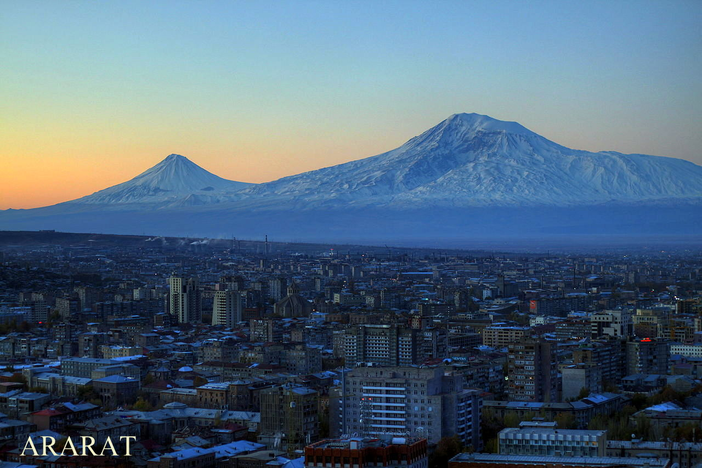
Mount Ararat in Judeo-Christian tradition is associated with the "mountains of Ararat" where, according to an interpretation of the Book of Genesis, Noah's Ark came to rest. It is a national symbol of Armenia and is considered a "holy mountain" by Armenians.
Armenia was the first nation to adopt Christianity as a state religion, an event traditionally dated to AD 301. The predominant religion in Armenia is Christianity.

Slide 4
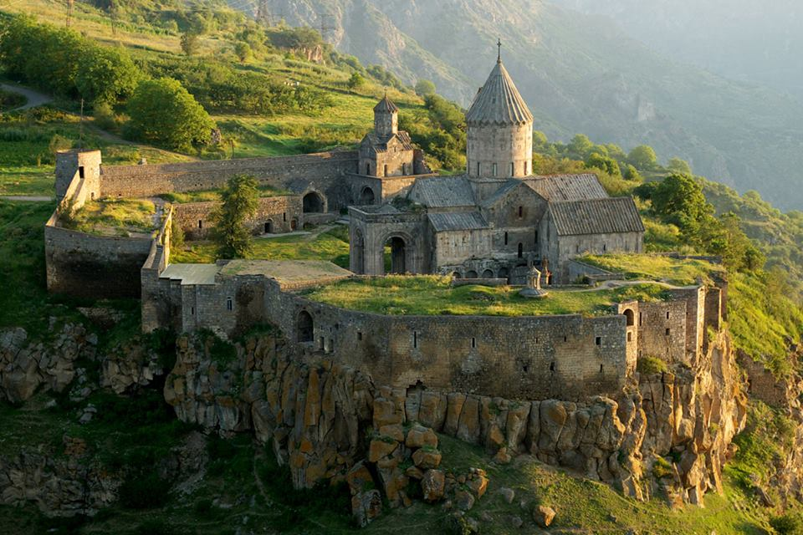
The monastery of Tatev

Slide 5
The world’s longest reversible aerial ropeway Wings of Tatev

Slide 6
Geghard
The monastery of Geghard (meaning spear) is a unique architectural construction being partially carved out of the adjacent mountain, surrounded by cliffs. While the main chapel was built in 1215, the monastery complex was founded in the 4th century.

Slide 7
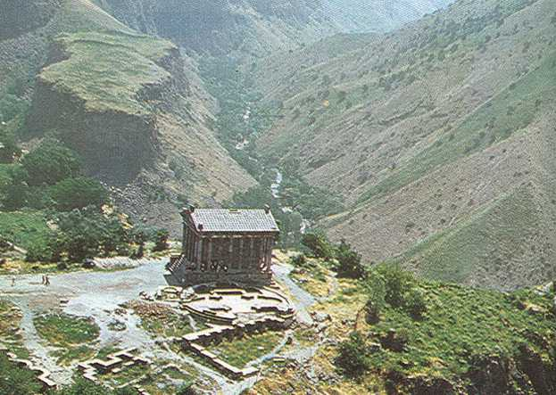
Temple of Garni
The Garni architectural complex (3rd century BC) was once a mighty fortress which stood on a rocky, triangular plateau rising steeply for the river Azat. The small square hall with the altar is surrounded by 24 columns with finely carved capitals. An extensively ornamented roof tops this "temple of coolness", which was used as the summer residence of the kings of Armenia after the country was converted to Christianity.

Slide 8
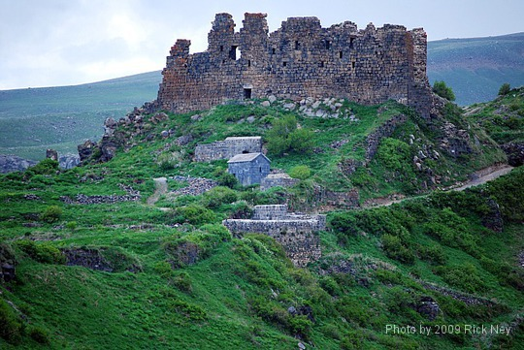
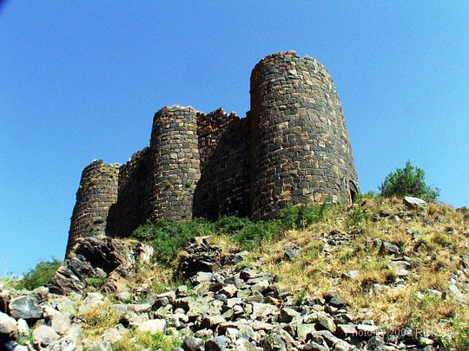
Amberd
Stone Age settlement at the spot evolved into a Bronze Age and Urartian fortress that protected Armenia's rulers, most famously during the Roman and Christian eras, when the current castle was built, expanded and rebuilt over successive periods.

Slide 9
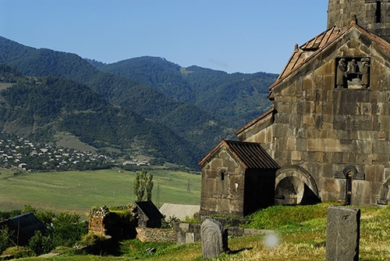
Monastery of Haghpat

Slide 10
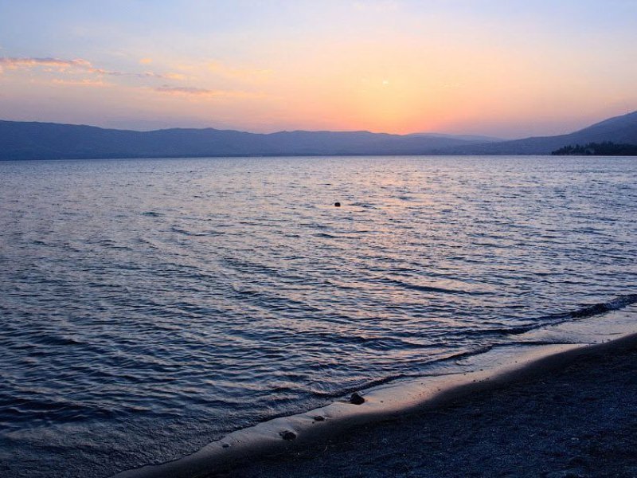
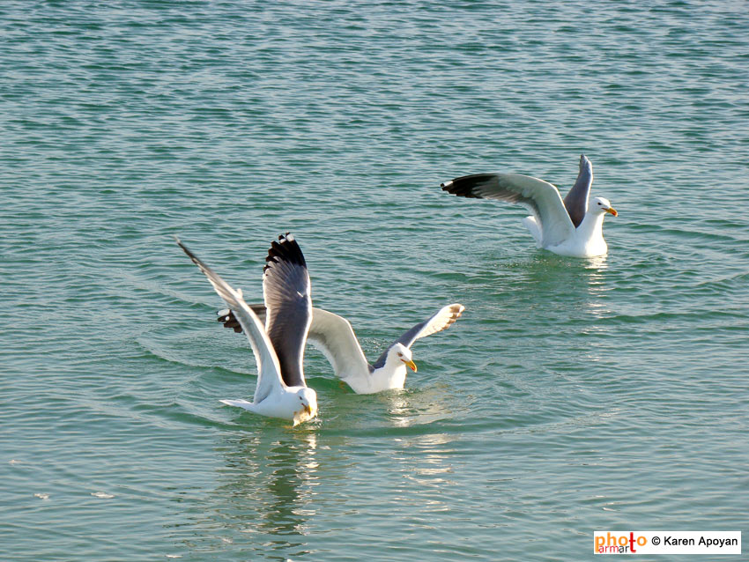
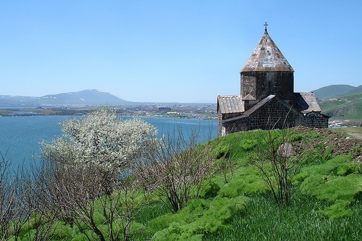
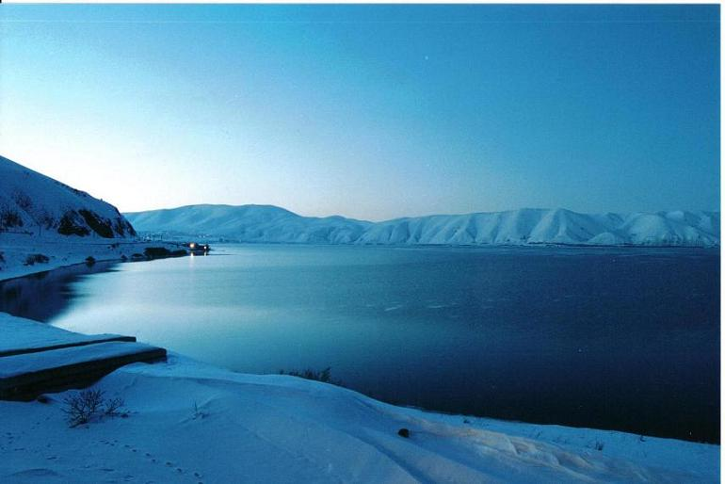
Lake Sevan

Slide 11
Karabakh

Slide 12
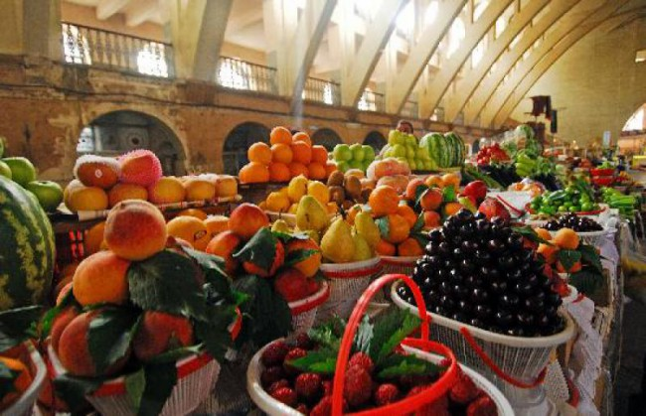
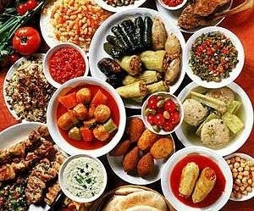
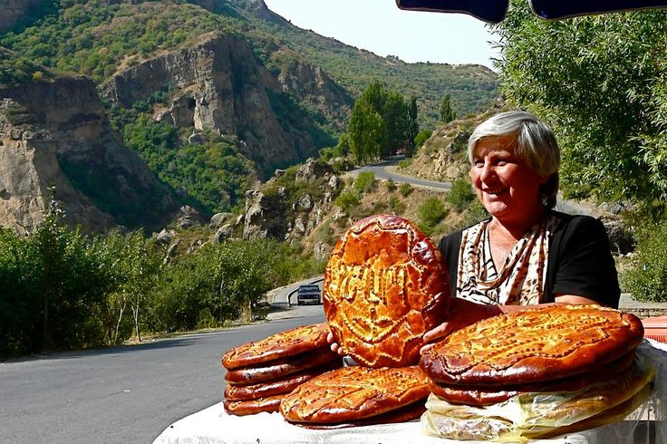
Armenians are known for their hospitality

Slide 13
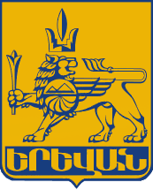
Our School is located in Yerevan The republic square
Yerevan – the capital of Armenia - is as old as Rome and Babylon, Nineveh and Carthage. In this year Yerevan celebrated 2797th anniversary.
It has been the capital since 1918.
In 782 B.C. the Urartian king Argishti the First founded Erebuni, the military and administrative center of the state of Urartu, on the place of the present-day Yerevan.
Official seal of Yerevan

Slide 14
Lake Swan in Yerevan

Slide 15
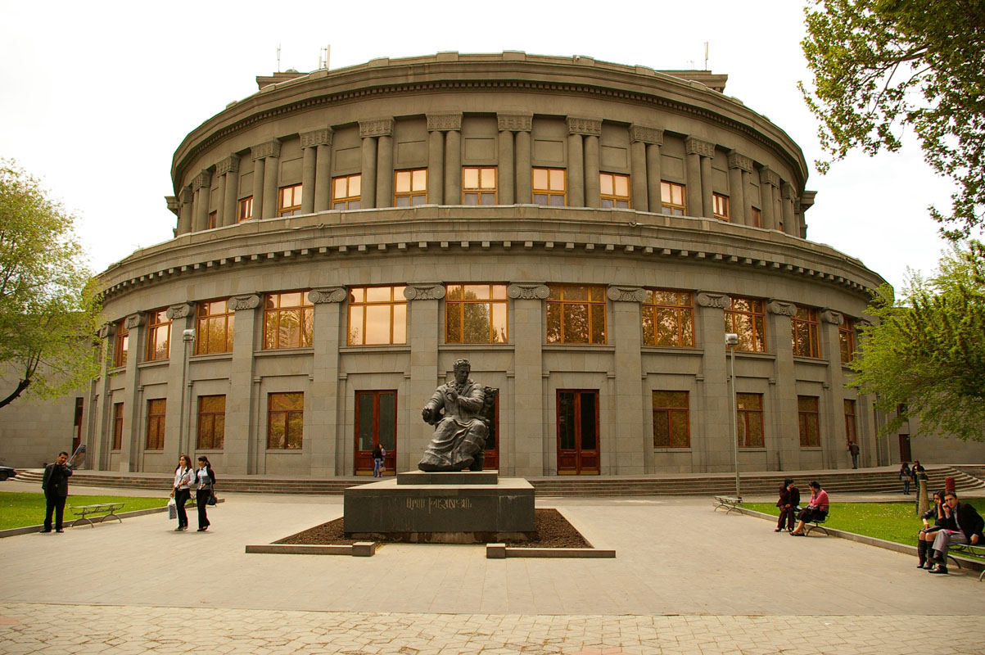
The Opera house in Yerevan

Slide 16
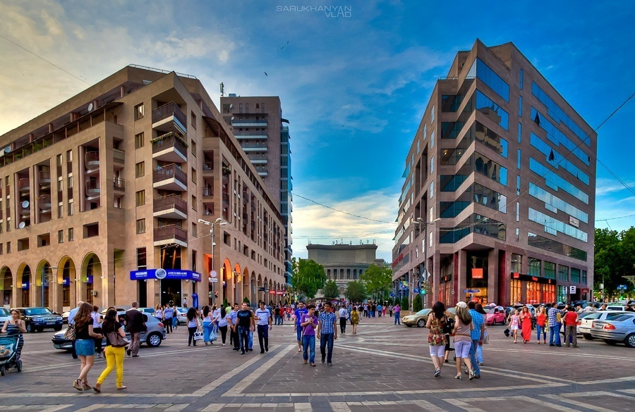
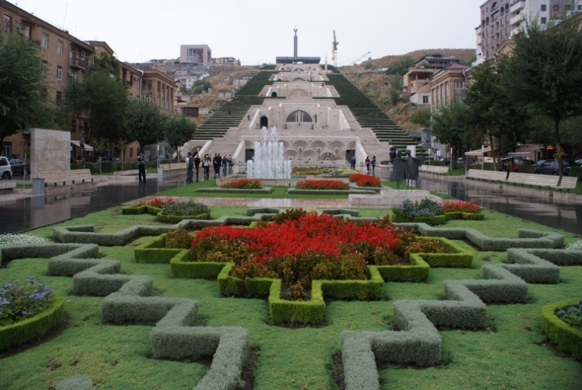
Yerevan North Avenue Cascade

Slide 17
This is My School – “Byurakn” Educational Complex

Slide 18
In our school the students are divided into groups of different ages, not classes. Each group has its own name and color.

Slide 19
Our school day begins with Assembly. Every morning from 8:30-9:00 the groups of pupils have discussions with their teacher before their lessons begin. During it the pupils speak about their problems and difficulties connected with the lessons, and plan the activities for the day.

Slide 20
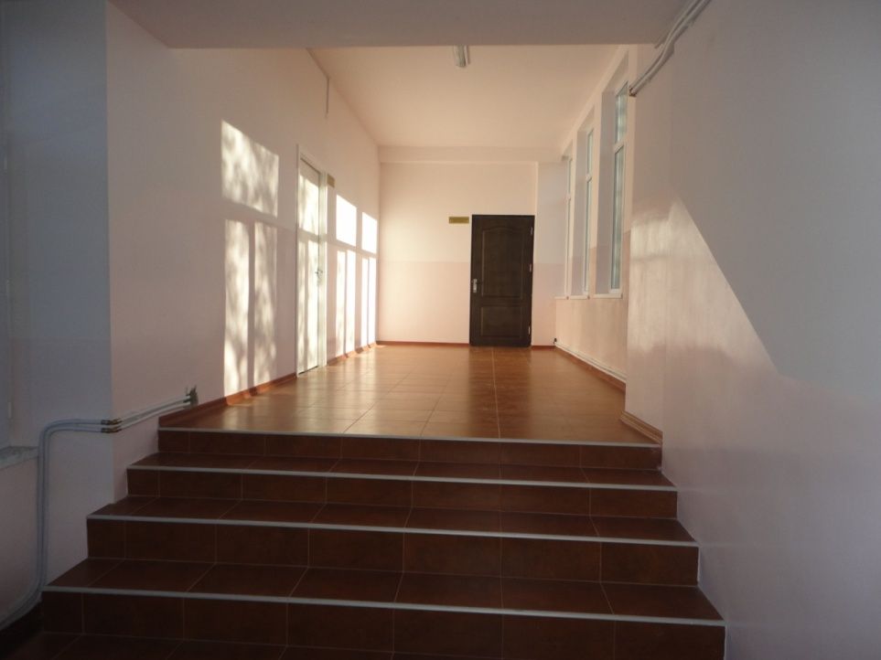
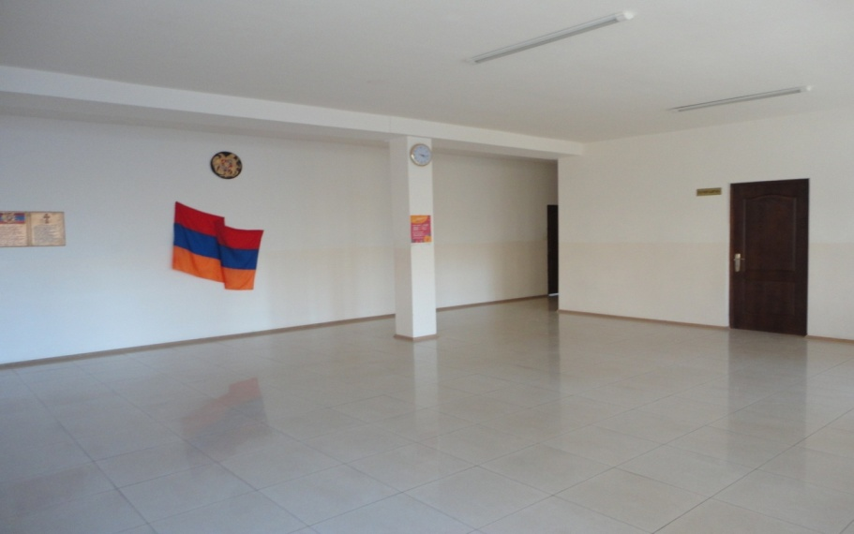
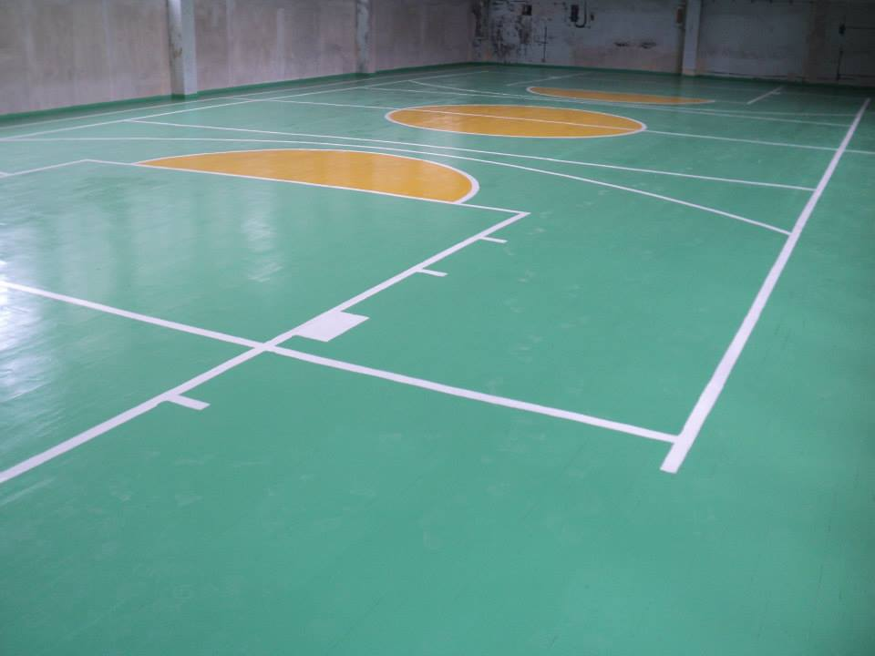
Our School…

Slide 21
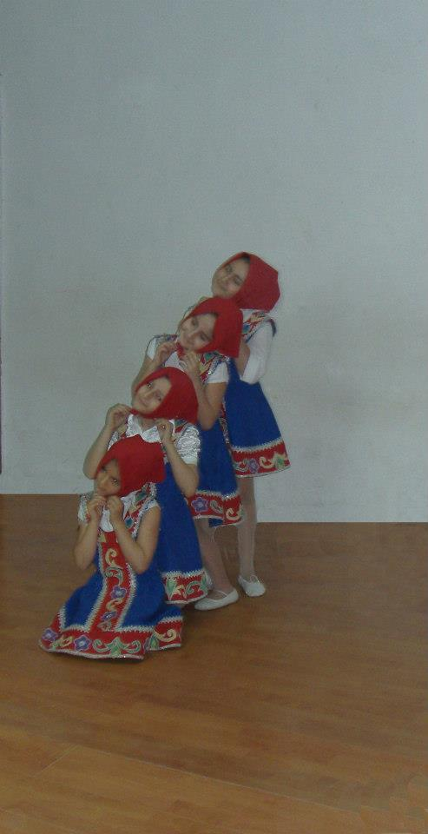
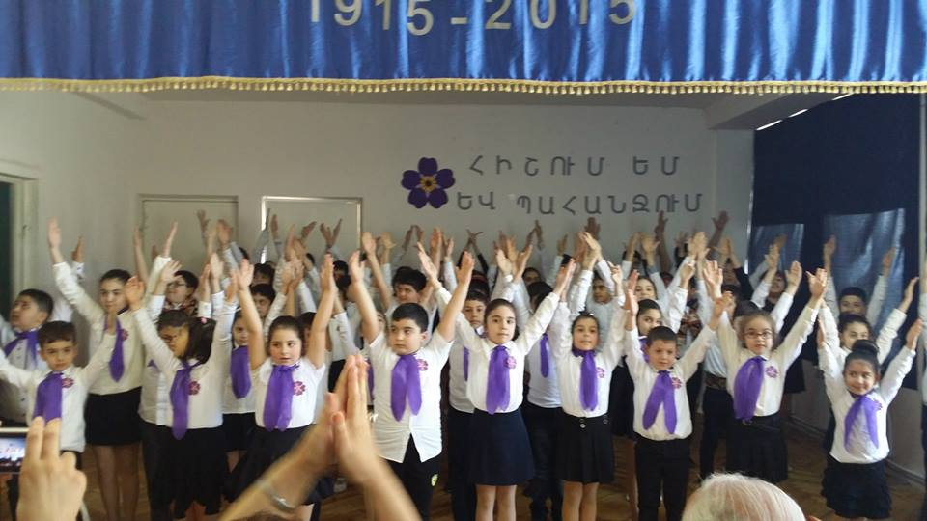
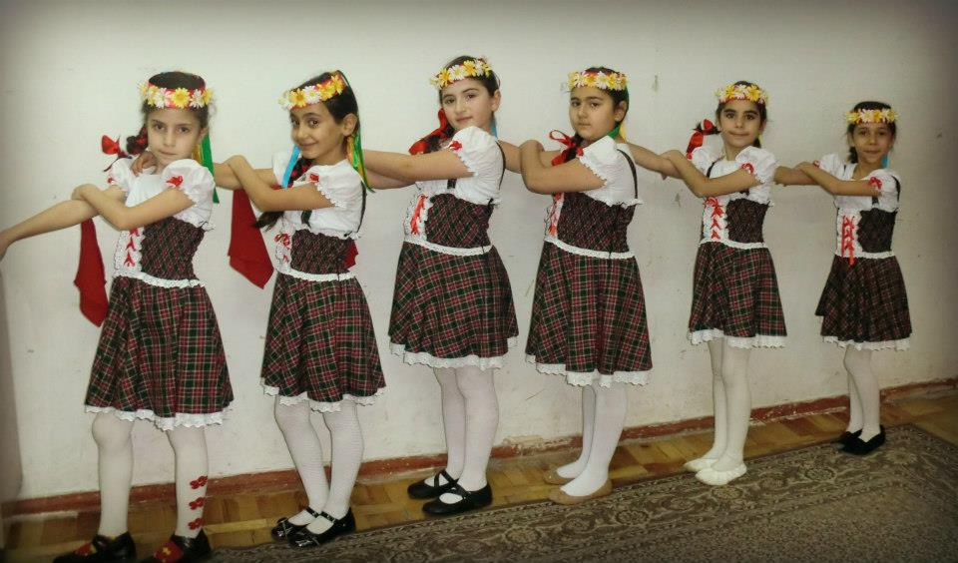
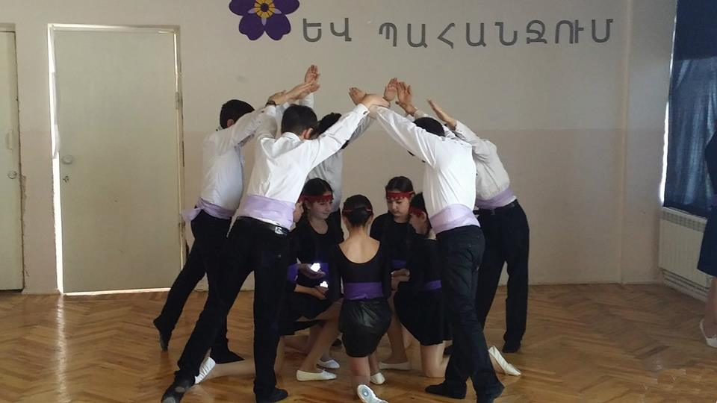
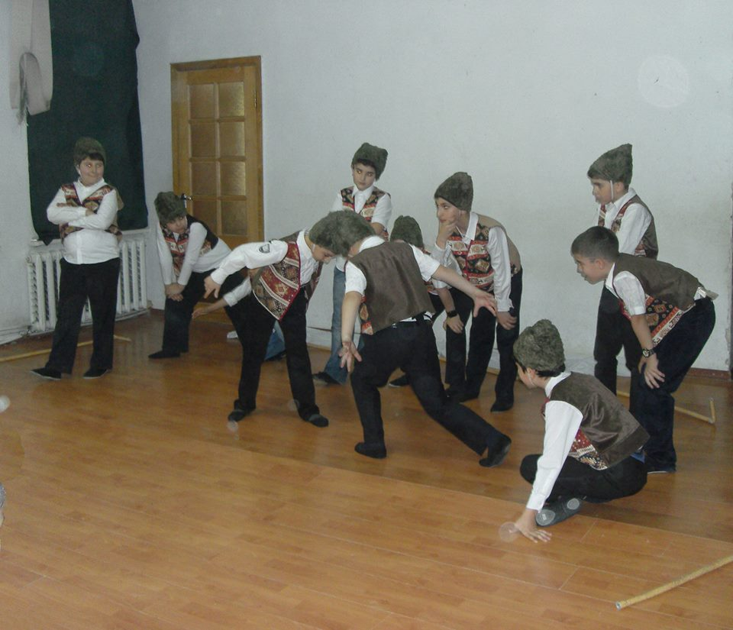
Dancing Classes

Slide 22
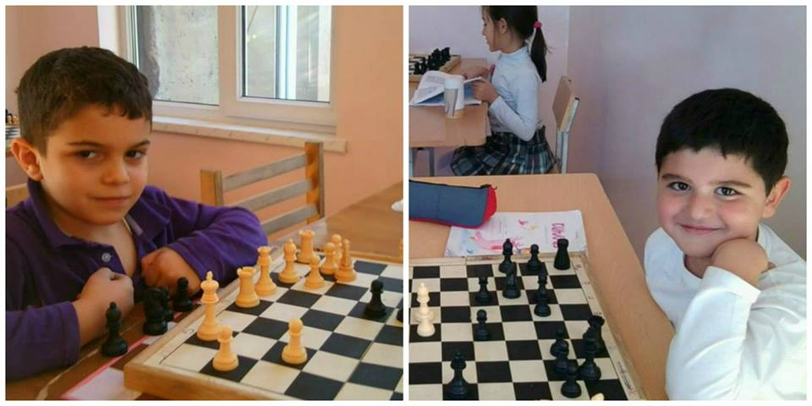
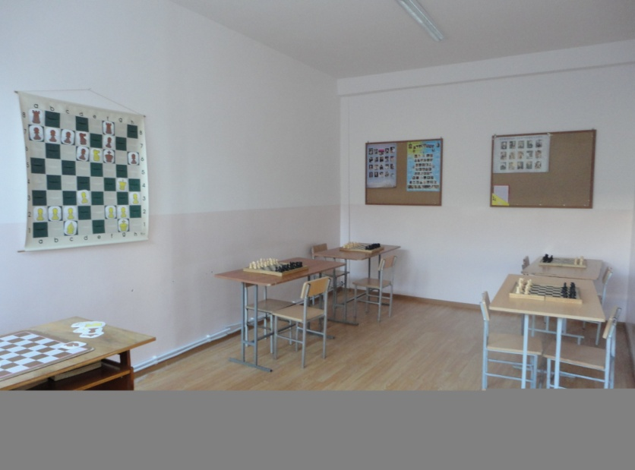
Chess is a popular sport in Armenia. Although a country of about 3 million people, Armenia is considered to be one of the strongest chess nations today. In 2011, the Ministry of Education of Armenia made chess part of the primary school curriculum.

Slide 23
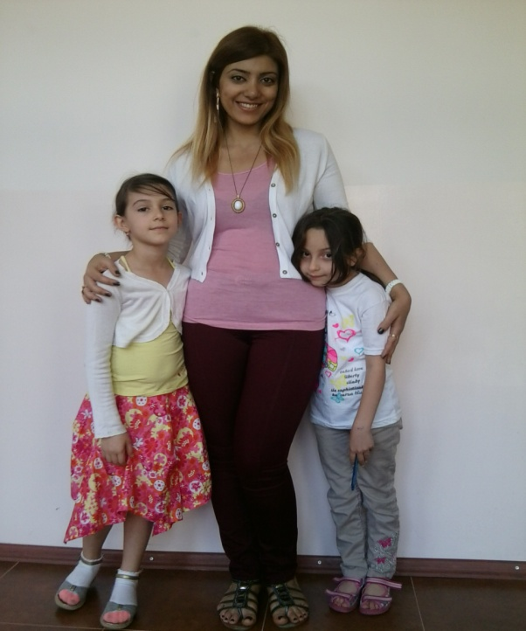
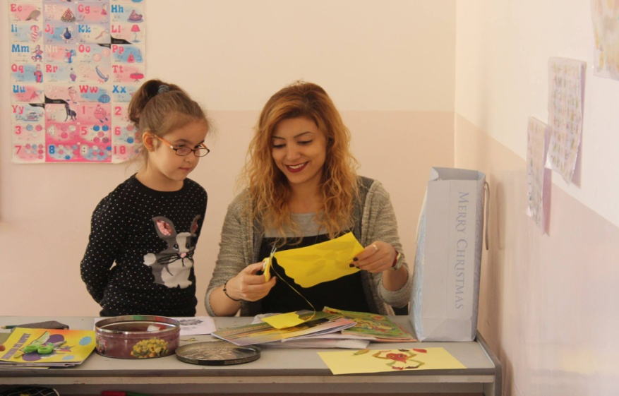
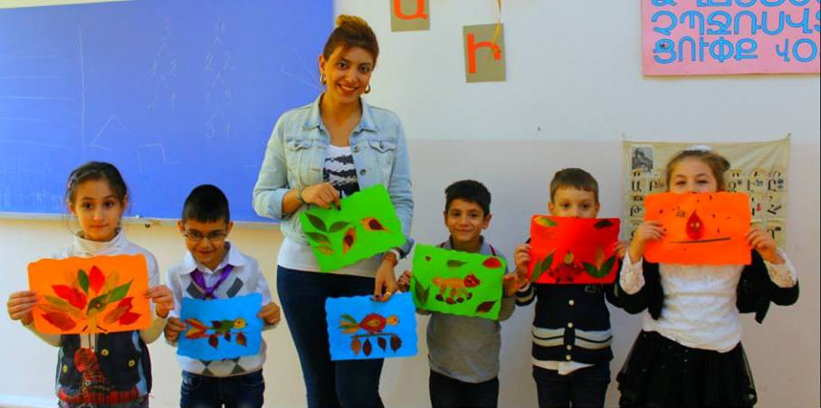
Me & my pupils

Slide 24
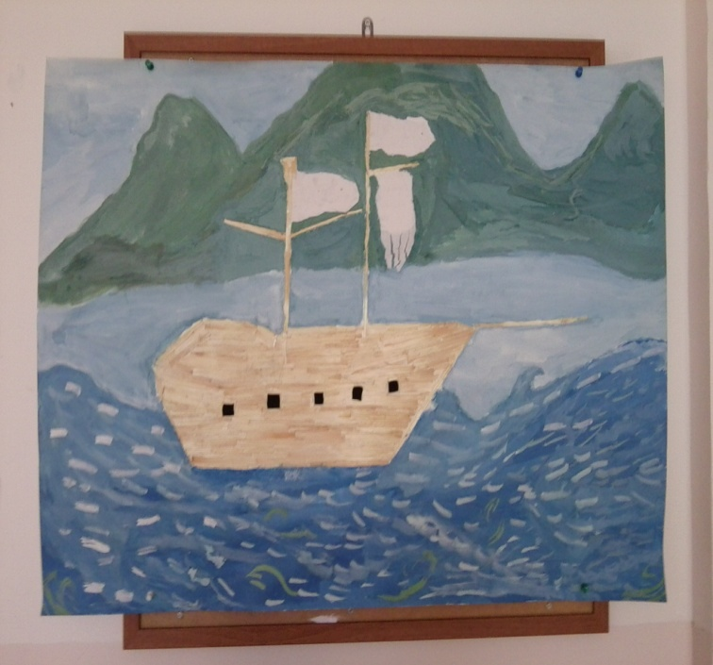
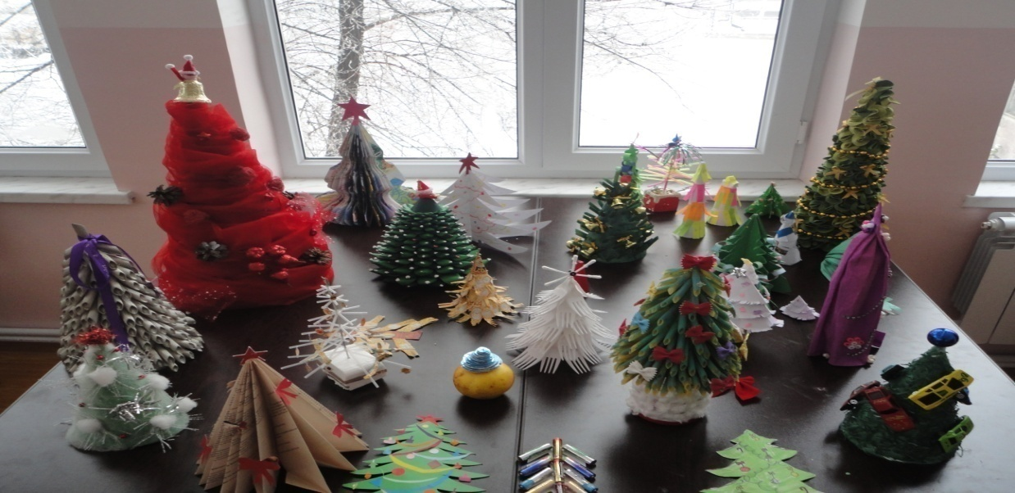
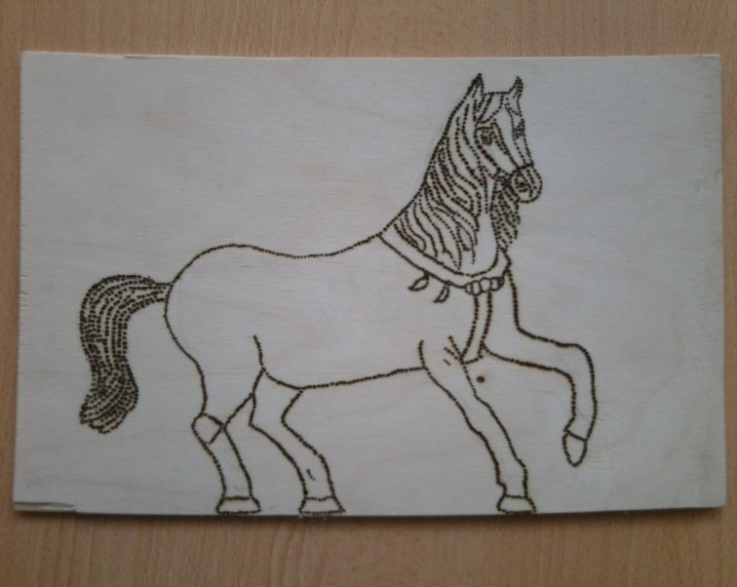
Our Technology Corner

Slide 25
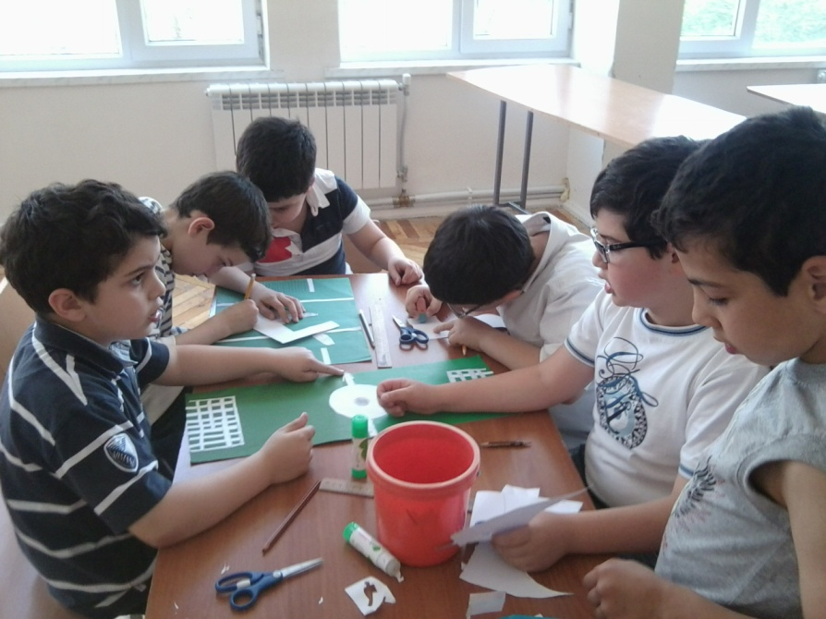
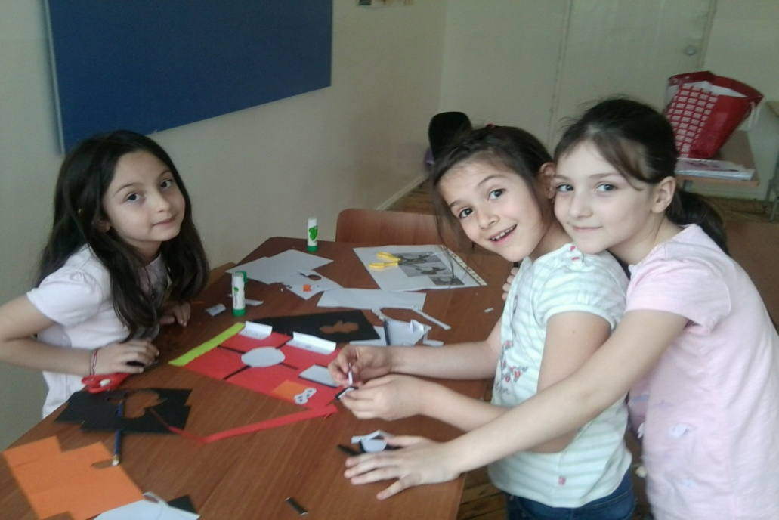
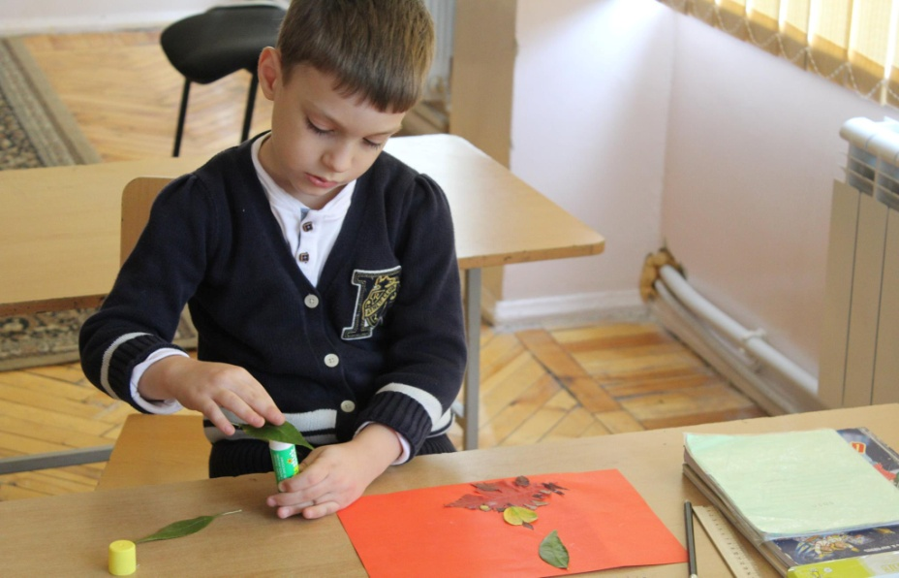
The technology class in process….

Slide 26
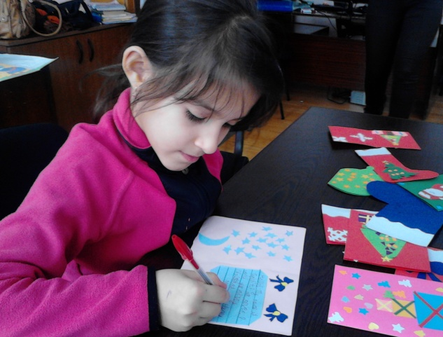
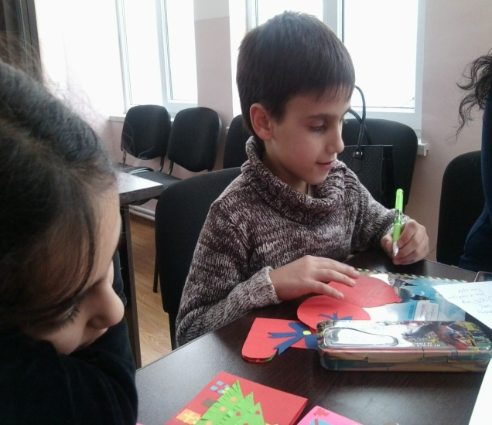
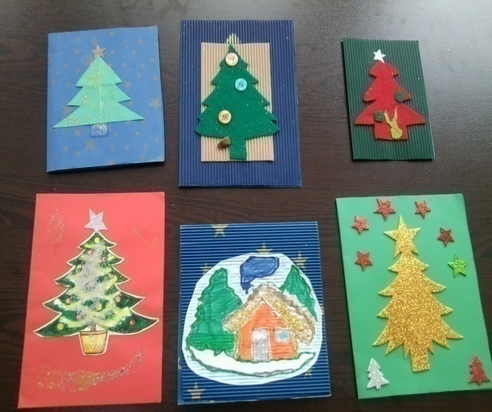
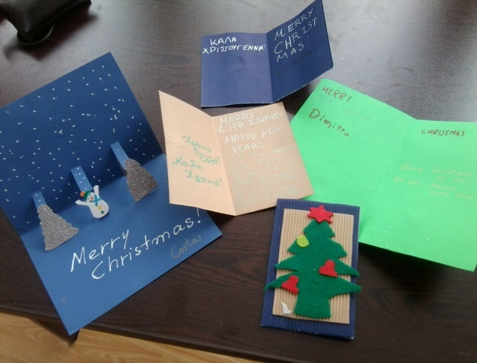
eTwinning in “Byurakn”
Our Christmas cards to Greece
Christmas cards from Greece )))

Slide 27
And one more interesting thing! We have no bell in our school.

Slide 28
Thanks for your Attention !!

