Slide 1
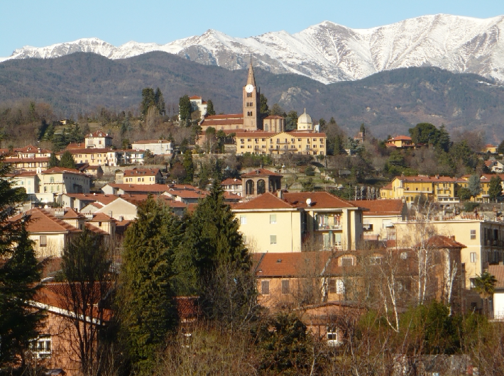
PINEROLO

Slide 2
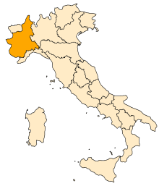
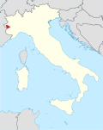
Pinerolo is in Piedmont region.
It is a town of approximately 36 000 inhabitants situated in North Italy, about 40 kilometers from Turin, on the river Chisone.
Pinerolo is surrounded by the Alpes.
In the Middle Ages, the town of Pinerolo was one of the main crossroads in Italy, and was therefore one of the principal fortresses of the dukes of Savoy . Its military importance was the origin of the well-known military school that still exists today. The fortress of Fenestrelle is nearby.
Pinerolo

Slide 3
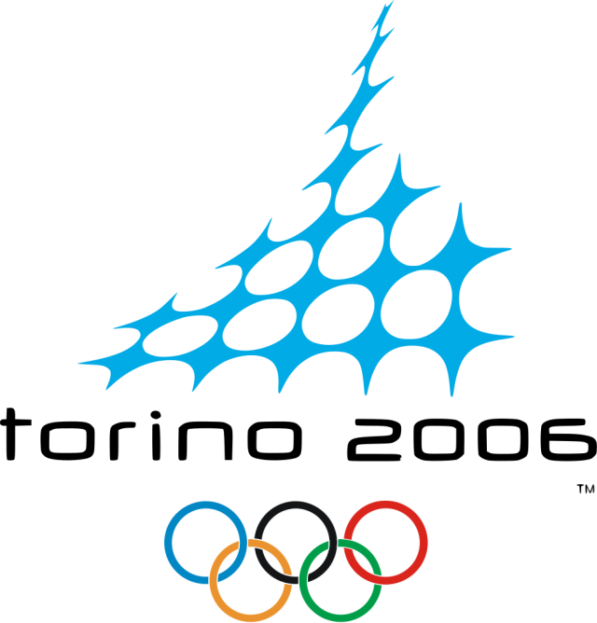
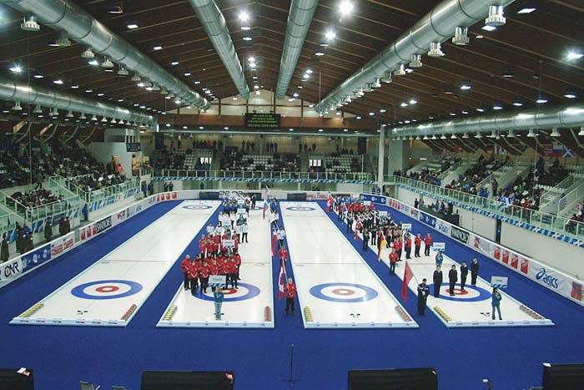
Pinerolo is a multicultural city; many families are from Marocco, Romania, Albania, China…
In 2006 were performed the «Winter Games Turin 2006».
In Pinerolo were disputed curling competitons and «Paralympic Winter Games» (Ice sledge hockey).
The 2011 Tour de France featured a stage in the area.

Slide 4
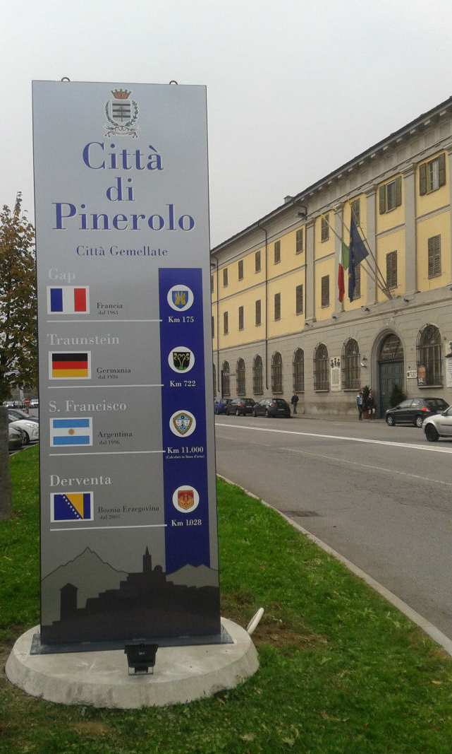
Twin cities
Gap, France, since 1963
Traunstein, Germany, since 1986
San Francisco, Argentina, since 1996
Derventa, Bosnia and Hersegovina,
since 2005

Slide 5
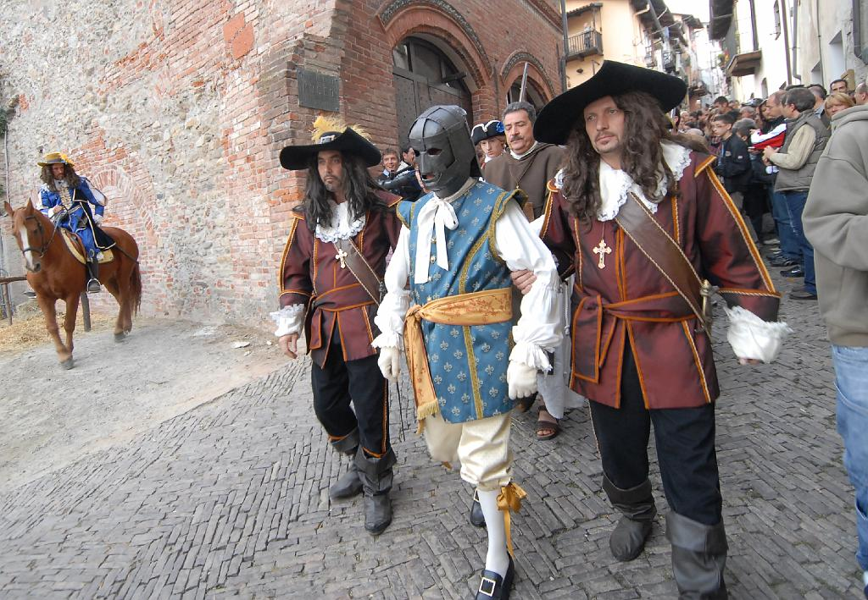
The “Man in the Iron Mask” was imprisoned in Pinerolo from 1669.
Nicolas Fouquet, Marquis of Belle-Ile, was imprisoned in Pinerolo from 1665 to his death in 1680.
The Montevideo football team Peñarol takes its name from the Montevideo neighbourhood of Peñarol, which in turn takes its name from this town.

Slide 6
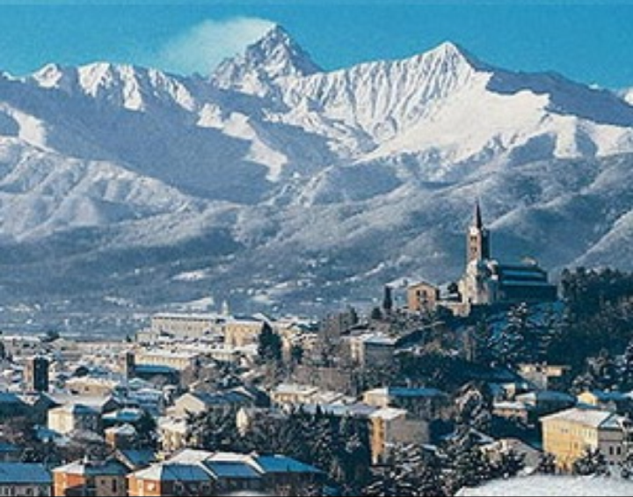
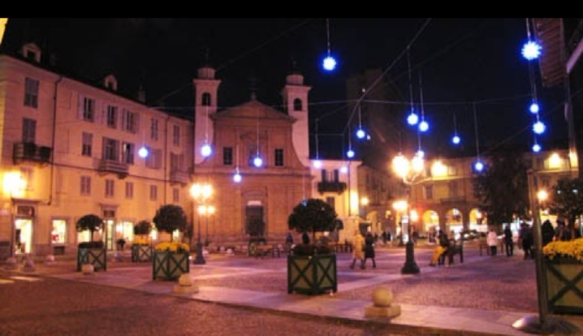
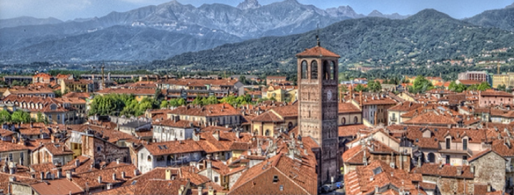

Slide 7
TURIN
Turin ( Latin: Augusta Taurinorum) is a city and an important business and cultural centre in Northern Italy, capital of the Piedmont region, located mainly on the left bank of the Po river, in front of Susa Valley and surrounded by the western Alpine arch.
The city has a rich culture and history, and is known for its numerous art galleries, restaurants, churches, palaces, squares, parks, gardens, theatres, libraries, museums …
The city currently hosts some of Italy's best universities, colleges, academies, lycea and gymnasia, such as the six-century-old University of Turin and the Turin Polytechnic. Prestigious and important museums, such as the Egyptian Museum and the Mole Antonelliana are also found in the city. Turin's several monuments and sights make it one of the world's top 250 tourist destinations, and the tenth most visited city in Italy in 2008.
Turin is well known as the home of the Shroud of Turin, the football teams Juventus F.C. and Torino F.C., the headquarters of automobile manufacturers FIAT (now FCA) and as host of the 2006 Winter Games and, in the same year, the 37 Chess Olympiad. Several International Space Station modules, such as Harmony and Columbus, were also manufactured in Turin.
It was the capital of the Duchy of Savoy from 1563, then of the Kingdom of Sardinia ruled by the Royal House of Savoy and finally the first capital of the Unified Italy.

Slide 8
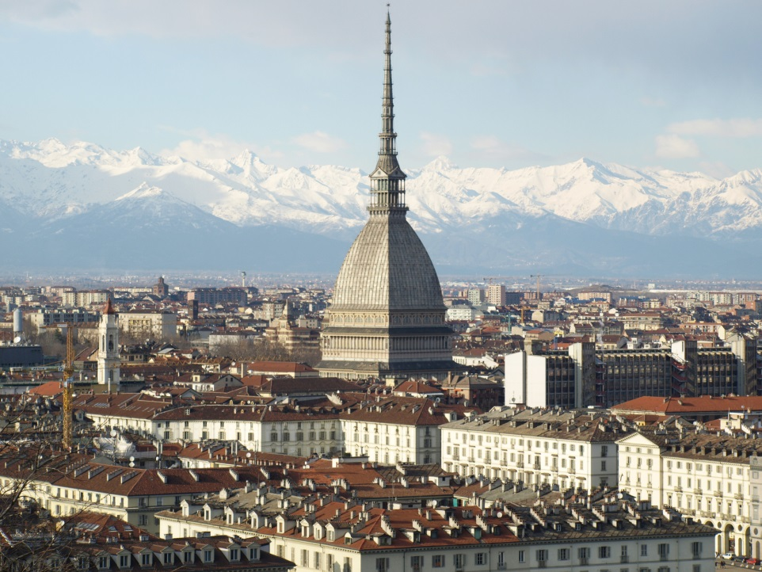
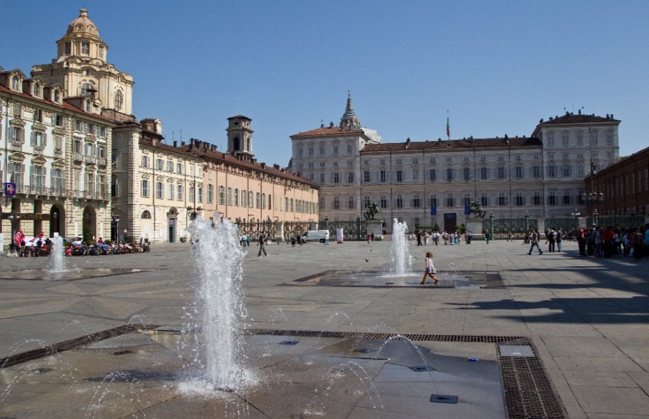
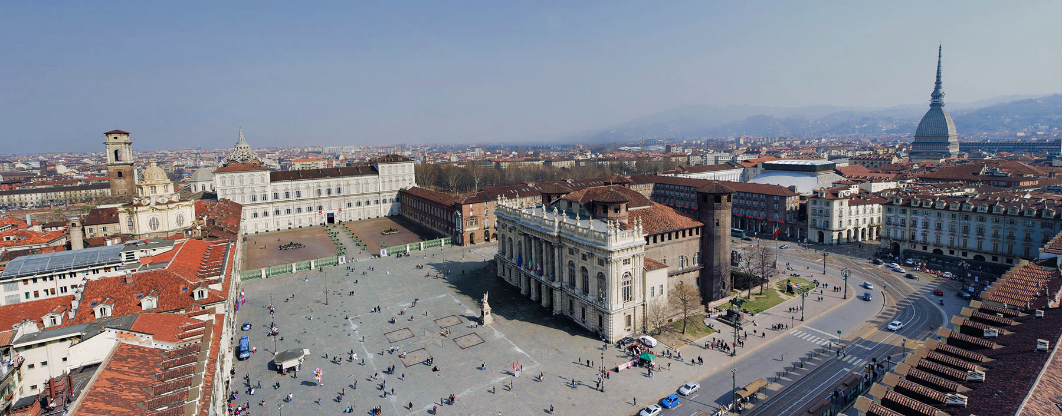

Slide 9
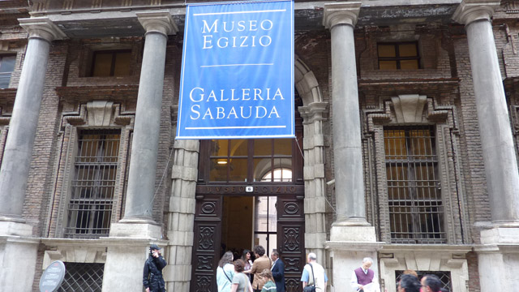
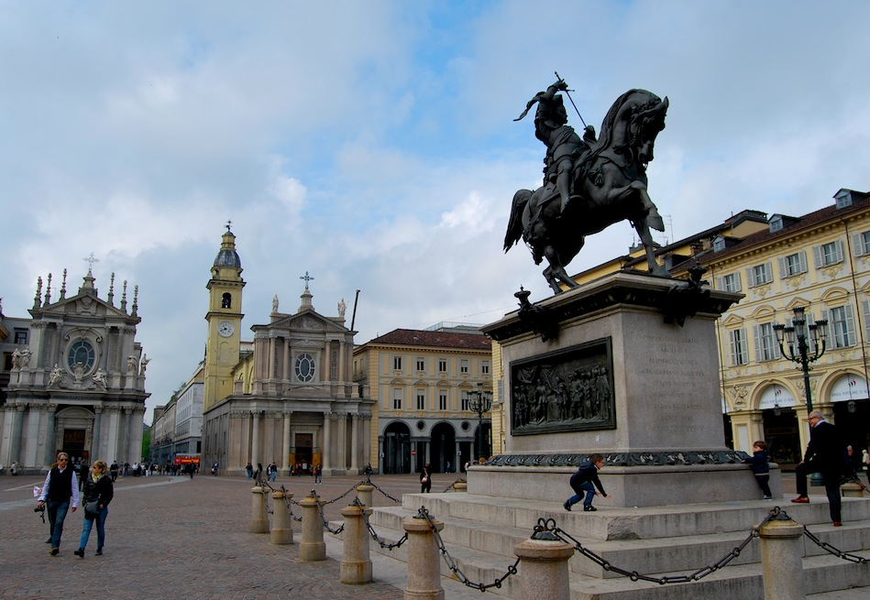
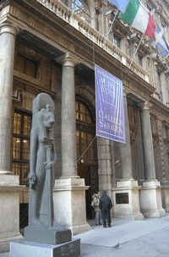

Slide 10
Education in Italy
At age six, or after the age five and a half, children start their formal, compulsory education with Primary School.
At Primary School their learn to read, write and study a wide range of subject including Maths, Geography, Italian, English, Science and Art. They also have P.E. and Music. Religion instruction is optional.
Primary School lasts for five years. At age of eleven they begin the Secondary School.

Slide 11
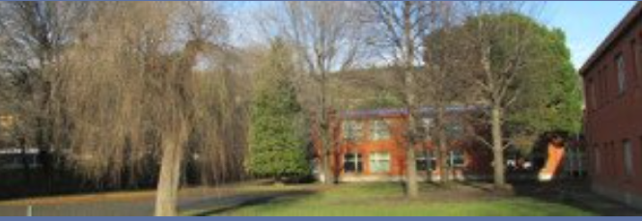
FERRUCCIO PARRI PRIMARY SCHOOL
Ferruccio Parri Primary School was founded in 1977.
It is located on the outskirts of Pinerolo.
In the School there are about 220 pupils ranging from the age 6-11.
Pupils stay at school from 8,30 a.m. to 4,30 p.m.; they have lunch in the canteen.

Slide 12
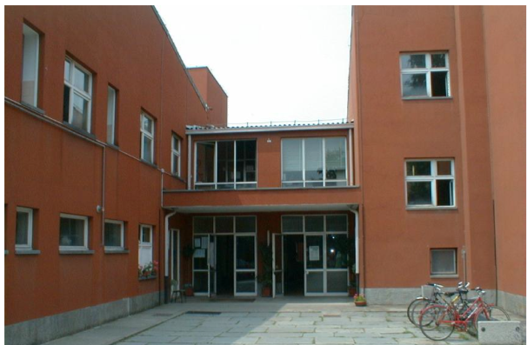
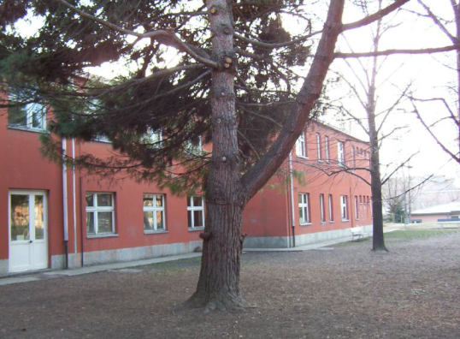
We don’t have lessons on Saturday and Sunday.
In the school there are 10 classes: two first grade classes, two second grade classes, two third grade classes, two fourth grade classes, two fifth grade classes.
The staff consists of 20 part–time or full time teachers, 4 teachers for special education and 2 Religion teachers.

