Slide 1
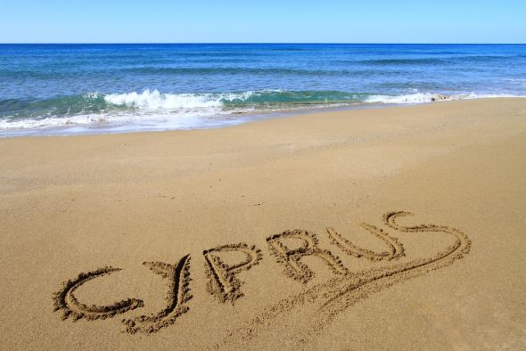
B’ Egkomis primary school

Slide 2
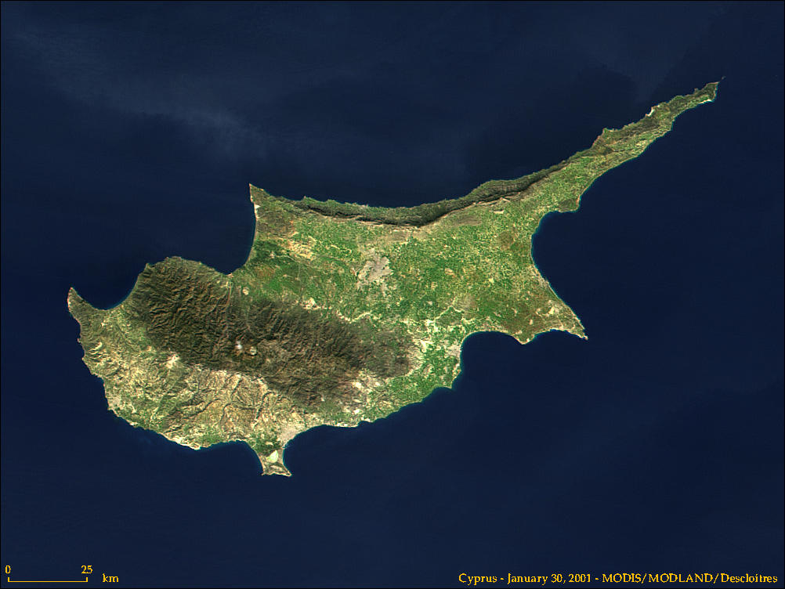
Cyprus: A Mediterranean island

Slide 3
CYPRUS
Cyprus is the third largest and third most populous island in the Mediterranean, and a member state of the European Union. It is located south of Turkey, west of Syria and Lebanon, northwest of Israel, north of Egypt and east of Greece.

Slide 4
BASIC INFORMATION
Capital: Nicosia
Official languages: Greek, Turkish
Ethnic groups: Greek Cypriots (great majority), Turkish Cypriots, Armenians, Maronites.
Government: Unitary presidential constitutional republic.
Independence from the United Kingdom, Independence day:
1st October 1960.
Joined the E.U: 1st May 2004.

Slide 5
BASIC INFORMATION
The majority of Greek Cypriots identify as Greek Orthodox, whereas most Turkish Cypriots are adherents of Sunni Islam.
Although without official status, English is widely spoken and it features widely on road signs, public notices, and in advertisements.
The Republic of Cyprus is de facto partitioned into two main parts; the area under the effective control of the Republic, comprising about 59% of the island's area, and the north, administered by the self-declared Turkish Republic of Northern Cyprus, which is recognised only by Turkey, covering about 36% of the island's area. The international community considers the northern part of the island as territory of the Republic of Cyprus occupied by Turkish forces

Slide 6
THE FLAG OF CYPRUS
Coat of arms

Slide 7
NICOSIA, THE CAPITAL CITY

Slide 8
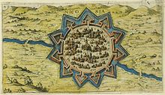
The Venetian walls of Nicosia were built by the Venetians to defend the city in case of an Ottoman attack

Slide 9
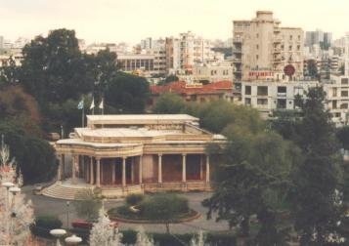
NICOSIA MUNICIPALITY

Slide 10
THE SIGN AND SLOGAN OF OUR SCHOOL!
Our web page:
http://dim-egkomi2-lef.schools.ac.cy/

Slide 11
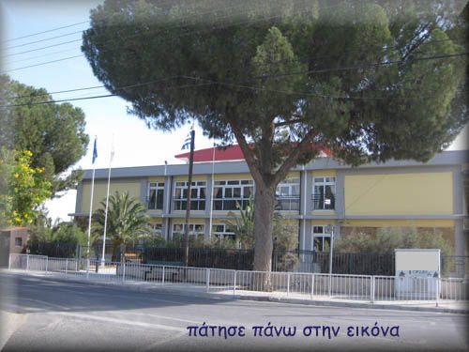
Our school! B’ EGKOMIS PRIMARY SCHOOL

Slide 12
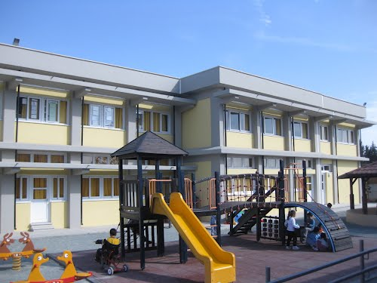
SIDE VIEW OF THE SCHOOL

Slide 13
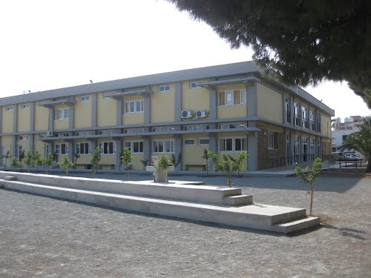
BACK VIEW OF THE SCHOOL

Slide 14
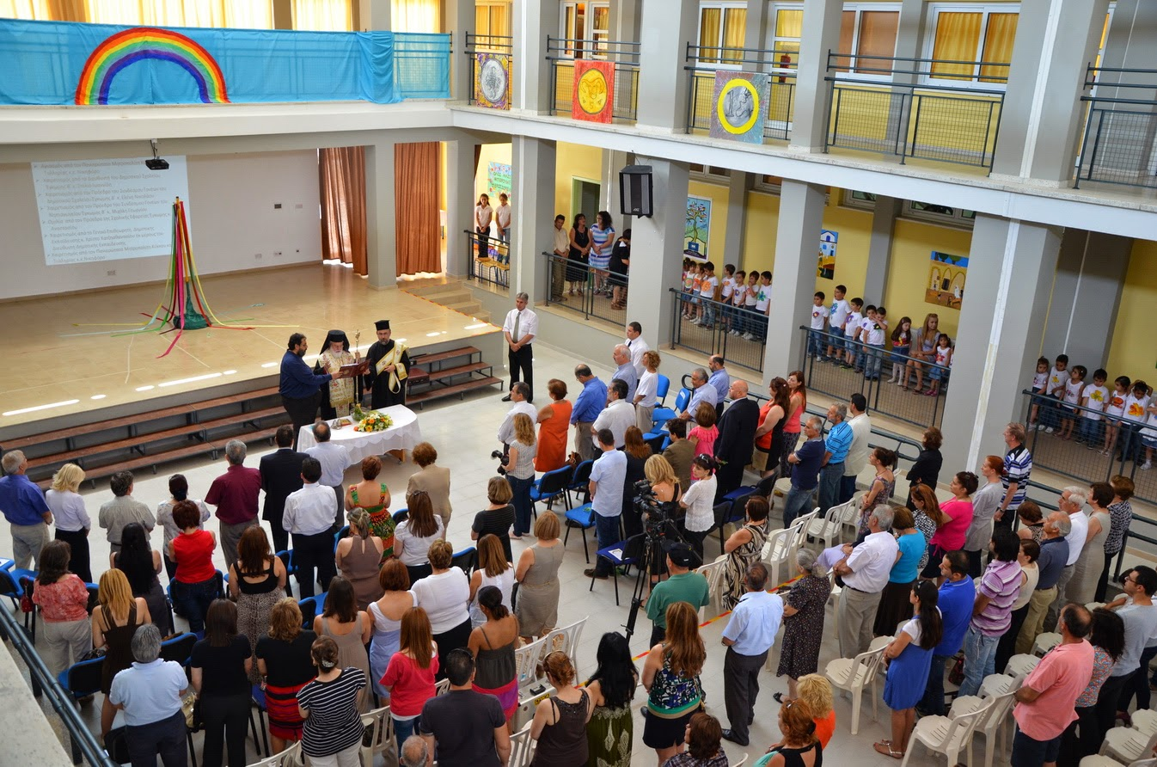
INSIDE THE SCHOOL

Slide 15
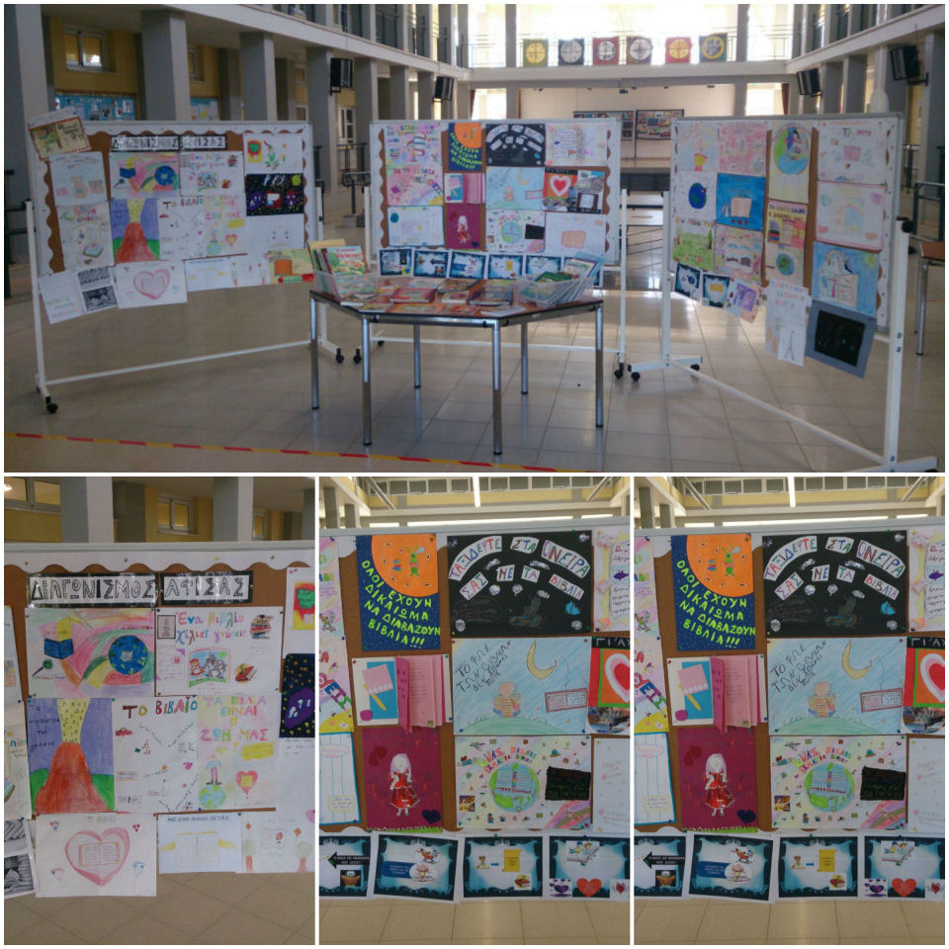

Slide 16
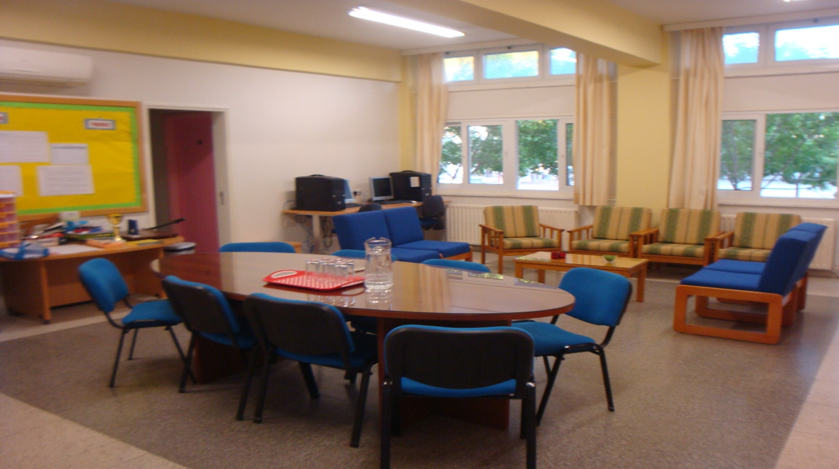
The teacher’s office

Slide 17
Basic information for our school
Engomi B’ Primary School was founded in 1965. It is situated in a relatively new housing area in Engomi, about 6-7 km southwest from the centre of Nicosia. It is a small urban school of about 120 pupils ranging from the age of 6-12. They are divided in six grades. The staff consists of 10 part-time or full-time teachers, including the head teacher and two assistant head teacher. There is also a visiting teacher for special education and a speech therapist.

Slide 18
Basic information…
During 2010-2011 the school has gone through a lot of reconstruction and refurbishment. Our school follows the National Curriculum and it functions according to the rules and regulations of the Ministry of Education and Culture of Cyprus. Besides participating in a Comenius Project, our school is also an Eco-School. We are in close co-operation with the Parents Association for the organisation of several school events, and we also have links with the local church and other social and economic organisations of our area.

Slide 19
Basic information…
We enjoy sports, music, dancing, day trips, being creative and working together! We believe that joining a Comenius project gives our pupils the opportunity to gain tremendously and promotes the objectives we set for providing a learning environment that will give them the chance to grow and develop into citizens with a strong sense of their own local and national identity and at the same time, citizens of a world with many other people with different cultures - a world where anything different is not rejected but is considered wealth!

