Slide 1
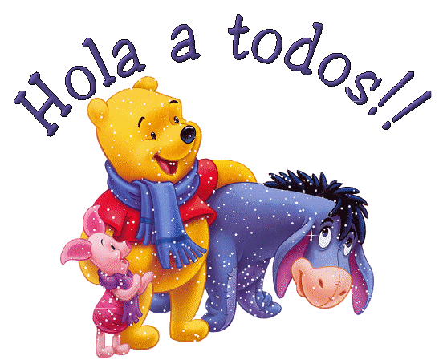
HELLO EVERYBODY!

Slide 2
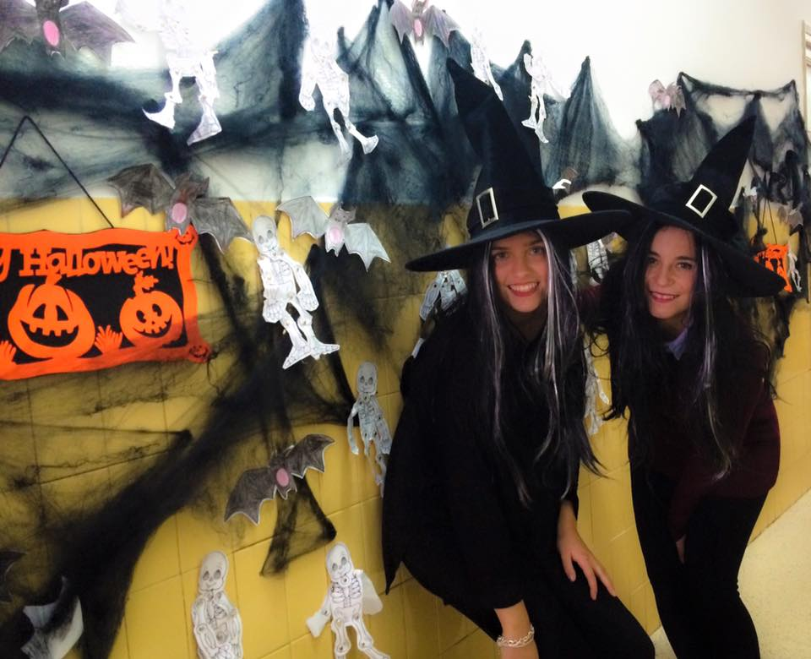
We are María and Isabel
We are Primary school teachers and we teach, maths, spanish language, science and arts and crafts.
Our students are 6 and 7 years old.

Slide 3
Our country is Spain

Slide 4
We live in Palencia, it is located in the north of the country.

Slide 5
It´s a beautifull city with many places to visit.

Slide 6
The cathedral

Slide 7
Otero´s Christ

Slide 8
The teacher´s monument

Slide 9
Main Street

Slide 10
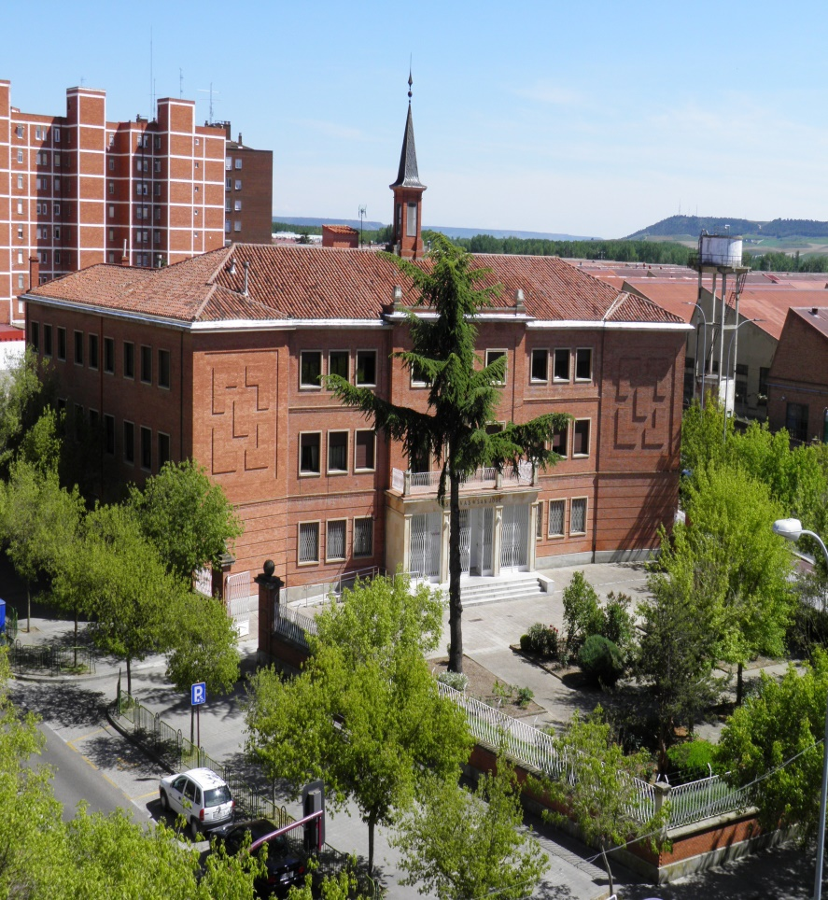
And this is our school
San Jose School is a bilingual School.
Children study English and German.
It is formed by Preschool Education, Primary Education and Secondary Education.
The classes are divided in ages.

Slide 11
Our playground

Slide 12
Our school in winter time
In the north of Spain usually snows in winter.
We have severals ski resorts close to our city.

Slide 13
CHRISTMAS TIME
On Christmas time we usually perform typical Christmas Carols for the whole school.
We love Christmas time!

Slide 14
The school symbol
It is a very important symbol for students, teachers and families in our school.
We are a religious school and we follow the values of work, faith and love in all of our subjects.

Slide 15
