Slide 1
Organic matter and energy production

Slide 2
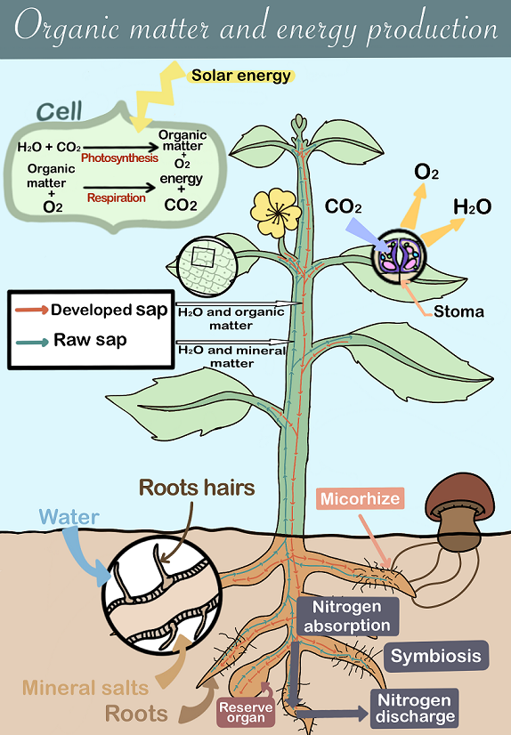

Slide 3
Plan of the presentation
Introduction
I/ Photosynthesis and cellular respiration
II/ Circulation of the matter in the plant.
III/ The role of microorganisms in plant nutrition
Conclusion

Slide 4
Introduction
To develop, a plant needs various elements present in its environment. Chlorophyllian plants use organic matter, which is essential for their function, as an energy source.
How do cells in chlorophyll plants produce their organic matter?

Slide 5
I/ Photosynthesis and cellular respiration
Photosynthesis and respiration in chlorophyll cell

Slide 6
Exchange surfaces within the plant
Exchanges in leaf stoma

Slide 7
Exchange surfaces within the plant
Exchanges of matter in the roots hairs

Slide 8
II/ The circulation of matters in the plant
The raw sap circulates in vessels from the roots to the leaves.
The sap developed circulates in vessels from the leaves to the rest of the plant.

Slide 9
Evapotranspiration
Evapotranspiration is the transformation of liquid water from the roots into water vapor that is discharged at the leaf level. It allows the root water to be sucked up. In addition, root growth helps the circulation of raw sap.

Slide 10
III/ The role of microorganisms in plant nutrition
Exchanges between the plant and the micro-organisms

Slide 11
Conclusion
The organic matter produced during photosynthesis by the plant allows plant cells day and night to carry out cellular respiration and thus produce their energy. This organic matter also allows the growth of the plant. It can also be stored in differents organs (seeds, fruit, tuber, etc…).

