Slide 1
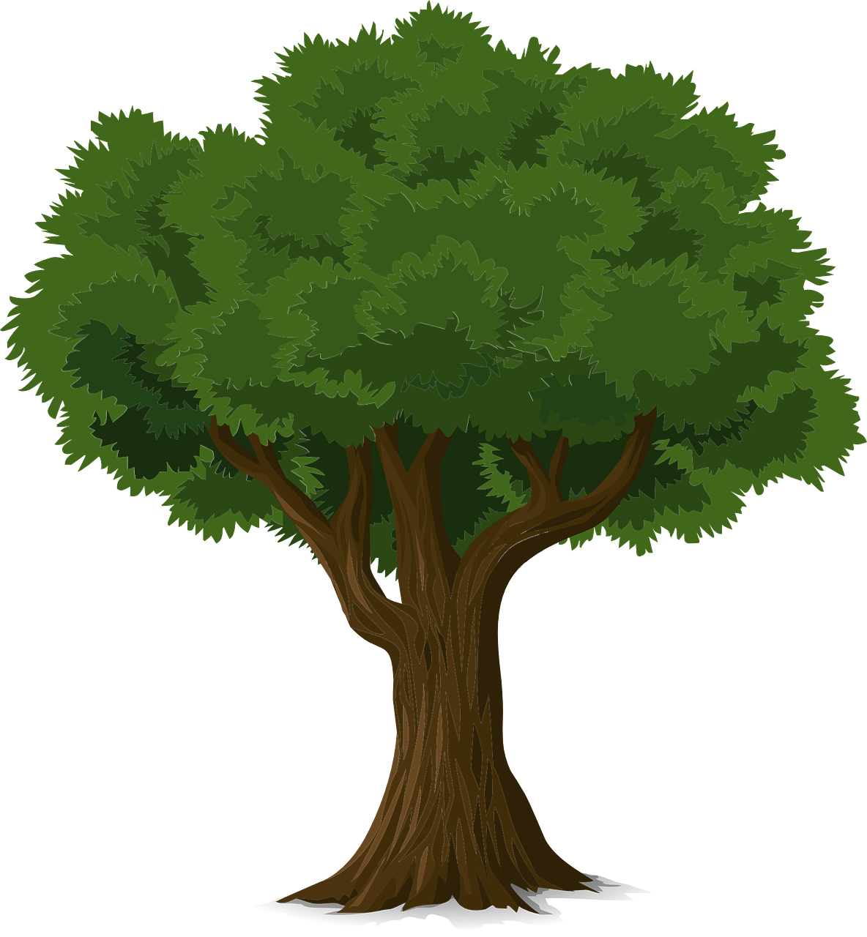
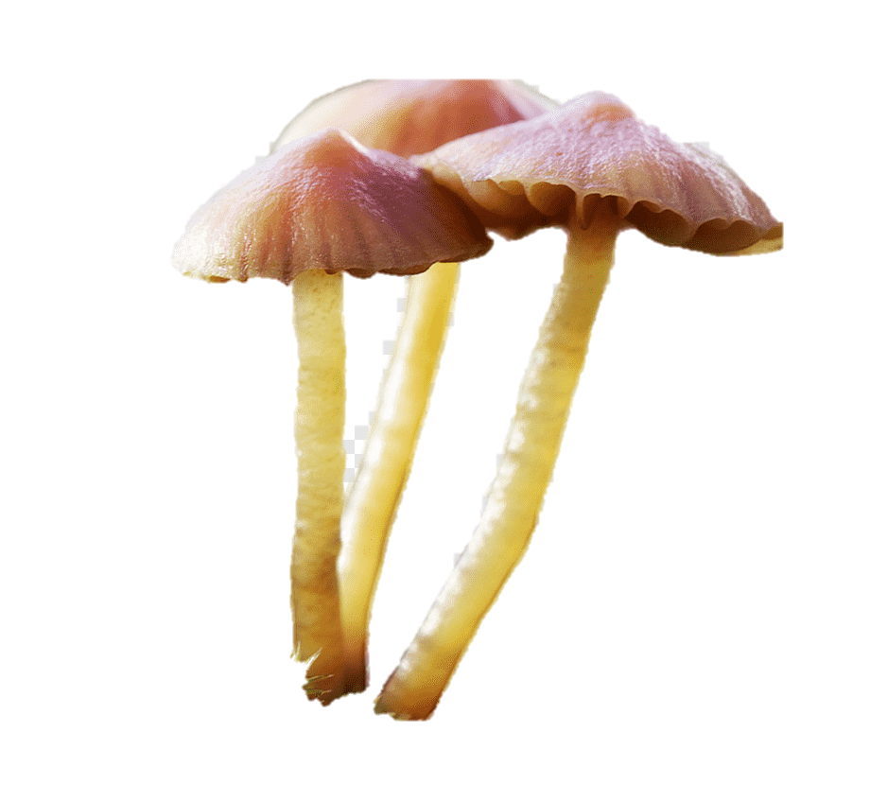
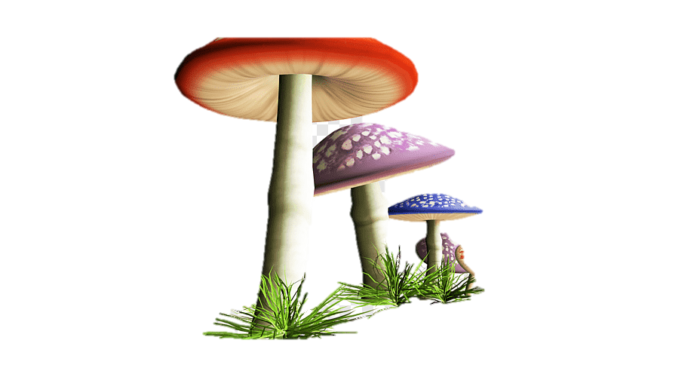
Plant communication. How it works
CO₂
On the surface: emission of volatile organic compounds.
These volatiles attract enemies of the herbivores, that is, organisms of the third trophic level (predators, parasitoids).
_{Photosynthesis}
C
C
C
C
C
Ectomycorrhizal fungi
C
P
Below the ground surface:
Chemical warning . Stressed plants secret soluble chemical compounds from their roots, which are then absorbed by the roots of neighbouring plants.
P
N
N
C
P
N
C
C
Below the ground surface: also transmit warning signals via the thin thread of fungi plants that connect their roots from the soil
Below the ground surface: hub trees use the mycelium network to provide food to other trees, from the same or different species.

