Slide 1
SPANISH LECTURE
Soil creation and erosion: a example of relationship between plants and biotope

Slide 2
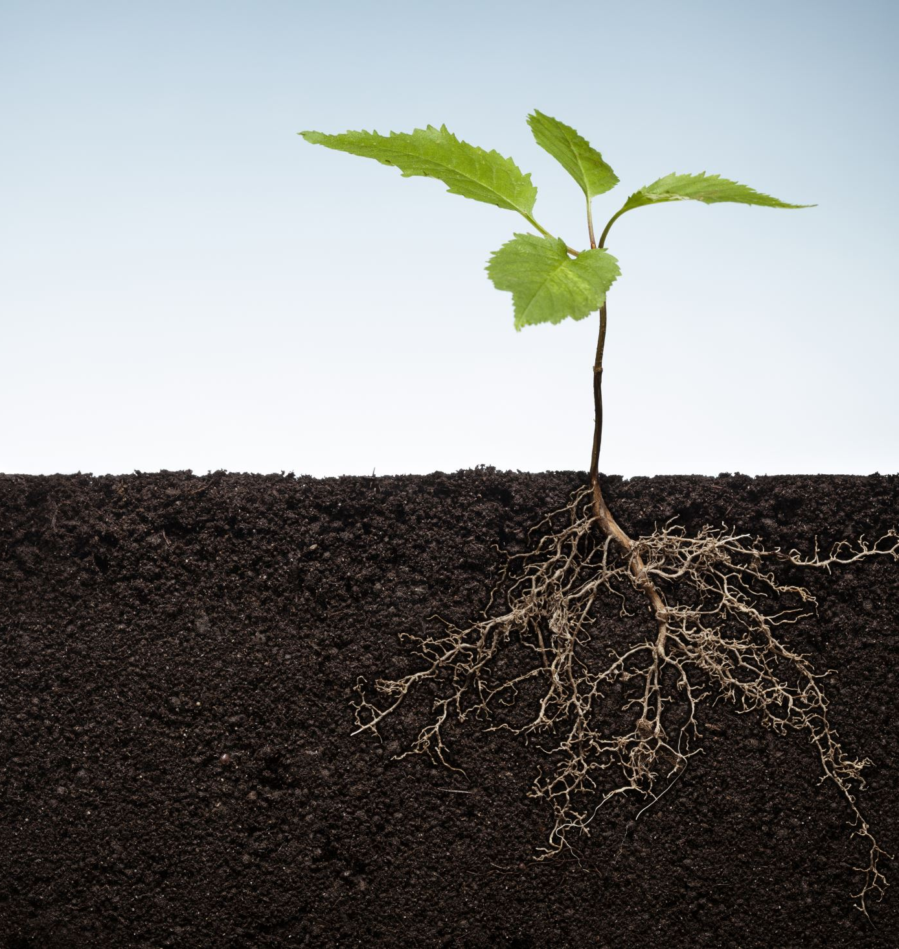
SOIL CREATION

Slide 3
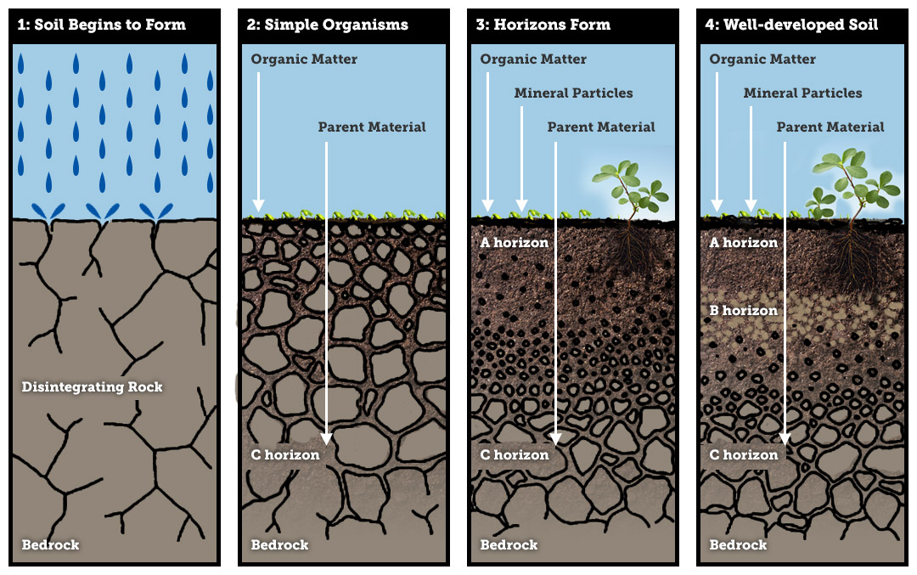
Soil creation depends on vegetation and climate.
It’s a very slow process of disintegration of the bed rock where the meteorological agents (rain, ice, wind) and vegetation (via the roots of the plants and organic matter) make this physical and chemical work.

Slide 4
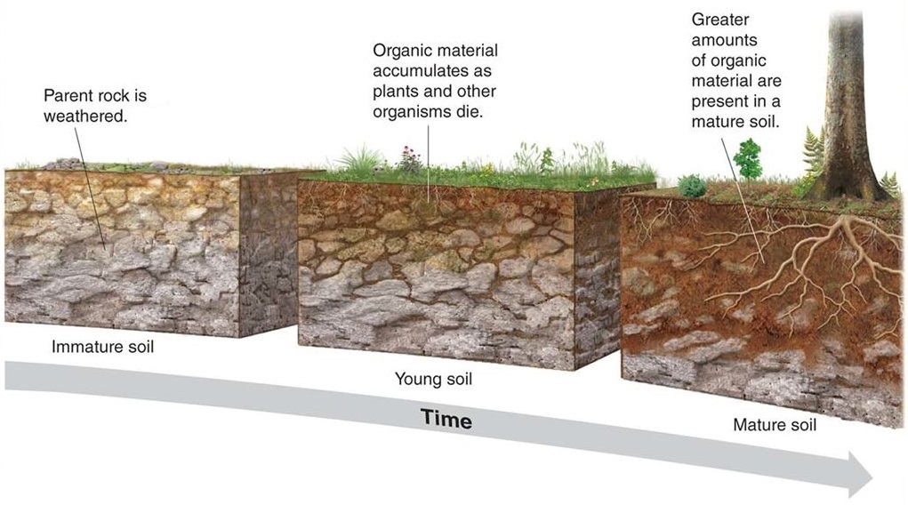
The more mature the soil the more biomass the ecosystem accepts

Slide 5
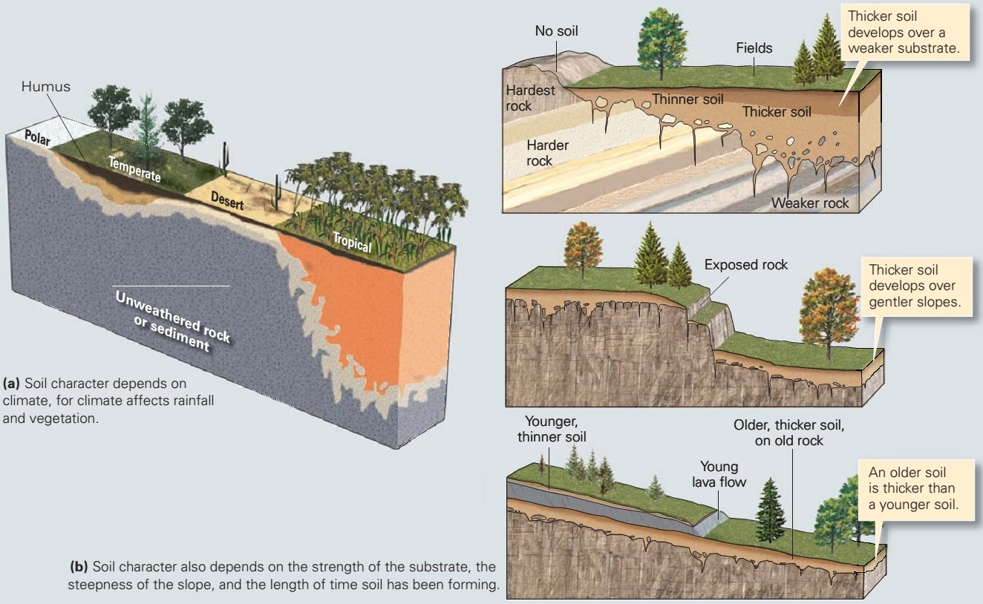

Slide 6
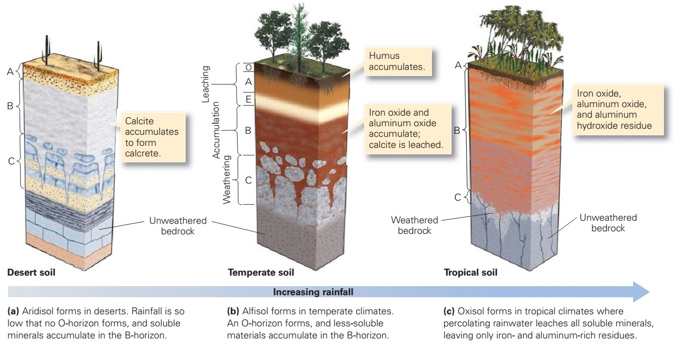
Different climates with distinct vegetation generate different type of soils

Slide 7
SOIL DESTRUCTIÓN: EROSION

Slide 8
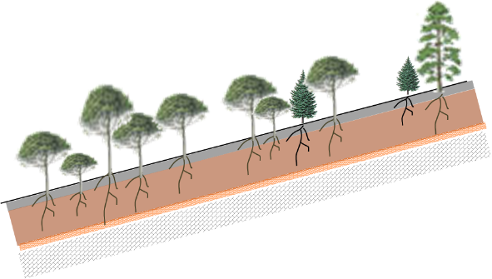
On this young soil a coniferous forest develops, taking advantage of rather sandy soils.
Upper layer of sand with a very sparse humic horizon
Clay layer is stiil underdeveloped

Slide 9
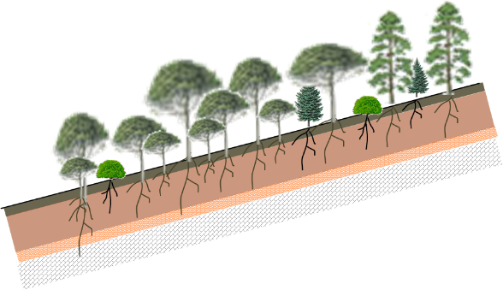
As conditions improve, the most demanding tree species appear
Humic horizon develops and sand layer receives greater amount of organic matter
Clay layer gets wider

Slide 10
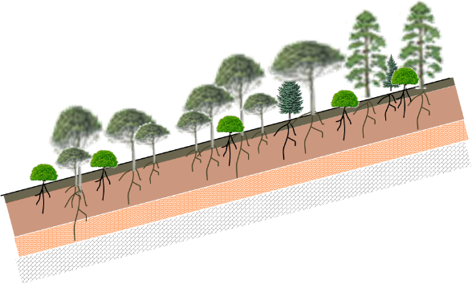
Pioneers (usually conifers) do not regenerate well in shade and compact soils…
…but broadleaved trees do!!

Slide 11
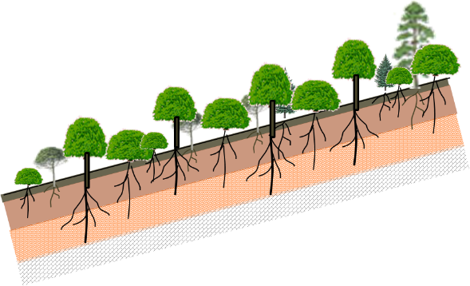
Broadleaved trees benefit from shade conditions on compact soils.
The root system of this trees take advantage of this deep clay horizon that has reached his máximum development

Slide 12
Now, what happen in this mature forest when it rains?
This arrow represent total rain
Part is intercepted by the forest canopy
Part of the rain become Surface runoff (quick and erosive procces)
Part become soil infiltration (a slow process)
Part become underground runoff (slow process, acuifer recharge)

Slide 13
BUT, what happen if this forest is destroyed?

Slide 14
BEFORE
AFTER
Surface runoff becomes a dangerous and destructive process
As forest canopy interception disappears, most of the rain became surface runoff. These are the ideal conditions for erosive processes.

Slide 15
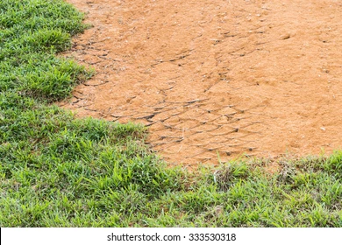
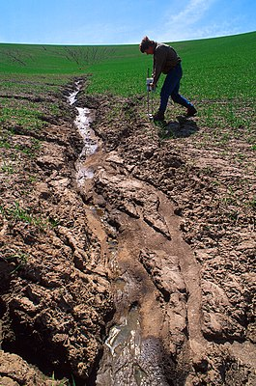
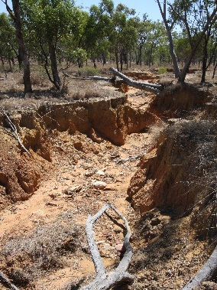
Stage 1: Sheet erosion
Stage 2: Rill erosion
Stage 3: Gully erosion
Conclusión:
soil erosión is a positive feedback process, getting worse as time goes by

Slide 16
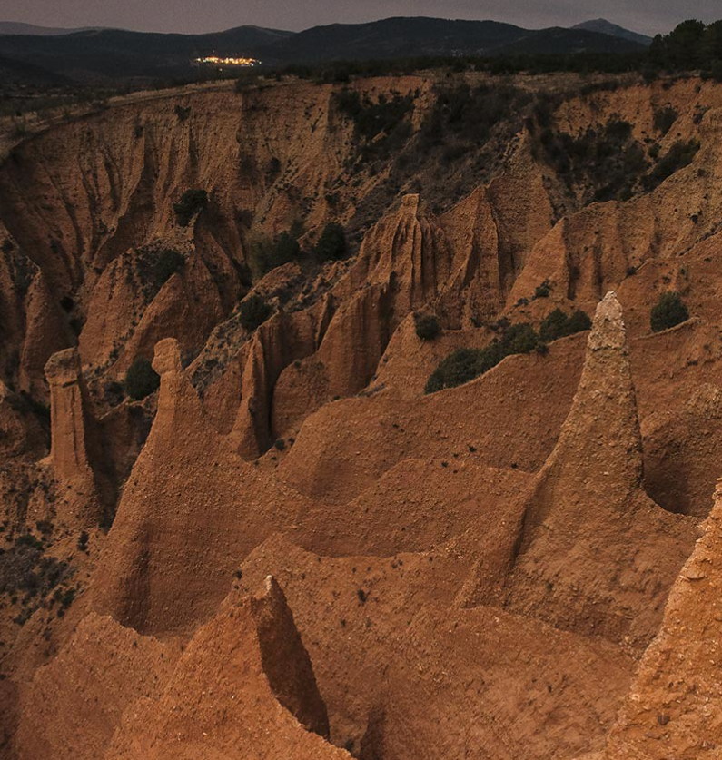
So, what can we do to stop erosion?
We have to return vegetation to its place

Slide 17
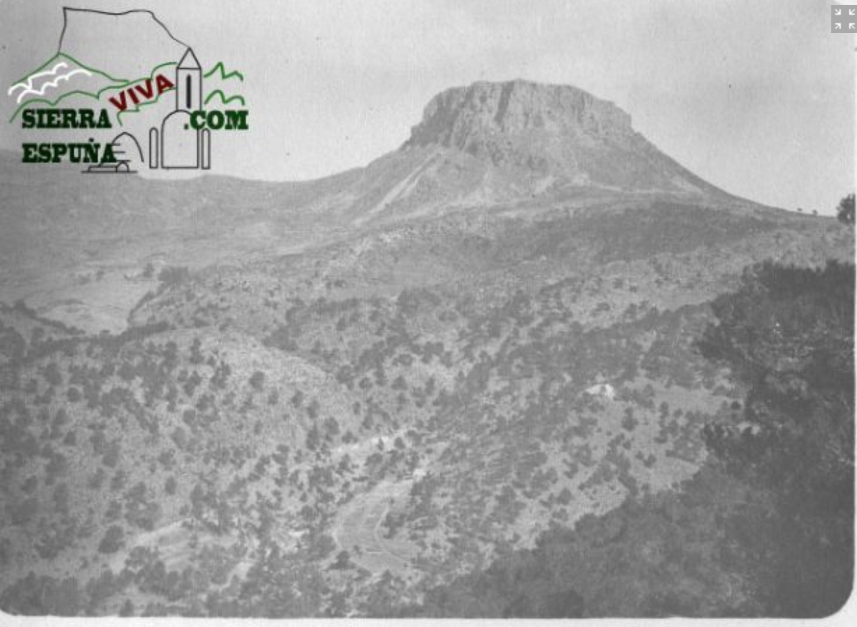
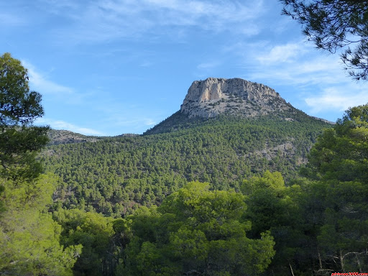
1890
Today
A mountain area in Southeast Spain: previously with flood and erosive problems, today is a natural area after an ambitious reforestation program

Slide 18
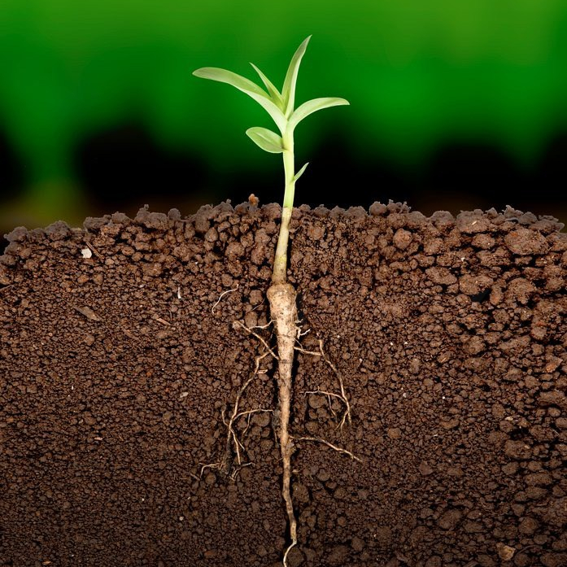
Let the plants do their work!
Thank you

