Slide 1
Decalogo sulle Emozioni e l’Arte
Decalouge on Emontions and Arts
I.C. Fontanellato e Fontevivo - A.S. 2018-19
ERASMUS + K229. VAN PROJECT (VIAJAR AMPLIA NACIONES):
THE INTEGRATION OF STUDENTS THROUGH EMOTIONS AND ARTISTIC EDUCATION
PROJECT NUMBER 2018-1-ES01-KA229-050749_6

Slide 2
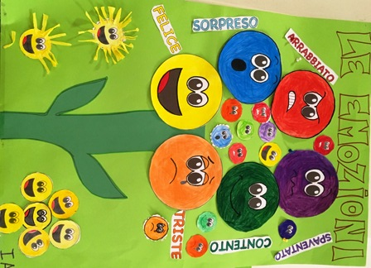
Different Steps of a Class Workshop on Emotions and Art
1) Teacher: presents to the pupils basic emotions. Focus on a specific emotion, in this case angriness.
Pupils :recognize the basic emotions in their own experiences.
2) Teacher: introduce a Class discussion on a specific emotion.
Pupils: represent thoughts, feelings and every day life experiences on a specific emotion first by a speech and then by a graphic expressions;

Slide 3
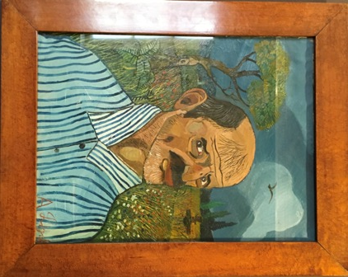
Find a local Artist: Antonio Ligabue
3) Teacher: presents to the pupils, with the use of ICT , an artist of the local territory that express in his paintings the specific emotion analized. (Antonio Ligabue an Italian naif painter).
Antonio Ligabue ‘s life was told the children of the class.
Pupils: know the Ligabue’s story and they were able to understand his personality and his artistic research and style.

Slide 4
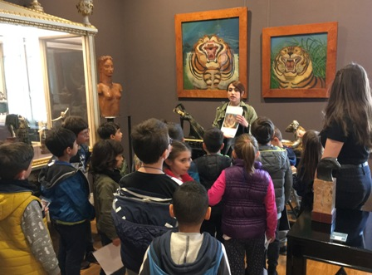
Discussion to Choice a Painting as Inspiration Work
6) Teacher: in class presents photos by ICT of the paintings studied during the Museum visit.
Pupils: open a guided discussion to choose a painting which could express the emotion analized ( angriness).

Slide 5
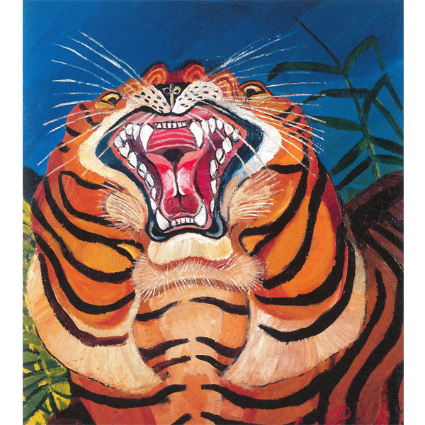
Individual Choice of the Painting
7) Teacher: help every one pupils to choose the painting to inspire himself/herself to produce an artistic work.
Pupils: chose a Ligabue’s painting that they feel to be inspirate on an artistic work to express the emotion analize
( angriness)

Slide 6
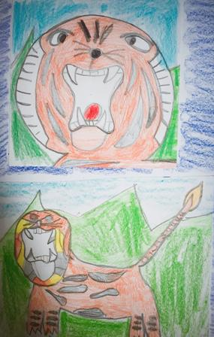
Art Workshop and Art Techniques
8) Teacher:prepare the art workshop for the class and show to the pupils a specific or different art techniques (crayons, waterpainting, tempera colors,etc.) to realize their own art works.
Pupils: to pay attention and to learn the different art techniques.

Slide 7
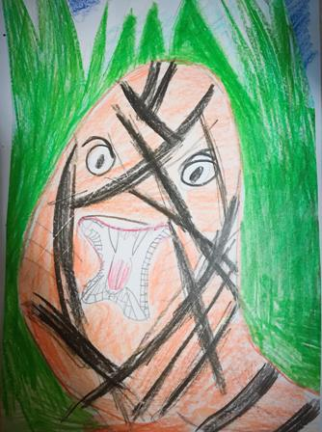
Art Workshop: Insipired Painting
9) Teacher: follows and helps pupils in the realization of their art works inspirated by a famous artist and that express a specific emotion (angriness).
Pupils: paint art works inspirated by the famous artist ( Ligabue) using a specific art technique ( crayon technique in this case).

Slide 8
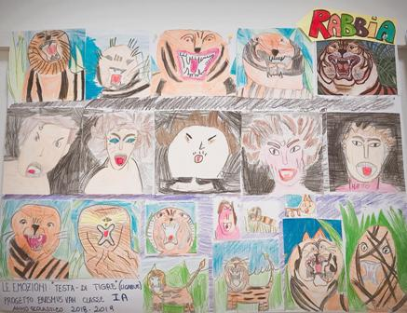
Art Exhibition at School
10) Teacher: collects all pupils art works and set up an Art Exibithon in the School. Every art work is reproduced by photos to post on Etwinning Platform or Eramsus Plus V.A.N. Social Media.
Pupils: opent the Art Exibition in the School and present it to the Headmistress and the Parents, Relatives, Friends.

