Slide 2
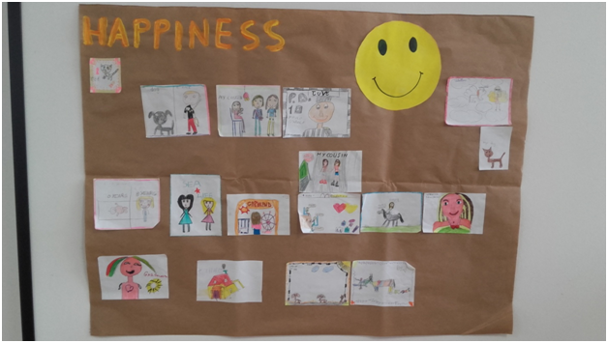
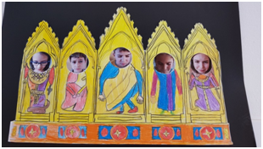
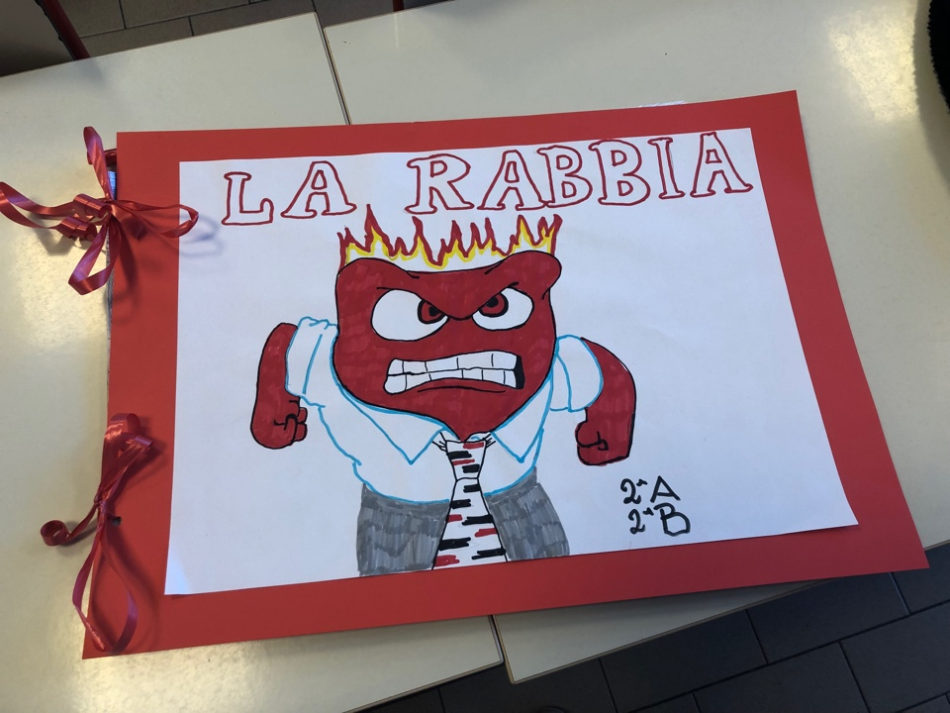
Identification of Basic Emotions

Slide 3
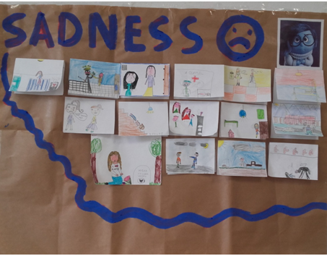
Language of Basic Emotion
The teacher asks pupils to think about a sad moment in their lives and to draw that moment. After that the teacher show on the interactive board their pictures, one at the time.
One pupil at the time explains what’s in the picture focusing on the event that makes him/her sad. The other pupils try to comfort that pupils suggesting actions and good words to make him/her feel better.These solutions are write down on the back side of the picture.
This method of work can be used with all the five basic emotions

Slide 4
Language of Basic Emotion - with Author masterpiece analysis
The children of the classes were told the life of the painter Antonio Ligabue , they were able to know his personality and his characteristics. Later we visited the Antonio Ligabue Foundation and museum house where a guide illustrated the artist’s works.
The pupils have “chosen” a painting which according the emotion of joy and reproduced it with the technique of pastels.

Slide 5
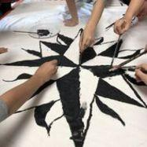
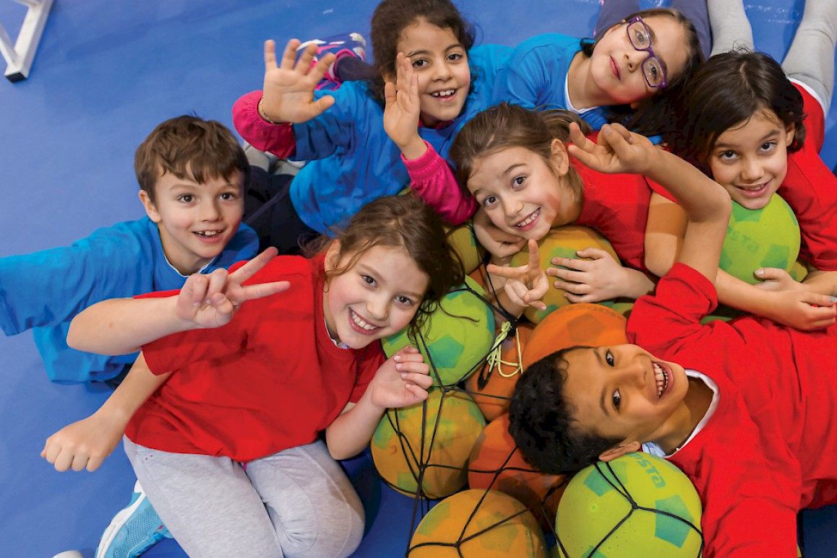
Multiple Intelligence ( Verbal- Not verbal- Creativity- Emotional)
To analyse to own and to internalize the emotions is very useful not only developing literacy but also other kinds of languages according to the multiple intelligence (thinking of and with: Art, Gym, Music
scuola rap al minuto 1
LOGO-Think of logo symbol of the project, reproduce the winning logo on white T-shirts and on a white big sheet
Joy of Moving: it’s an educational method: to play with the “variable”(pupils discover variations and new solutions). To promote the pupil development, focusing on cognitive functions and creativity

Slide 6
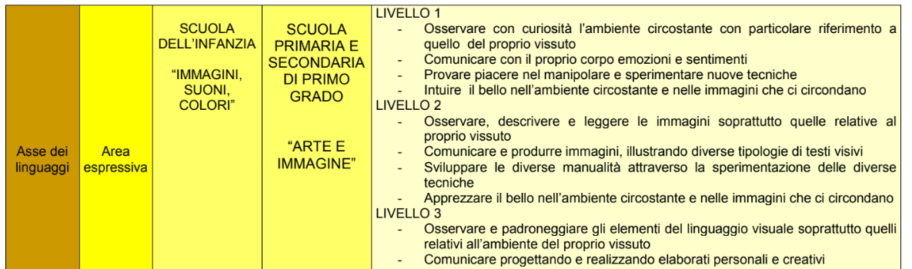
Learning Objectives within Curriculum
This is part of our school curriculum and the keywords about art and emotions are:
ART WORKS AND PERSONAL FEELINGS

Slide 7
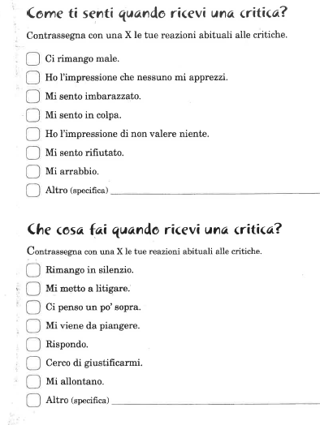
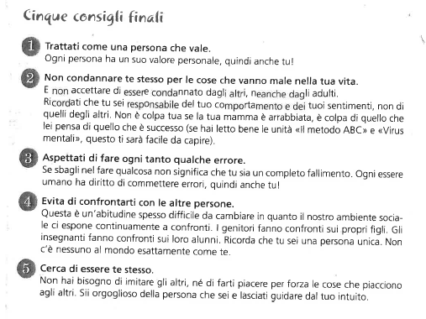
Strategies to Manage Emotions( Framework- Resolve conflicts
after following the “emotional intelligence course” we propose pupils some activities about “how to manage emotions”
after different activities we propose five useful differents suggestions to overcome emotional problems

Slide 8
Five finals suggestions
Treat yourself like a valuable person
Do not condemn yourself for things that are going wrong in your life
Expect to do mistakes sometimes
Avoid to compare yourself to other people
Try to be yourself

Slide 9
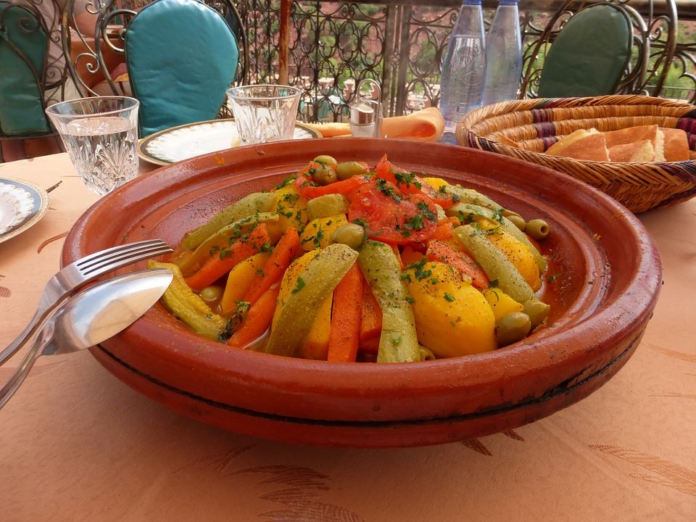
Cultural diversity
The percentage of foreign pupils is about 20/21%
Many of them are of second generation, that means that they were born in Italy from foreigner parents
The educational strategies take care of the single individualities, identities, abilities and weakness
We put the pupils at the center of the educational action in all the aspects: cognitive, emotional and ethic
We Involved families at school to show their traditions ( food, dances, costumes) encouraging their identity not to feel them apart

Slide 10
Getting the expertise of outside agencies
In our Institute there’s a couple of psychologists for counseling to parents, teachers and secondary school pupils to improve wellbeing school
Courses about parenting problems
conflicting separations
The first kiss, a book by A. Pellai about teenagers experience/sentimental education

Slide 11
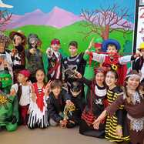
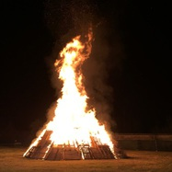
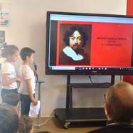
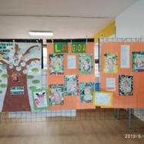
Partnership with the community
This project involves many stakeholders from local area
The custom of our Carnival is to burn the puppet of an old witch in a big Bonfire
Exhibition inside the school for parents showing pupils masterpiece
Little performances around the village to show some scenes about the work from Identities course (Prof. Bosi)
Museums
Labyrinth

Slide 12
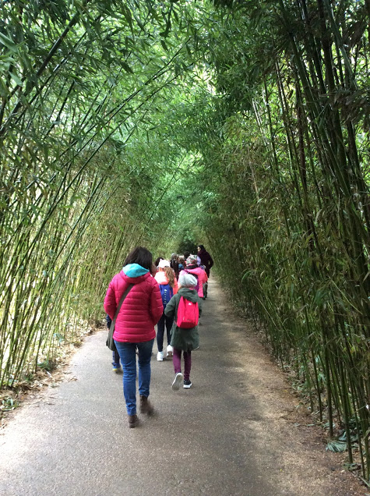
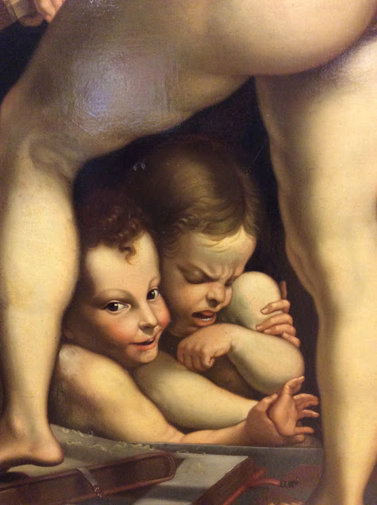
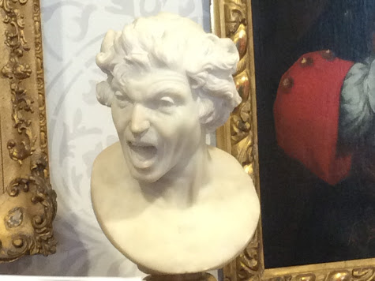
At the museum
At the labyrinth

Slide 13
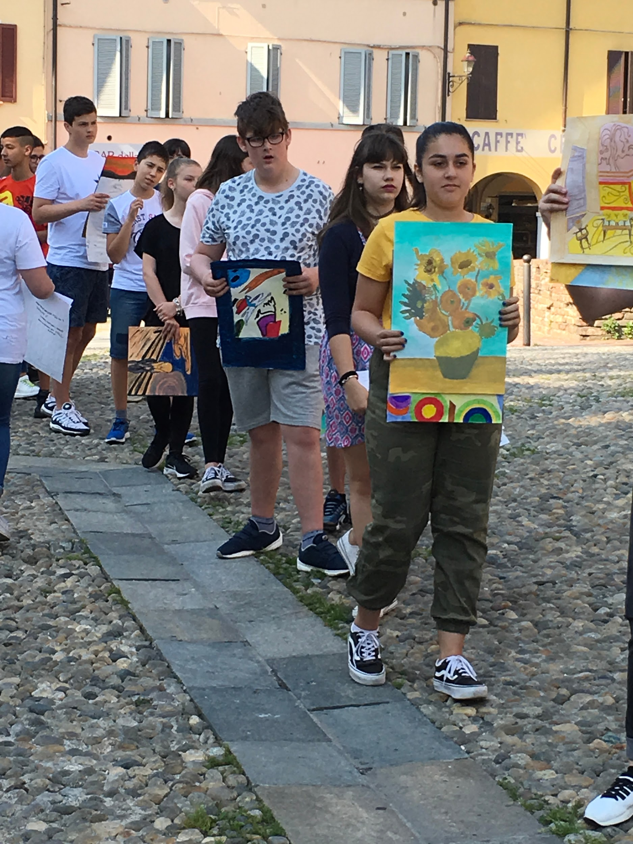
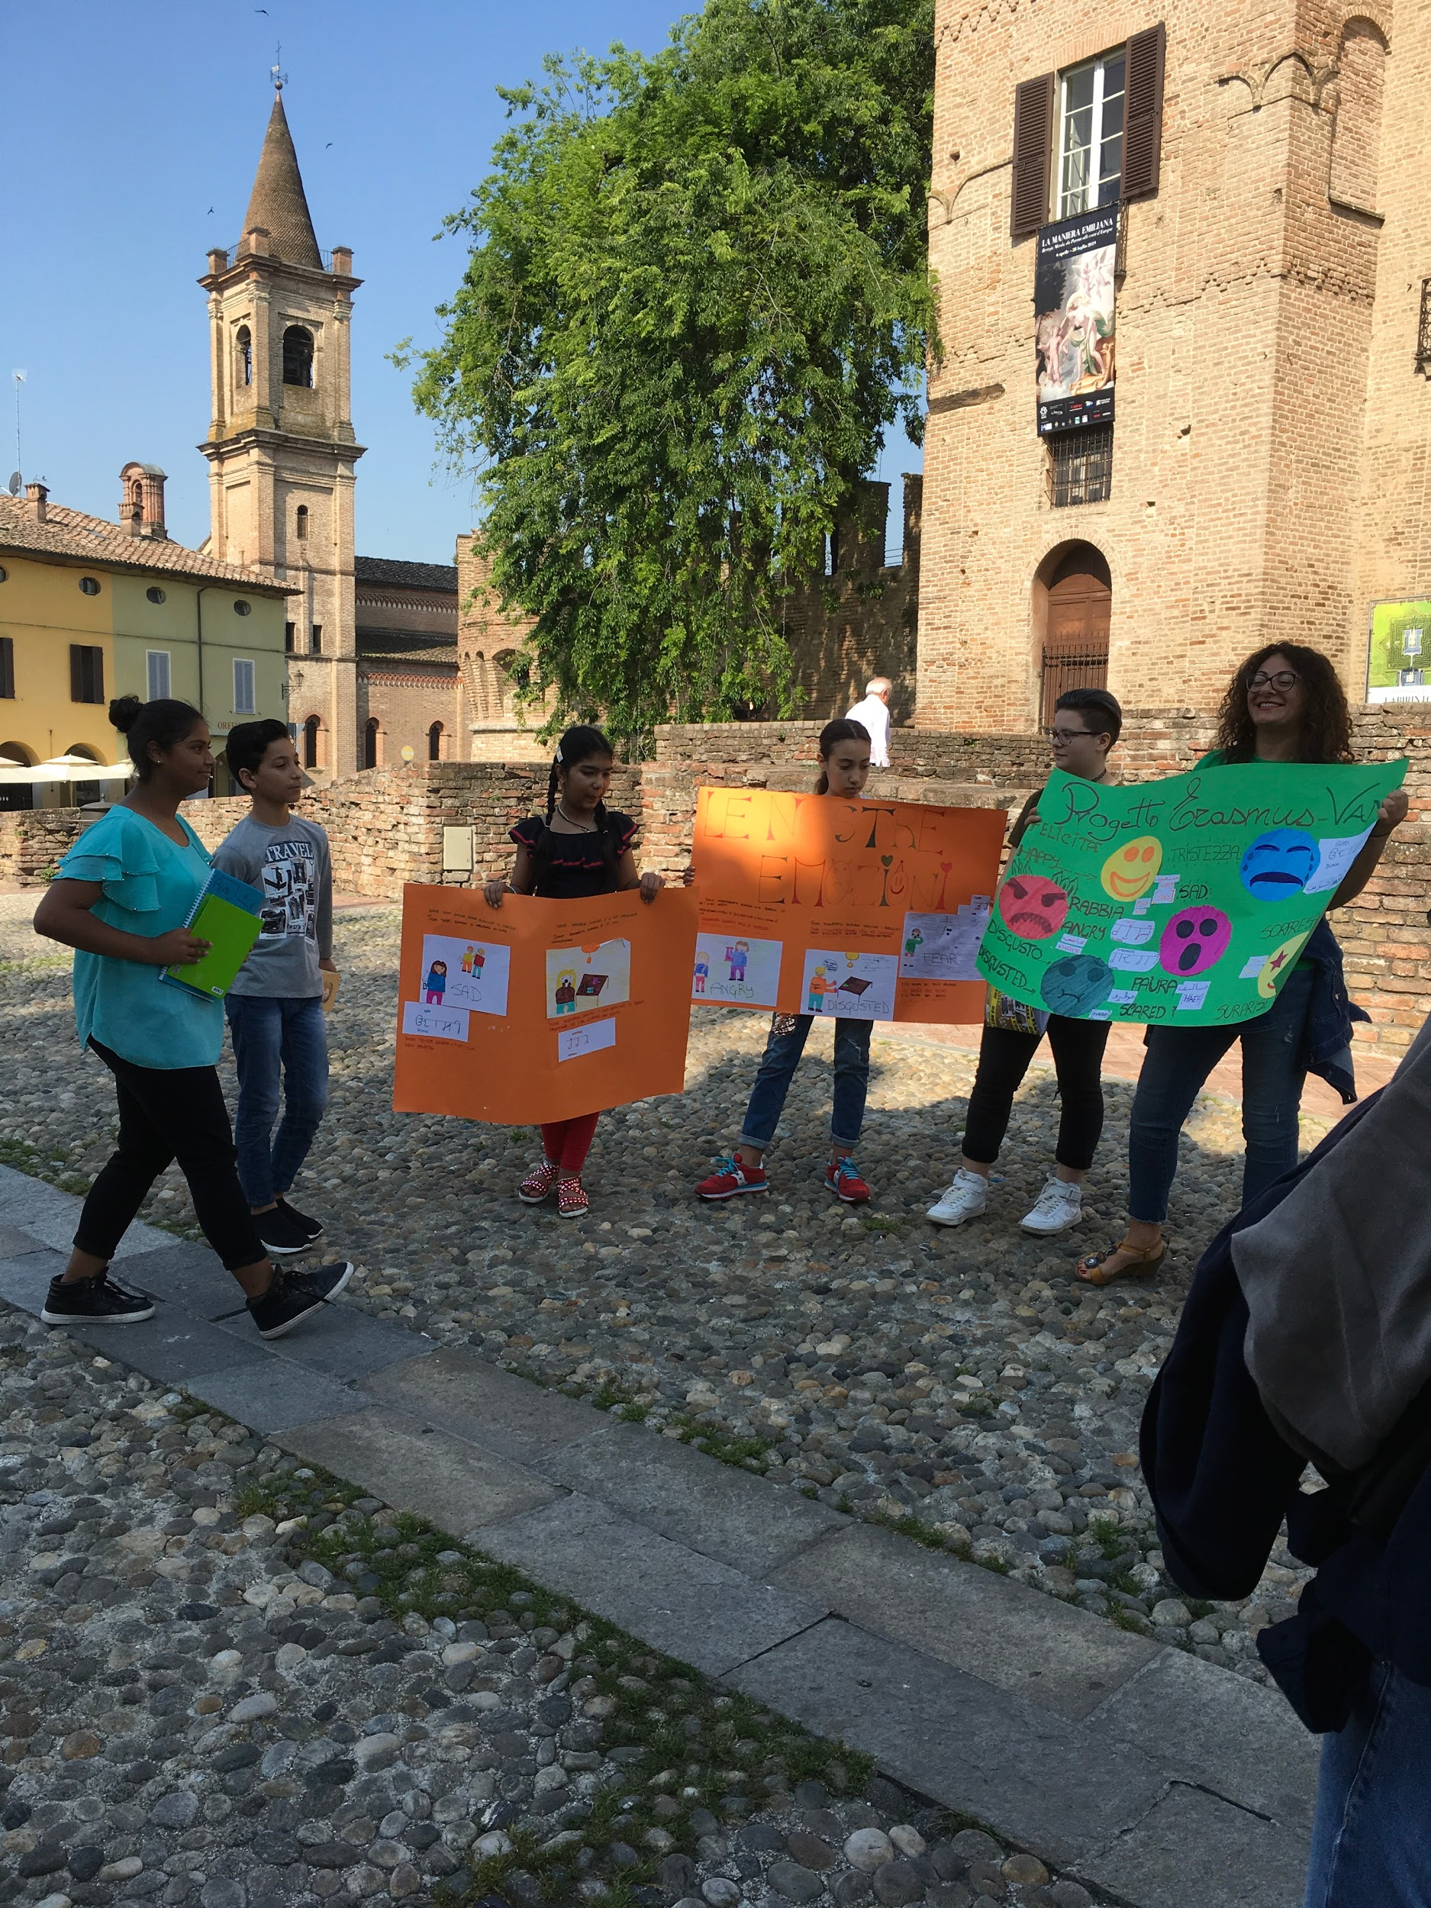
Art and theatre on the road

Slide 14
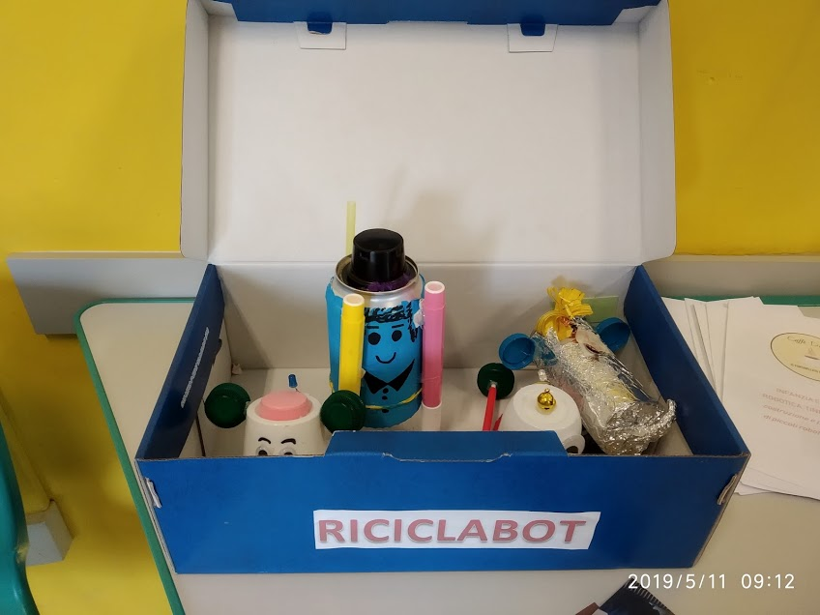
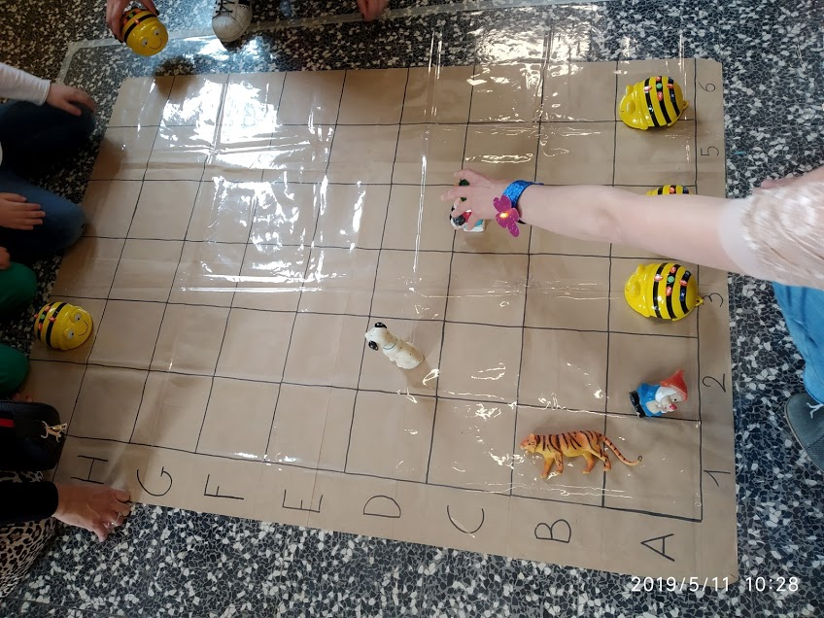
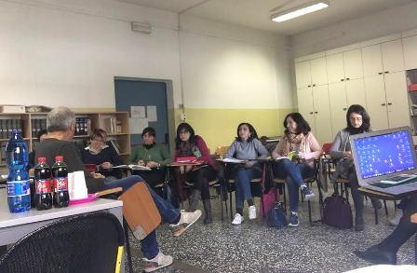
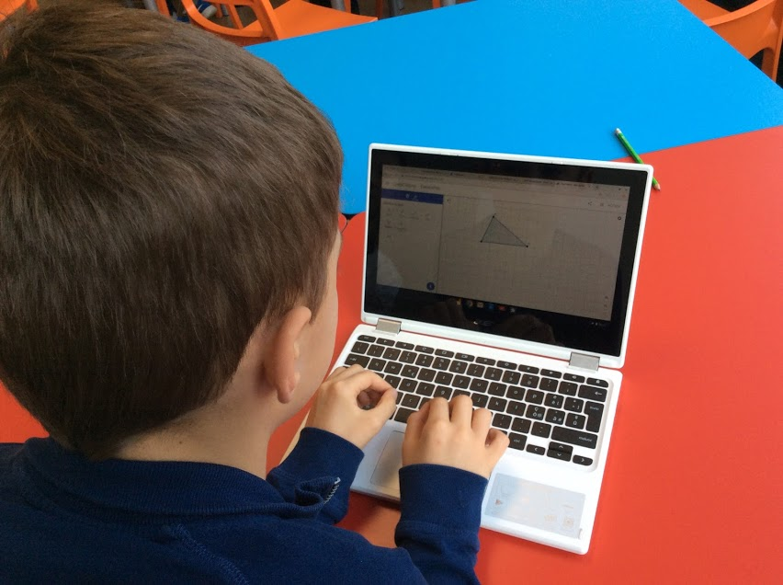
Upskill of educator: 1) ICT- 2) Continuous professional development
Chromebook course
Prof . Bosi
Psychologist Berti
Digital coffee Open day/workshop for kids and parents with tinkering, coding, robotic activities

Slide 15
Restorative practice
What happened?
Identification of the fact and the actors
What were you thinking of at the time?
Help the pupil to analyse and recognize his/her emotions in that moment
What have you thought about is since?
Help the pupil and welcome his/her emotions through a conversation guided by the teacher
Who has been affected and in what way?
Collective conversation to find a solution to support everyone that has been affected.

Slide 16
Restorative practice
How could things have been done differently?
Helping pupils to think about their actions finding a different strategy to solve the problem without being aggressive
What do you think needs to happen next?
Conversation about what can be the consequences of different ways to solve the question.

