Slide 1
ISTITUTO COMPRENSIVO DI FONTANELLATO E FONTEVIVO
di Scuola dell'Infanzia, Primaria e Secondaria di 1° grado
Cod. Fisc.80012110344 – E-mail: pric813002@istruzione.it
www.icfontanellatoefontevivo.edu.it
ERASMUS PLUS K229. V.A.N. (VIAJAR AMPLIA NACIONES) PROJECT:
THE INTEGRATION OF STUDENTS THROUGH EMOTIONS AND ARTISTIC EDUCATION
PROJECT NUMBER 2018-1-ES01-KA229-050749_6
LIST OF THE MUSEUMS AND ARTISTIC PLACES VISITED BY EACH PARTNER SCHOOL
TO PREPARE ARTISTIC WORKSHOP OF PUPILS

Slide 2
LIST OF THE MUSEUMS AND ARTISTIC PLACES VISITED BY EACH PARTNER SCHOOL TO PREPARE ARTISTIC WORKSHOP OF PUPILS
The list of European museums and artists is important in our Erasmus Plus V.A.N. because it allows everyone (pupils, parents, teachers, local authorities) to fully understand the long emotional and artistic journey carried out by the children of the six primary schools involved in the project.
The teachers took the children to visit the museums and chose the works of an artist who, according to the pupils' sensitivity, significantly expressed one of the five basic emotions studied: happiness, sadness, fear, anger and disgust.
This virtual journey, but also concrete in the Museum Corners created in each school, has allowed the different classes and numerous children / teenagers to discover a broad artistic sensitivity and a broad cultural horizon in our Europe, aimed at expressing basic emotions.
Getting to know new artists and their stories and works has opened the minds of our students to numerous fields of expression, towards which they will be able to direct their creativity in the future.
The artistic work carried out in the classes in the three-year period of the Erasmus Plus V.A.N. it was huge, I would like to say bigger ...
Thanks to this challenging project, our children / teenagers have grown a lot, both in the knowledge of basic emotions and in the consequent better behavior, and in the knowledge of local artists and their emotional sensitivity, but also in the creative ability to take inspiration from the environment or from a work of art to express their feelings.
An invitation is addressed to parents, to teachers of other classes and schools, to local administrators, to the public who will read these pages, it’s to visit the museums indicated by the six schools.
It will be for everyone a very curious and innovative discovery of how artists who have expressed themselves with such different styles, materials, times and places, have reached such significant artistic heights.
TeacherRosaria Poi - I.C. Fontanellato and Fontevivo

Slide 3
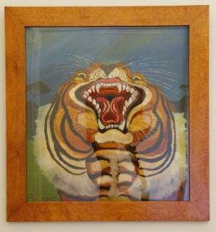
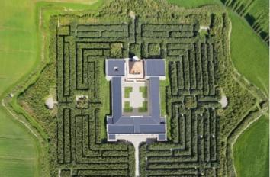
SCHOOL (NATIONAL NAME) | MUSEUM | DESCRIPTION | PLACE ADDRESS | WEB SITE AND E-MAIL
ISTITUTO COMPRENSIVO DI FONTANELLATO E FONTEVIVO PARMA ITALY | MUSEO DELLA MASONE FONTANELLATO PARMA | Local Museum of a private Italian Art Collection of XVI- XX Centuries of Franco Maria Ricci. It has the largest Bamboo Maze in the World around the Museum. | FONTANELLATO, STRADA MASONE 121 (PARMA) ITALY | labirinto@francomariaricci.com https://www.labirintodifrancomariaricci.it/it/labirinto/homepage-labirinto/ La Tigre Antonio Ligabue Labirinto e Museo della Masone

Slide 4
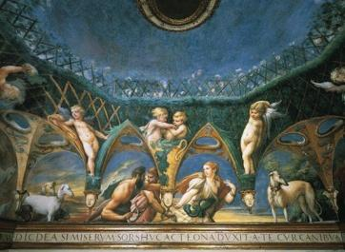
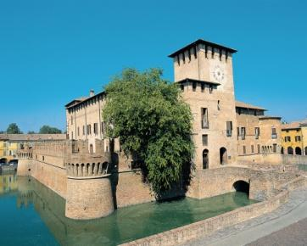
SCHOOL (NATIONAL NAME) | MUSEUM | DESCRIPTION | PLACE ADDRESS | WEB SITE AND E-MAIL
ISTITUTO COMPRENSIVO DI FONTANELLATO E FONTEVIVO ITALY | MUSEO DELLA ROCCA SANVITALE DI FONTANELLATO | A Local Museum, inside the Rocca, that houses the private art collection of the Sanvitale Family, Count of Fontanellato since the Middle Ages. It houses Parmigianino's youthful masterpiece, the fresco of Diana and Atteone, inspired by the myth told in Ovid's Metatamorphoses. It is one of the masterpieces of the Italian Renaissance. | FONTANELLATO PIAZZA GARIBALDI 1 43012 (PARMA) ITALY | E MAIL: iat@fontanellato.org - rocca@fontanellato.org WEB: www.fontanellato.org Diana e Atteone Parmigianino Rocca Sanvitale di Fontanellato

Slide 5
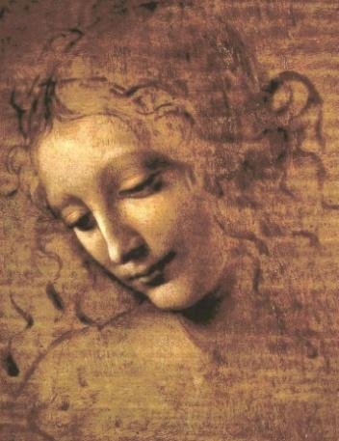
SCHOOL (NATIONAL NAME) | MUSEUM | DESCRIPTION | PLACE ADDRESS | WEB SITE AND E-MAIL
ISTITUTO COMPRENSIVO DI FONTANELLATO E FONTEVIVO PARMA ITALY | GALLERIA NAZIONALE DI PARMA | One of the Italian National Galleries that stores the Art Collections of Farnese and Borbone Families, the Dukes of Parma. It hosts many important Italian Artists work since the Middle Age to XIX Century. The most famous one is Leonardo da Vinci, a famous Italian Painter. In the Galleria , many other famous Italian painters are on show such as; Beato Angelico, Canaletto, Guercino, Parmigianino, Tintoretto, Correggio, Sebastiano del Piombo. | PARMA PIAZZA della PILOTTA, 5, 43121 ITALY | E MAIL cm-pil@beniculturali.it PEC mbac-cm-pil@mailcert.beniculturali.it Web Site La Scapigliata Leonardo da Vinci

Slide 6
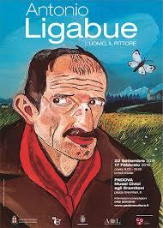
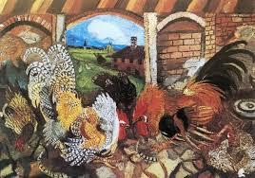
SCHOOL (NATIONAL NAME) | MUSEUM | DESCRIPTION | PLACE ADDRESS | WEB SITE AND E-MAIL
ISTITUTO COMPRENSIVO DI FONTANELLATO E FONTEVIVO PARMA ITALY | MUSEO ANTONIO LIGABUE GUALTIERI (RE) | Antonio Ligabue Local Museum that collect the most part of the operas of naif painter Antonio Ligabue. The pupils of the Primary School of Ponte Taro went to visit the museum and the house of Ligabue and were inspired by his artistic works. The children expressed in drawings and paintings and emotions of anger, fear, disgust and happiness, following the style of Ligabue. | GUALTIERI PALAZZO BENTIVOGLIO, VIA GIARDINO; 27 GUALTIERI (REGGIO EMILIA) | https//www.museo-ligabue.it Antonio Ligabue Galli nel cortile

Slide 7
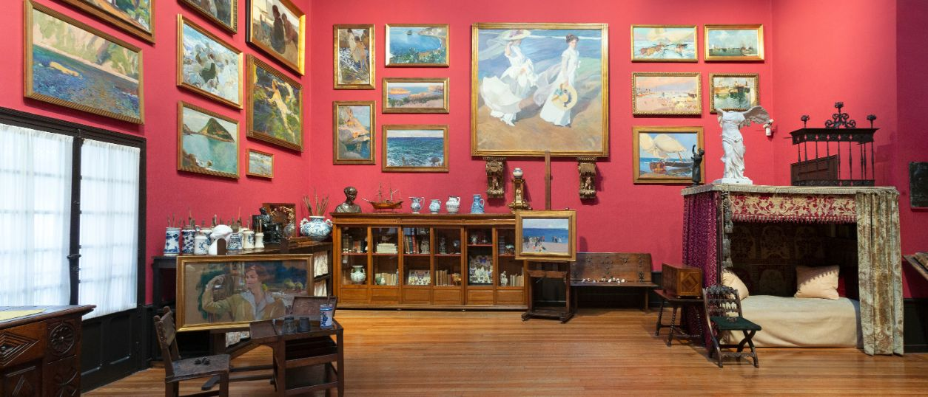
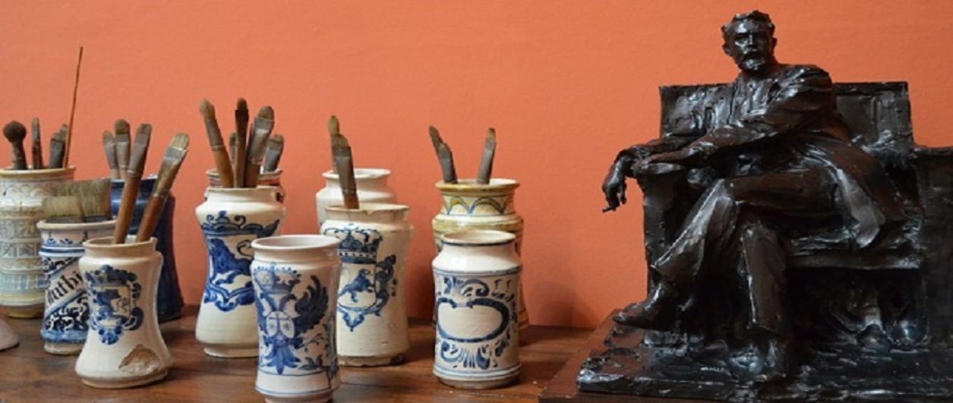
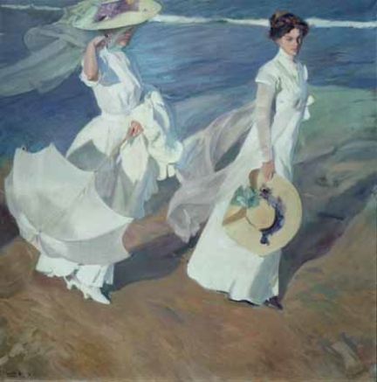
SCHOOL (NATIONAL NAME) | MUSEUM | DESCRIPTION | PLACE ADDRESS | WEB SITE AND E-MAIL
CEIP SEIS DE DICIEMBRE ALCOBENDAS –MADRID SPAIN | MUSEO CASA SOROLLA MADRID | A little but very important museum featuring one of the most important Spanish painters from the late XIX century and beginning of XX century. He is considered as the Painter of the light. He was a special viewer of the Spanish society that he painted through his masterpieces. A great sample can be found at the Hispanic Society of America centre in New York. Specially famous pictures are those from Valencia and the beach, his birth place. Through this museum, we not only visit his pictures but his studio and house in the centre of Madrid. | Paseo del General Martínez Campos 37 28010 Madrid | http://www.culturaydeporte.gob.es/msorolla/inicio.html Casa Sorolla

Slide 8
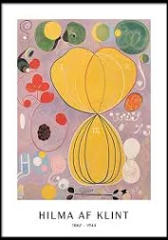
SCHOOL (NATIONAL NAME) | MUSEUM | DESCRIPTION | PLACE ADDRESS | WEB SITE AND E-MAIL
MÖSSEBERGSSKOLAN FALKÖPING SWEDEN | Modern Museum Stockholm Modern Museum Malmö | HILMA AF KLINT Among the highlights of the exhibition are ”The ten largest” ten paintings from 1907, which are shown together. | Exercisplan 4 Stockholm Ola Billgrens plats 2-4 Malmö | https://www.google.com/search?q=hilma+af+klint&rlz=1C1GCEA_enSE841SE841&oq=hilma+af+klint&aqs=chrome..69i57j46i433j0j69i59j0l6.5459j0j15&sourceid=chrome&ie=UTF-8

Slide 9
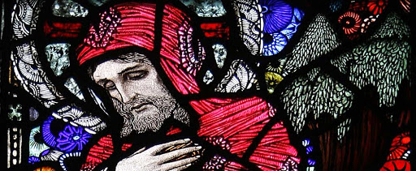
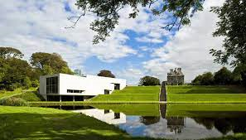
SCHOOL (NATIONAL NAME) | MUSEUM | DESCRIPTION | PLACE ADDRESS | WEB SITE AND E-MAIL
ST.ANGELA’S NATIONAL SCHOOL CASTLEBAR MAYO IRELAND | St Patricks | Roman Catholic Church housing the stained glass windows of the artist Harry Clarke. | Barrackhill, Newport, Co. Mayo
 | National Museum of Country Life Ireland | The museum offers a year-round programme of workshops, talks and tours for all ages and a changing programme of temporary exhibitions on historical and contemporary themes. | Turlough Castlebar Co Mayo

Slide 10
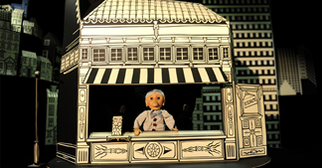
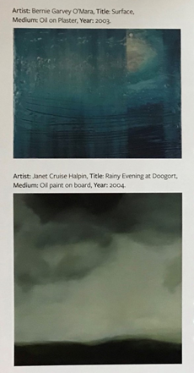
SCHOOL (NATIONAL NAME) | MUSEUM | DESCRIPTION | PLACE ADDRESS | WEB SITE AND E-MAIL
ST.ANGELA’S NATIONAL SCHOOL CASTLEBAR MAYO IRELAND | On line Collaboration with Artist in Residence Maeve Clancey | Maeve Clancy is an artist who works in installation, animation and comics. She creates work for children and adults using cut paper, story and drawings. She has worked on music videos for singer Lisa Hannigan, mounted solo exhibitions and written both fictional and historical comic stories.as well as a large scale installation at a National Trust property in Somerset, UK. | http://www.maeveclancy.com/
 | Mayo County Council Art Collection | “A Splash of Blue” is a Schools Exhibition and classroom resource that comprises over 200 artworks, including paintings, prints, photography, sculpture and mixed media. | Mayo County Council, Aras an Chontae, The Mall, Castlebar, Co Mayo

Slide 11
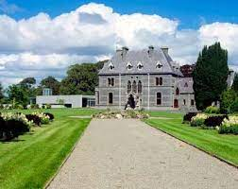
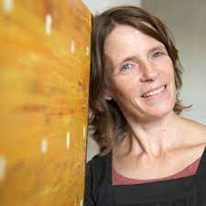
SCHOOL (NATIONAL NAME) | MUSEUM | DESCRIPTION | PLACE ADDRESS | WEB SITE AND E-MAIL
ST.JOHNS N.S. BREAFFY BREAFFY –CASTLEBAR- MAYO IRELA see ND | National Museum of Country Life Ireland | The museum offers a year-round programme of workshops, talks and tours for all ages and a changing programme of temporary exhibitions on historical and contemporary themes. | Turlough Castlebar Co Mayo | http://www.museumsofmayo.com/museum-country-life/building.html
ST.JOHNS N.S. BREAFFY BREAFFY –CASTLEBAR- MAYO IRELA see ND | Online with our Local artist in ce Lucy Hill | Children are exploring themes of emotions through the medium of art our local artist Lucy Hill | www.lucyhill.ie | www.lucyhill.ie

Slide 12
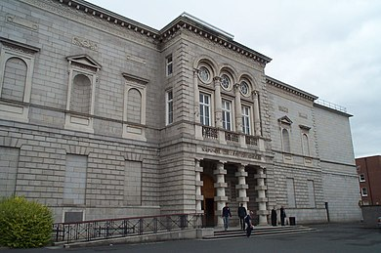
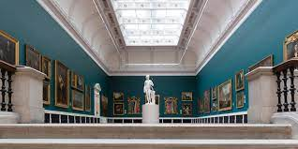
SCHOOL (NATIONAL NAME) | MUSEUM | DESCRIPTION | PLACE ADDRESS | WEB SITE AND E-MAIL
ST.JOHNS N.S. BREAFFY BREAFFY –CASTLEBAR- MAYO IRELA see ND | Virtual Tour of the National Gallery Ireland | The children explore and visit our national gallery to enjoy our national treasures of art. | Merrion Square W, Dublin 2, D02 K303, Ireland | https://www.nationalgallery.ie/virtual-tour

Slide 13
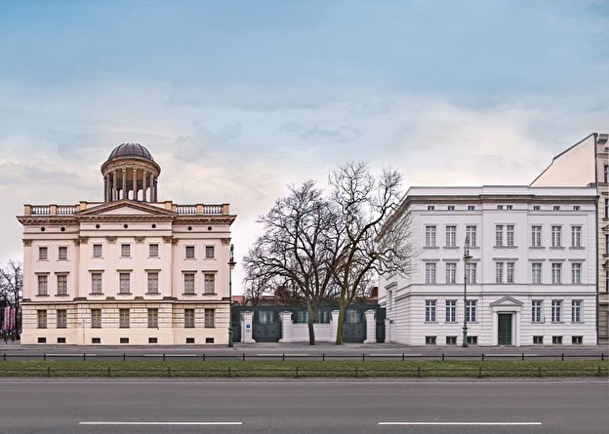
SCHOOL (NATIONAL NAME) | MUSEUM | DESCRIPTION | PLACE ADDRESS | WEB SITE AND E-MAIL
BORSIGWALDER GRUNDSCHULE- BERLIN GERMANY | Museum Berggruen BERLIN | Paul Klee In this museum there are works of art by Paul Klee. The 5-6 year old pupils discovered the emotions of happiness, exuberance, and exploration of all emotions in the artist's works. The children produced works of art inspired by Paul Klee's masterpieces with drawings and large-scale paintings. | Schloßstr. 1 14059 Berlin Zum Stadtplan | https://www.smb.museum/en/museums-institutions/museum-berggruen/home.html

