Slide 1
The Angriness
Classes 1^A and 1^C on Primary School in Fontanellato went to visit on April 2019 the Museum of Masone in Fontanellato.
The pupils look at different artists and discover in their pictures or statues the five Emotions: Happiness, Sadness,Angriness, Fear, Disgusting....

Slide 2
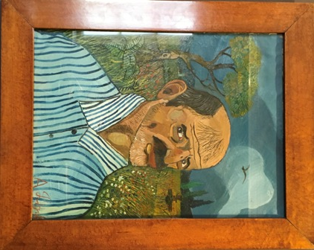
The Angriness inspired by “The Tiger” of Antonio Ligabue
Pupils discover the paintings of Antonio Ligabue, an Italian naif painter that painted animals to express his emotions.
Antonio Ligabue was a poor man and he worked in the country farms with animals. He died crazy in an hospital ....just like Vincent Van Gogh.

Slide 3
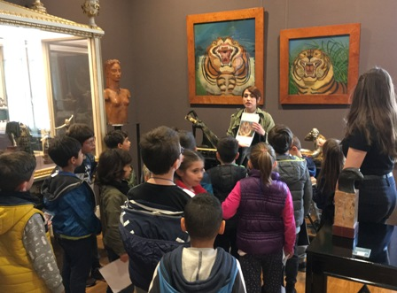
The Angriness inspired by “The Tiger” of Antonio Ligabue
Two very important and famous operas of Ligabue are “Tigers” .
Antonio painted them to express to the world his angriness and his desperation , because he was an exceptional artist, but people look at him as a foolish man, not as a nailf painter.

Slide 4
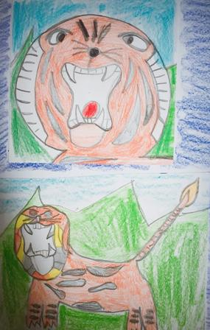
The Angriness inspired by “The Tiger” of Antonio Ligabuehe
Pupils of class 1^A started to discuss about the Emotions that “Tiger” of Ligabue transmitted them.
Children recognized the Emotions of Angriness and Fear.
Teacher Claudia Cocozzello ask to the pupils to draw and paint the images that “Tiger” of Ligabue inspire them.

Slide 5
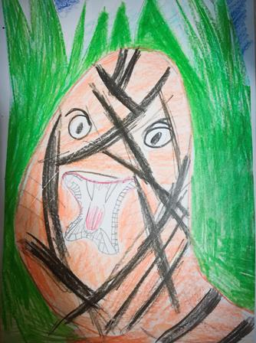
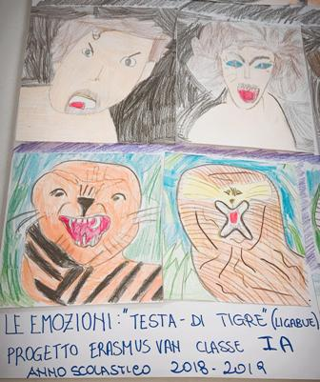
Emotions: “Head of a Tiger”

Slide 6
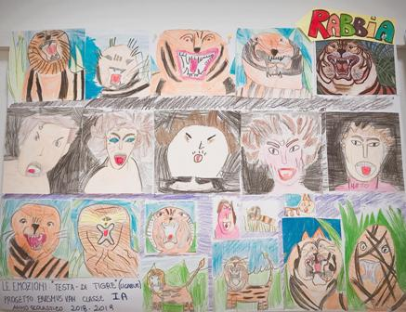
The Angriness “Head of a Tiger” “Angry Faces”

