Slide 1
SLOVAKIA
Michal Mišutka

Slide 2
Famous areas of slovakia visited

Slide 3
Hiking
Kriváň
→Hinking in High Tatras is attractive among foreign tourists
→Another mountais people like to visit are e.g. Rysy , Kriváň , Kráľova Hoľa , Kľak etc.

Slide 4
National parks
Tatranský National Park (TANAP/
National Park Low Tatras (NAPANT/
National Park Slovak Paradise
National Park Pieniny (PIENAP/
Nat. Park Small Fantra
Nat. Park Great Fatra

Slide 5
castles
Almost every major city has Its own castle
There are also guided tours around the castles
The best time to visit them is early in the morning, in order to avoid the crowd.

Slide 6
caves
Most famous caves are :
Demänovská ice cave
Domica
Harmanecká ice cave
Gombasecká cave
Ochtinská aragonite cave

Slide 7
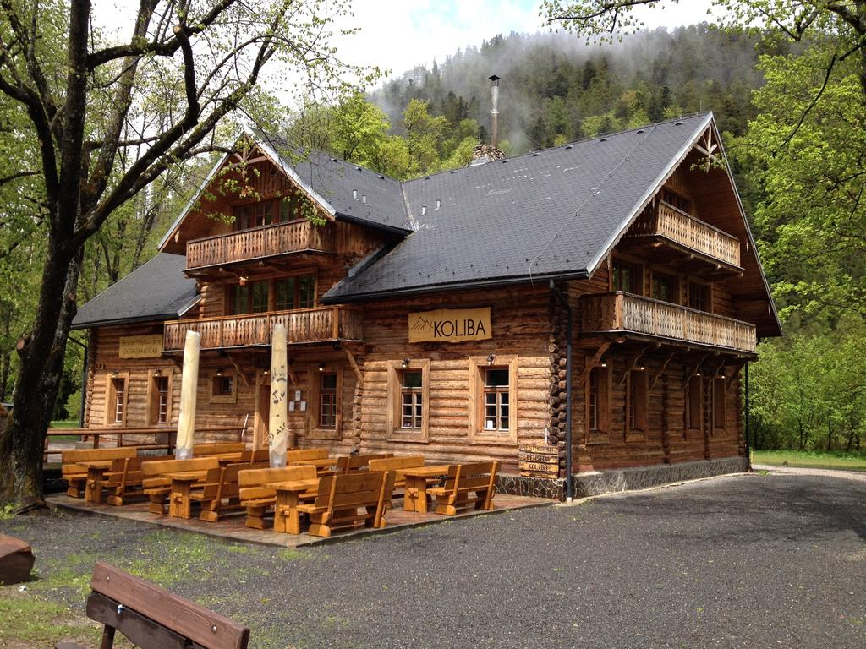
Local cousine
Traditional slovak dishes are often made from milk/cheese,sheep cheese, potatoes, pork
Slovaks are also famous by drinking alcohol (borovička,slivovica,etc./
Restaurant where they cook traditional slovak dishes is called Koliba (many of them are really convenient for the price/
This is how koliba looks like

Slide 8
Skiing
Slovakia is one of the countries which has a lot of snow during winter
There are lots of skiing centres such as :
Jasná low tatras
Park Snow Donovaly
Winter Park Martinky

Slide 9
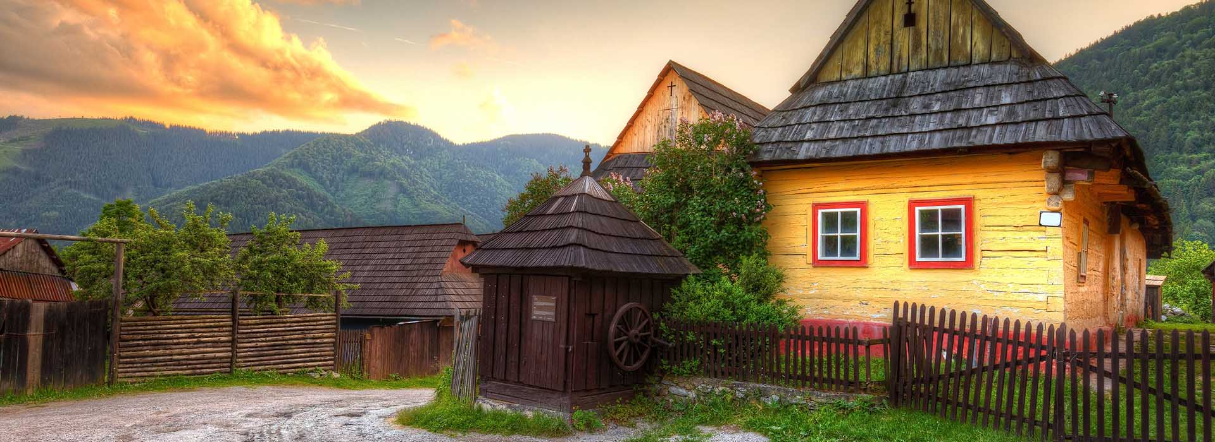
Folk architecture
Two most famous villages with folk type architecture are
Vlkolínec and čicmany
Both of them are also signed in UNESCO
vlkolínec

Slide 10
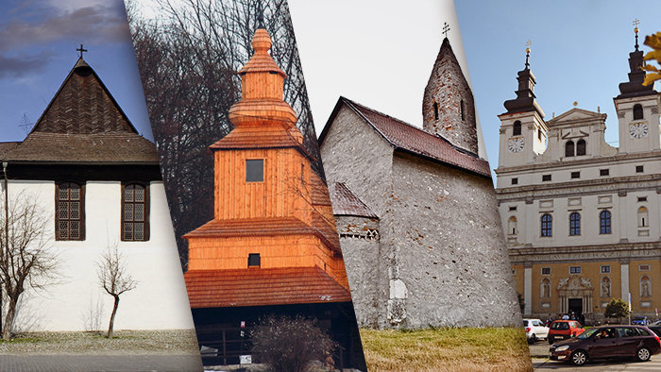
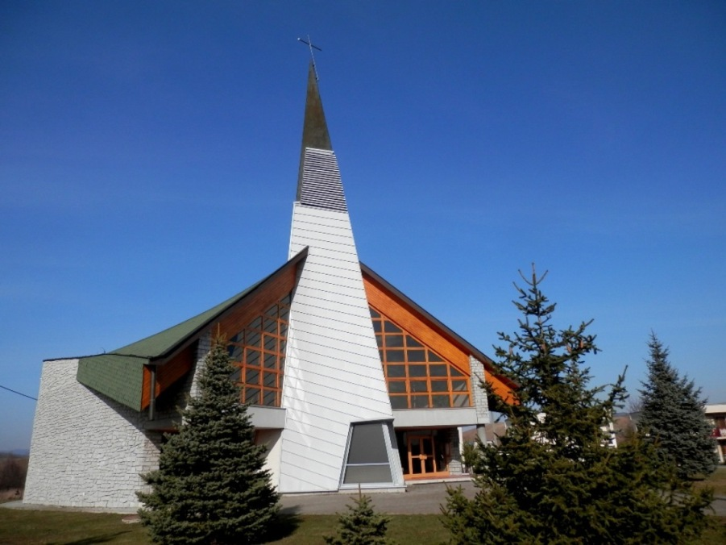
churches
Approximately 71% of Slovak people admit religion
Lots of churches (wooden, gothic , or even newly build)
Some of them are also signed in UNESCO

Slide 11
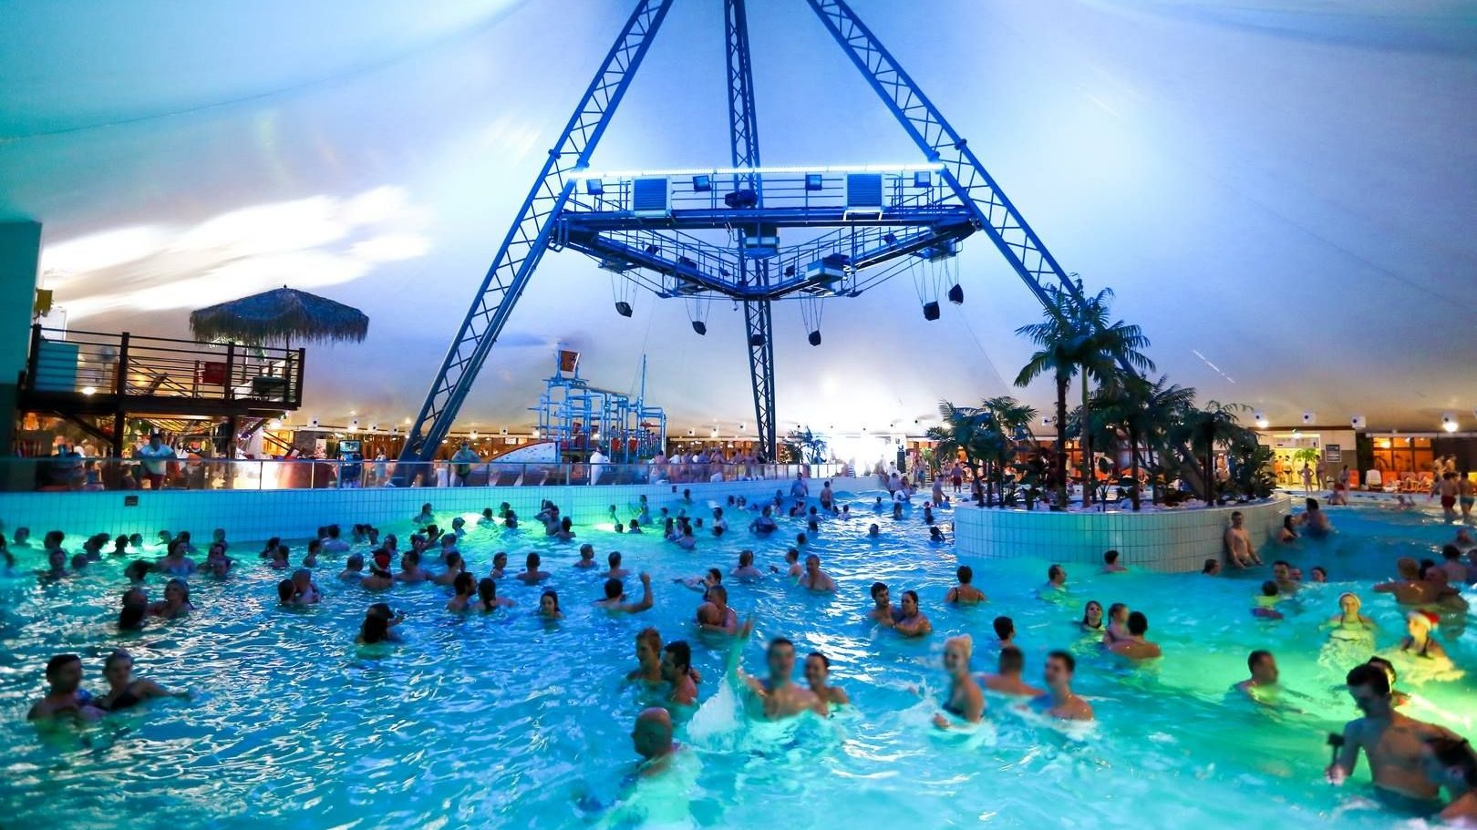
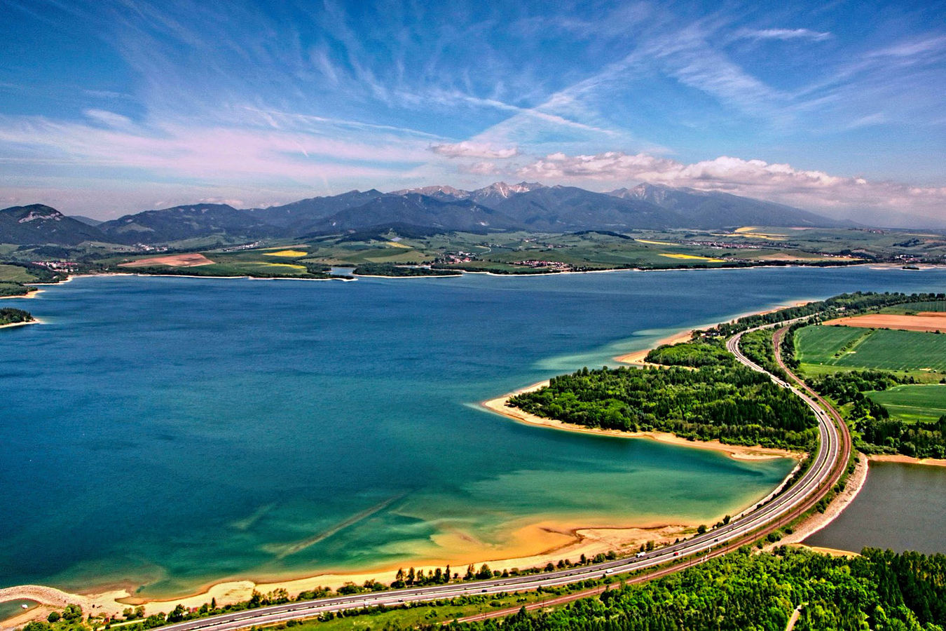
Water
Slovakia also has quite a number of spa resorts
But if you dont want to spend money on resorts , you cant visit Slovak lakes : Liptovská Mara, šútov, devín

Slide 12
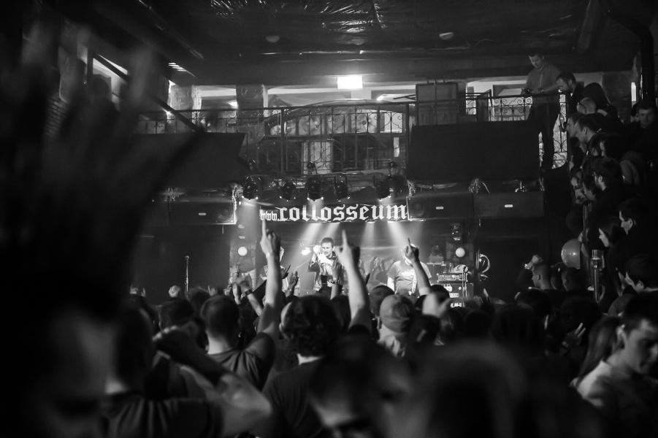
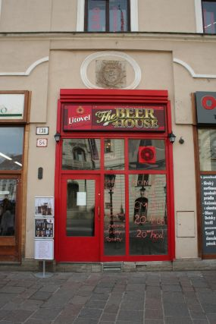
Košice – Sin City of SVK
City you enjoy
Charming atmosphere (night/
Friends on every corner
Exclusive clubs (beerhouse,Coloseum/

Slide 13
resources http://slovakia.travel/co-vidiet-a-robit/priroda-a-krajina/narodne-parky http://slovakia.travel/co-vidiet-a-robit/kultura-a-pamiatky/hrady-a-zamky

Slide 14
Thanks for attention

