Slide 1
Understanding the national symbols of Albania
Flag of Albania
The flag of Albania is a red flag with a silhouetted black double-headed eagle in the center. The red stands for bravery, strength and valor, while the double-headed eagle represents the sovereign state of Albania. The flag was first adopted as the national flag of modern Albania in 1912.

Slide 2
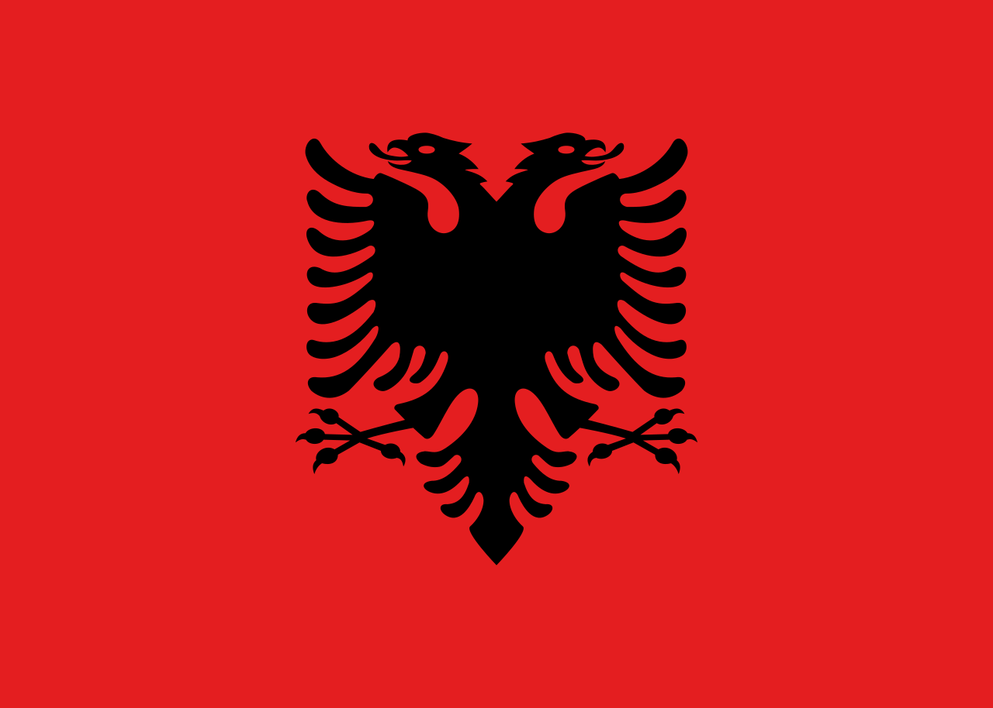
FLAG OF ALBANIA

Slide 3
The Albanian national anthem
"Himni i Flamurit" was the anthem of the all Albanian states since 1912, composer Romanian Ciprian Porumbescu. Original title "Pe-al nostru steag e scris Unire". Lyrics translated in Albanian by Romanian of Albanian origin poet Victor Eftimiu
The words were written by the Albanian poet Asdreni (Aleksandër Stavre Drenova), and are close to the original Romanian lyrics which Andrei Bârseanu wrote for Porumbescu's piece.

Slide 4
Geographical location
The Geography of Albania is defined by its location. Albania is a small predominantly mountainous country in Southeastern Europe, on facing the Adriatic and Ionian seas within the Mediterranean Sea.
Area: 28,748 km²
Currency: Lek (ALL)
Official languages: Albanian
Calling code: 355
Continent: Europe
Neighboring countries: Kosovo, Greece, Macedonia (FYROM), Montenegro

Slide 5
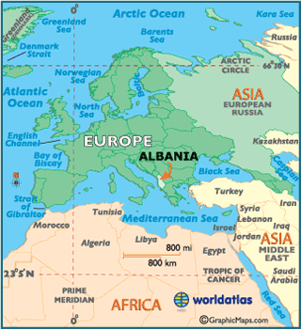
Geographical location

Slide 6
Albania population 2017
During 2017 Albania population is projected to decreased by -1,041 people and reach 2,890,054 in the beginning of 2018. The natural increase is expected to be positive, as the number of births will exceed the number of deaths by 17,260. If external migration will remain on the previous year level, the population will be declined by 18,301 due to the migration reasons. It means that the number of people who leave Albania to settle permanently in another country (emigrants) will prevail over the number of people who move into the country (to which they are not native) in order to settle there as permanent residents (immigrants).

Slide 7
Myths and legends
Albanian mythology comprises myths and legends of the Albanians. Many of the characters in Albanian mythology are included in the Albanian Songs of the Frontier Warriors (Albanian: Këngë Kreshnikësh or Cikli i Kreshnikëve), the traditional cycle of Albanian epic songs.
Albanian myths can be divided into two major groups: legends of metamorphosis and historical legends.

Slide 8
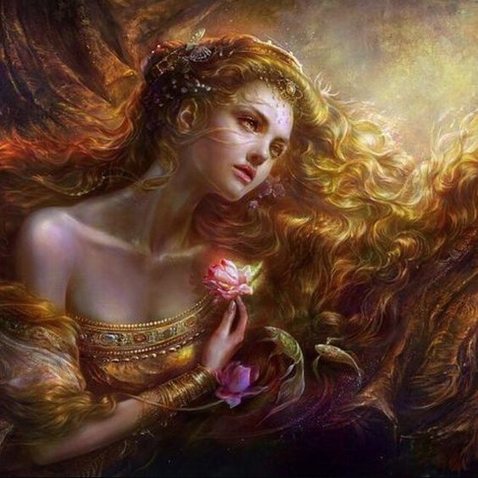
Prende – is the goddess of love and beauty in the Albanian mythology.

Slide 9
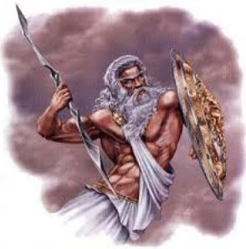
Perëndi is an old Illyrian (Albanian) word for God and the sky.

Slide 10
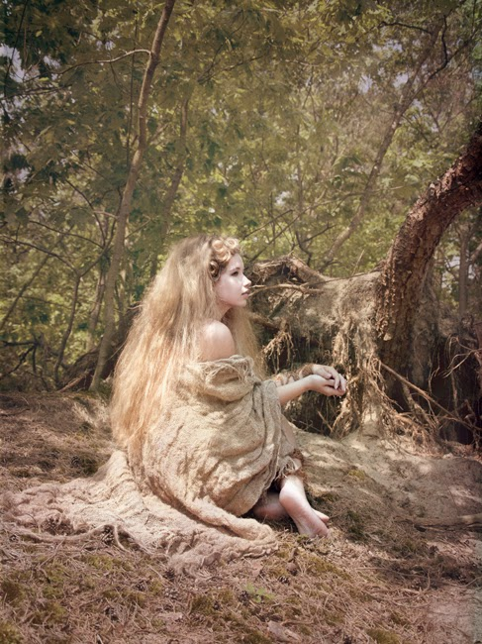
Rodon (God of the oceans)

Slide 11
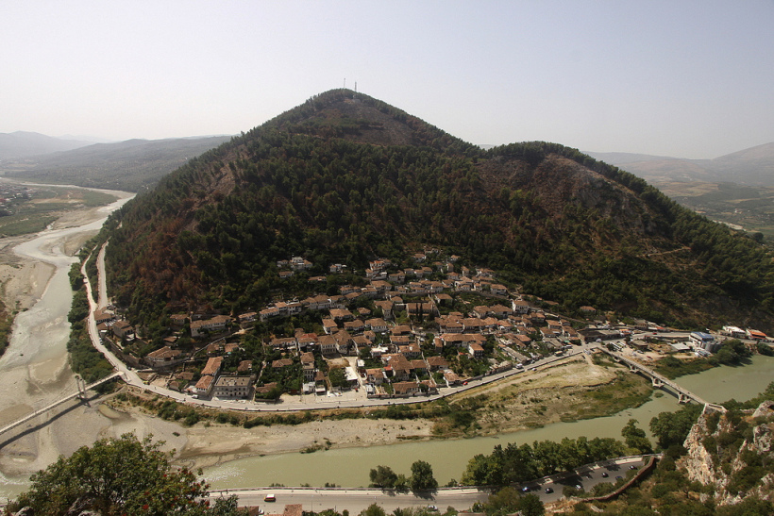
Mount Tomor in Berat is seen as an old man with a long white beard

Slide 12
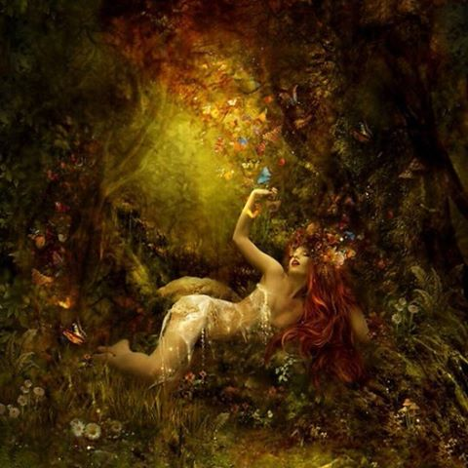
The Zana e malit is an Albanian mythological creature

Slide 13
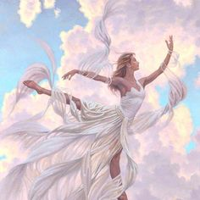
E Bukura e Qiellit (English: The beautiful one in heaven)

Slide 14
THE END

