Slide 1
“ 28 NENTORI” SCHOOL
Kucove, Berat
School from Albania

Slide 2
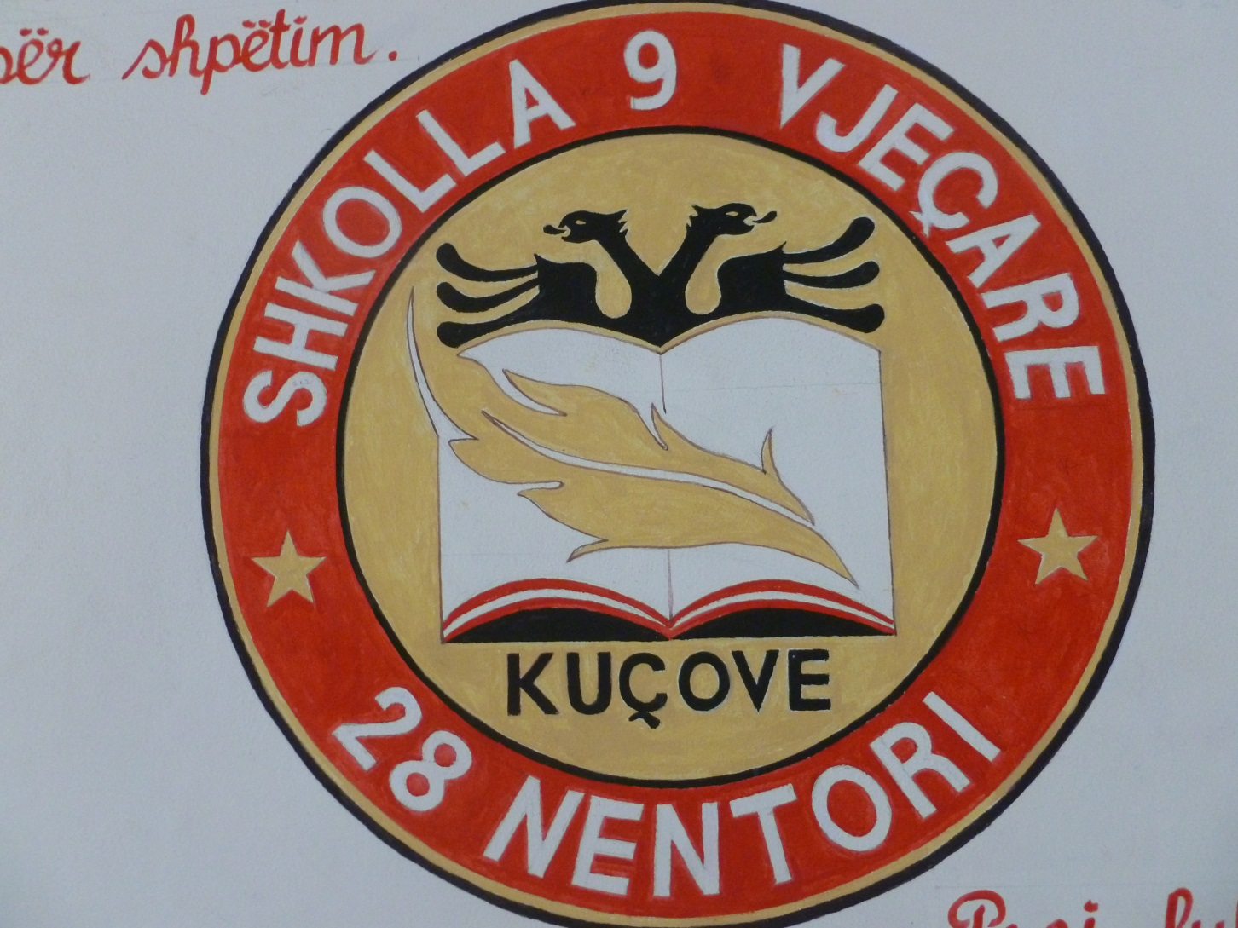
Logo of my school

Slide 3
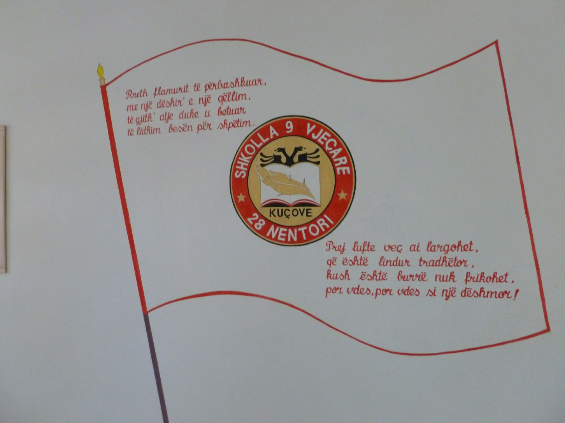
Symbols: Our Flag and Our National Anthem

Slide 4
About my school
MY SCHOOL is located in the centre of the city of Kucove, Berat and has about 600 pupils. We teach students from 5 to 15 years of age. It is a great school with three floors and 30 teachers.
Classes and teachers in elementary education are 11. This school year i teach pupils aged 10 - 11. I have 29 pupils in my class.
We are a Community Centre School.
There are three school leaders, one director and two deputy directors. One of the deputy directors is for Primary Education.
Everyone works a lot.

Slide 5
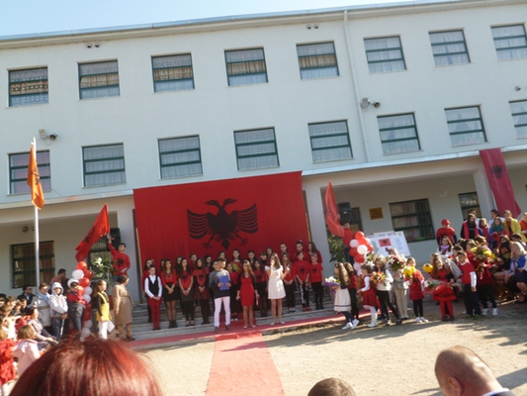
The name of the school is in honor of the Independence Day

Slide 6
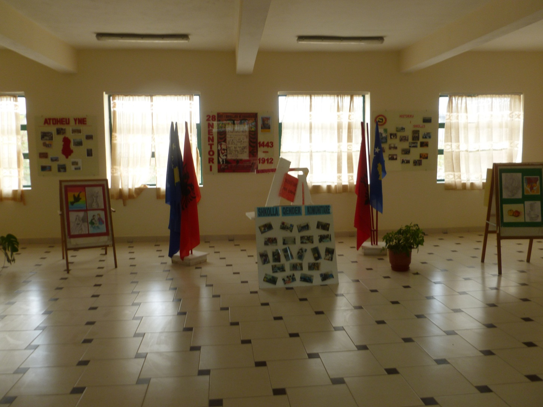
Environments from my school

Slide 7
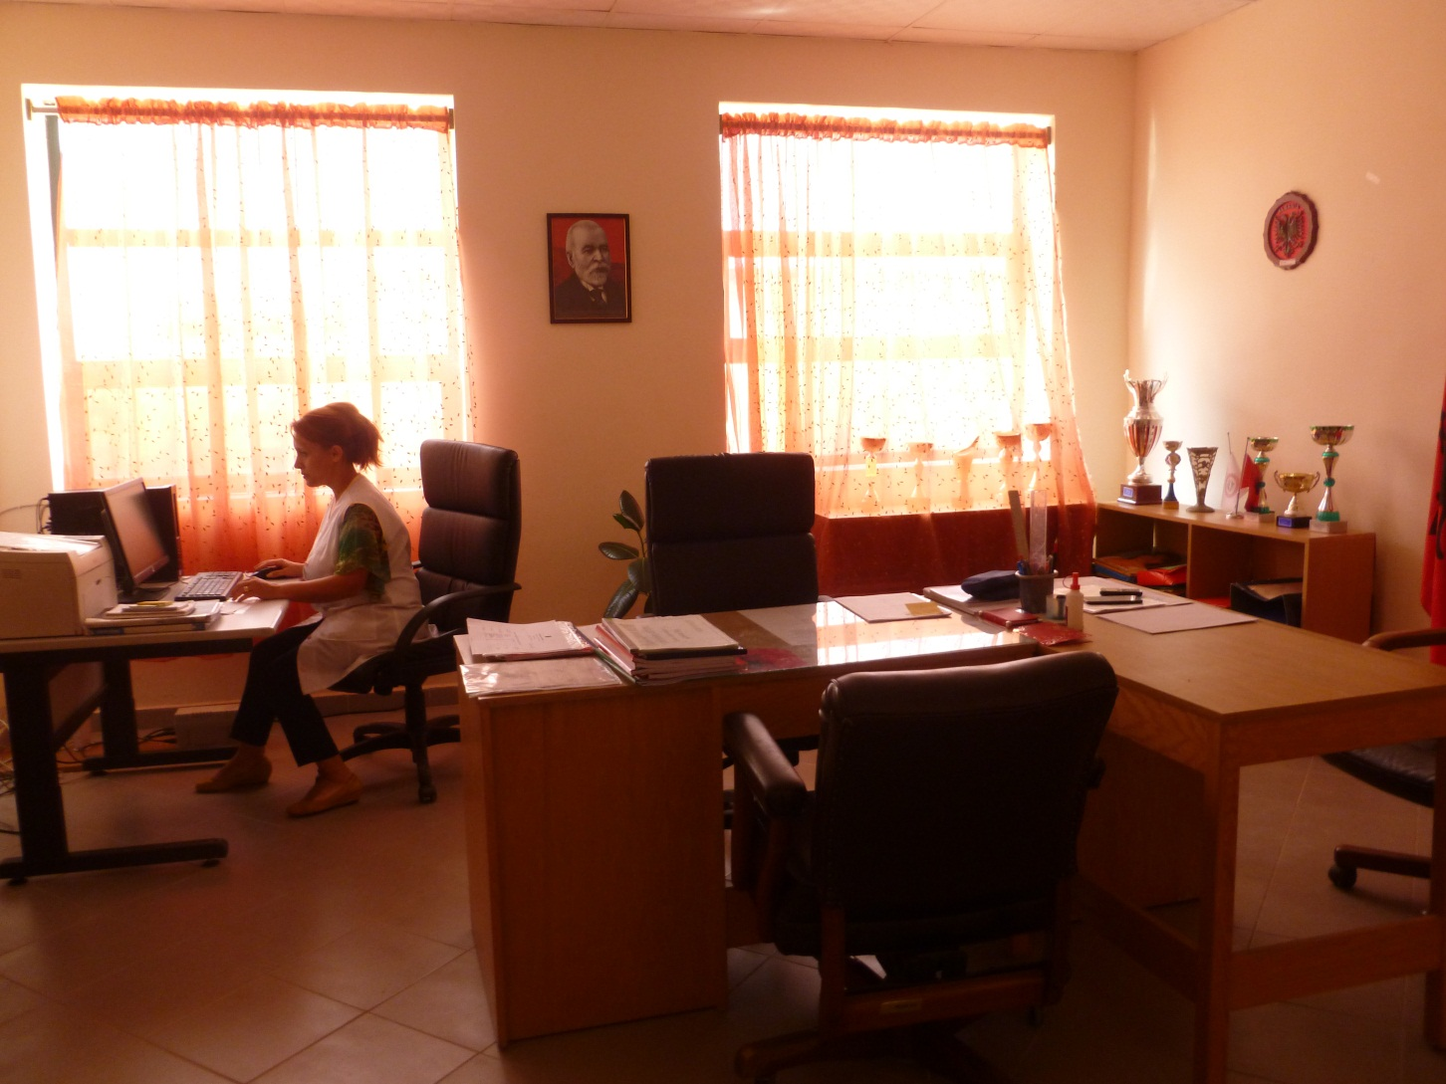
The director's office and our principal

Slide 8
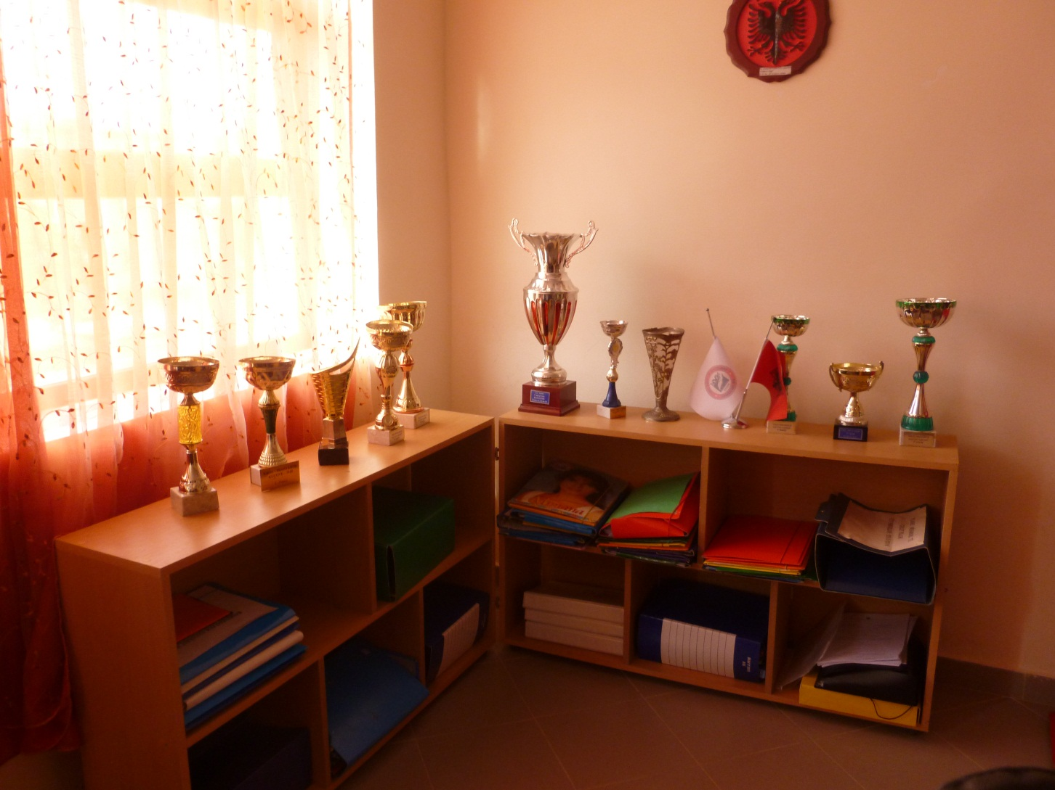
Cups won in artistic and sports activities, competitions…

Slide 9
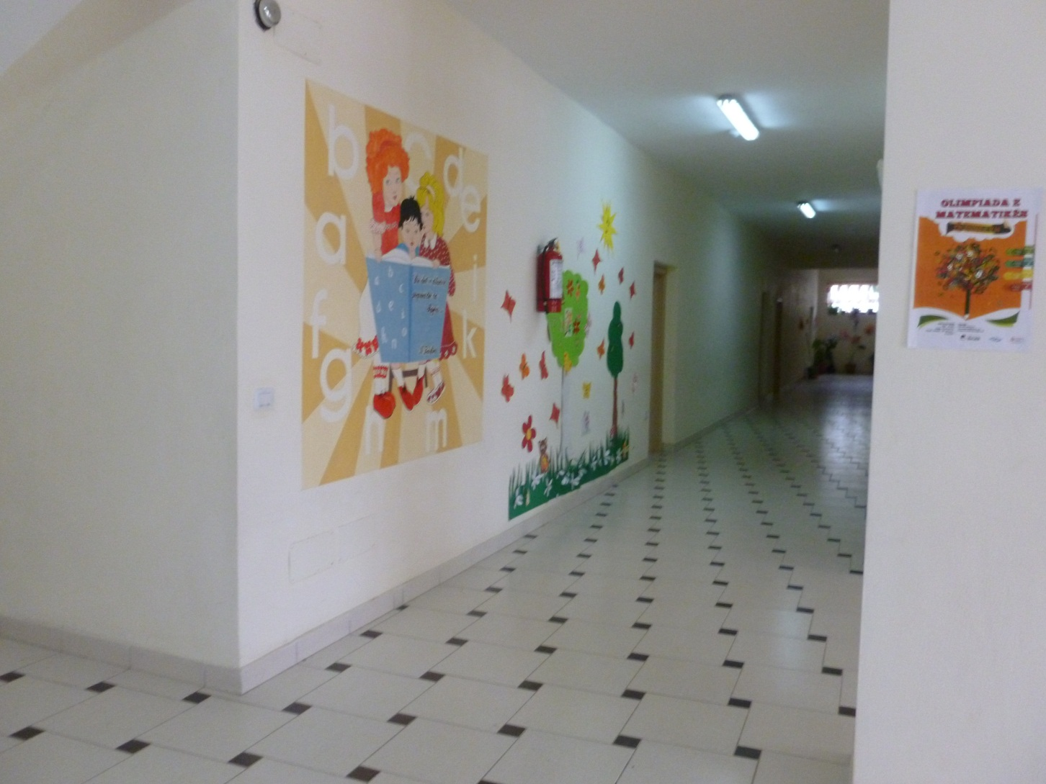
Works of children on the walls of the school

Slide 10
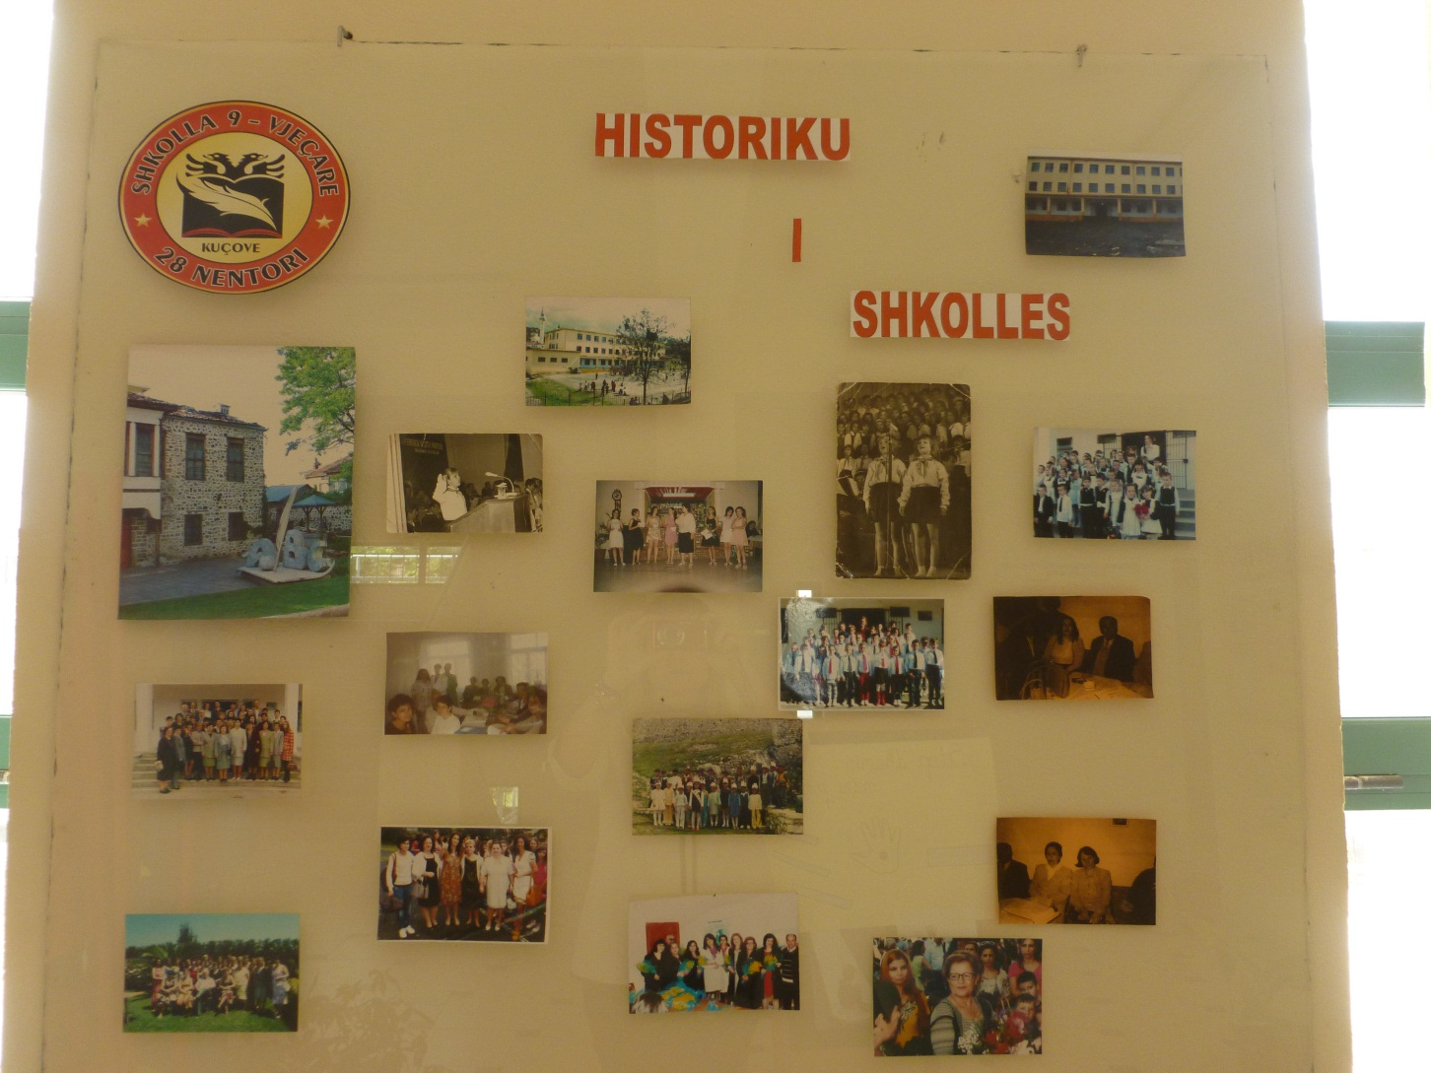
The history of our school

Slide 11
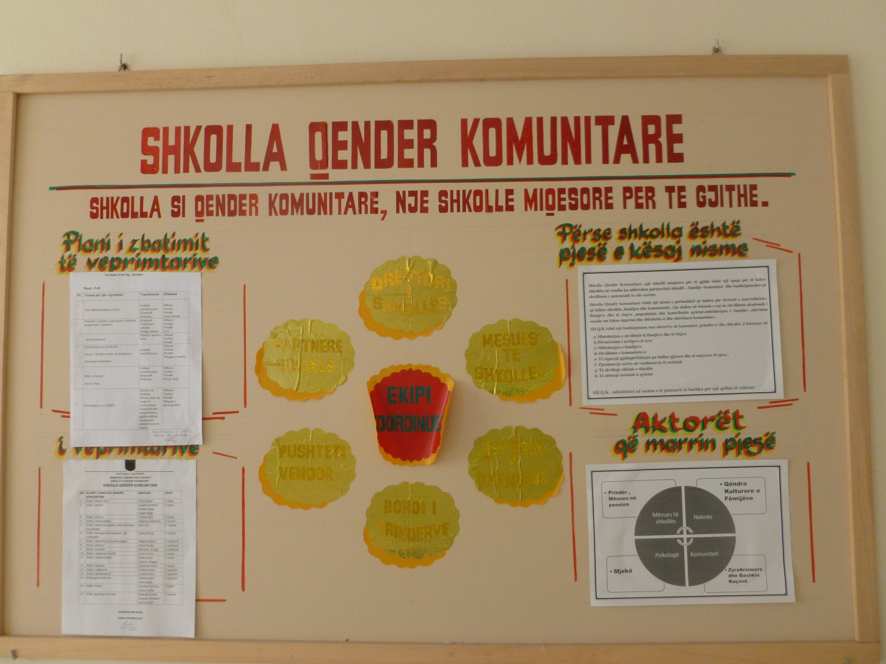
Our Community School Center

Slide 12
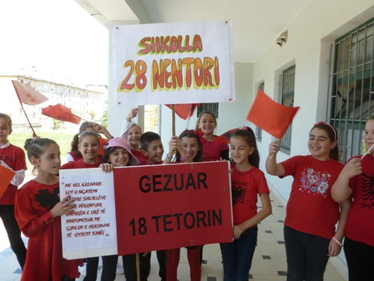
On the Day of Liberation of our City

Slide 13
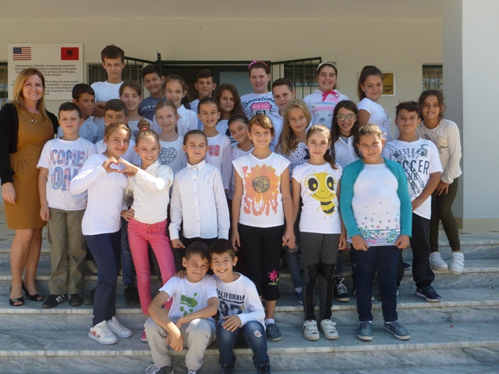
Our project team

Slide 14

THE END

