Slide 1
Orange

Slide 2
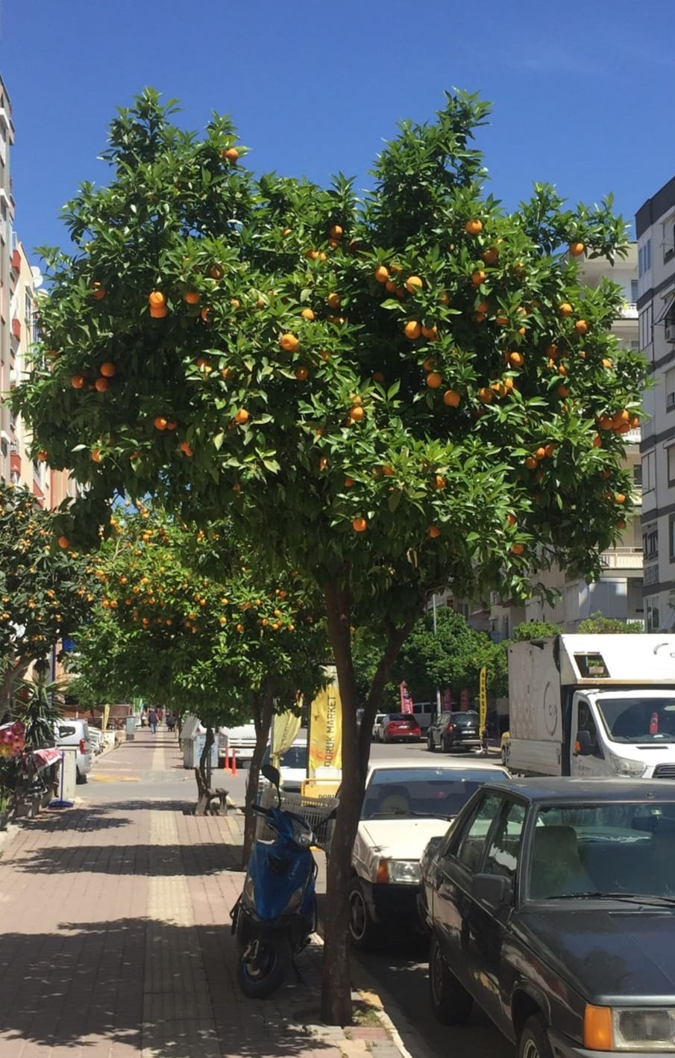
The orange first came to Antalya around the 1930s, when the first many orange groves were planted on the outskirts of the city. The citrus Institute, which opened in 1936, was promoting cultivation of the orange, so it was widespread and used throughout Turkey. The bitter oranges (which is still used for marmalade, perfume, scented water and pickled oranges as Antalya is famous for) have grown in the region from around.

Slide 3
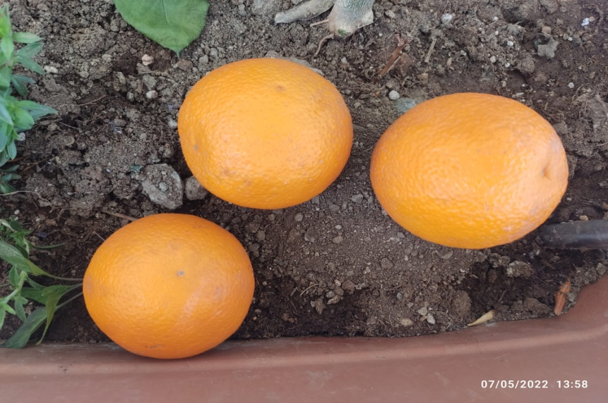
What is the first thing comes to your mind when you think of orange? This juicy fruit is definitely one of the best breakfast drinks ever. Healthy too! While most of us consider orange as an a healthy fruit with lot’s of vitamin C.

Slide 4
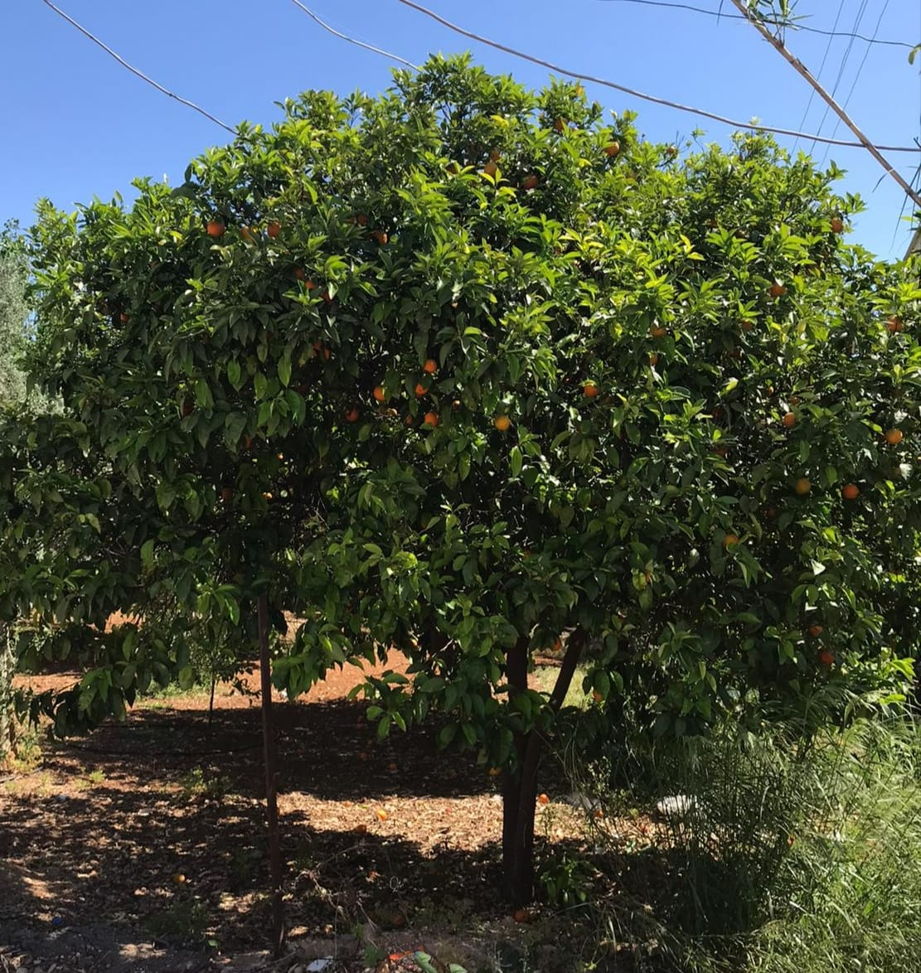
It is also widely used in perfumery, food and medicine sectors. The city of Antalya alone delivers approximately 25 % share of the total orange production of Turkey. Moreover, Antalya is home for one of the world class type of oranges: the Finike Sweet Orange!

Slide 5
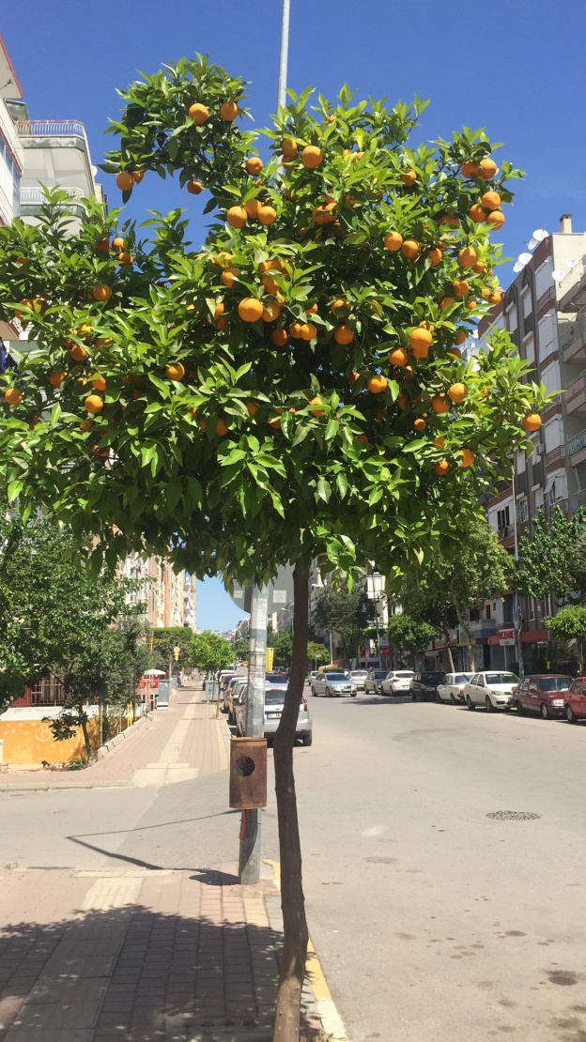
This sweet fruit is not only the symbol of Antalya, but also is the symbol of the second most significant film festivals in Turkey: Antalya Golden Orange Film Festival which was inaugurated in 1964. 57th edition of Antalya Golden Orange Film Festival will be held in between 03 – 10 October.

