Slide 1
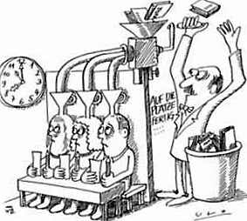
Cooperative learning
-
…because unfortunately this does not work:

Slide 2
Cooperative learning
-
What does it mean?
A definition:
Cooperative learning is a teaching strategy meant to help children to aquire skilled, personal, social as well as methodical competences.

Slide 3
Cooperative learning
-
Why?
„Dividing students into smaller groups does not mean they will be working together as a team.“
(Norm Green)

Slide 4
Cooperative learning
-
Why?
Quality aspects of cooperative learning:
    positive dependency on each other
    individual responsibility
    face to face – interaction
    social and team competences
    group strategies

Slide 5
5% teacher lecture
75% learning by doing
90% teaching others/ applying what you have learned
10% reading
20% audio-visual
30% demonstration
50% discussions in small groups
active/ cooperative learning

Slide 6
In order to introduce cooperative learning there has to be a shift in attitudes towards teaching:
• the teacher‘s role
• the student‘s role
• the school‘s role
from pure knowledge provider to learning companion
from simply storing information/ knowledge to active actor
from teaching institution to learning institution

Slide 7
The choice of the following methods allows the teacher...
  to modify his/ her teaching
  to transfer responsibility for learning to the students
  to encourage independent student work
  to promote the students‘ social and communicative skills

Slide 8
METHODS OF COOPERATIVE LEARNING
Knowledge of the methods/ end of class | 1 | 2 | 3 | 4
3-Finger-Evaluation | +
Pair-Check | +
Mind-Map |  | +
Meeting-Point & Check-Point |  | +
Date Calendar |  | +
Double-circle |  |  | +
Placemat |  |  | +
Think-Pair-Share |  |  | +
Learning diary |  |  |  | +
Jigsaw (group- puzzle) |  |  |  | +
Line-up
Graffiti
The methods in italics are additional methods which can be used if needed and interested.

Slide 9
3 – Finger – Evaluation
students show with three fingers, if and to which extend they have reached the requested teaching goal.

Slide 10


Pair – Check
two students work on a shared worksheet at the same time
they then explain to each other how they have solved the worksheet

Slide 11
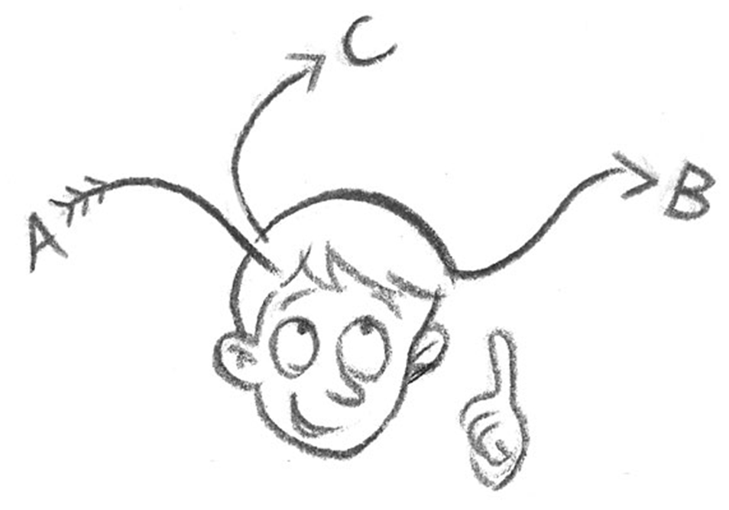
Mindmap (brain-storming)
graphics are used to arrange information/ data about certain topics in an organized map

Slide 12
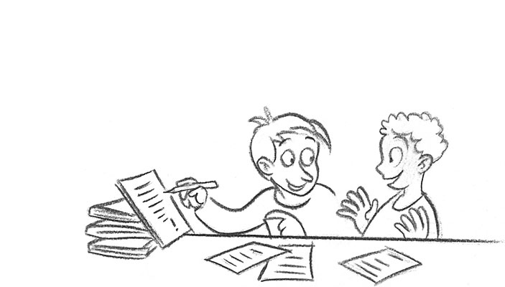
Meeting – Point/
Check – Point
A meeting- point in the classroom that the students can go to...
  to find a partner
  to compare and double- check finished tasks
  to exchange and find new ideas with a partner

Slide 13
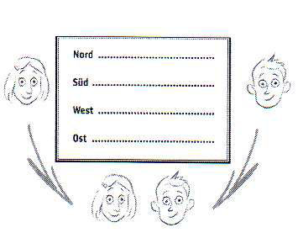
Date- calendar
goal: to find a learning partner

Slide 14
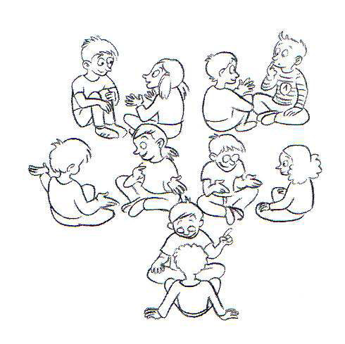
Double- circle
Quick exchange with several partners
  exchange of previous knowledge
  communication about newly acquired knowledge
  repetition of last lessons learning objectives/ results
  interim reflection

Slide 15
Placemat
Process of the placemat method:
in small groups each student writes into one area of the placemat
the results of the areas are being discussed in the small group
the group decides about their common results/ about what to present

Slide 16
Think – Pair - Share
Think
the focus is on individual knowledge first
Pair
exchange with a partner to compare/ to correct/ to complement/ to expand/ to give and to take information
Share
presentation of results in the small group
individual previous knowledge is being activated
personal thinking ability is the basis of learning
the word „presentation“ receives a new meaning…
presentation of results in the plenum

Slide 17
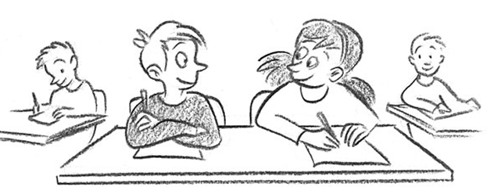
Learning diary
documentation of individual learning/ of exploring/ of revision/ of modifying

Slide 18
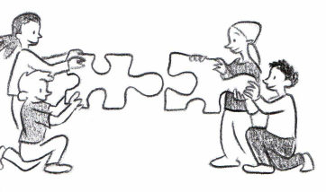
Jigsaw/ group- puzzle
The core group members split up a text, then go to work on this text in different small expert groups and finally present their results in their original core groups.

Slide 19
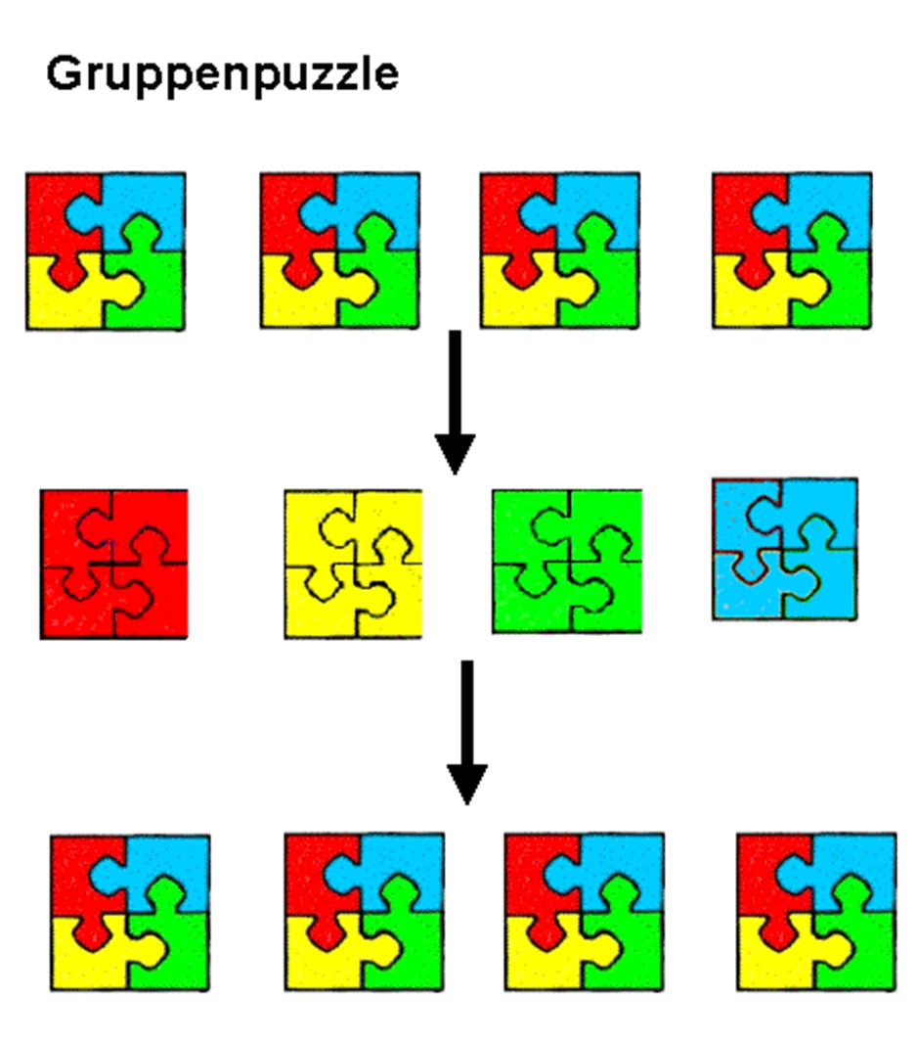
First Phase: Core groups: initial information is given/ a problem is being introduced
Second Phase: Expert groups: students work on their specific topic or questions in an expert group.
Third Phase: Core groups: students take information from the expert group back to their original group where all students exchange information and results

Slide 20
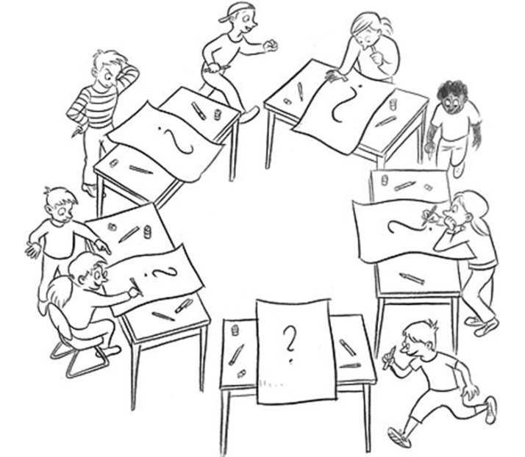
If needed and interested:
Line up (criteria- based lines)
Graffiti
(rotation of ideas)
to find partners or groups
to collect opinions
as an ice- breaker
collection of opinions/ previous knowledge/ wishes

Slide 21
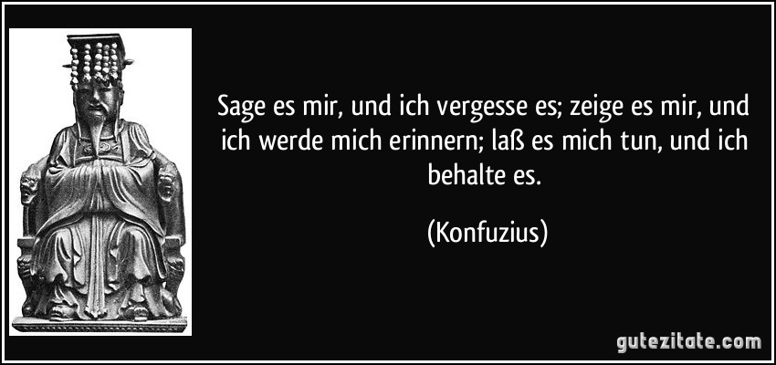

Slide 22
"The European Commission support for the production of this publication does not constitute an endorsement of the contents which reflects the views only of the authors, and the Commission cannot be held responsi­ble for any use which may be made of the information contained therein."

