Slide 1
"The Little Prince's Journey through Europe" - A theatrical guide for Primary Education
WORKSHOP: eTwinning,
Cornelia Melcu, eTwinning ambassador, Șc. Gimn. Nr. 9 „Nicolae Orghidan” Brașov, Romania

Slide 2
eTwinning- How to use TwinSpace?
eTwinning TwinSpace
eTwinning LIVE
Journal
Materials
Pages
Invitation of the students to join the project

Slide 3
eTwinning LIVE
Click on it and you will find the list of your projects!

Slide 4
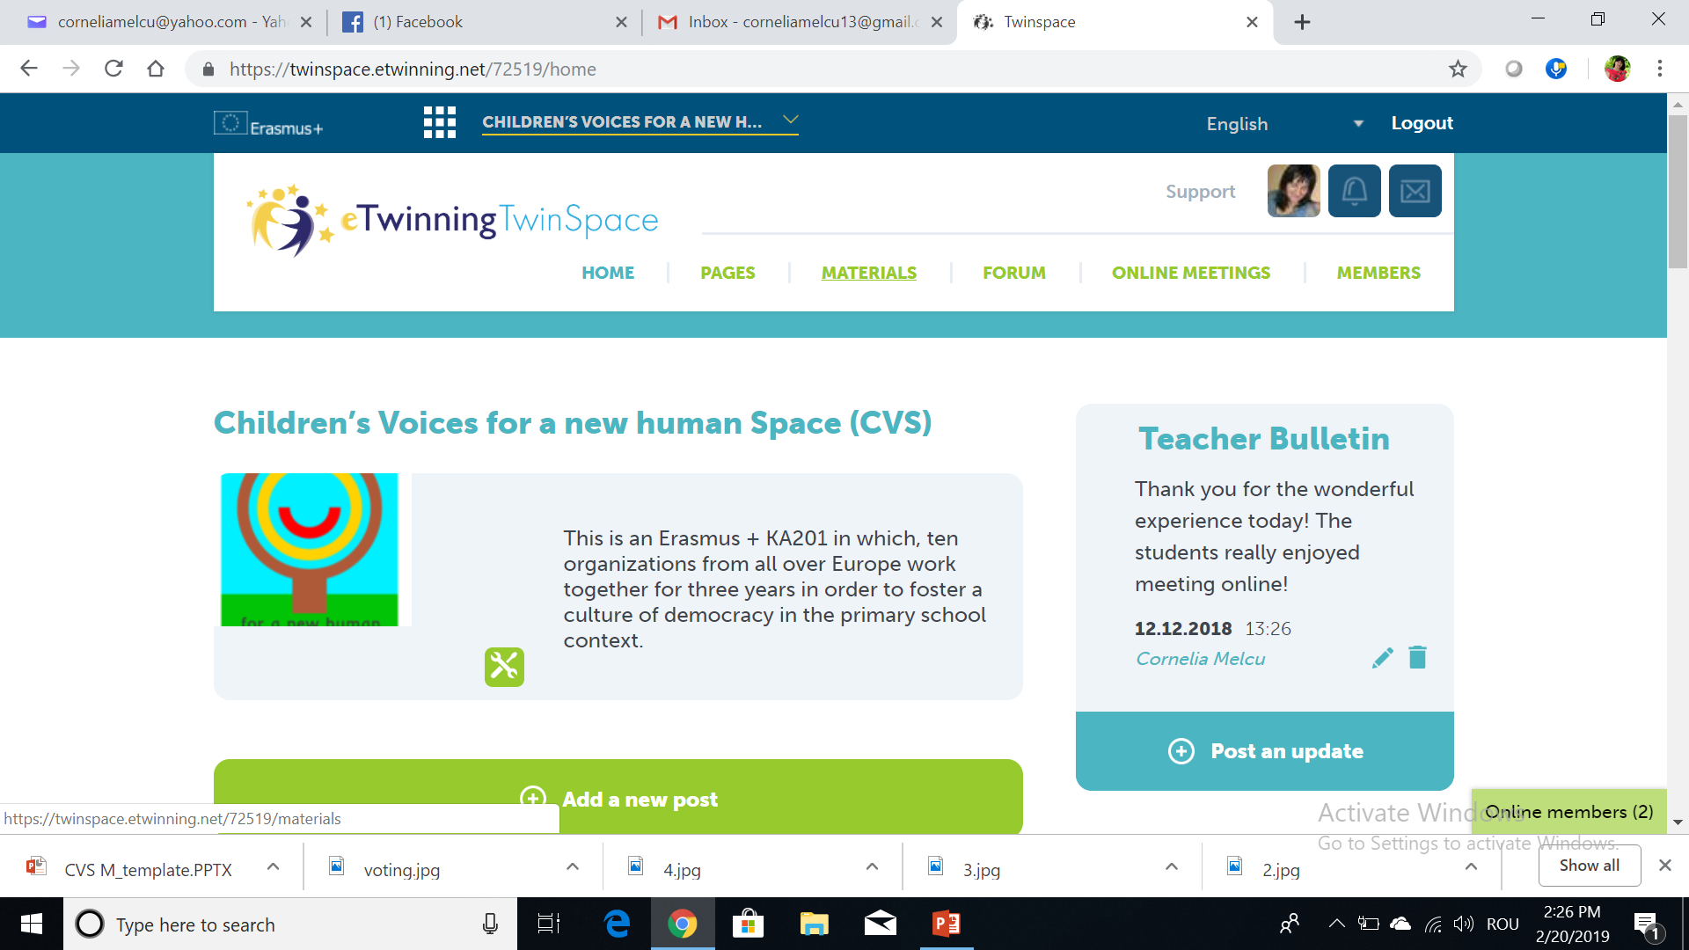
Projects

Slide 5
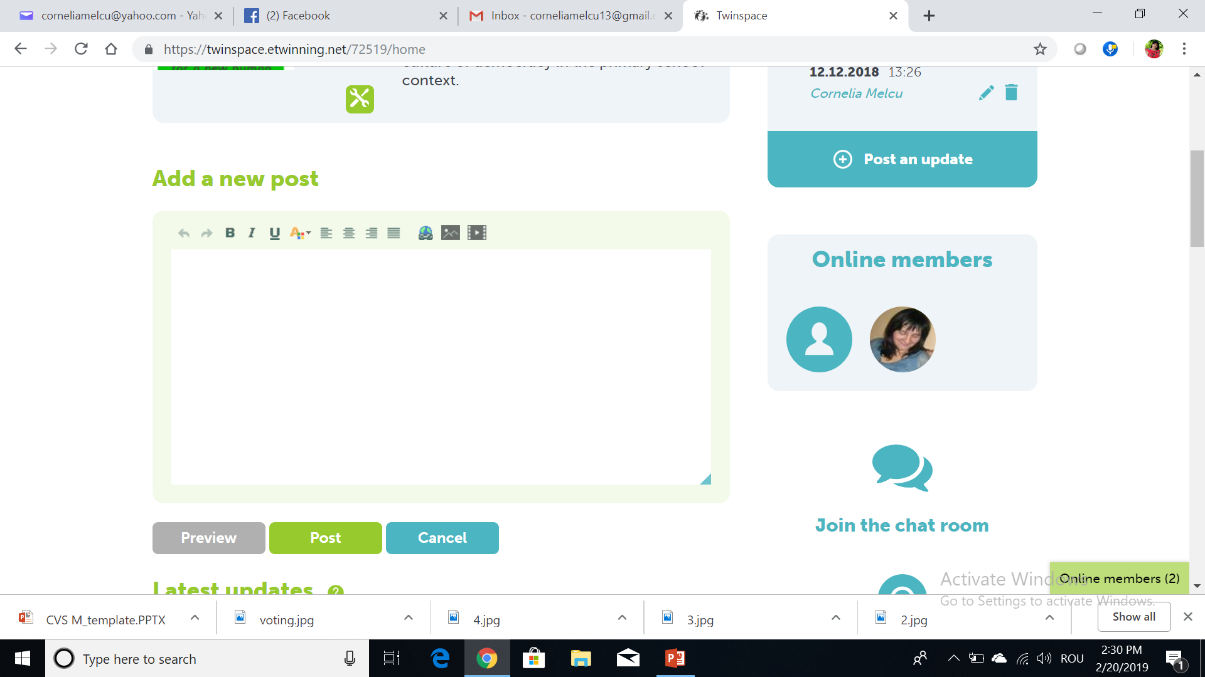
Journal

Slide 6
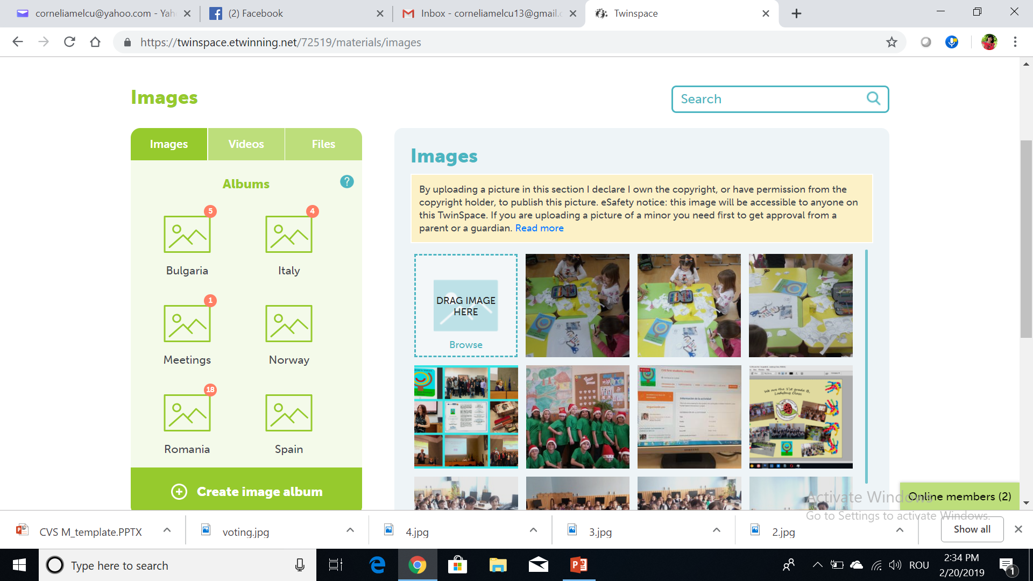
Materials
Any material you need should be added in folders
In videos you can add links from videos uploaded on DailyMotion; Vimeo; Youtube
In files you can add any file in word, ppt, pdf, etc.

Slide 7
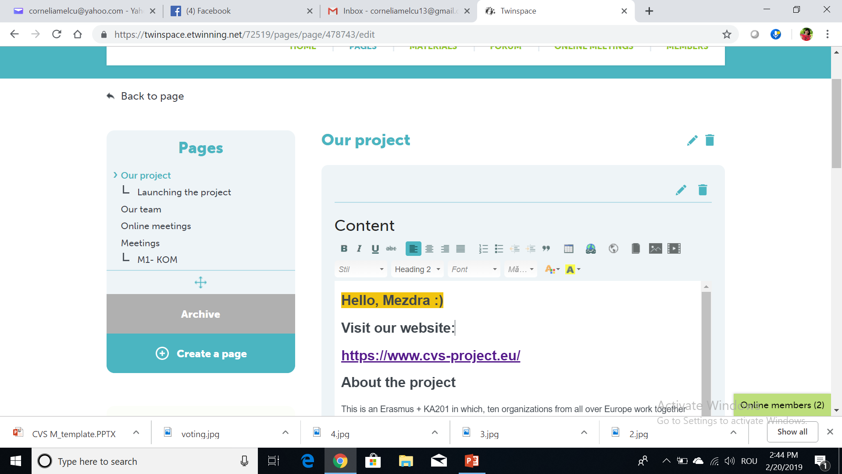
Pages
You can add any material on the page from MATERIALS
You have Preview option- use it before posting ☺
Tip: use photo collage (is a good option for posting more photos in the same time)

Slide 8
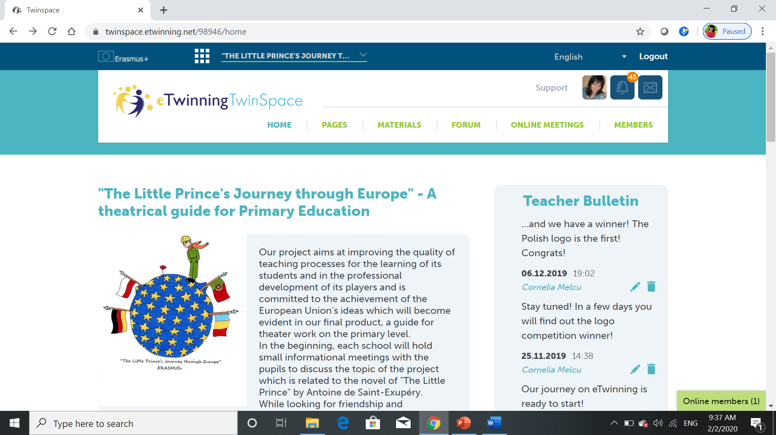
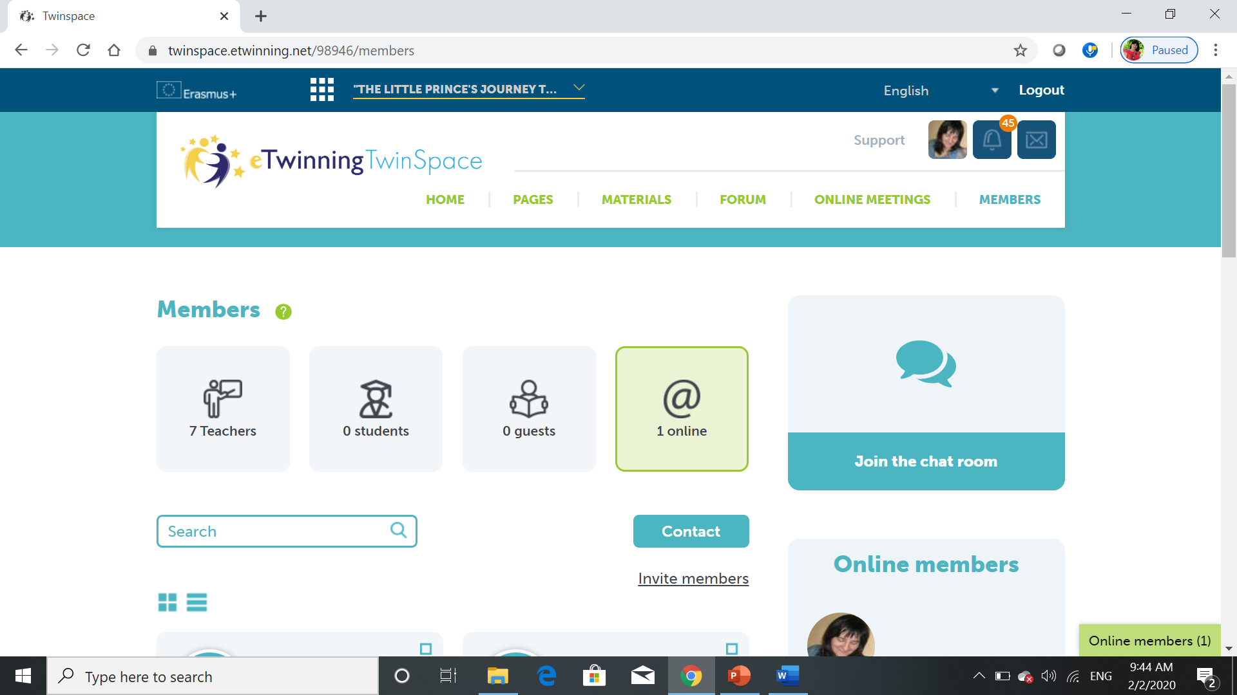
Invitation of the students to join the project, part 1
Go to TwinSpace and find Members, click on it and you will find this:
Click on Invite members

Slide 9
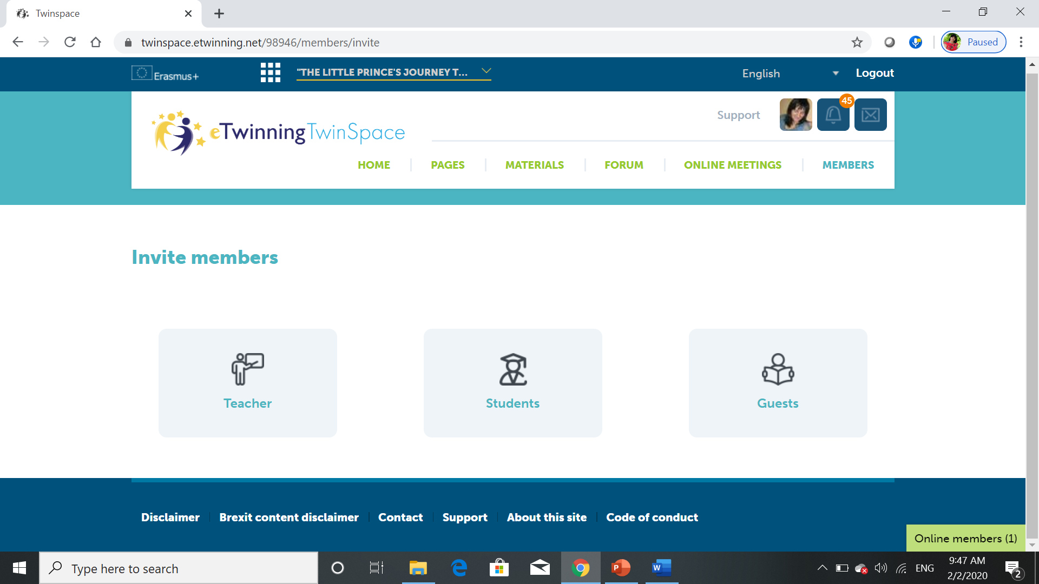
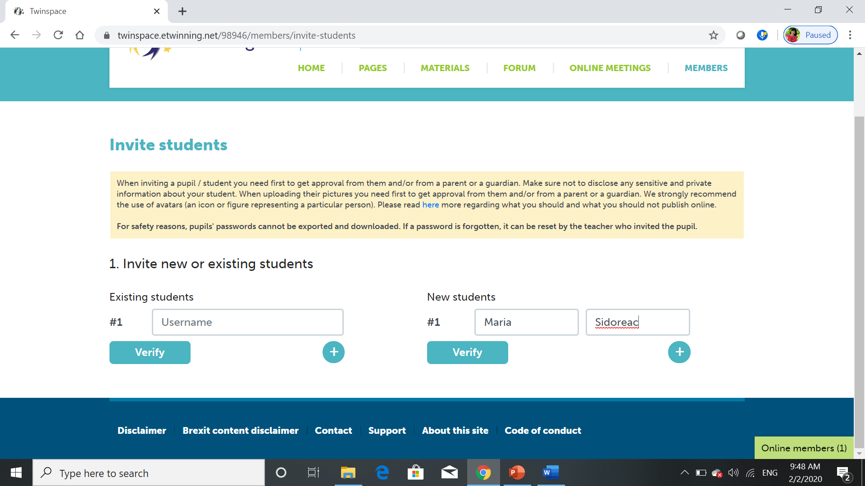
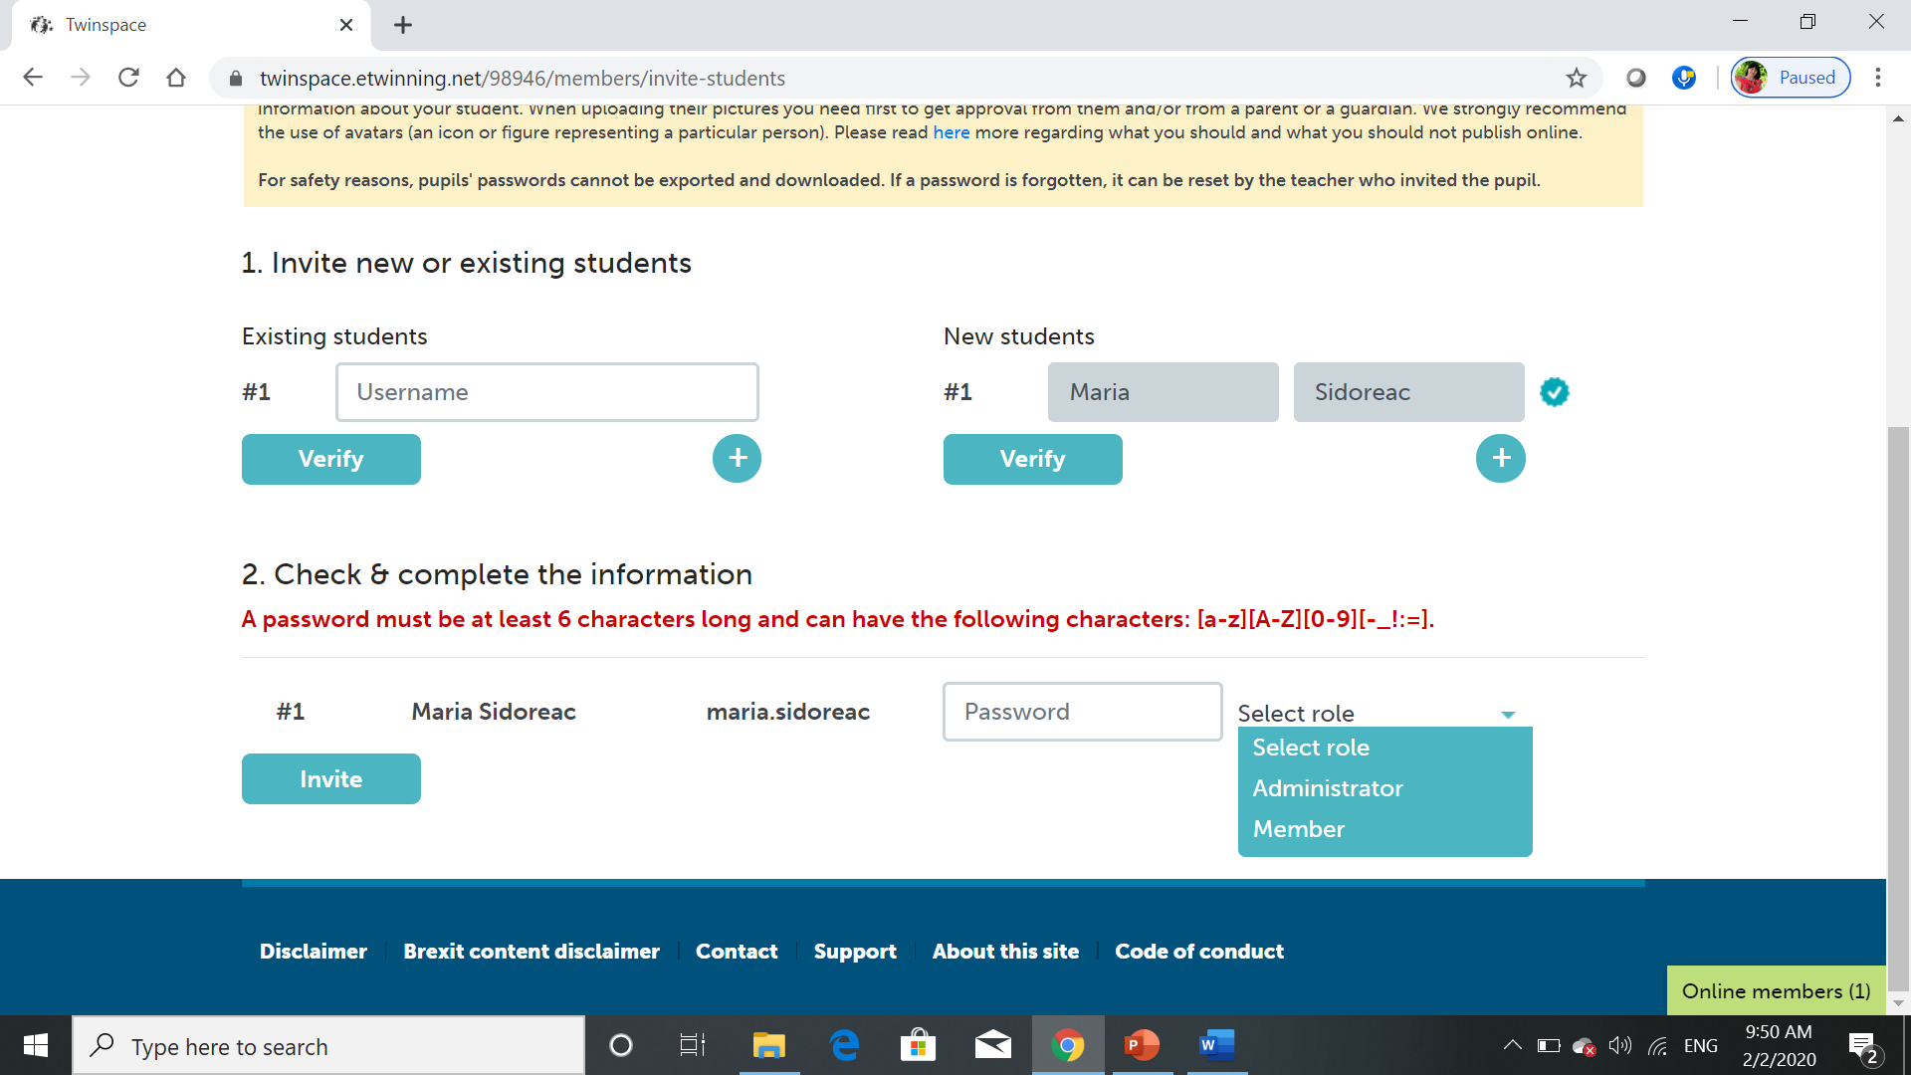
Part 2
Click on students, and a page will open where you have to fill in some info about the process
The teacher will set the password for the students and will write them down to remind it when necessary. The role of each student will be Member. Good luck!

Slide 10
Web tools for creating content/products
flyers, posters, logos
Canva- https://www.canva.com/
brochures/books/publications
ISSUU https://issuu.com/
Photo editor
piZap https://www.pizap.com/
Presentation
Adobe Spark https://spark.adobe.com/
Online converter
https://www.freepdfconvert.com/word-to-pdf
Resize images:
https://resizeimage.net/

Slide 11
More info here:
https://www.youtube.com/watch?v=IHWdv3IqP0E&feature=youtu.be
Contact: corneliaproiecte@gmail.com
"The European Commission support for the production of this publication does not constitute an endorsement of the contents which reflects the views only of the authors, and the Commission cannot be held responsi­ble for any use which may be made of the information contained therein."

