Slide 1
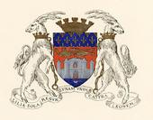
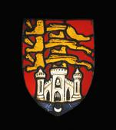
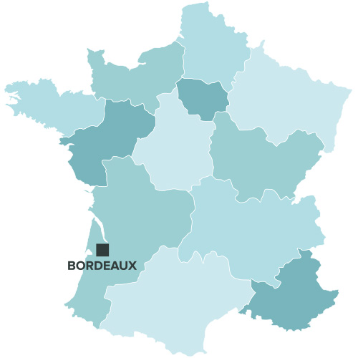
Bordeaux
The city's coat of arms now (after Bordeaux went back to France)
The city's coat of arms in the days of Richard the Lionheart (Richard I, king of England, when Bordeaux belonged to England in the Middle Ages)
Bordeaux logo

Slide 2
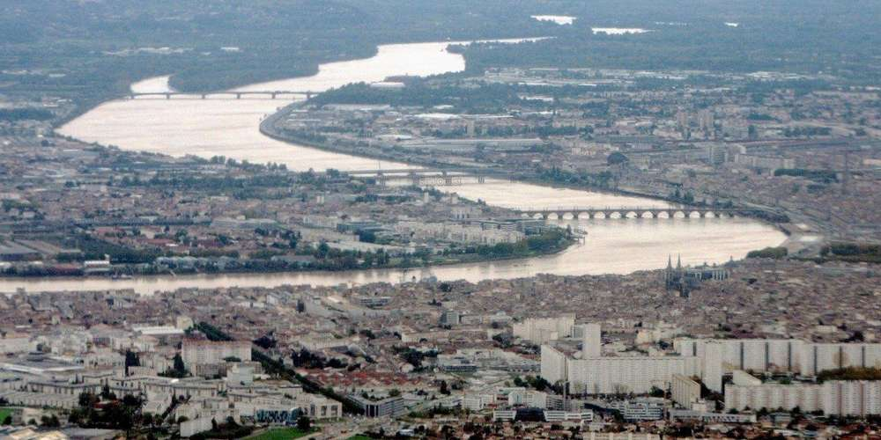
Bordeaux
Bordeaux was built around the river Garonne. Many monuments run along the river and there is a lot of entertainment around the river.

Slide 3
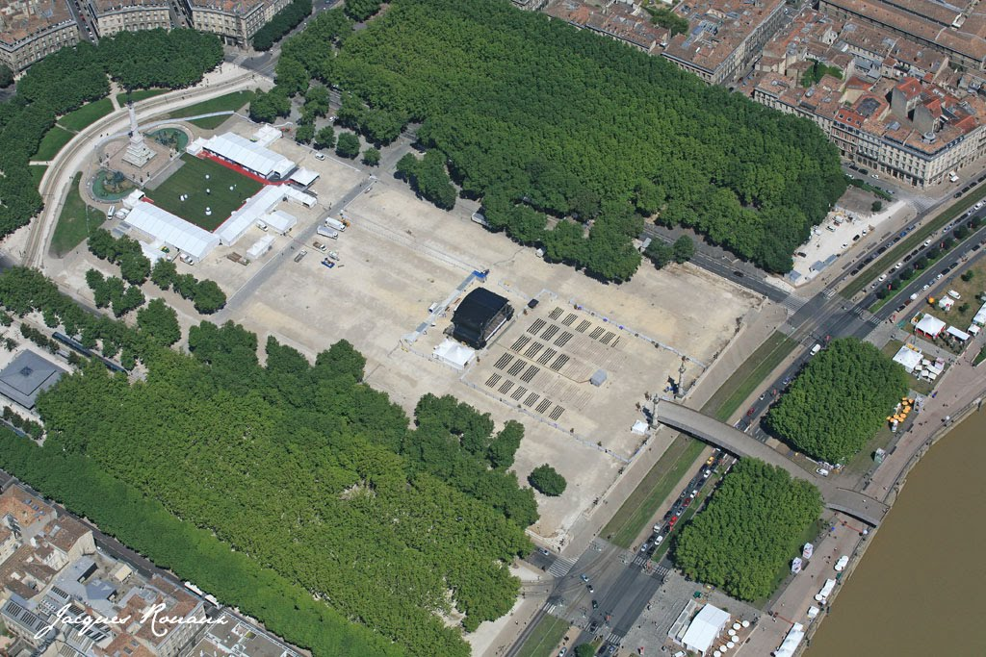
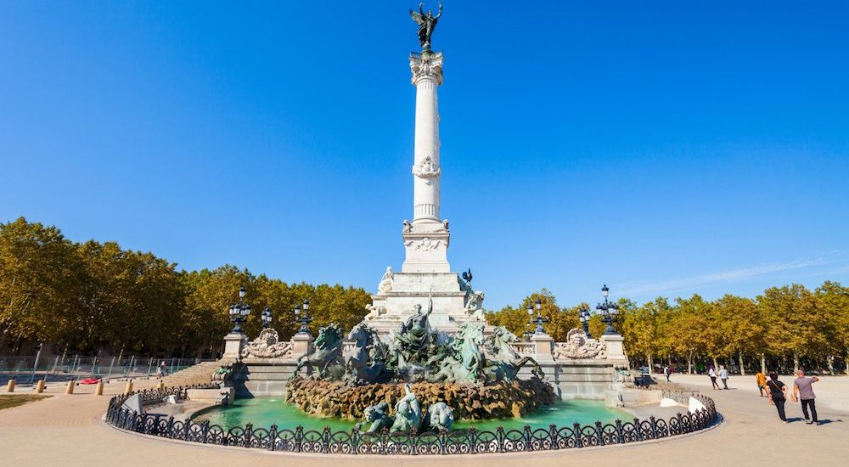
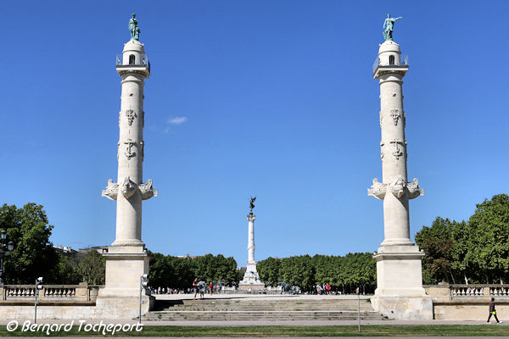
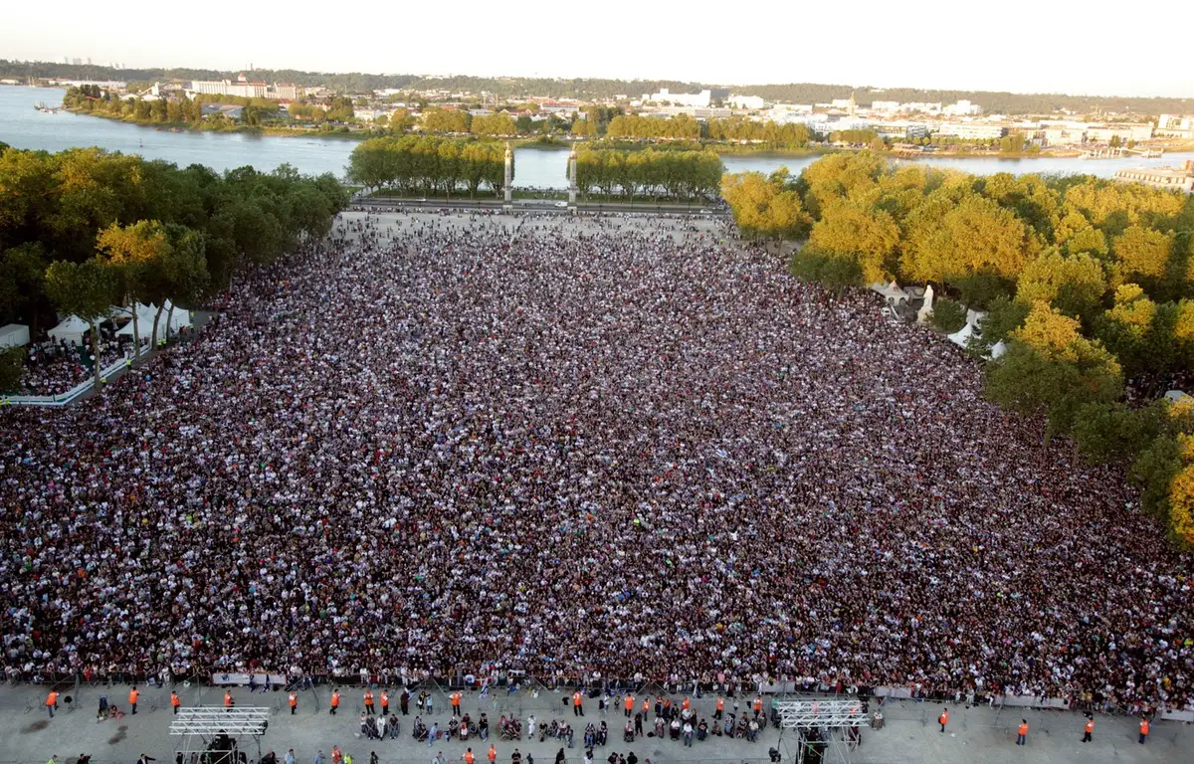
La place des Quinconces
Monument to the Girondins (Girondins = political group during French Revolution)
The Esplanade des Quinconces, lined with trees planted in quinconces, occupies a vast site of 12 hectares (including 6 green spaces) on the edge of the Garonne, making it the largest square in Europe. It is decorated to the east by two rostral columns and, to the west, by the Monument to the Girondins. Many events take place throughout the year: Festival of the River, Wine Festival, Flea Fair, Pleasure Fair, concerts, circuses, sports activities...
Fan zone during Euro 2016

Slide 4
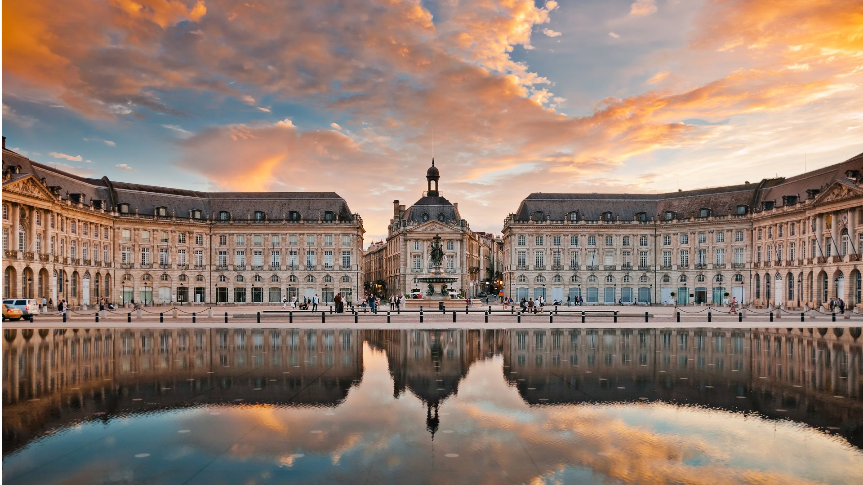
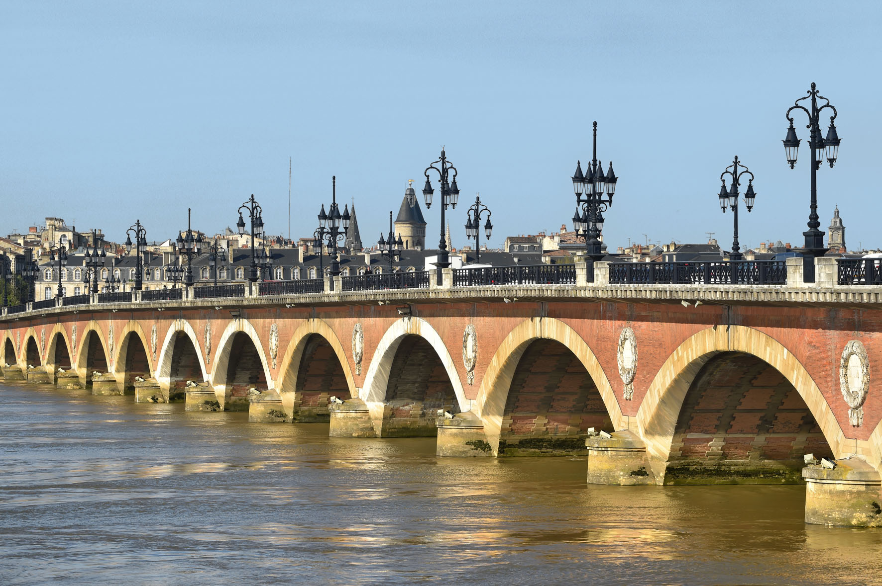
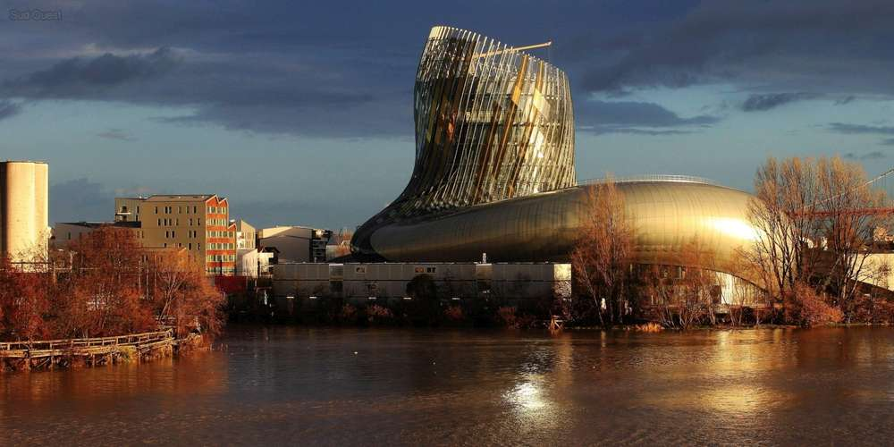
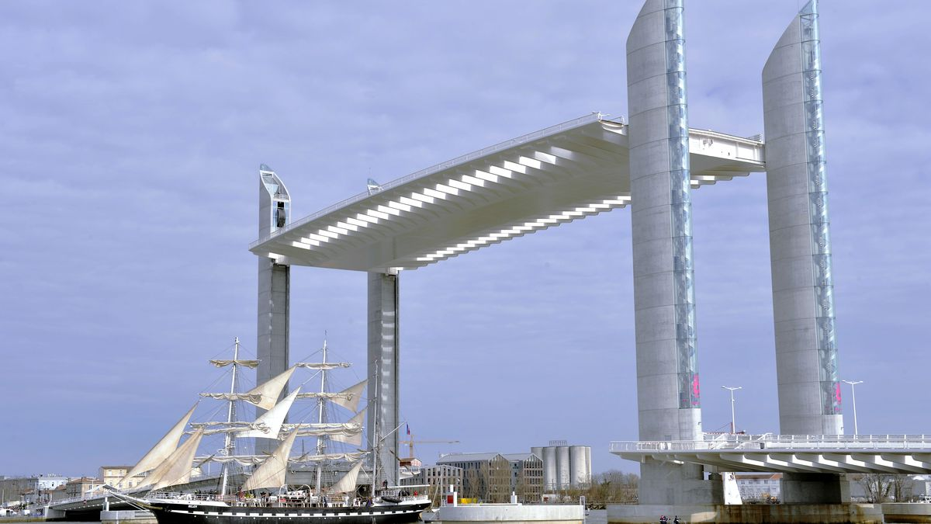
Along the river Garonne
place de la Bourse
pont de pierre
cité du vin
pont Chaban Delmas

Slide 5
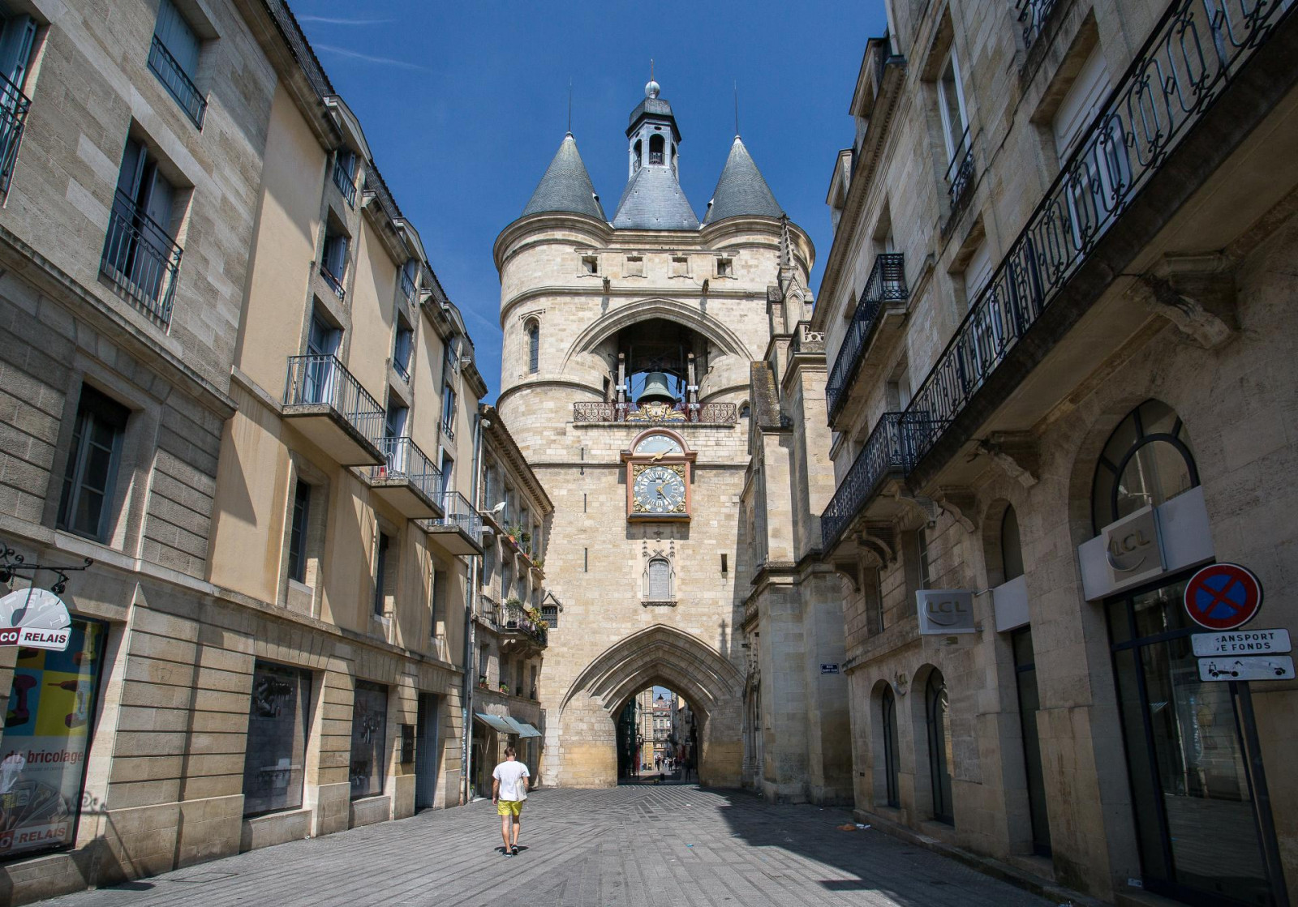
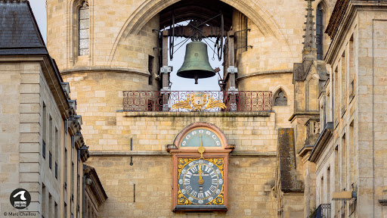
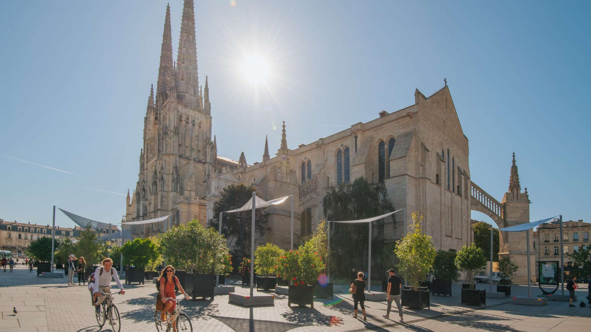
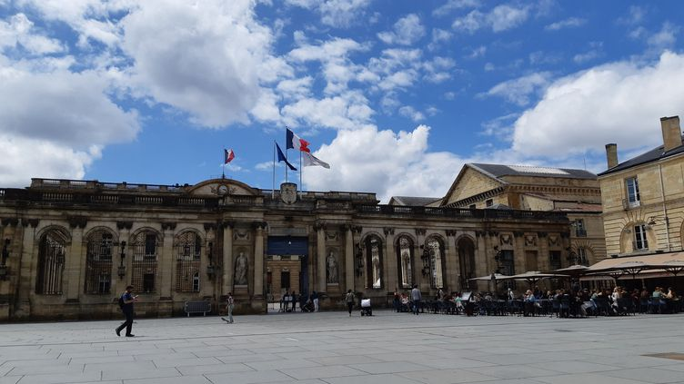
In town
la porte de la Grosse Cloche
cathédrale Pey-Berland
city hall

Slide 6
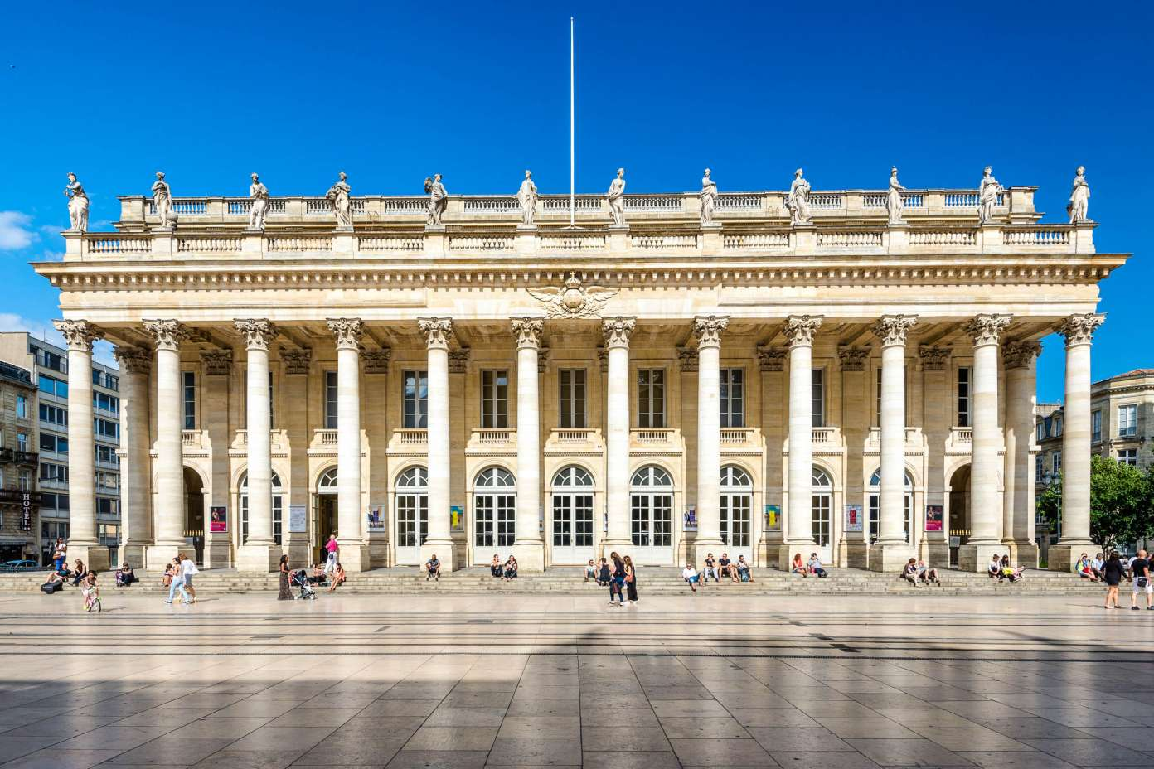
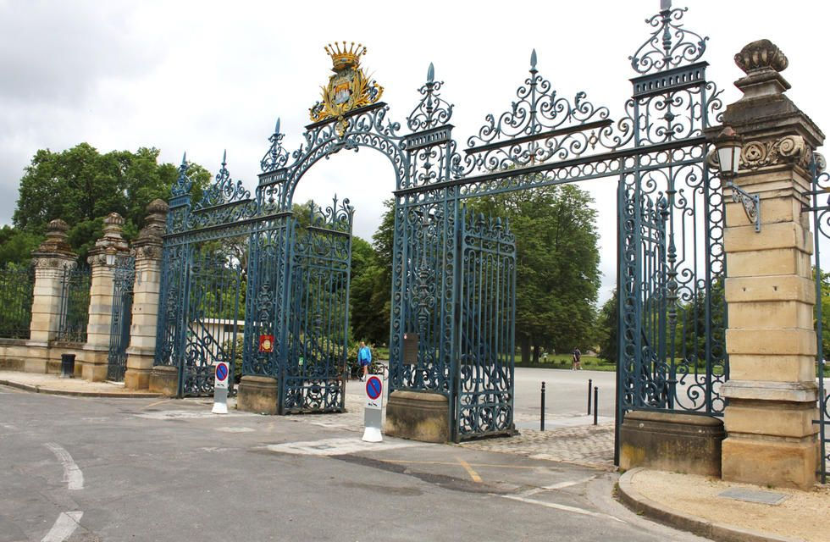
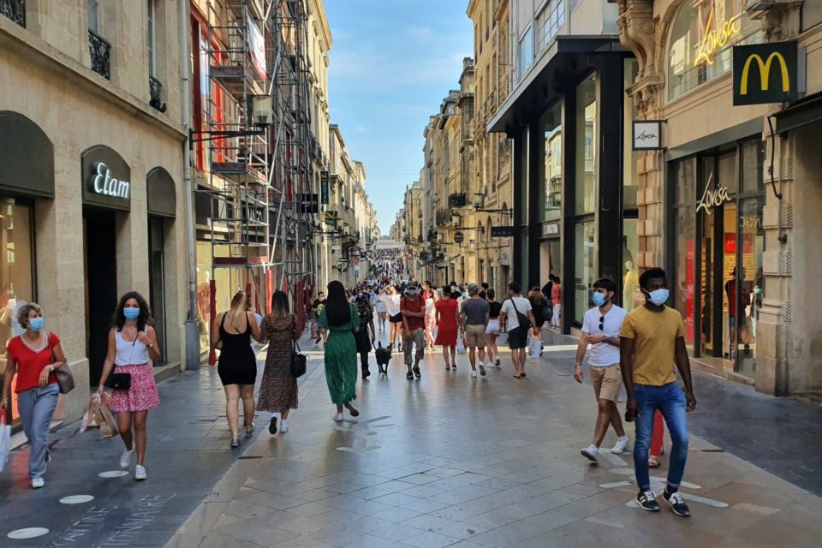
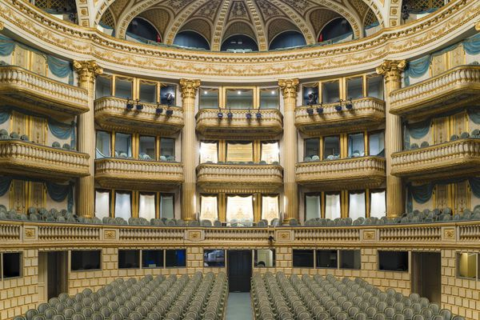
In town
entrance of Parc bordelais
le Grand Théâtre
Sainte Catherine Street

