Slide 1
Murcia, spain
3.3.2018.-10.3.2018.
Notes:
© Copyright PresentationGo.com – The free PowerPoint library

Slide 2
Beginning…….
Here we are, Domagoj, Leon, Karlo and me. Here are also teachers: Ivana, Ozrenka and Ksenija. Teacher Marijana isn’t here because she is waiting for us in Osijek.
Notes:
© Copyright PresentationGo.com – The free PowerPoint library

Slide 3
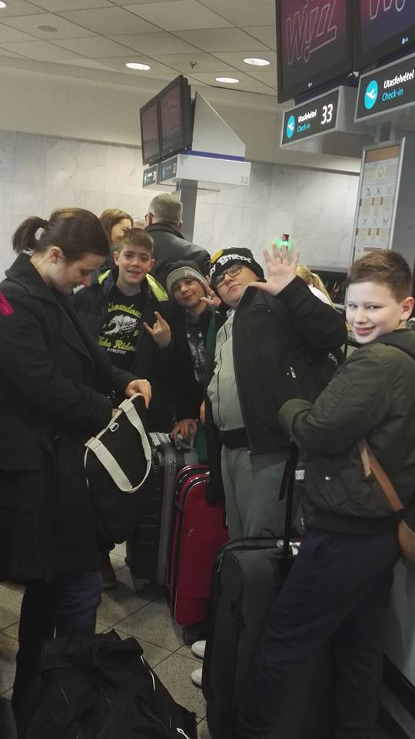
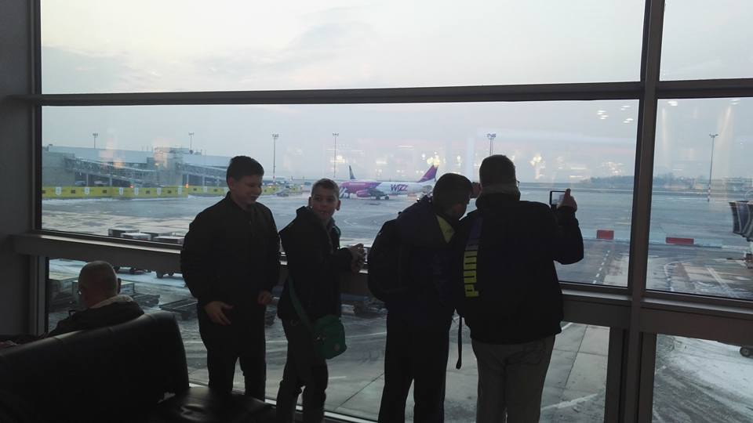
Budapest Airport
Here we are at the Budapest Airport. On the left picture we are watching the runway.
On the right we are at the check in.

Slide 4
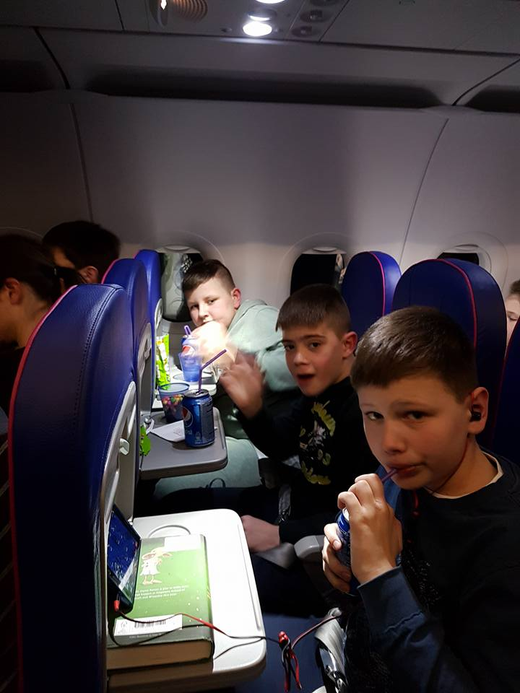
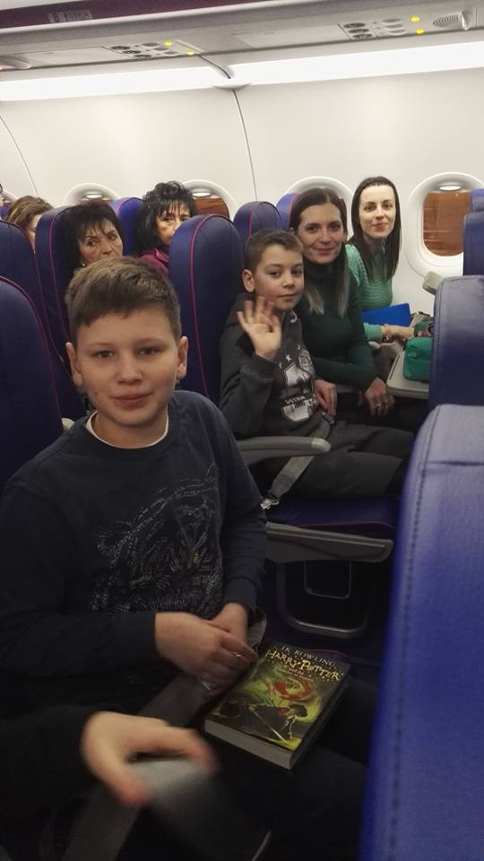
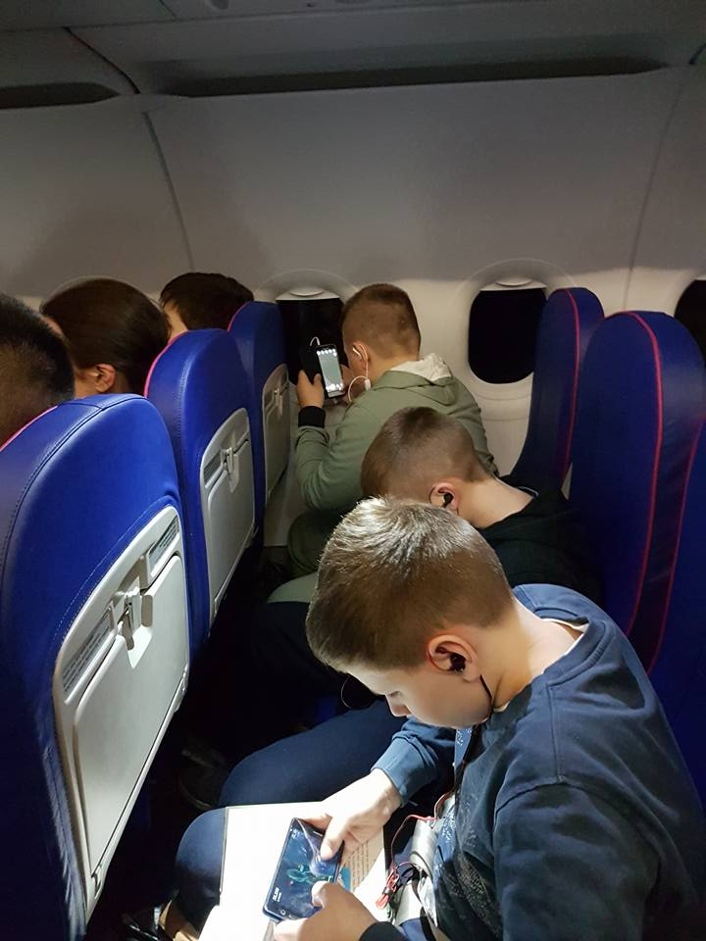
In the plane…..
In the left picture we are playing on our mobile phones. In the middle picture you can see Karlo, teachers Ksenija and Ivana, and me. On the right we are drinking Pepsi and eating Skittles.

Slide 5
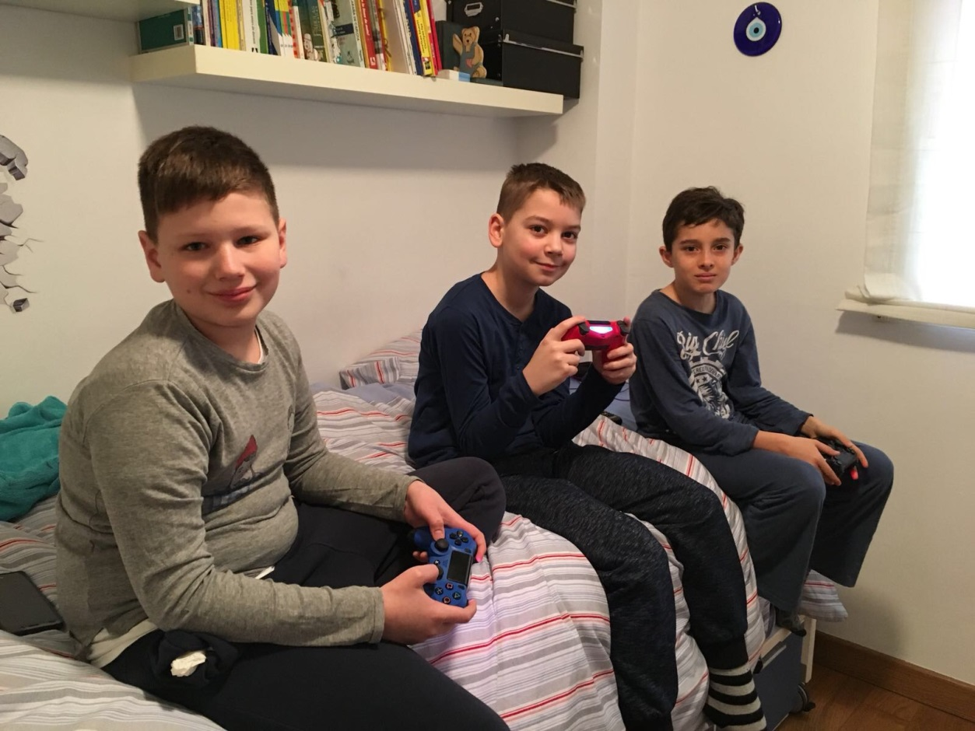
At the host familly….
Here are Mario, my host, Karlo and me, at Mario’s home. Mario is 9 and he goes to the 5th grade. We are playing Gang beasts at ps4.

Slide 6
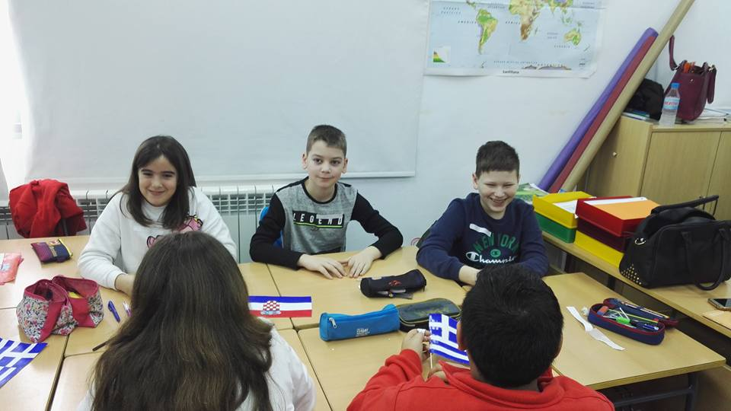
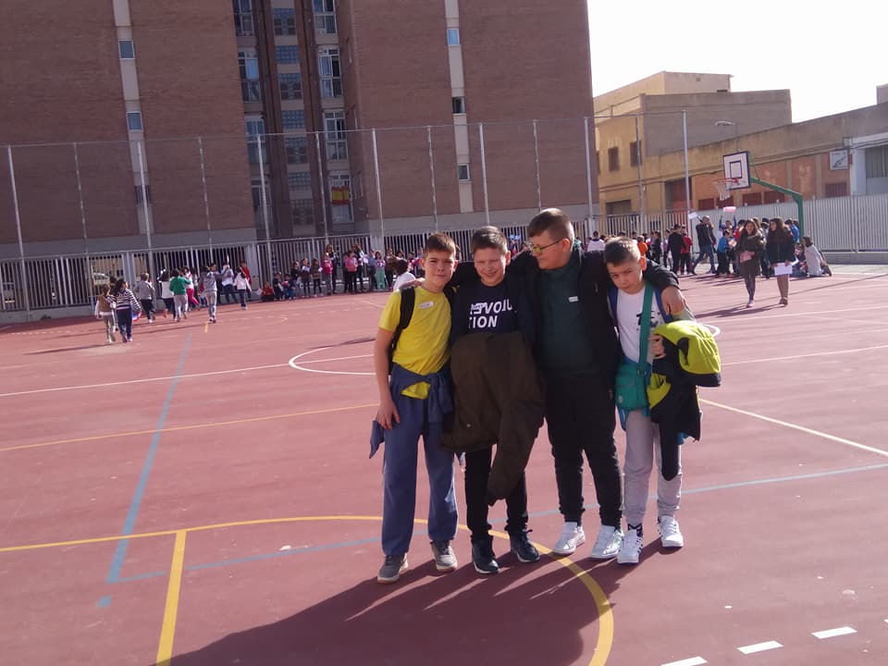
1st day at school….
Here we are in the classroom. We are introducing ourselves.
And here we are on the school playground. This is not the entire playground, it’s bigger.

Slide 7
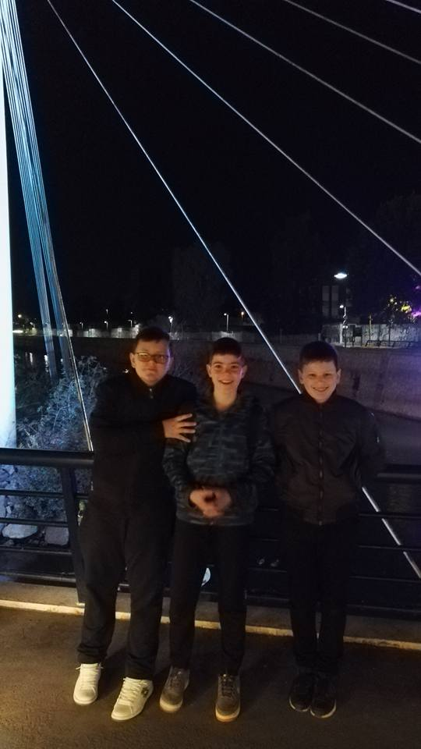
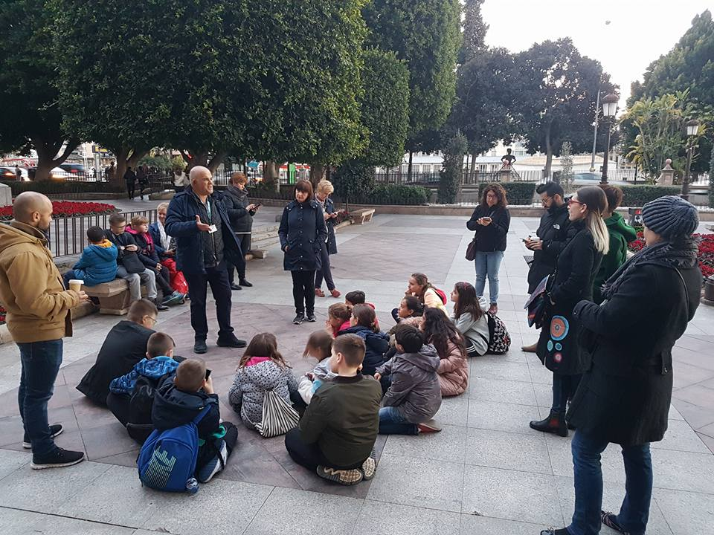
Sightseeing….
Here we are in Murcia. The guide is talking about Murcia’s history.
This is a beautiful bridge. It’s amazing but unfourtunately I don’t have more photos of it.

Slide 8
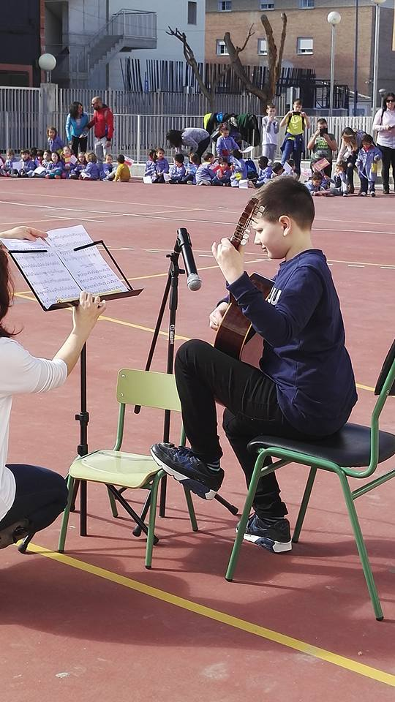
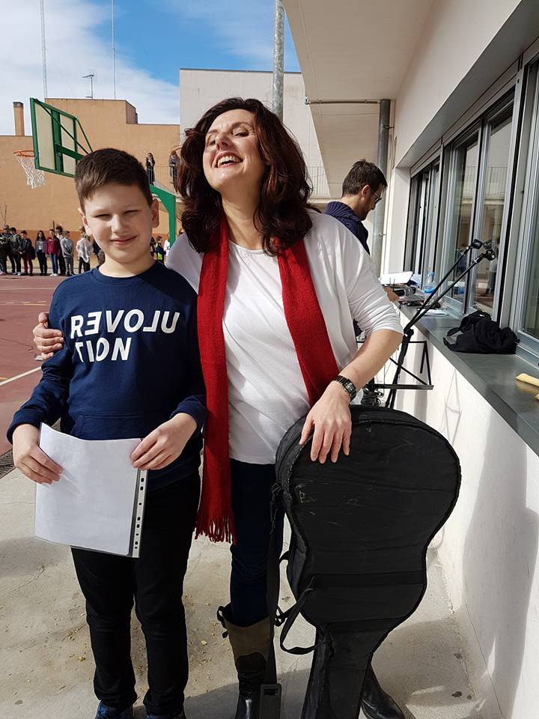
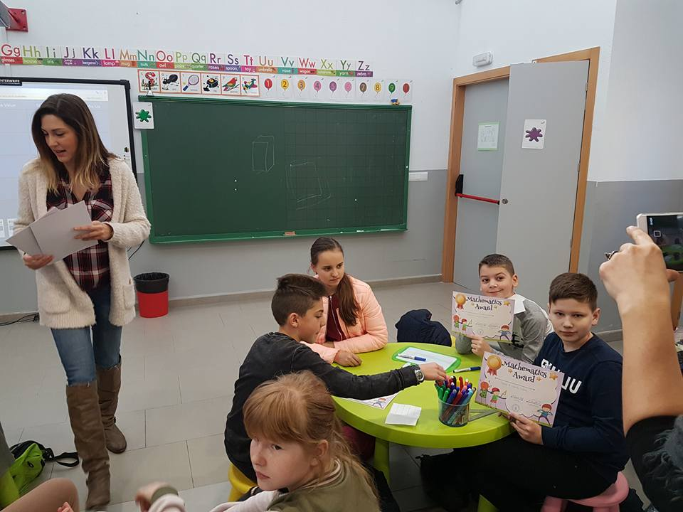
2nd day at school….
And here’s their Music teacher coungratulating me.
Here I’m playing the guitar at the welcoming ceremony.
This is Maths quiz. We won the first place!!!

Slide 9
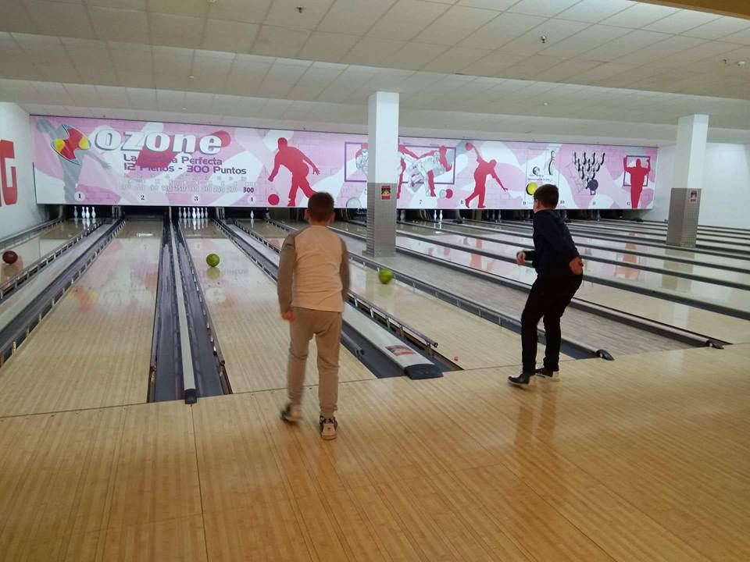
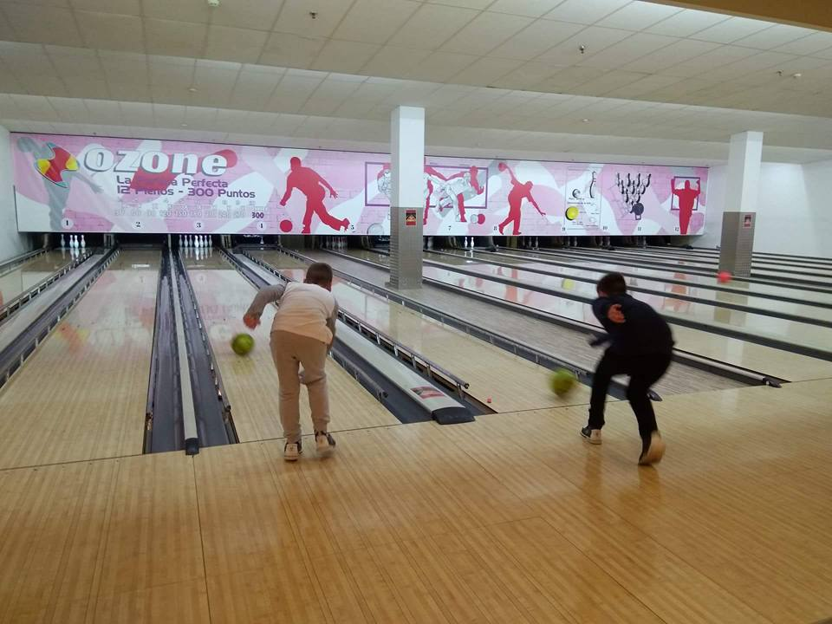
Tuesday afternoon…..
Here we are in the bowling centre. It’s in the open shopping centre. Later some of us went to Burger King and others went home.

Slide 10
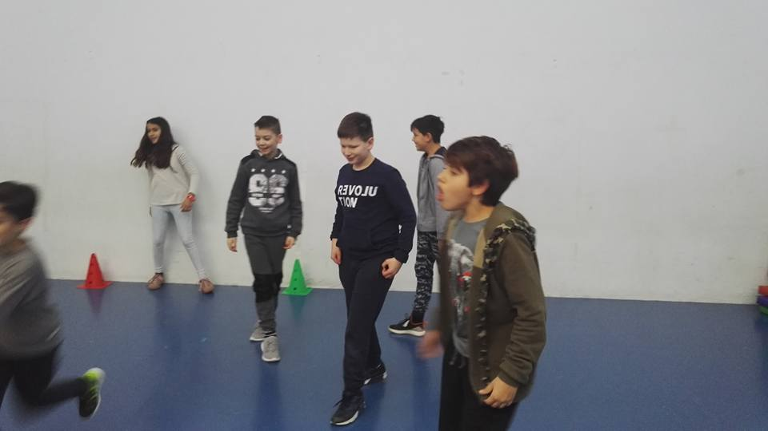
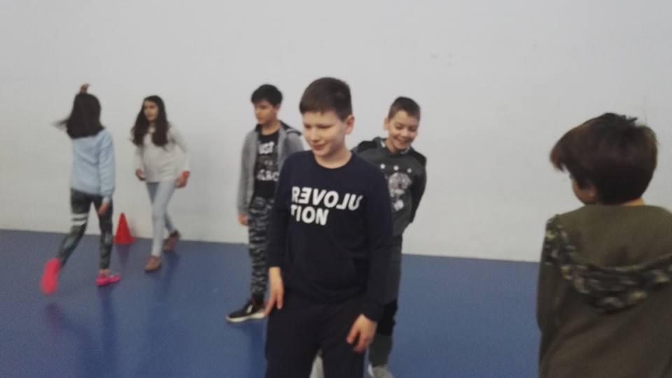
3rd day at school…..
Here we are in the gym. I don’t have more photos about this school day.

Slide 11
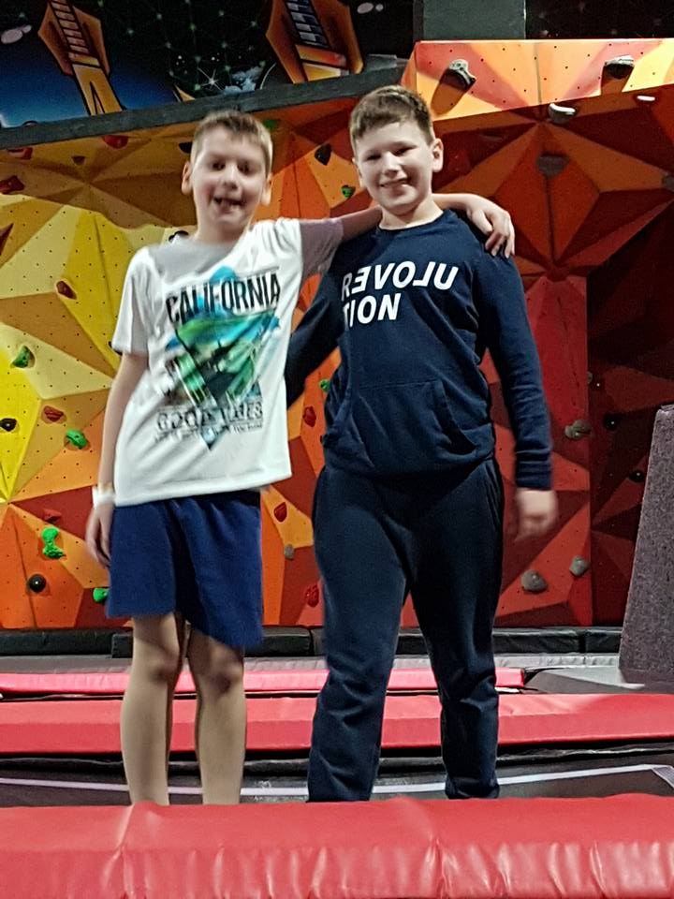
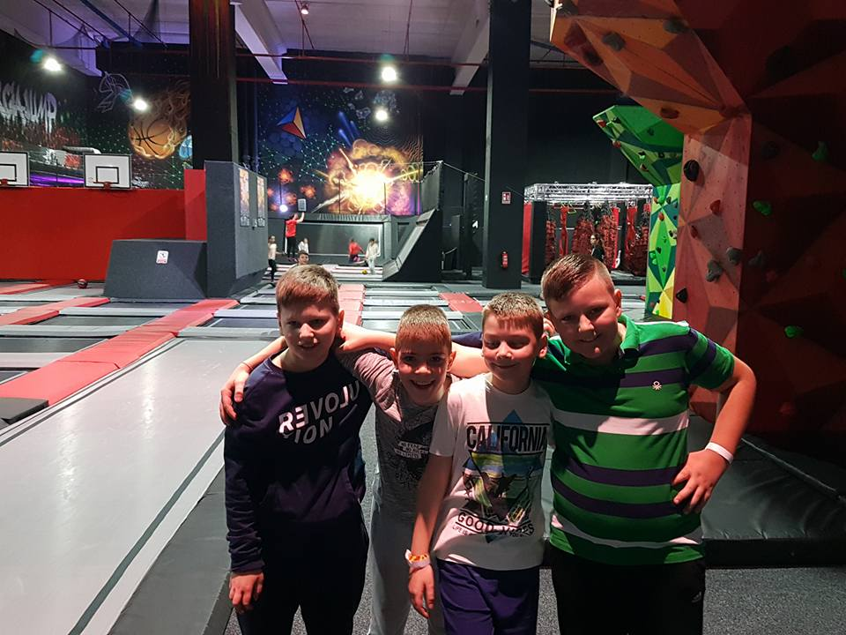
Wednesday afternoon….
Here we are in Murcia Jump. Here are lots of trampolines. Here you can play volleyball on trampolines. We’ve got socks from there. It was so much fun!! I want to go there again and jump.

Slide 12
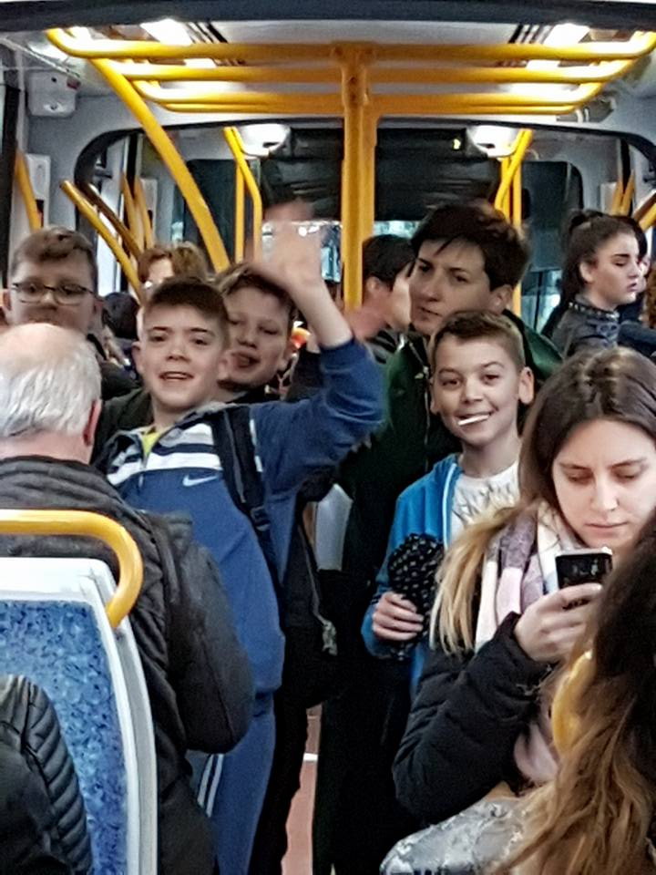
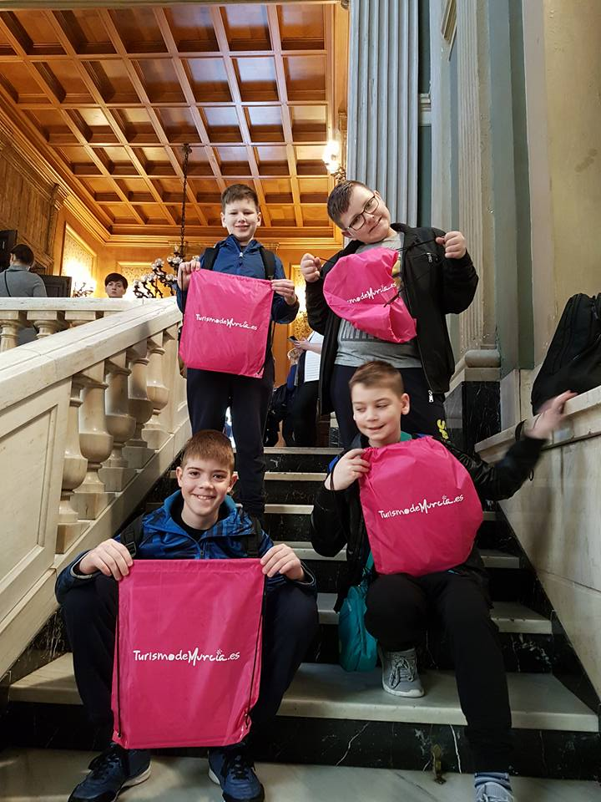
4th day……
Here we are in the tram going to meet the mayor.
Here we are in the city Town hall. We got some presents.

Slide 13
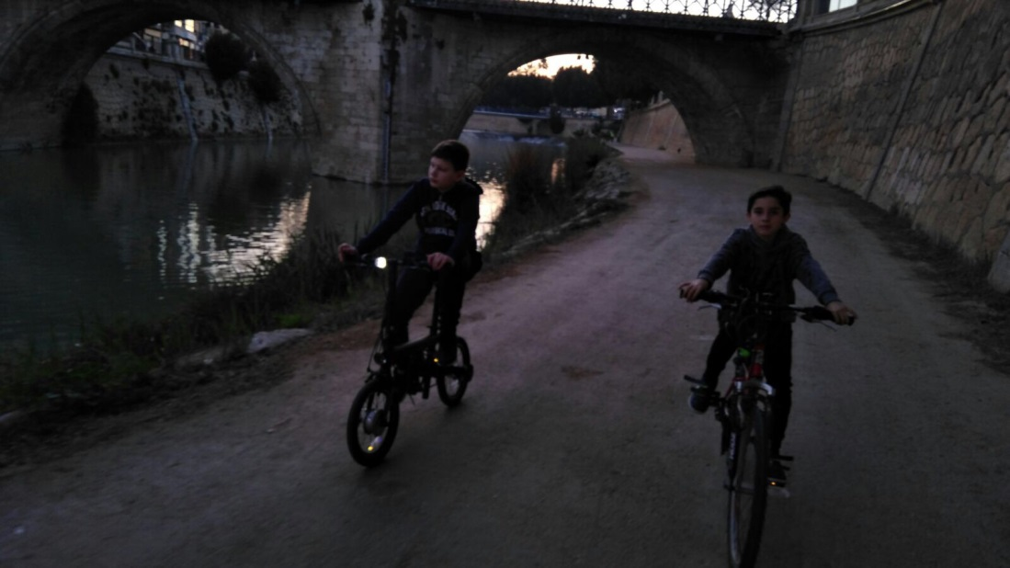
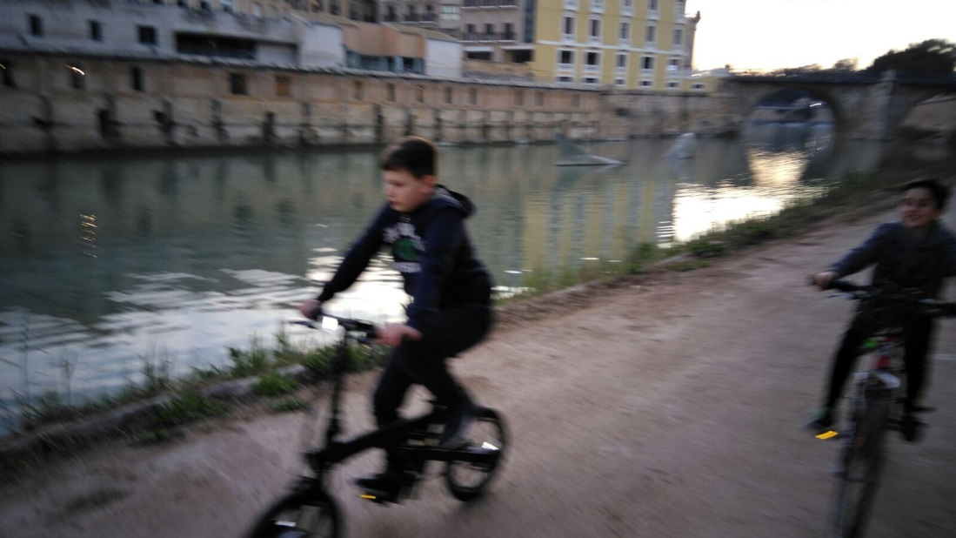
Thursday afternoon I spent with Mario and his dad. I rode an electric bike. I saw some new things in the city, like the big fish coming out of the water.

Slide 14
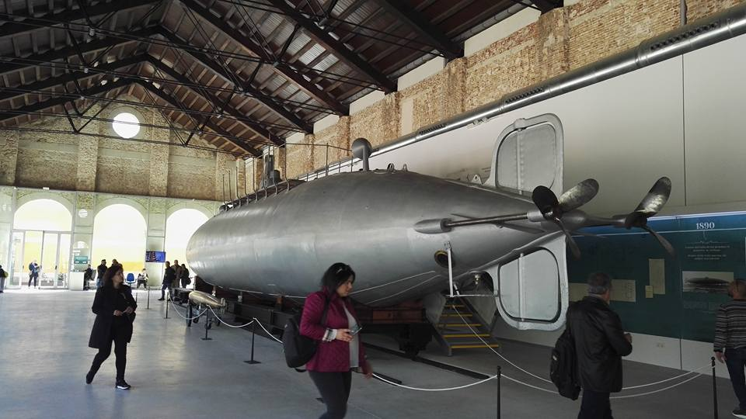
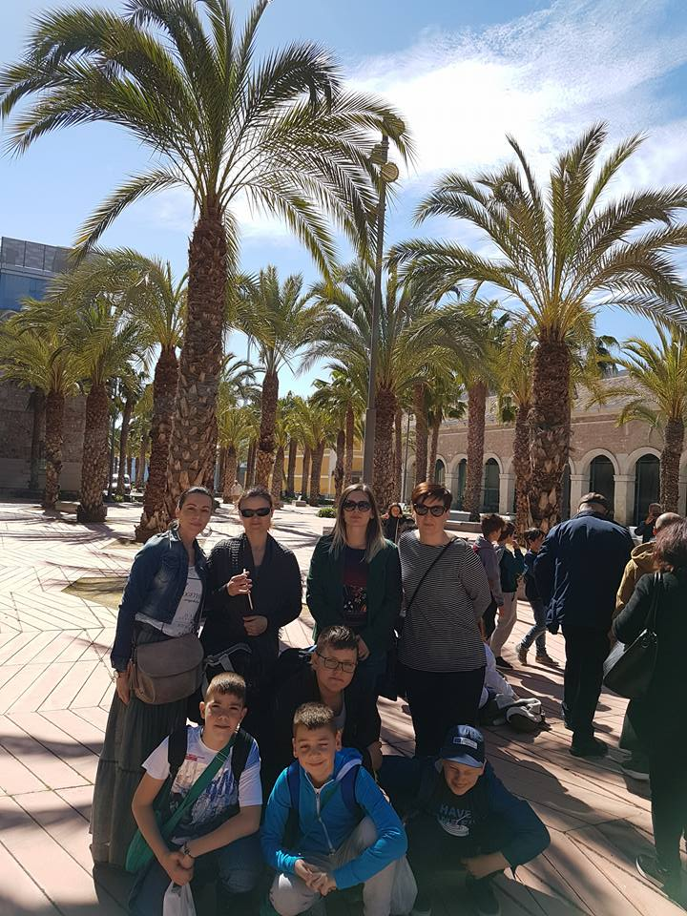
5th day….. Cartagena
Cartagena is a town on the coast. It’s a tourist town. There are lots of palm trees.
In the right photo is the first submarine with torpedo.

Slide 15
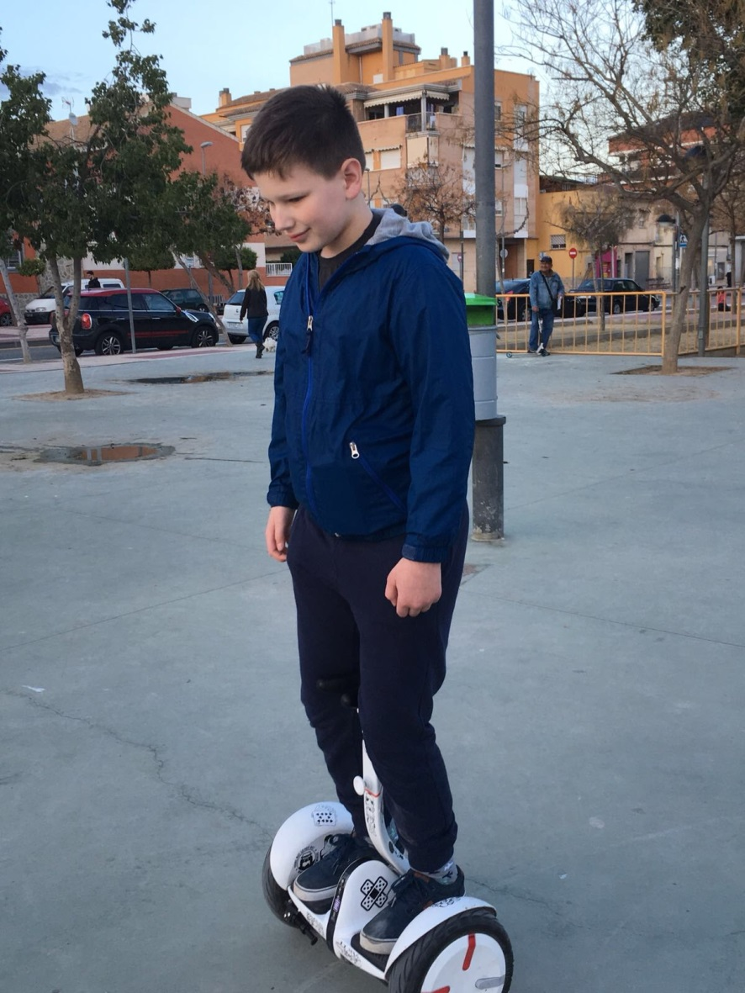
Friday afternoon I rode hoverboard with Karlo and his host. It was fun to ride hoverboard.

Slide 16
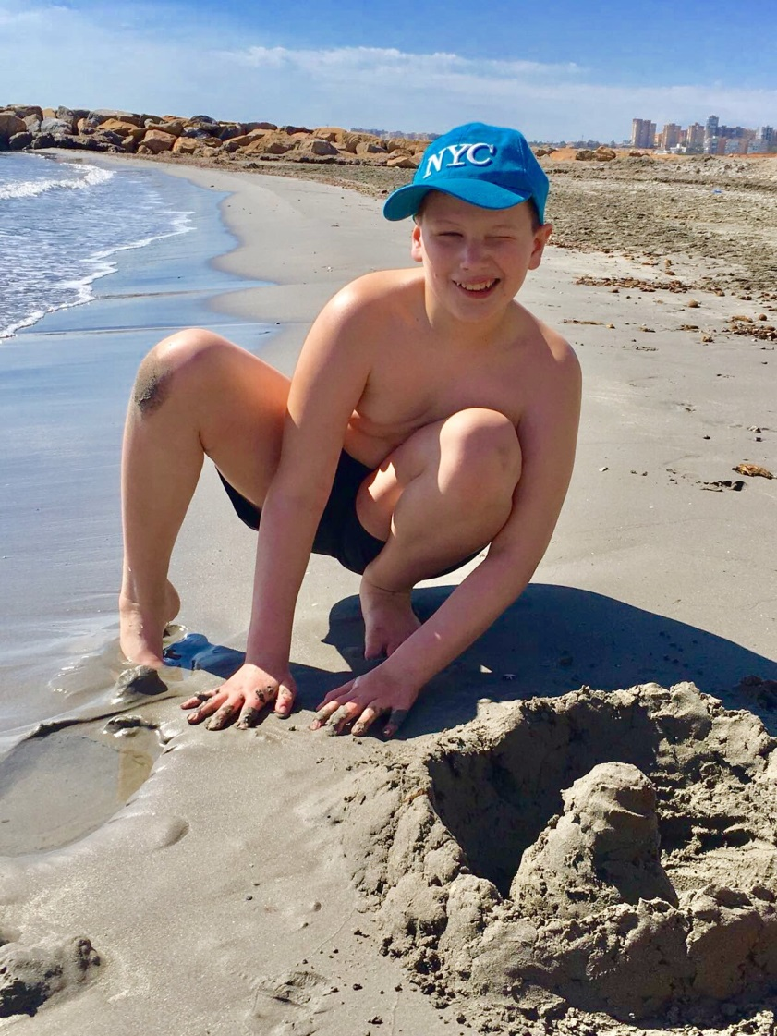
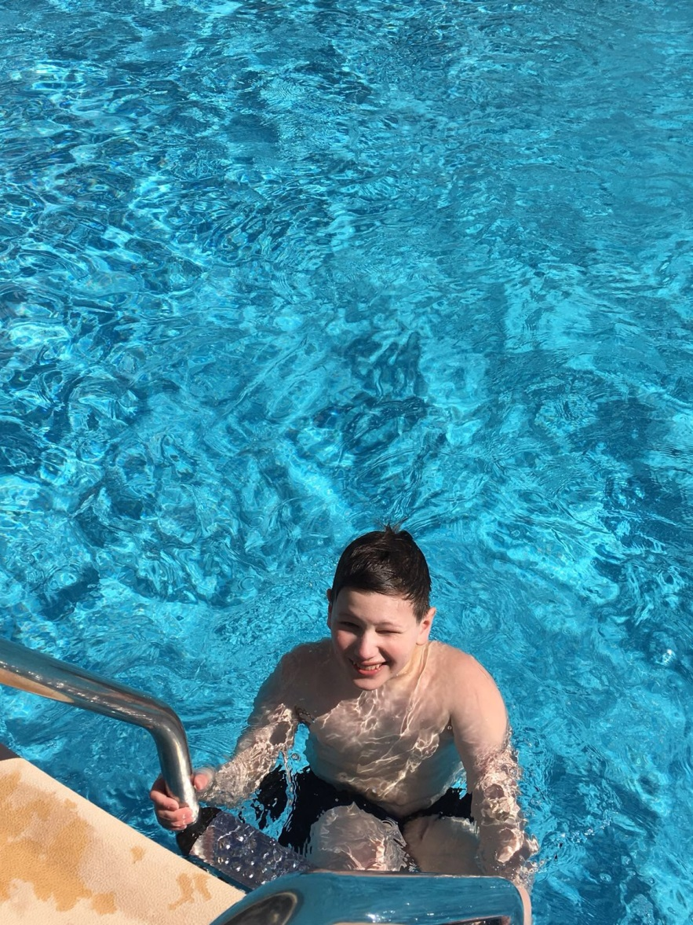
The last day
Before I went home I spent some time on the beach and in the pool. It was a pretty hot day.

Slide 17
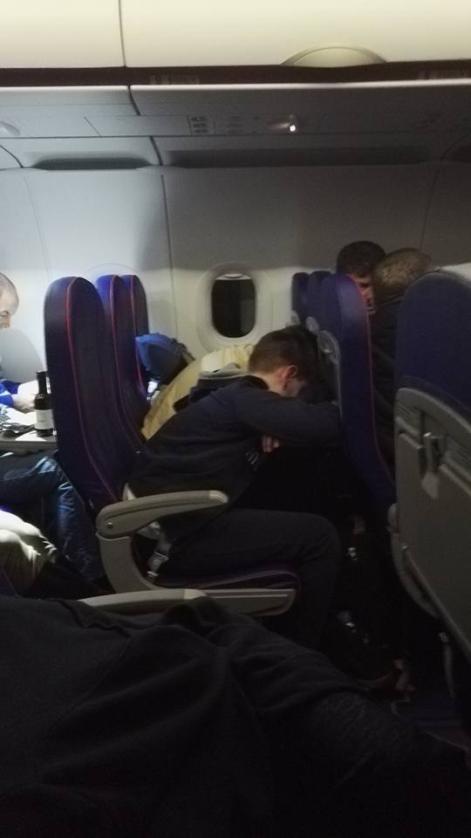
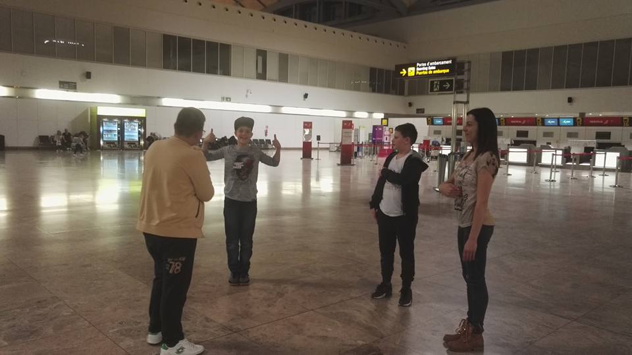
Going home…..
Before our flight it was boring so we played some games with teacher Ivana.
On the plane we were sleeping most of the time.

