Slide 1
MY TRIP TO SPAIN
Domagoj Suhić, 5th grade

Slide 2
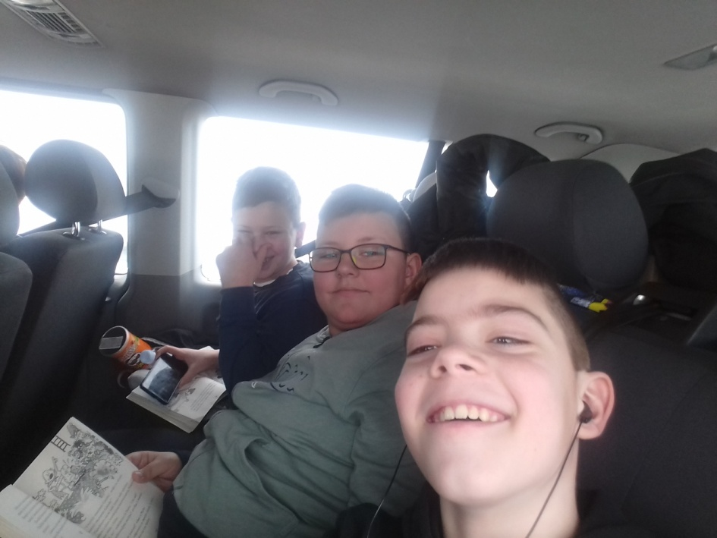
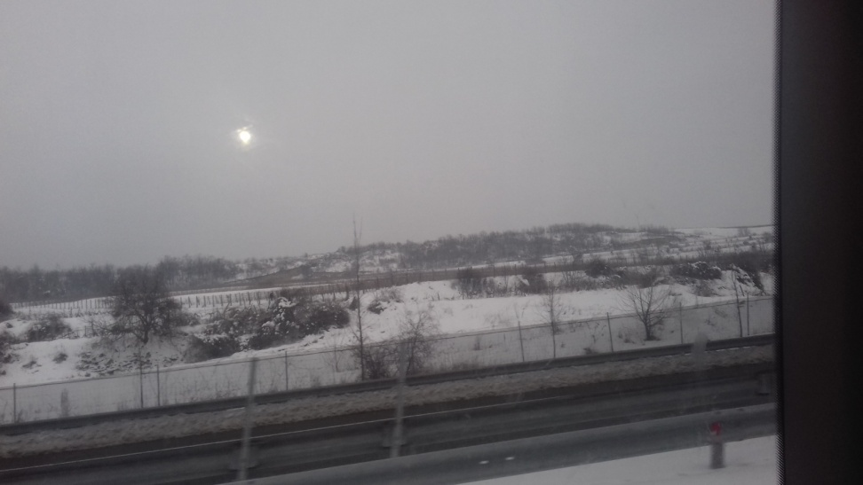
The trip
The trip was fun.We took the bus from the school to the airport in Budapest.We took the flight to Spain.

Slide 3
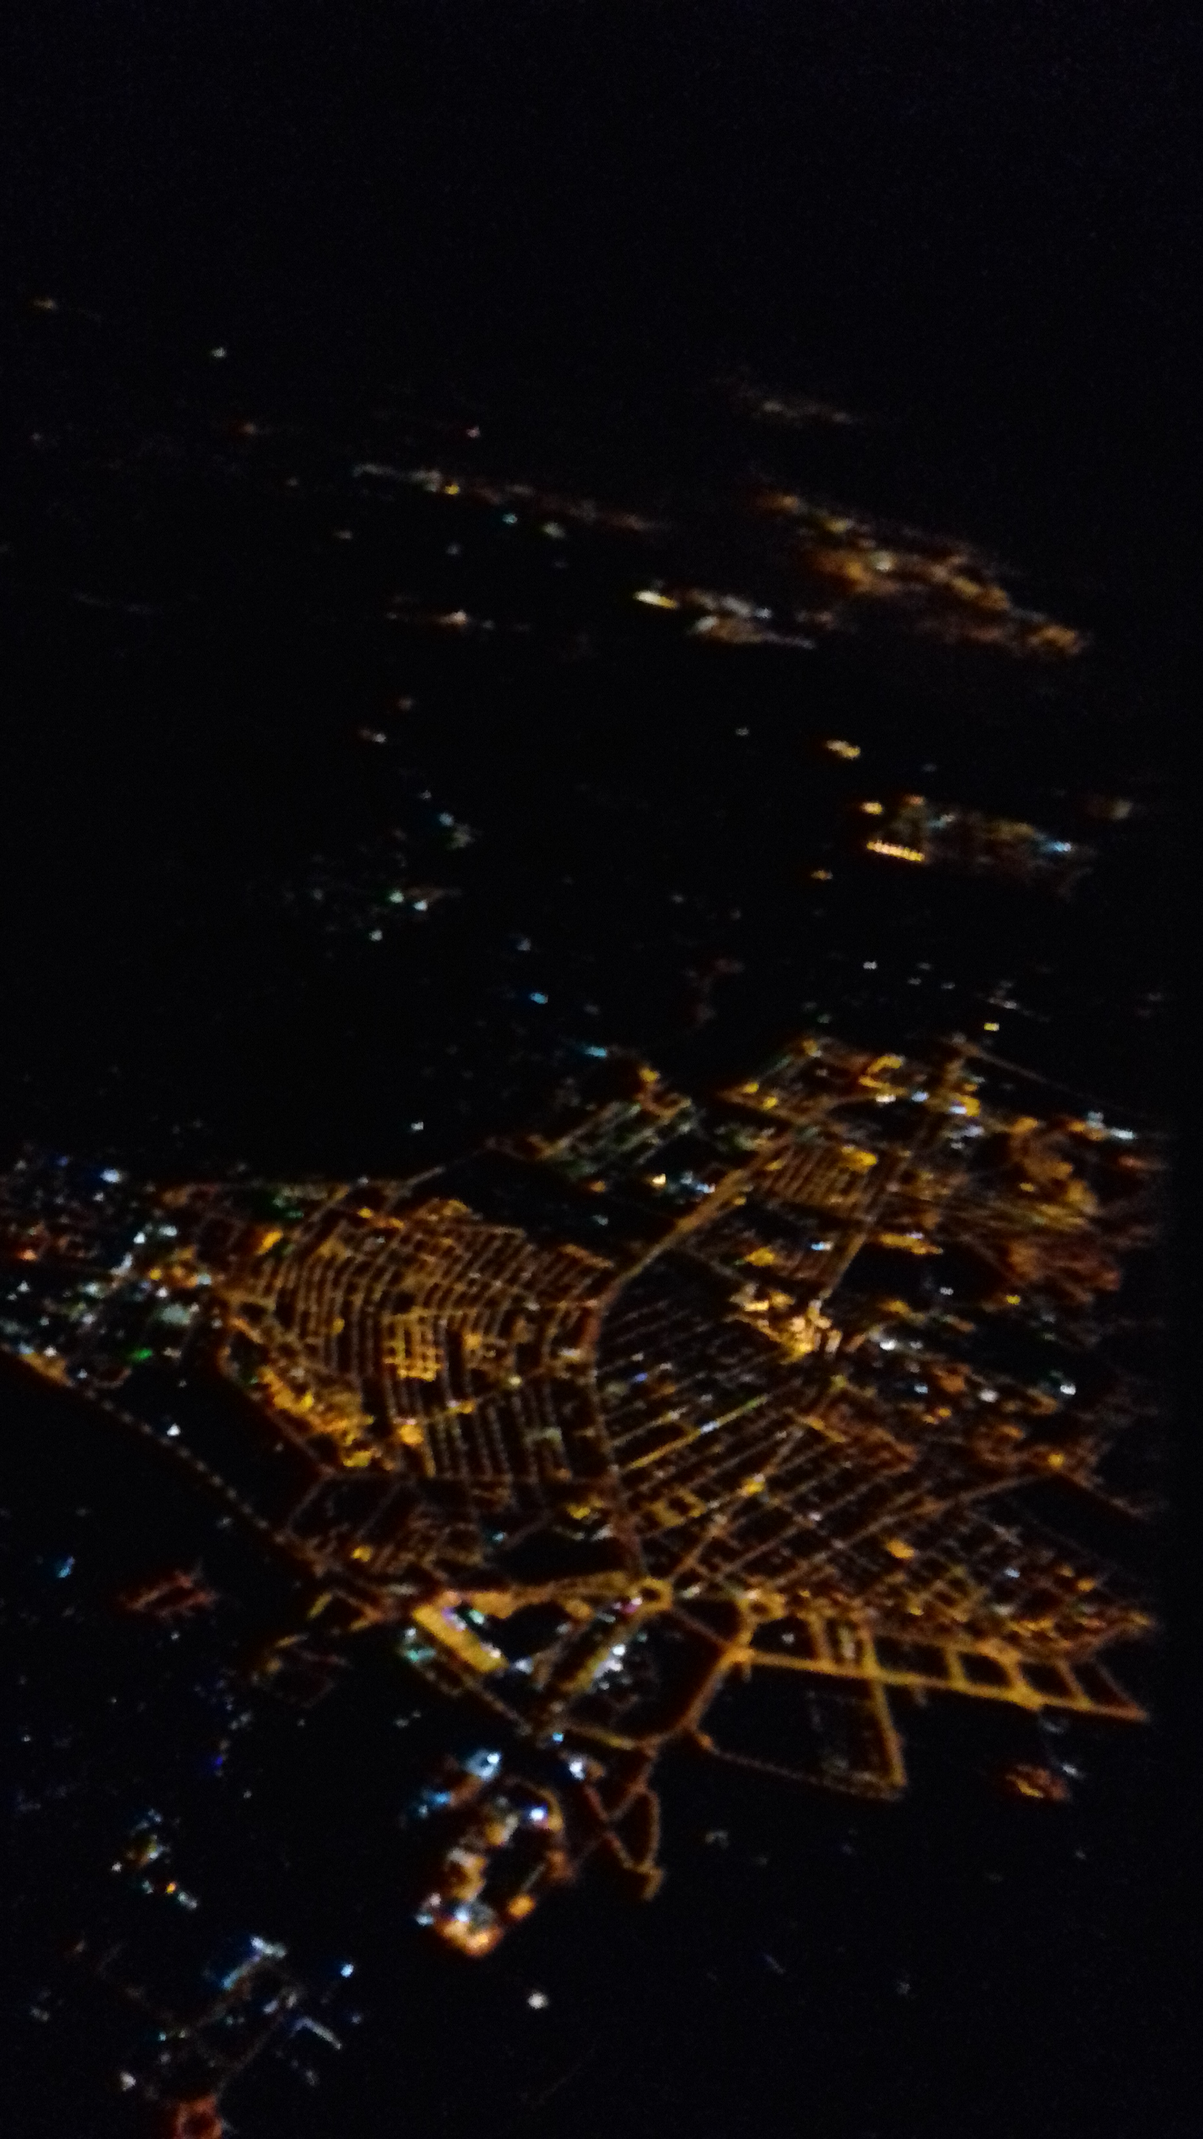
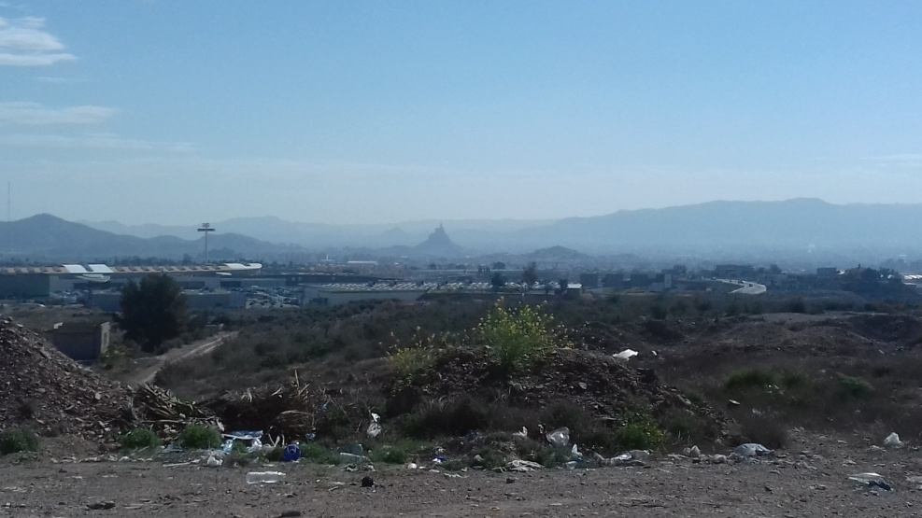
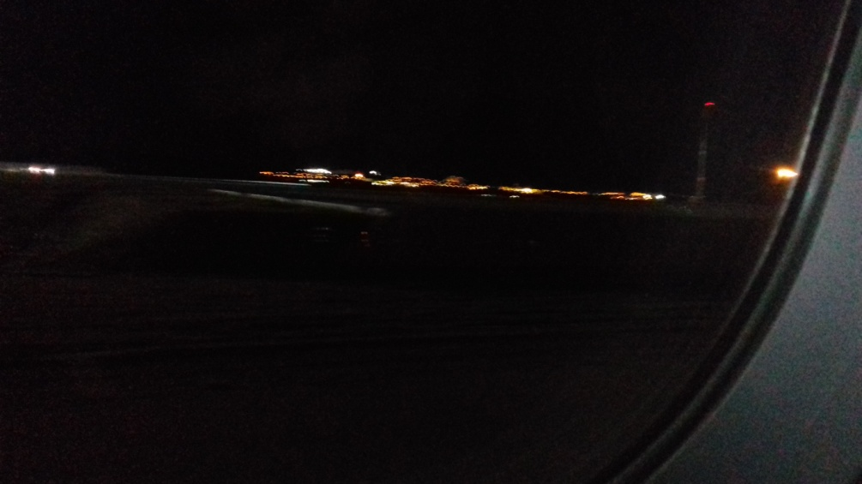
More pictures

Slide 4
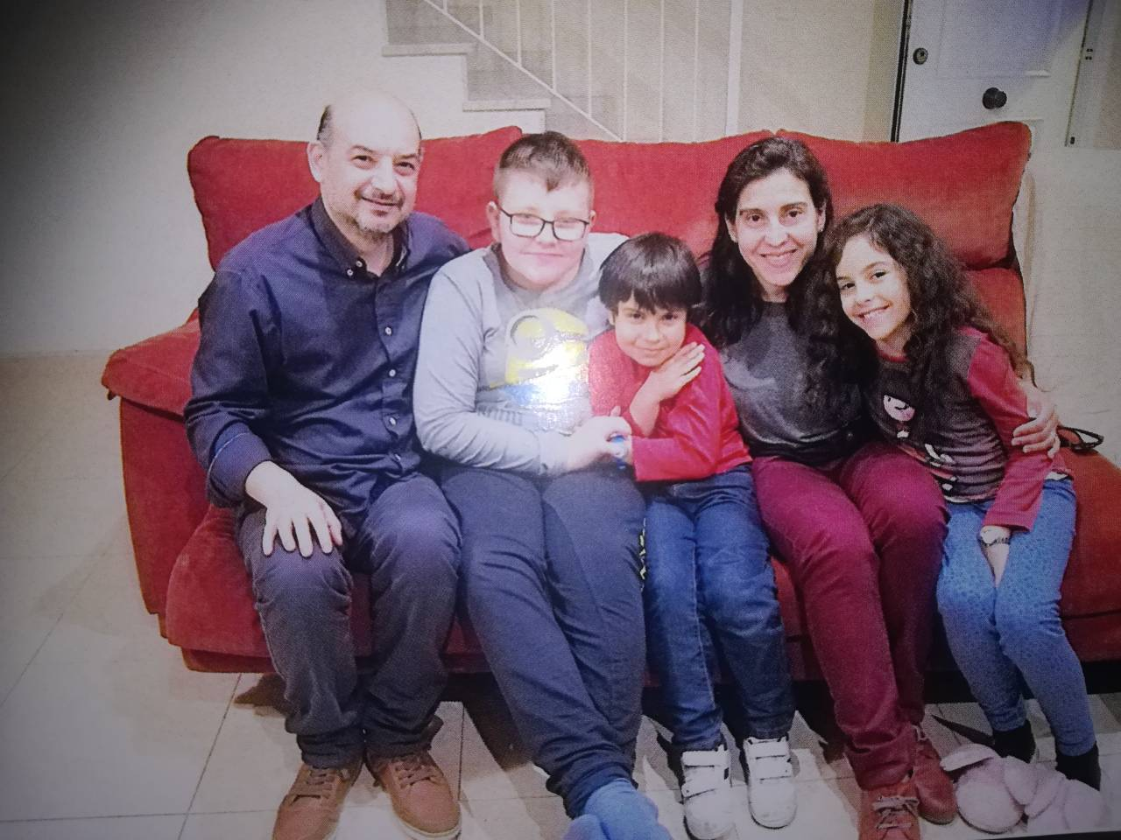
The Family
The family had four members:
The dad: His name
is Antonio. I like him.
He was nice and
knew a lot of
English.
Daniel: He is 7
years old and he
likes reading books.

Slide 5
I played games with him a lot.
Lucia: She was my partner in the project.
She was nice and spoke English very well.
She’s 10 and I can’t wait for her to visit us.
The mom: Her name is Mirela. She liked me. She didn’t speak English well. She was really nice.

Slide 6
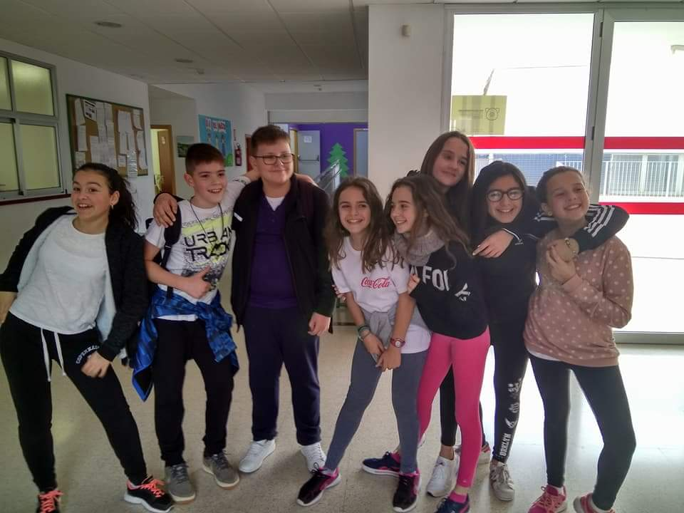
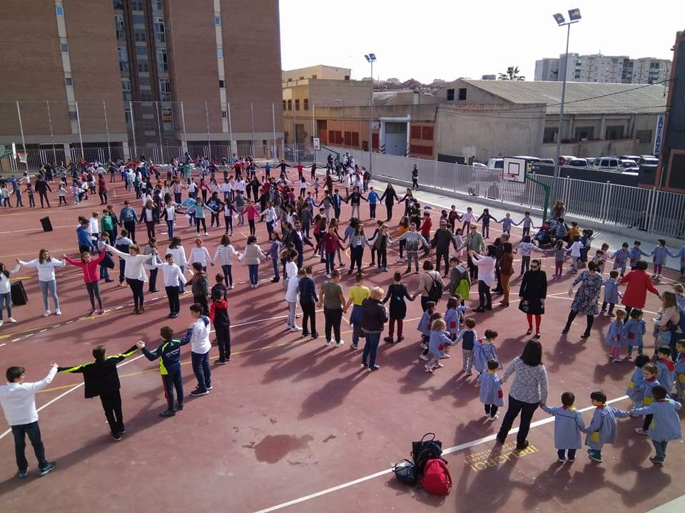
The school
We had a great time! We did so many fun activities . I made a lot of friends.

Slide 7
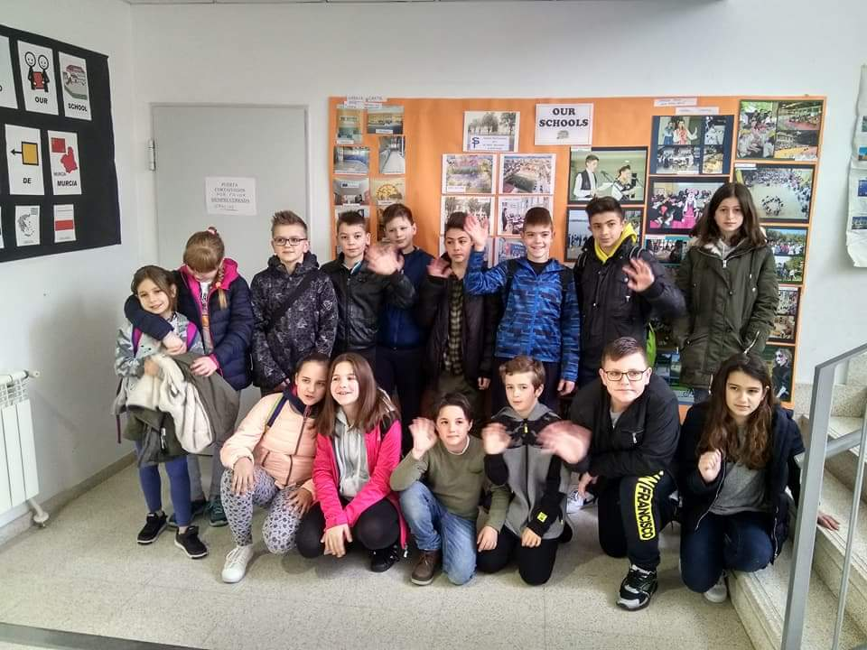
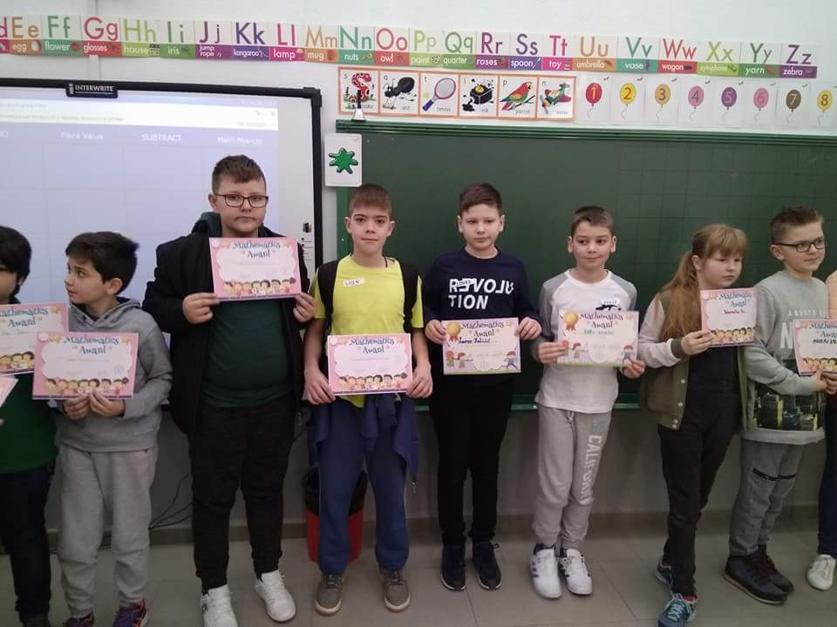

Slide 8
Fun activities
We went bowling and we had a blast!
I don’t have any pictures…

Slide 9
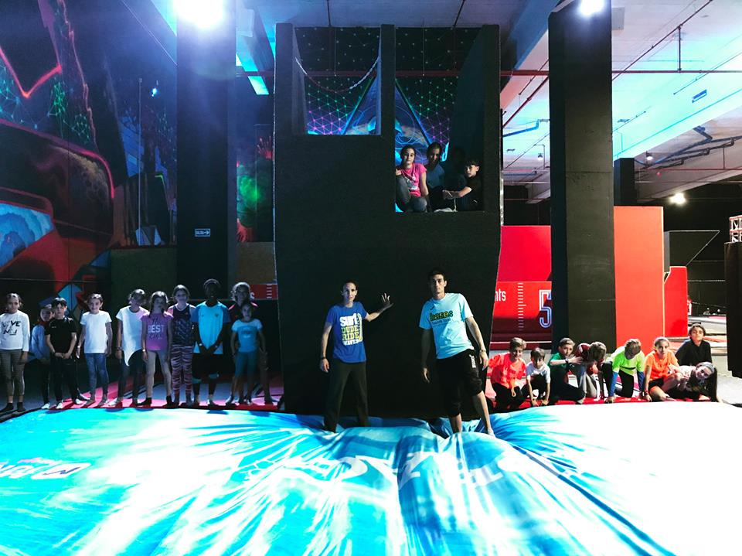
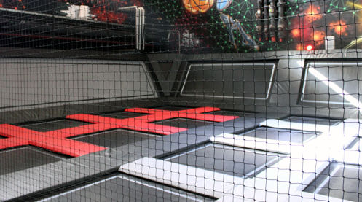
Murcia Jump
IT WAS AMAZING!!!!!!! We did wall jumping , just jumping, played volleyball on trampolines and we even jumped off the tower.

Slide 10
What it was like
It was really fun and exciting. I hope to visit Spain in the future. I also hope to visit Greece and Poland.

