Slide 1
There and Back…
Zuzanna Szczepaniak Julia Sobaszczyk Mikołaj Kopka
Gabriela Zwarycz Patryk Raźny

Slide 2
Monday, 19th February, 2018
Our trip began at 8 a.m., when we met at our school. We went to Warsaw by minibus. At the airport we had some time, so we ate breakfast. Our next step was to get to France where we met our partners from Finland and Catalonia. We had some time to rest before our longest part of the trip – flight to Reunion. Our flight took 11 hours.

Slide 3
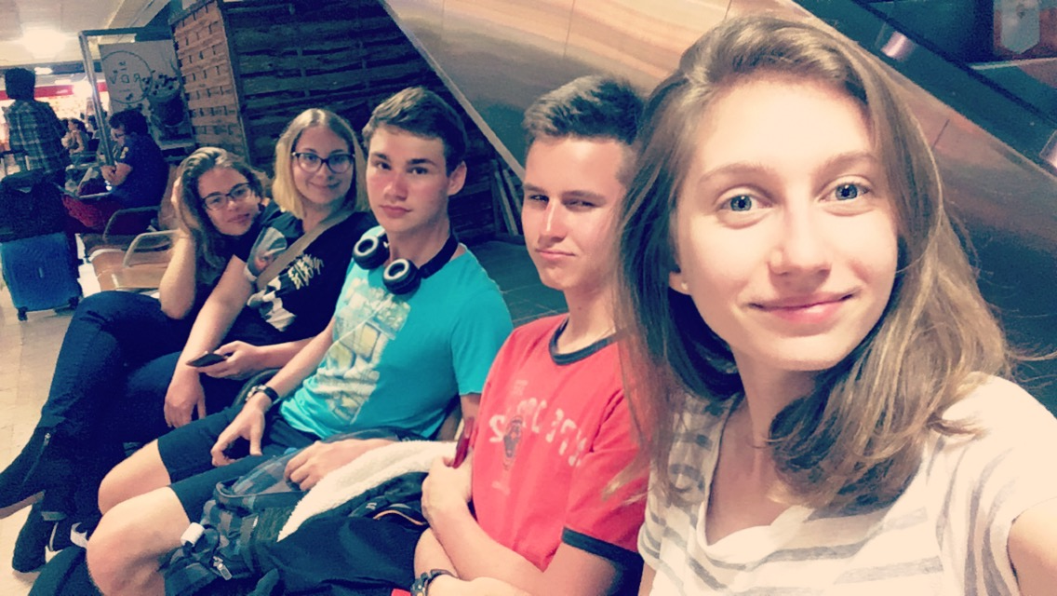

Slide 4
Tuesday, 20th February, 2018
Our Tuesday started at 11 a.m., when we finally arrived in Reunion. The journey was tiring, but it paid off. Awesome tropical humid climate welcomed us after a long journey. We met there with our Reunion partners and went for a picnic at the seaside. We were able to enjoy beautiful views while eating lunch. The next point of our trip was integration – playing an exploring game in which everyone took part. The goal of the game was to get to know our partners. In the evening, tired but happy, we went to our partners' houses where we ate supper and spent some time with the host families.

Slide 6
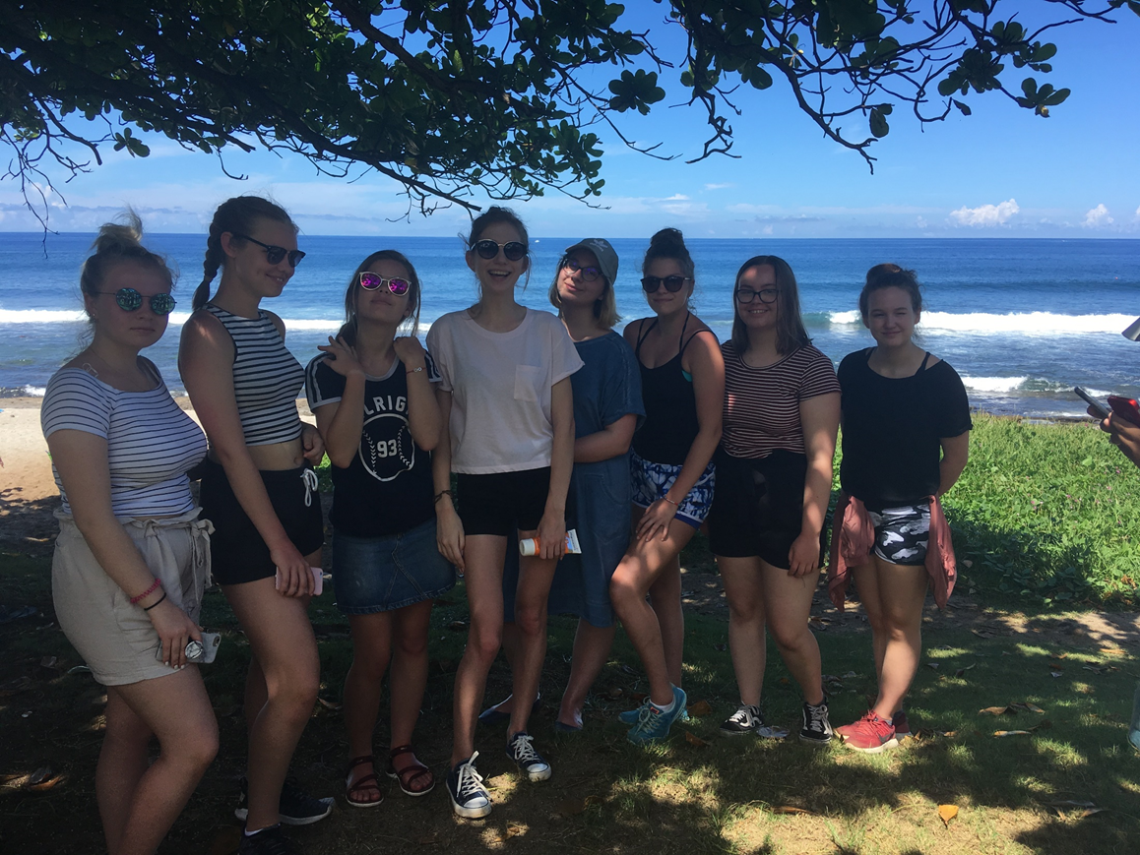

Slide 7
Wednesday, 21st February, 2018
We spent this day primarily working. When we arrived at Jean Joly High School we were greeted by the partners, teachers and headmaster. Then we took our seats in one classroom, where later we showed our presentations. Every project partner, that is: students from Finland, Catalonia, Reunion and Poland were presenting some information about their country and school. After the working session we went by bus at the riverside and there we had a picnic. Having eaten our meals we went for a discovery walk along the riverside. The views were breathtaking. Our last attraction of the day was visiting the village of Entre-Deux. The guide took us around this beautiful town and he told us some interesting trivia about local plants, traditional Creole houses and mores of local people. We also learnt something about the history of village. After these amusements we came back at Jean Joly High School and then we went to our partners' houses

Slide 8
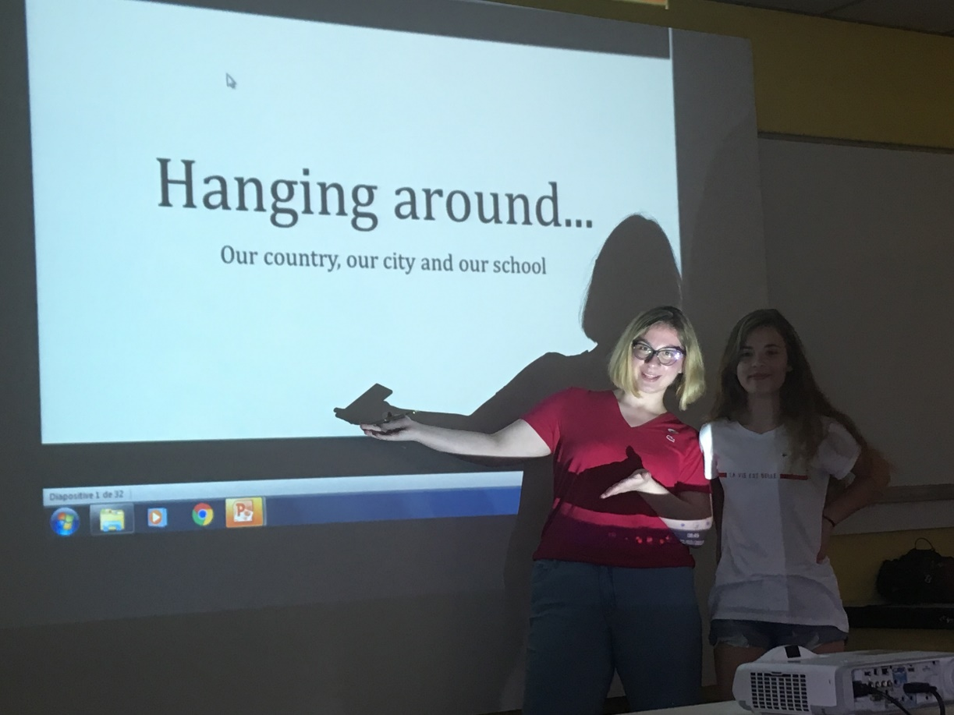

Slide 9
Thursday, 22nd February, 2018
This day was a test for us! We had to climb a mountain and overcome our weaknesses. We did it! We were very pleased. The whole climb lasted 3 hours. It was hard, but the most important thing was that we pulled it off despite obstacles. After a hard expedition, dinner awaited us and later we did yoga with a professional trainer. However hard we tried, not all of us succeeded. You have to be really stretched to do this sport.

Slide 10
Friday, 23rd February, 2018
In the morning we were tired after the previous day's climb. We were by the Indian Ocean and we had all day to relax, sunbathe, swim, paddle in transparent kayaks, and admire the unbelievable views. This day was a great opportunity to integrate with project partners. By the ocean, time was passing slowly. Unfortunately, at the end of the day we had to go back to school.

Slide 11
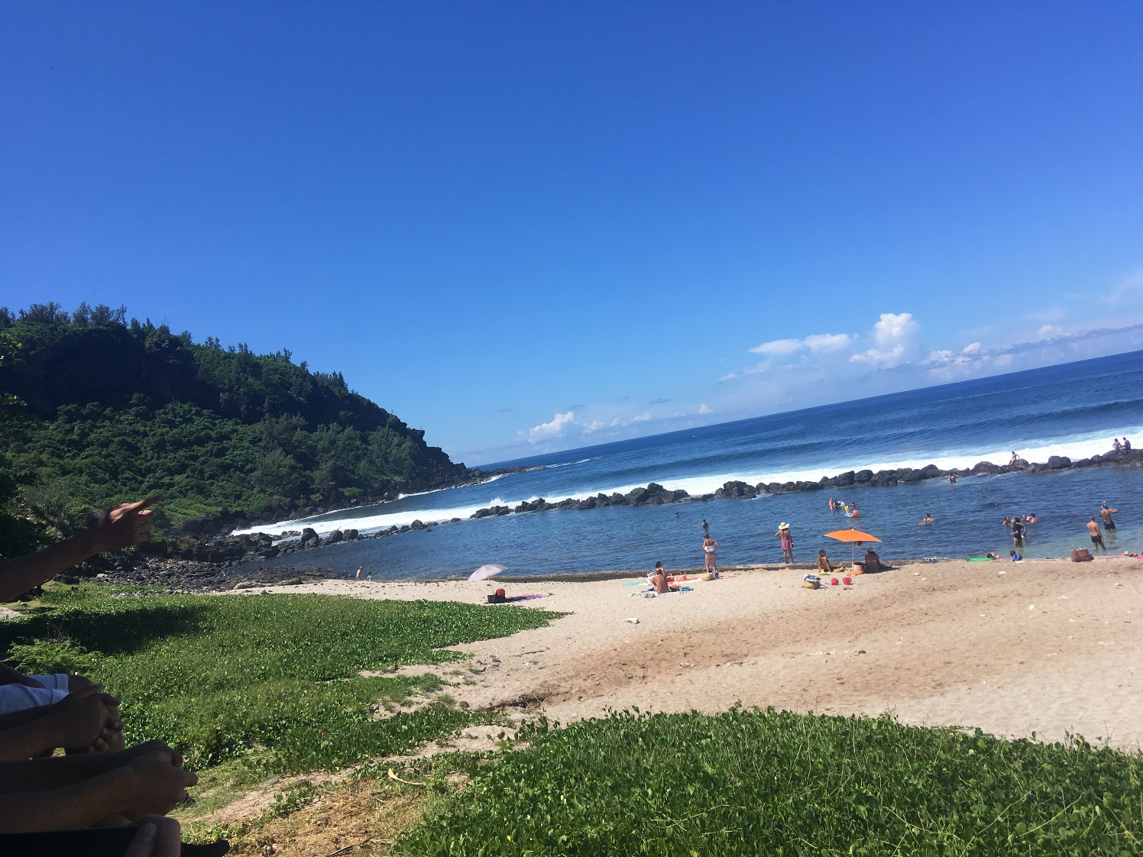
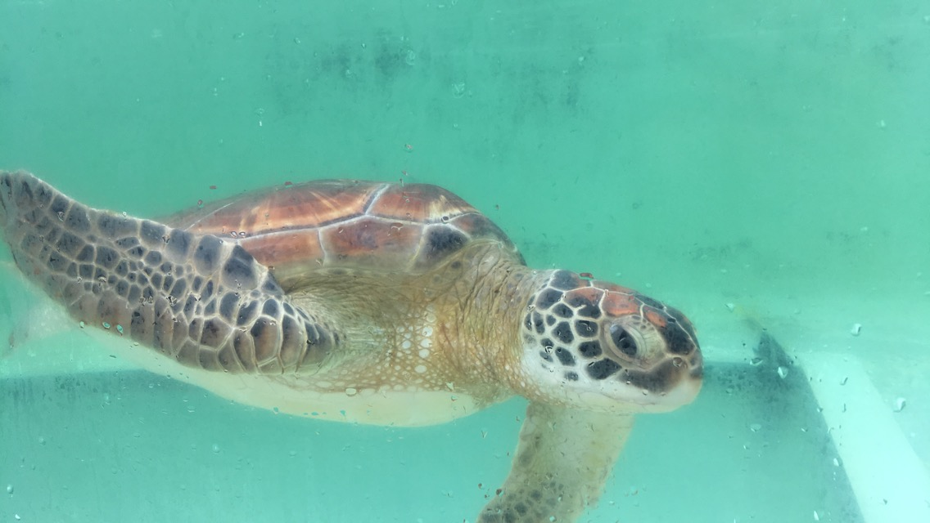

Slide 12
saturday, 24th February, 2018
We spent this day at the local market buying souvenirs. After the shopping we went for lunch by the river and soaked up some sun and had a rest. In the evening we had a picnic on the beach with all the partners and host families. It was really fun and a great opportunity to tighten friendship. By the end of the day we realised that we had to leave the next day.

Slide 13
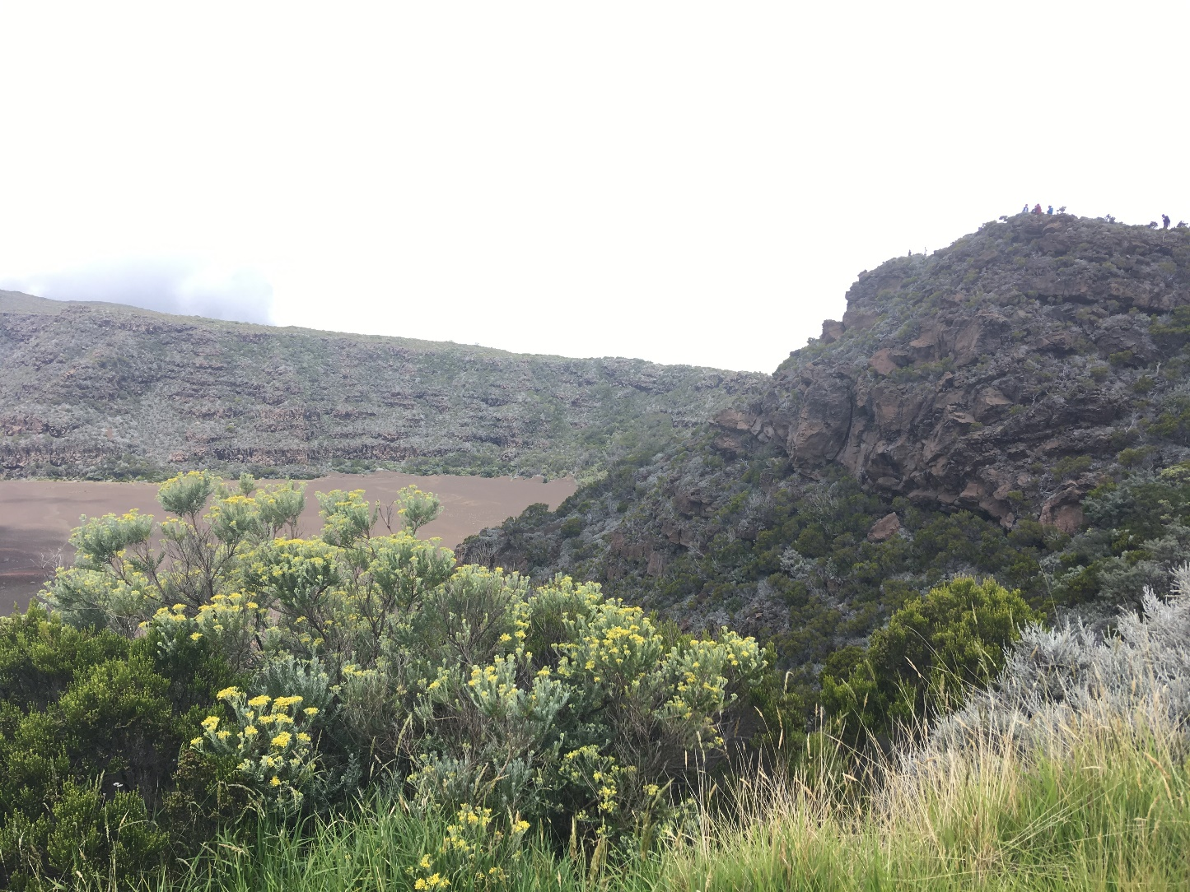
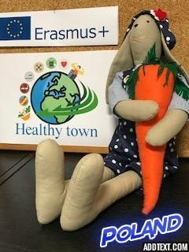

Slide 14
sunday, 25th February, 2018
This was our last day on the Island. In the morning we said goodbye to our host families and went to the museum of the Reunion volcano. After discovering how the volcano was created we went to eat lunch near this mountain. Unfortunately then we headed for the airport. On the way we stopped by the river to rest and soak up the sun. Saying ‘goodbye’ was sad because no-one wanted to leave.

Slide 16
monday, 26th February, 2018
On Monday morning we landed in Paris. Since our flight back to Warsaw was in the evening, we had a lot of time to spare, so we went for a several-hour sightseeing tour. We saw the most important places and took a lot of selfies! Our flight to Warsaw took only 2 hours 15 minutes, and then we went by minibus to Sieradz. That was definitely the travel of our lives.

