Slide 1
Poland, the center of Europe

Slide 2
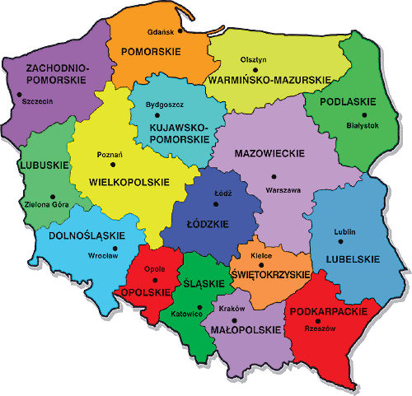
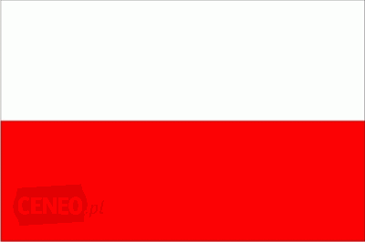
Poland is a country located in the center of Europe. Poland has 7 neighbors, access to the Baltic sea and mountains. Poland is divided into 16 voivodeship. Area of Poland is 312 679 km². Population of the country is 38,5 million people. The capital city of Poland is Warsaw where live 1,8 million people. Poland is the sixth economy of the European Union and twenty-fifth in the world.Average height of Poland is 173 m.a.s.l. The Polish flag is in white and red colours.

Slide 3
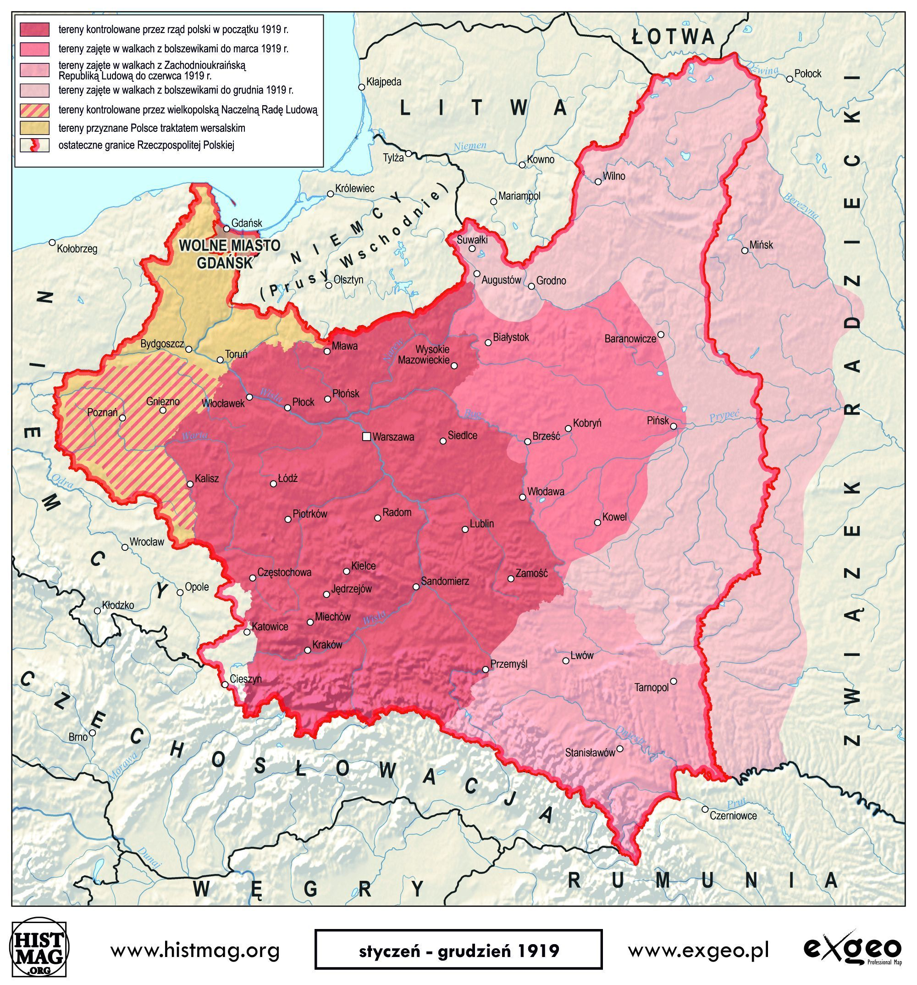
History of Poland
Poland was officially created in 966 when Mieszko I, first prince of Poland, incorporated his state into the Western circle of Christian culture. The first king of Poland became Bolesław Chrobry whose coronation took place in 1025. In 1795 Poland has disappeared from maps for 123 years. In 11 November 1918 Poland recovered independence, but Polish borders weren’t determined so shape of Poland was changing for years. The most traumatic event in poland was the World War II, in which died near 6 millions of Poles.

Slide 4
Poland is a regional power as well as a possible emerging world power. It has the eighth largest and one of the most dynamic economies in the European Union, simultaneously achieving a very high rank on the Human Development Index. Additionally, the Polish Stock Exchange in Warsaw is the largest and most important in Central and Eastern Europe. Poland is a developed and democratic country, which maintains a high-income economy along with very high standards of living, life quality,safety, education and economic freedom. According to the World Bank, Poland has a leading school educational system in Europe. The country provides free university education, state-funded social security and a universal health care system for all citizens. Situated between Eastern and Western European cultures and coined by a changing history, Poland developed a rich cultural heritage, including numerous historical monuments and 15 UNESCO World Heritage Sites. It is visited by approximately 17.5 million tourists every year (2016), making it the 16th most visited country in the world. Poland is a member state of the European Union, the Schengen Area, the United Nations, NATO, and the OECD.
Source: https://www.facebook.com/Easytravelng/

Slide 5
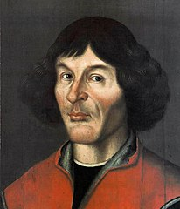
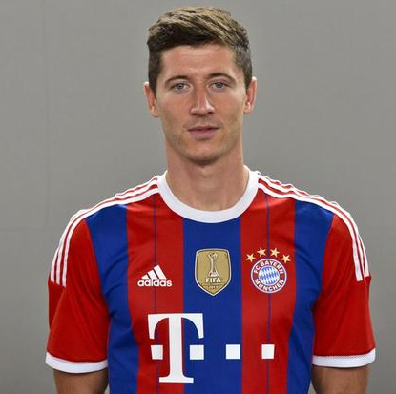
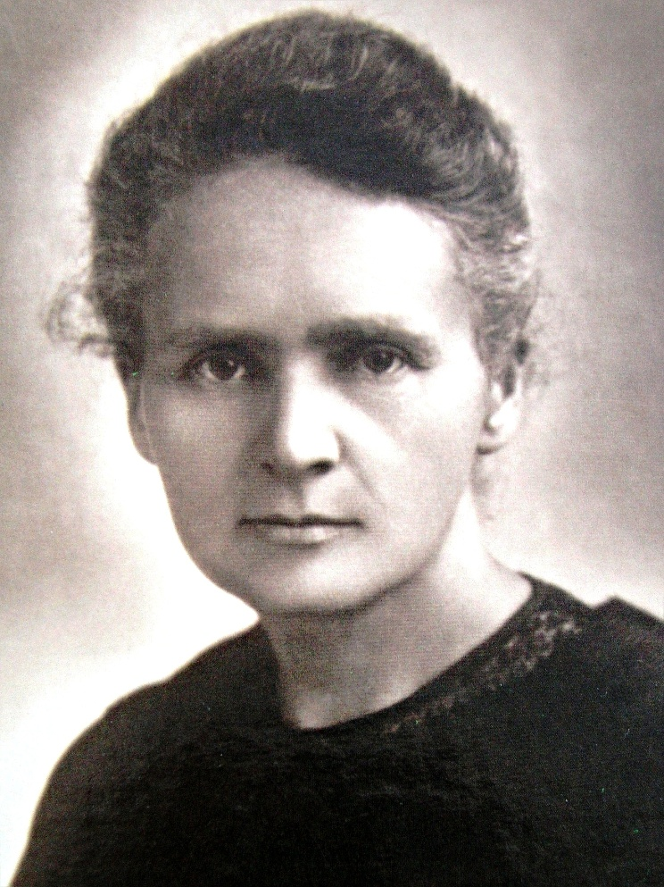
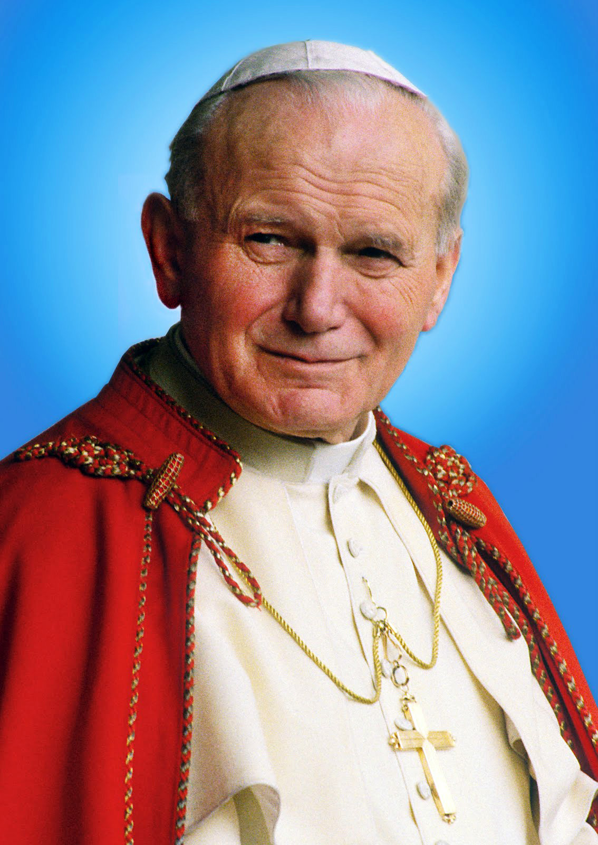
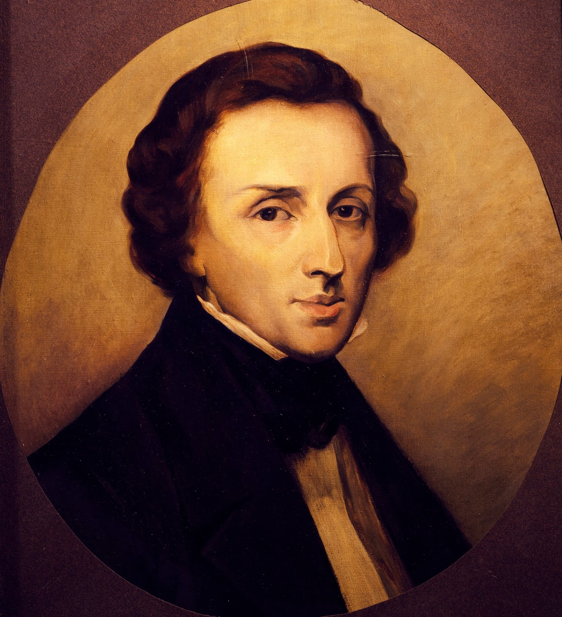
Famous people from Poland
Nicolaus Copernicus, astronomer who formulated a model of the universe that placed the Sun rather than the Earth at the center of the universe, author of “On the Revolutions of the Celestial Spheres”,
Robert Lewandowski, is a Polish professional footballer who plays as a striker for Bundesliga club Bayern Munich and is the captain of the Poland national team,
Marie Skłodowska Curie, physicist and chemist who conducted pioneering research on radioactivity thanks to she became the first woman to win a Nobel Prize,
Pope John Paul II, he was head of the Catholic Church from 1978 to 2005,
Frédéric Chopin, composer and virtuoso pianist of the Romantic era who wrote primarily for the solo piano.

Slide 6
Facts About Poland
Poles marry the youngest in the European Union
90% of Poles have completed at least secondary education
Poles eat pizza with ketchup
Nearly 35% of the 60 million Poles live abroad
The 1st floor is regarded as floor “0” so you press “1” when you want to go to the 2nd floor in the elevator
Polish constitution was first in Europe and second in the world
Watching “Home Alone” is a Christmas tradition
The Ottoman Empire was the only major country which did not recognize the Partitions of Poland
Poland is world’s biggest amber exporter
Polish alphabet consists of 32 letters (English of 26)
Poland is one of the few countries in the world, where courteous hand-kissing is still a common practice

Slide 7
Sieradz
Guest for development

Slide 8
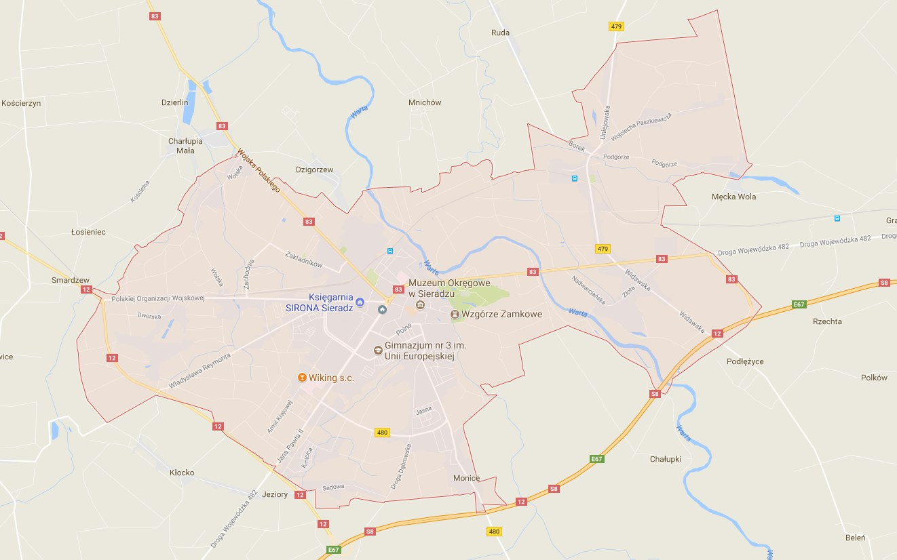
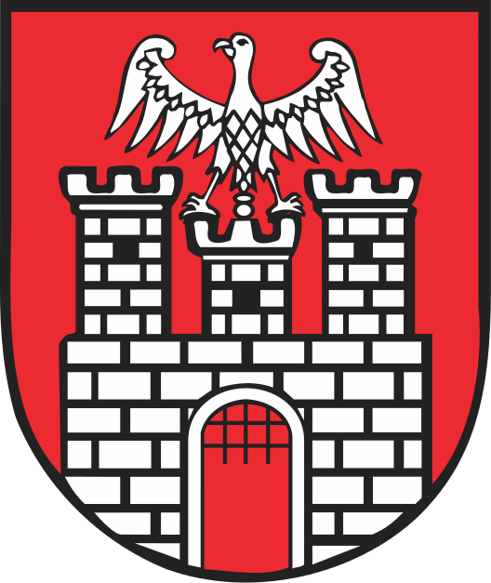
Sieradz [ˈɕerat͡s] is a town on the Warta river in central Poland with 42,762 inhabitants (2016). It is situated in the Łódź Voivodeship (since 1999), but was previously the eponymous capital of the Sieradz Voivodeship (1975–1998), and historically one of the minor duchies in Greater Poland.

Slide 9
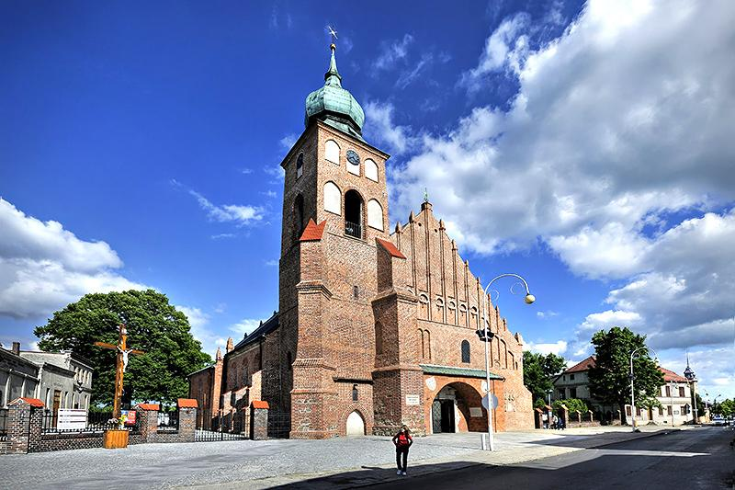
Parish church in Sieradz

Slide 10
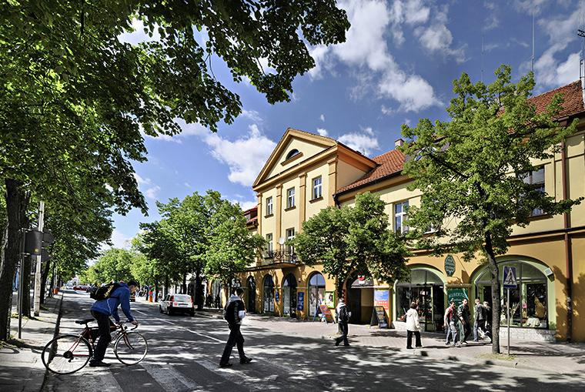
Kosciuszko street in Sieradz

Slide 11
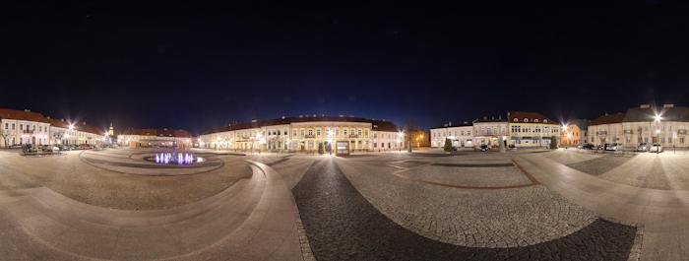
Old town in Sieradz

Slide 12
Panoramic view of Sieradz

Slide 13
High School
of Kazimierz Jagiellończyk

Slide 14
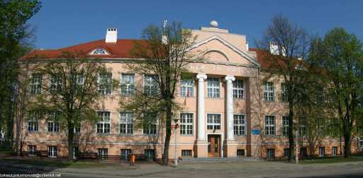
High School of Kazimierz Jagiellończyk is a school in the city center. Our High School is the oldest place of educational institution in Sieradz. The first mention about school dates from 1260. The building is inscribed on the Register of Monuments.

Slide 15
Our chemical lab

Slide 16
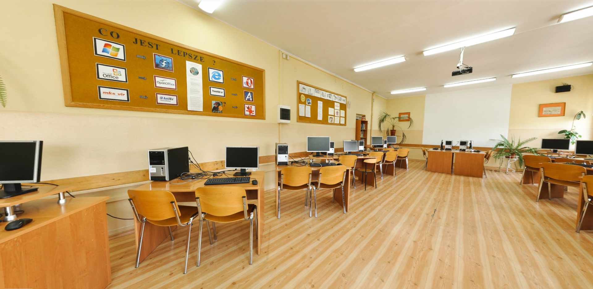
Informatic lab

Slide 17
Created by:
Source: Wikipedia, lojagiellonczyk.pl
Patryk Razny
Nicholas Kopka
High School pupils

