Slide 1
Sportive ways to spend the summer
Allison Claramunt
Mireia Garcia
Albert García

Slide 2
Introduction

Slide 3
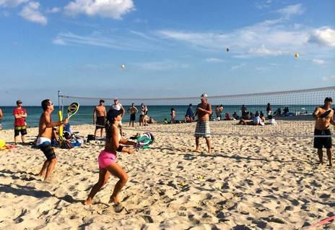
PLAYING BEACH TENNIS

Slide 4
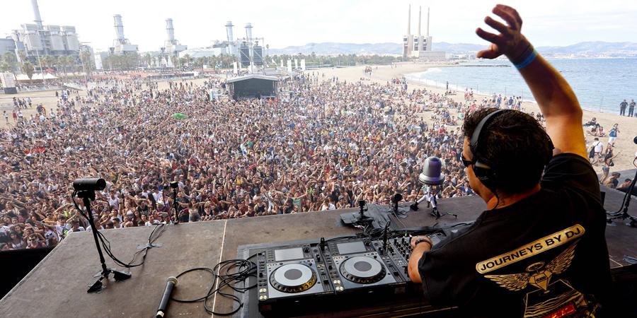
Attend a festival

Slide 5
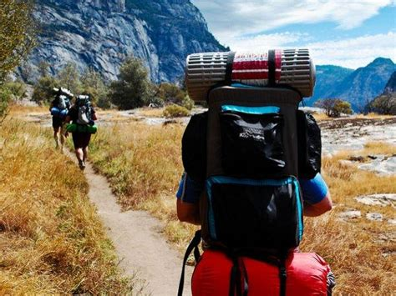
Travel

Slide 6
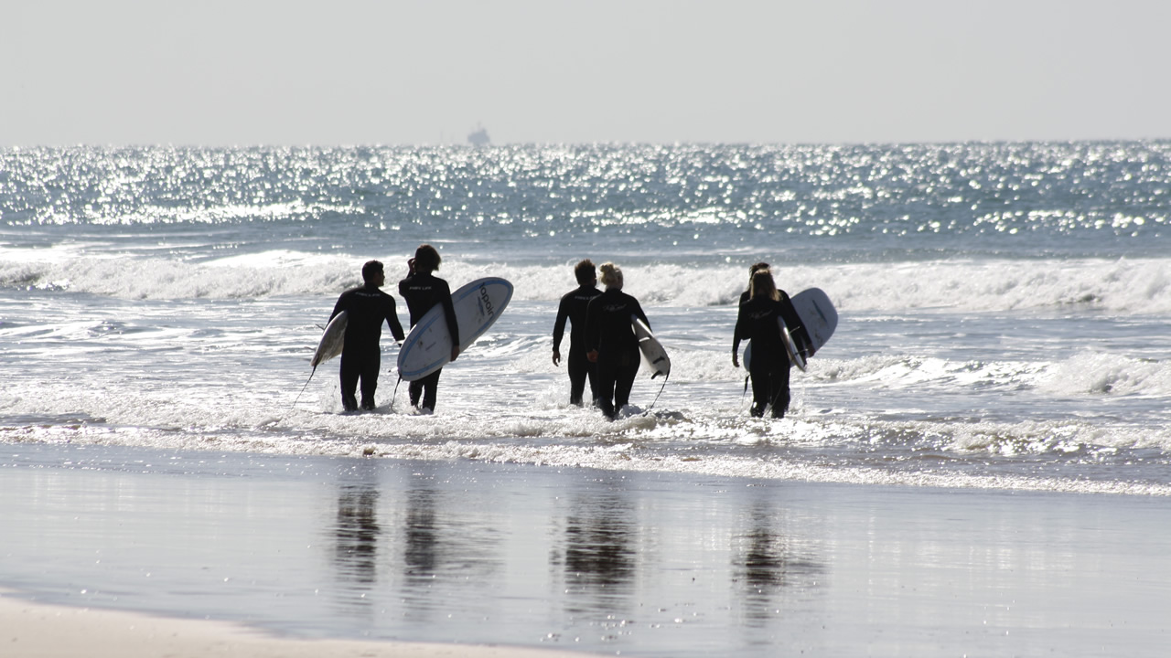
Go surfing with your friends

Slide 7
