Slide 1
Hanging around...
Our country, our city and our school

Slide 2
POLAND

Slide 3
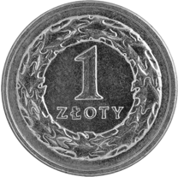
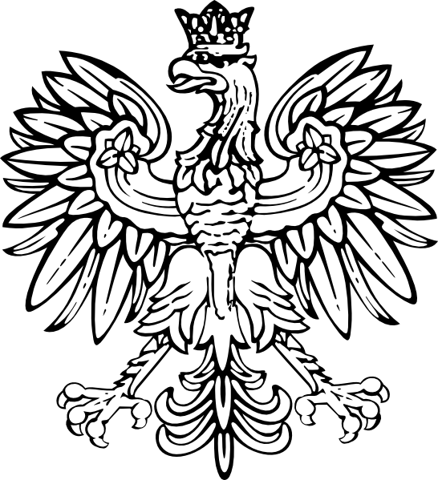
Here are some basic facts:
Poland is the 9th largest country in Europe
Our currency is Polish zloty
Cabbage rolls (Gołąbki) are said to be one of the most popular Polish dishes
It is a homeland to over 38 million people and about 21 million ones
of Polish origin who live abroad
The White Eagle (Orzeł biały) is our national symbol

Slide 4
Polish national anthem
The lyrics were written by Józef Wybicki in Reggio Emilia, Cisalpine Republic in Northern Italy, between 16 and 19 of July 1797, two years after the Third Partition of Poland erased the Polish–Lithuania Commonwealth from the map. It was originally meant to boost the morale of Polish soldiers serving under General Jan Henryk Dąbrowski's Polish Legions that served with Napoleon's French Revolutionary Army in the Italian campaigns of the French Revolutionary Wars.
It is also known as "Song of the Polish Legions in Italy" and "Poland Is Not Yet Lost"

Slide 5
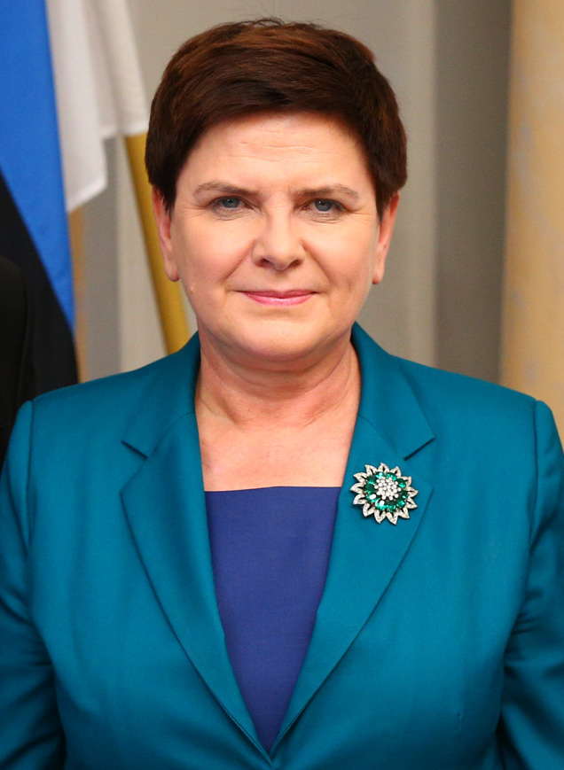
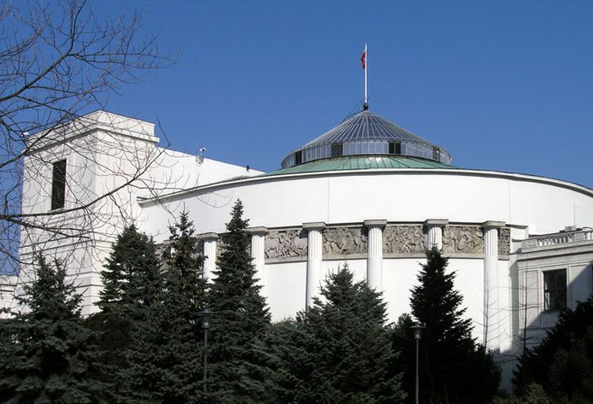
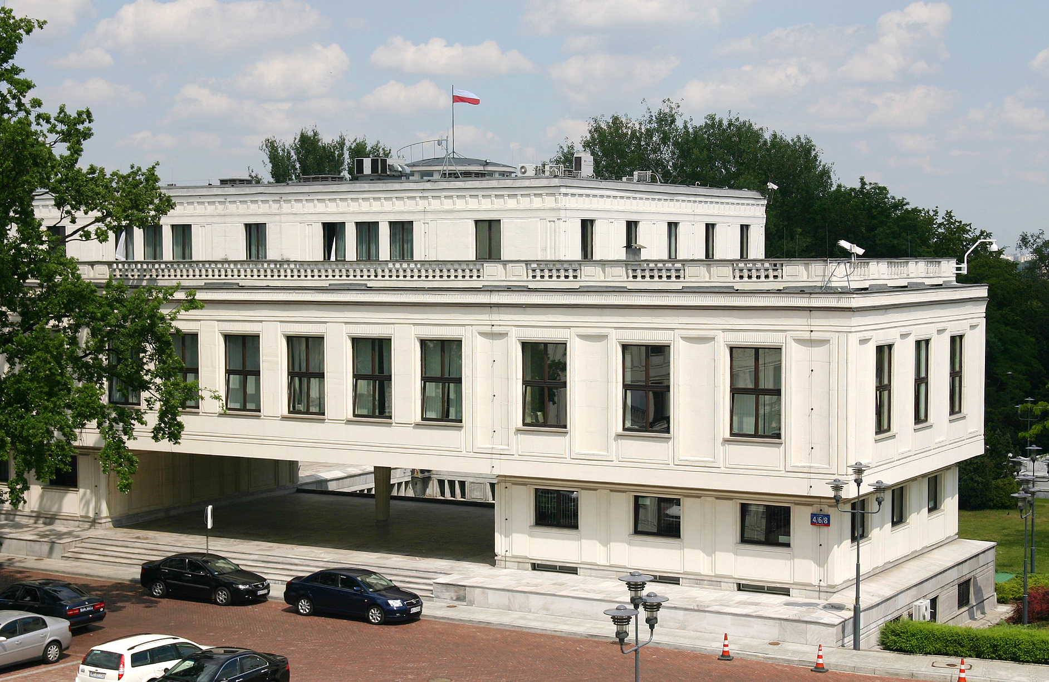
Politics of Poland
Beata Szydło,
The Prime Minister of Poland
Andrzej Duda, The President of Poland
The Polish Parliament has two chambers. The lower chamber (Sejm) has 460 members, elected for a four-year term. The Senate (Senat) has 100 members elected for a four-year term.

Slide 6
Warsaw – Paris of the East

Slide 7
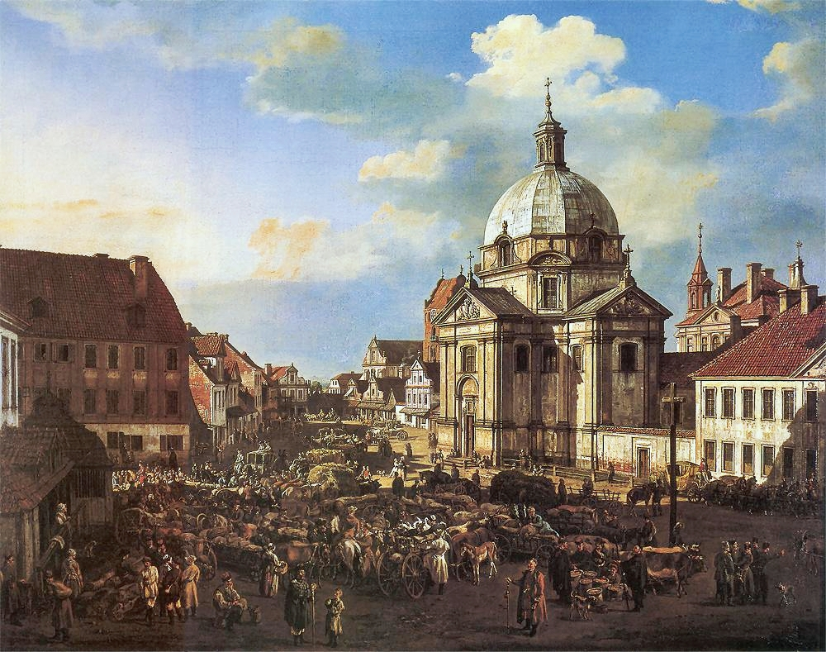
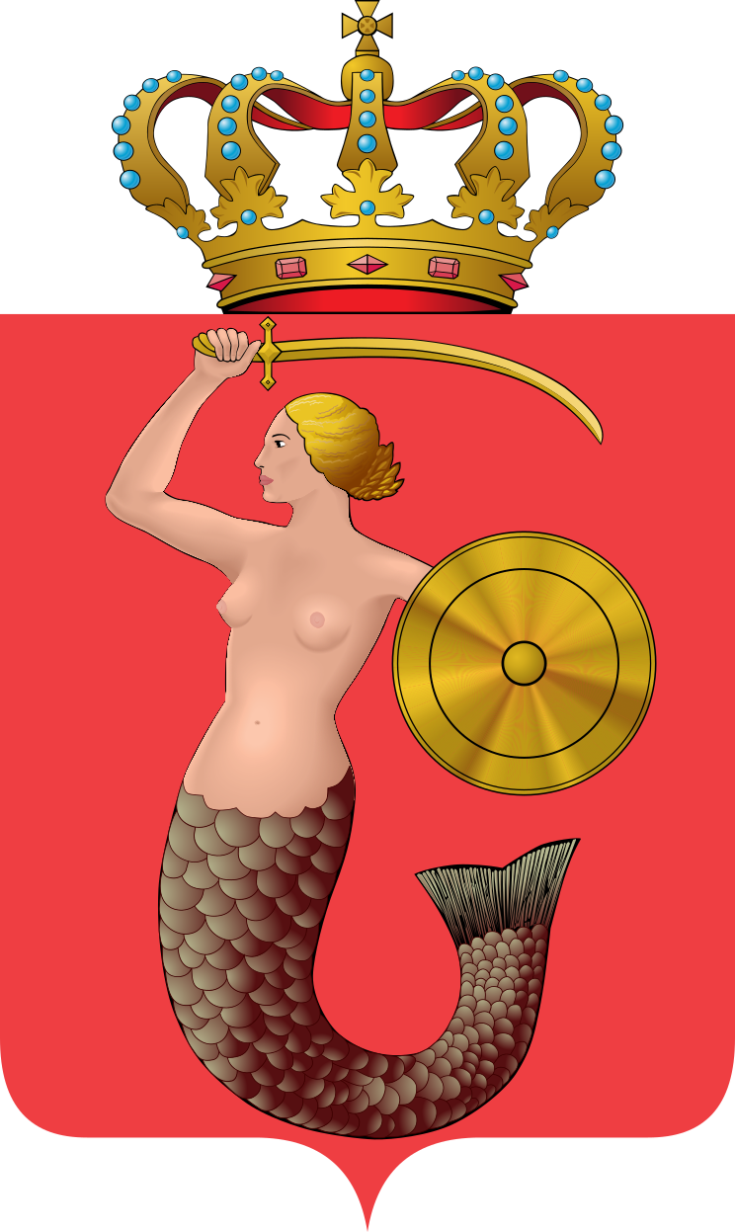
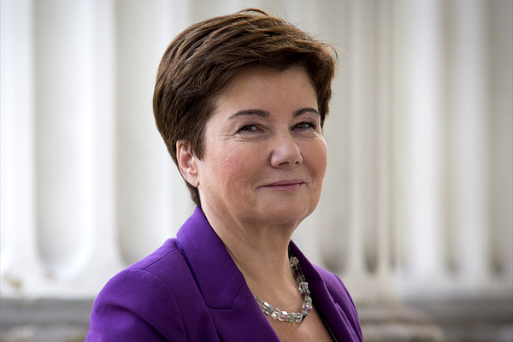
The symbol of Warsaw
The Flag of Warsaw
Warsaw New Town in 1778. Painted by Bernardo Bellotto
Hanna Gronkiewicz-Waltz, The President of Warsaw

Slide 8
Castle Square

Slide 9
Copernicus Monument

Slide 10
Royal Baths Park

Slide 11
Palace of Culture and Science

Slide 12
Now let's move on to Sieradz...

Slide 13
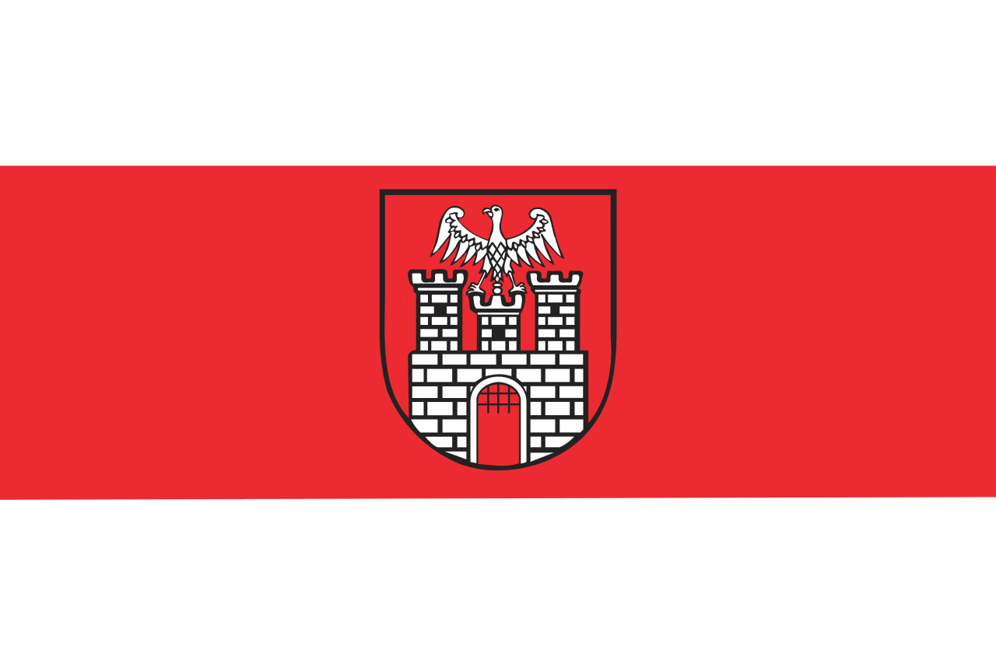
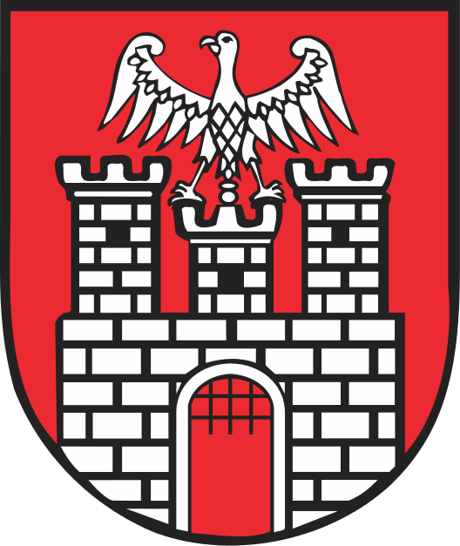
Some basic information
Sieradz is placed in the heart of the country. It is also one of the oldest cities in Poland. About 43 thousand people live here. The first piece of information that came out was from Bulla Gnieźnieńska (XII century) which is a formal document signed by a Pope.

Slide 15
The Square in Sieradz

Slide 17
Saint Stanisław Church
A roman catholic church built in 1233-1245 as one of the oldest dominican temples in Poland. Currently it is owned by Zgromadzenie Sióstr Urszulanek Serca Jezusa Konającego.

Slide 18
Kolegiata Wszystkich Świętych w Sieradzu (All Saints Collegiate Church in Sieradz)

Slide 19
It was built in 1370 in a Gothic style. During The Medieval Period, it was the most important place in Sieradz.

Slide 20
The Castle Hill

Slide 21
It comes from The Medieval Period. There used to be a castle which had been destroyed.

Slide 22
Some pages about Sieradz
Sieradz.naszemiasto.pl
sieradz.com.pl
Sieradz to my
Sieradz Praga
Most of the pictures I've posted come from aforementioned pages.

Slide 23
Kazimierz Jagiellończyk High School in Sieradz
A virtual walk

Slide 25
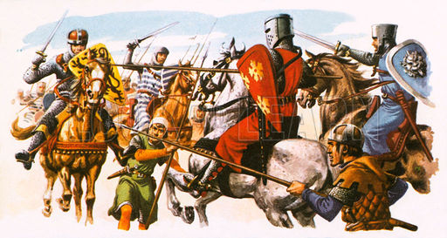
Kazimierz Jagiellonczyk High School is one of the oldest schools in Poland. The first piece of information about it came out in the XIII century.

Slide 26
1937

Slide 27
1942
After The Second World War had broken out, the title "Wiedza to potęga" ("Knowledge is power" was destroyed.

Slide 28
1965
When the war was over, the title came back to its place.

Slide 29
2016

Slide 30
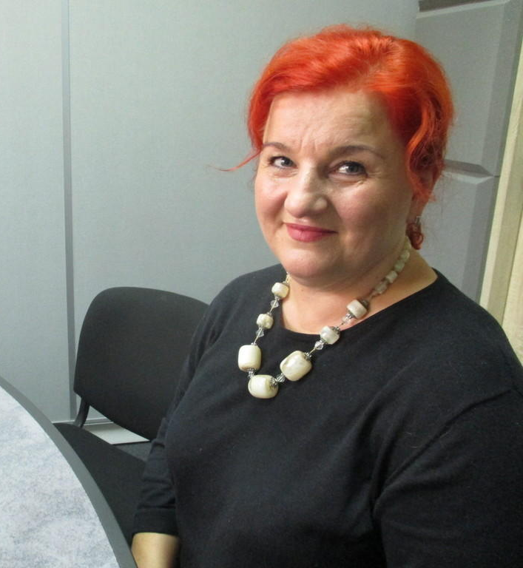
The School Authorities
MSc Eng. Grzegorz Pietrucha, The Headmaster
Mrs Jowita Królikowska, The Deputy Head

