Slide 1
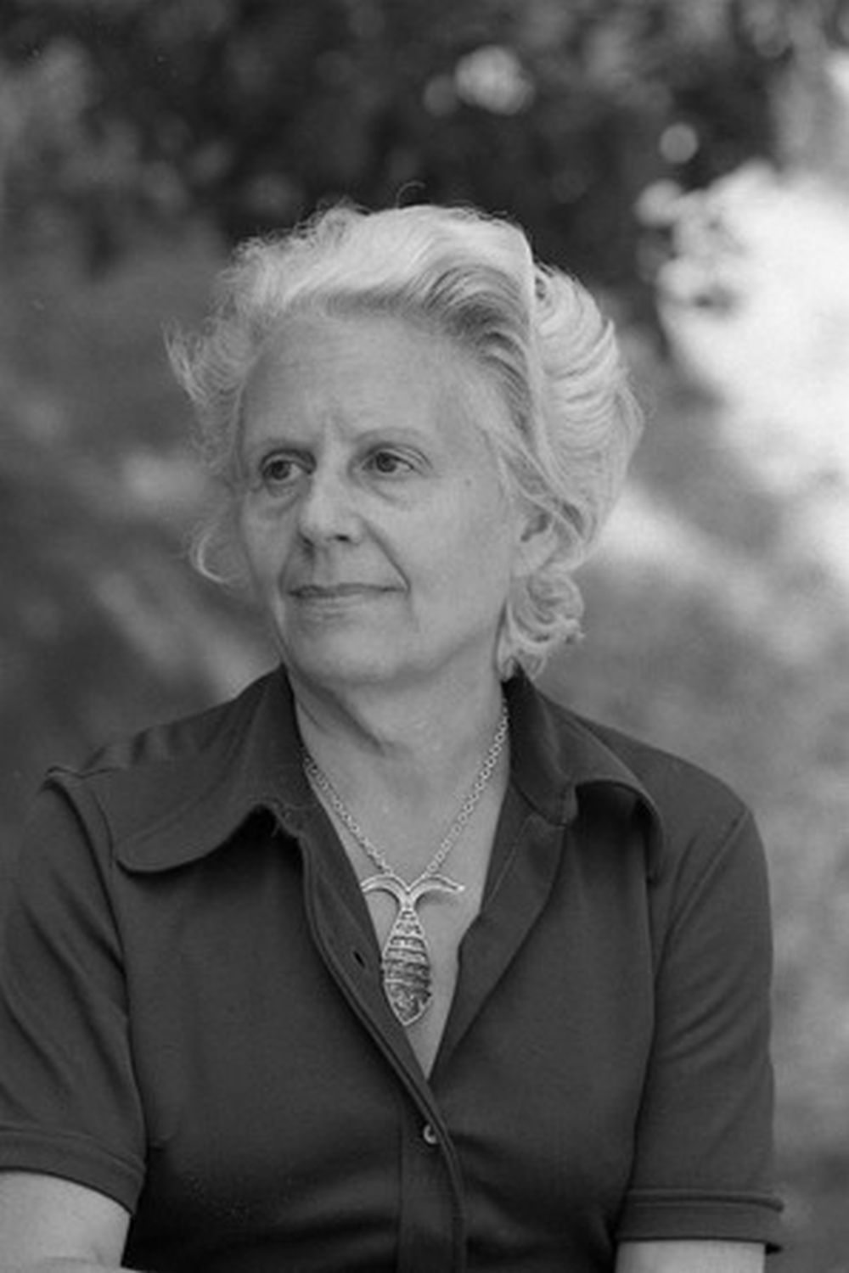
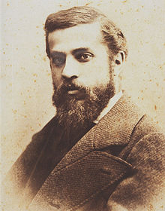
Historical Catalan figures
Mar Llorens
Víctor García
Ingrid Canalda
Dani González

Slide 2
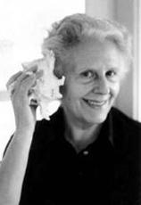
Mercè Rodoreda
Barcelona
1908-1983
Exiled to France during the civil war
Soc una dona honrada?
Aloma
La plaça del diamant
Died of cancer at the age of 75

Slide 3
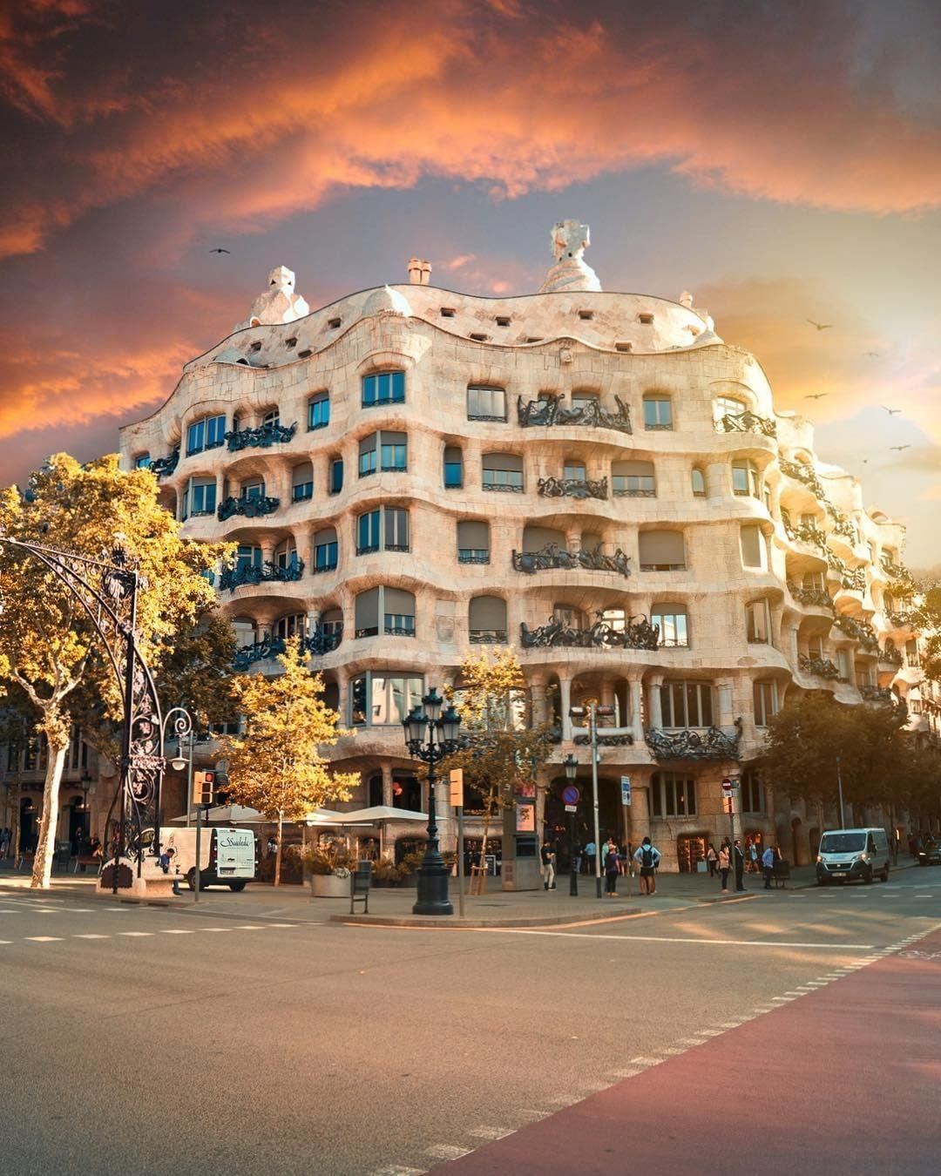
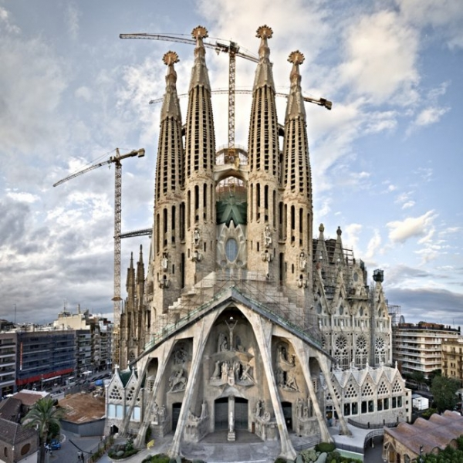
Antoni Gaudí
Reus (Barcelona)
1852-1926
Most important modernist architect
Parc Güell
Casa Batlló
Casa Milà
Sagrada familia
Killed by a tram

Slide 4
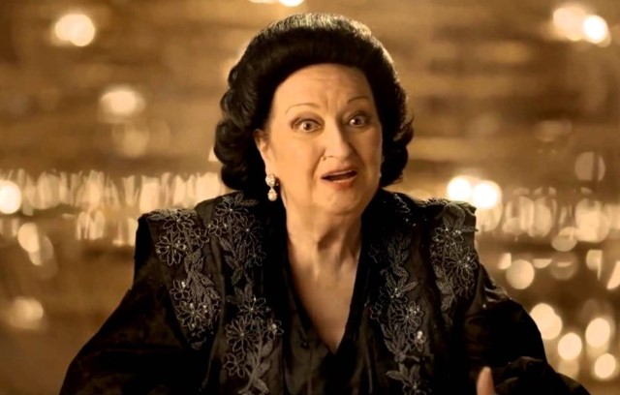
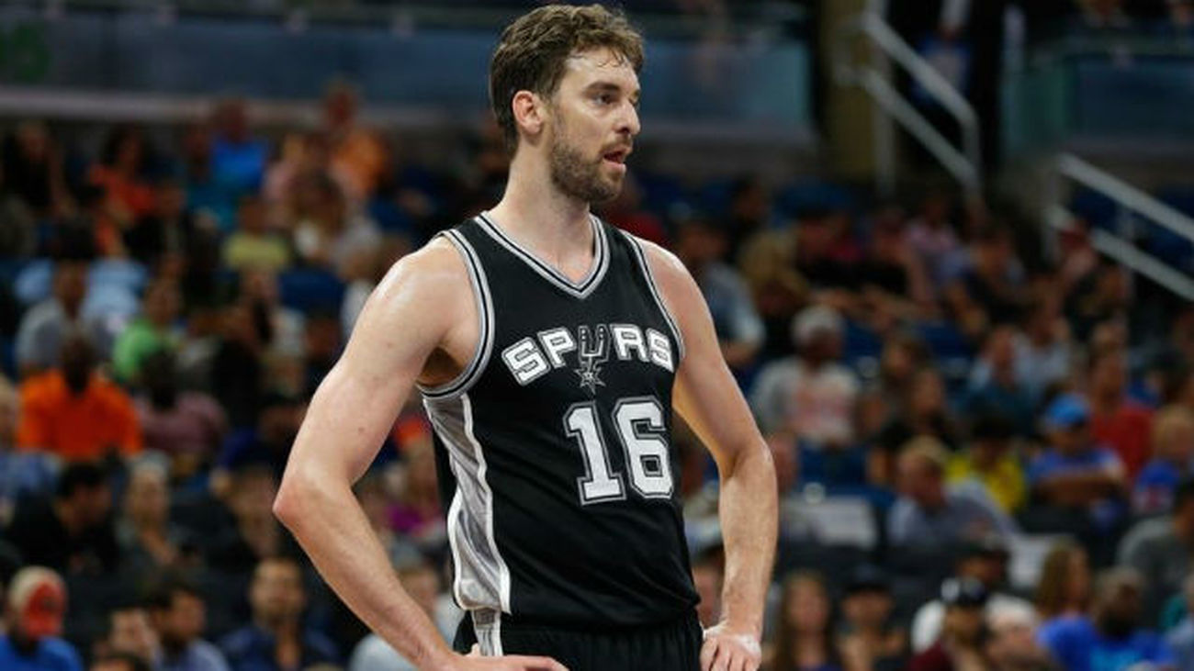
Other important figures
Montserrat Caballé
Marc Márquez
Ferran Adrià
Pau Gasol
Mireia Belmonte
Xavi Hernández

