Slide 1
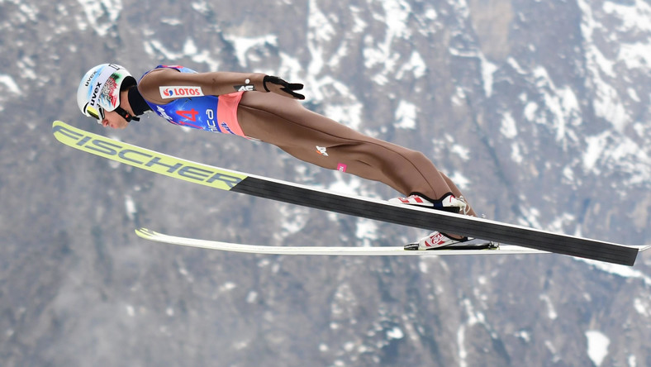
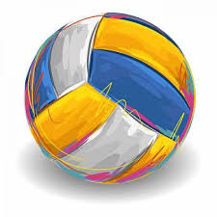
Popular sports in Poland

Slide 2
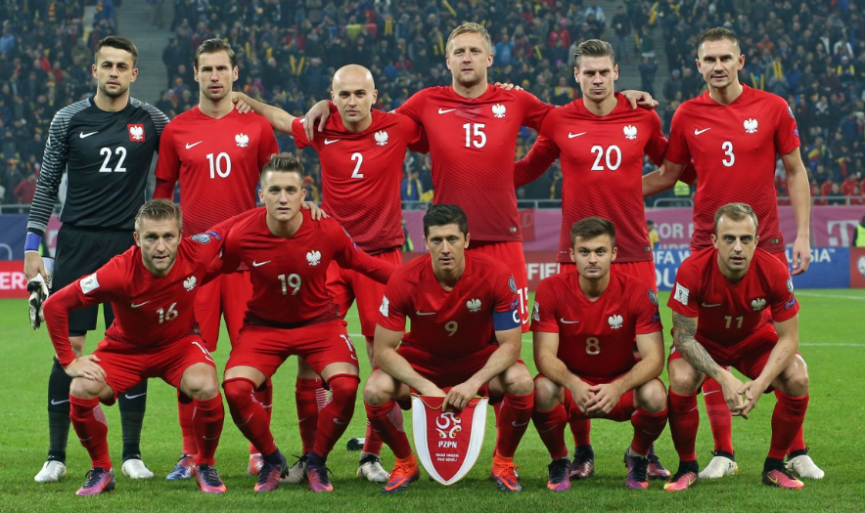
Football is definitely the most popular sport in Poland. The first professional clubs were founded in the early 1900s and the first match of Polish National Team was played in 1921.

Slide 3
Polish Football Association
PZPN was started on December 1919 in Warsaw. It’s founder was Edward Cetnarowski with the seat in Cracow.

Slide 4
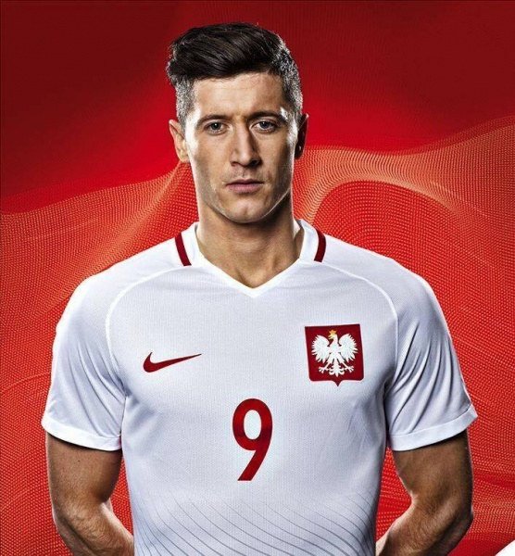
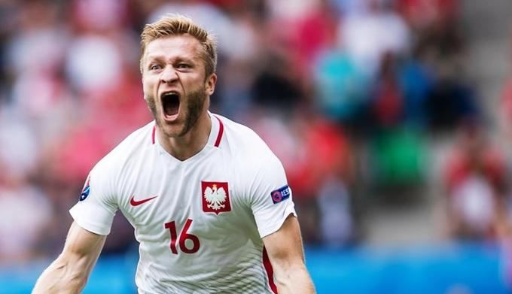
THE MOST FAMOUS POLISH FOOTBALLERS

Slide 5
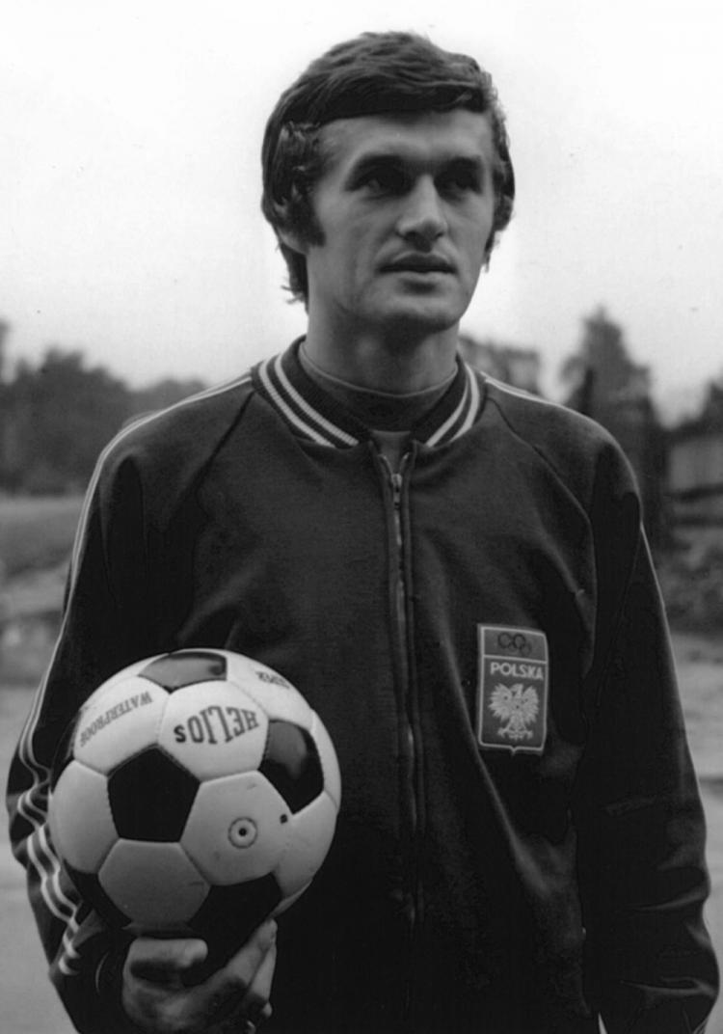
Włodzimierz Lubański
He’s a former Polish football striker, the all-time highest goal scorer for the national team.

Slide 6
Zbigniew Boniek
Boniek represented Poland in 80 international matches and scored 24 goals. He won a bronze medal as a player of the Polish team in the 1982 FIFA World Cup.

Slide 7
Wojciech Szczęsny
He is a Polish footballer who plays for Arsenal London and the Polish national team as a goalkeeper

Slide 8
Robert Lewandowski
He plays as a striker for the German Bundesliga club Bayern Monachium and the Polish national team.

Slide 9
National Stadium in Warsaw

Slide 10
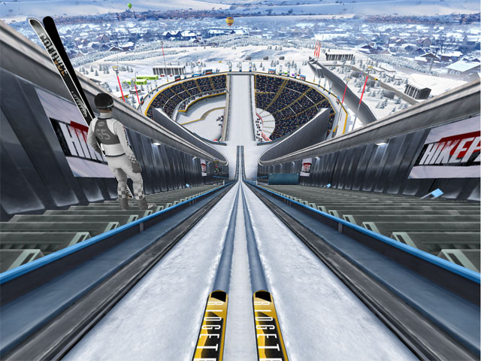
Skijumping

Slide 11
Kamil Stoch
He is one of the most successful ski jumpers from Poland, as well as in the history of the sport, having won two overall World cup titles, two consecutive Four Hills Tournaments, three individual gold medals and a team bronze at the Winter olympics

Slide 12
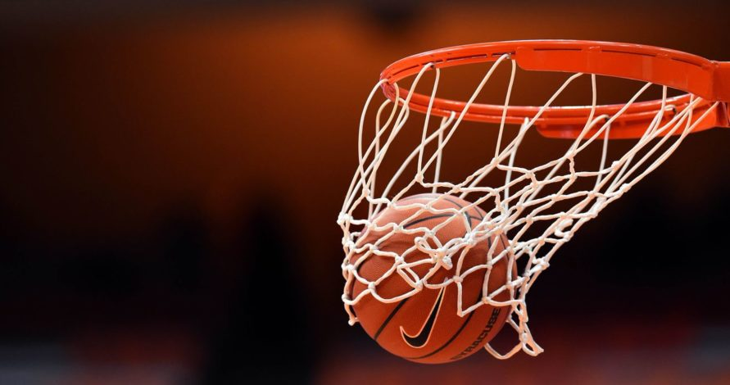
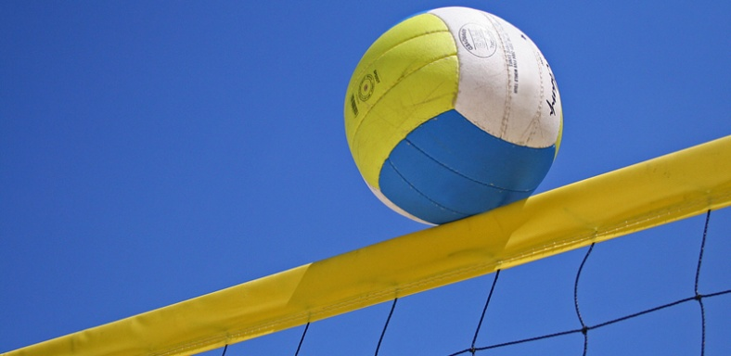
Famous volleyball and basketball Polish players

Slide 13
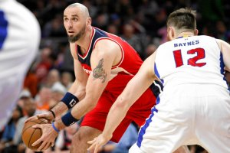
Basketball
Marcin Gortat is one of the most wildely recognized basketabll players not only in Poland, but also in the whole World. This 34-year-old man comes from Lodz( a city in central Poland, nearby Sieradz) and nowadays he belongs to far and away the most famous team in the USA – Washington Wizards. He started as a Polish basketball player in Lodz, but then step-by-step he achieved his goal, and finally he became the first Pole in history, who played in NBI.
Some curiosities about Gortat
1. He’s 2,13 m height might surprise even professional players.
2. He set up his own charitable foundation in 2009, whose main aim is to supprt, escpecially finacially, skilled youth to fulfill their dreams about sports carrers.

Slide 14
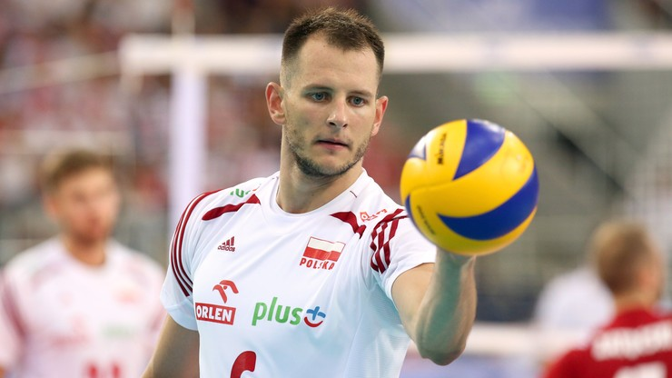
Volleyball
Bartosz Kurek is one of the best Polish volleyball players. He’s in his thirties and grew up in Walbrzych (near Wroclaw in west Poland). Currently he plays for the Ziraat Bankasi Ankara team, but he is also a member of the official Polish National Team.

Slide 15
Mariusz Wlazly is a Polish former representative, however he still supports his team and is the best example of successful and talented volleyball player. He’s homehome is Wielun (a small town in central Poland). He took part in the World Championships twice.

Slide 16
Created by:
Thanks for your attention!
Natalia Jackowska, Aleksandra Fryncel

