Slide 1
Education in
Northern Ireland

Slide 2
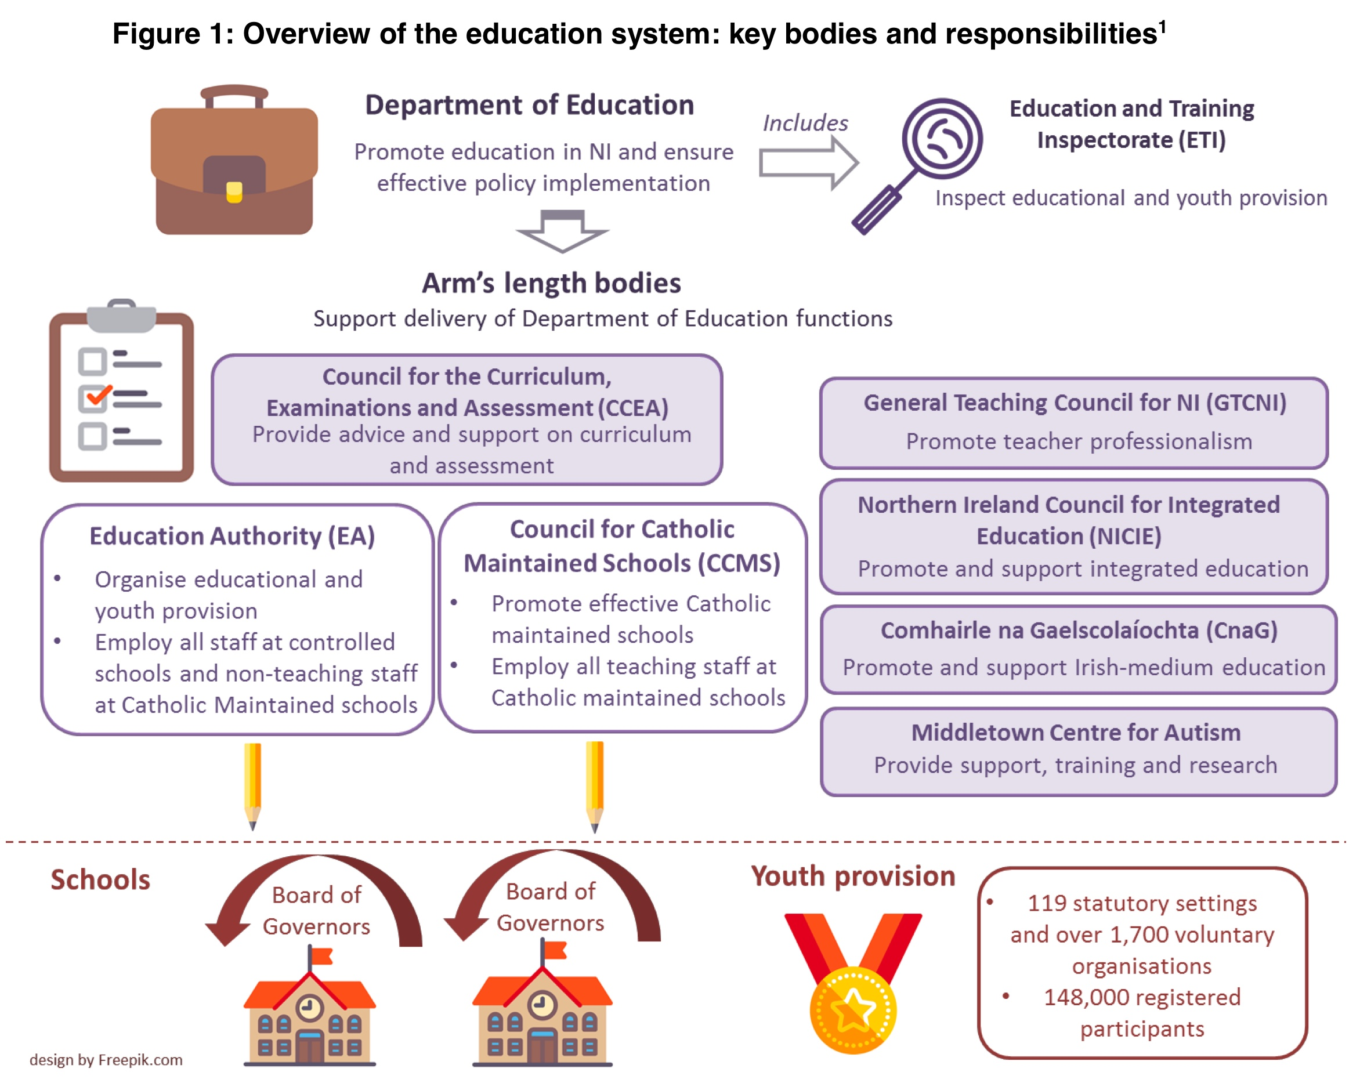

Slide 4
Nursery / Pre-School Education
Age 3-4
Not Compulsary
Competition for places.
Foundation Stage Curriculum
Activity Based Enriched Curriculum.

Slide 5
Primary Education
Age 4-11
Compulsary
Criteria for admissions
Curriculum
Assessment
Budget
Transfer procedure

Slide 6
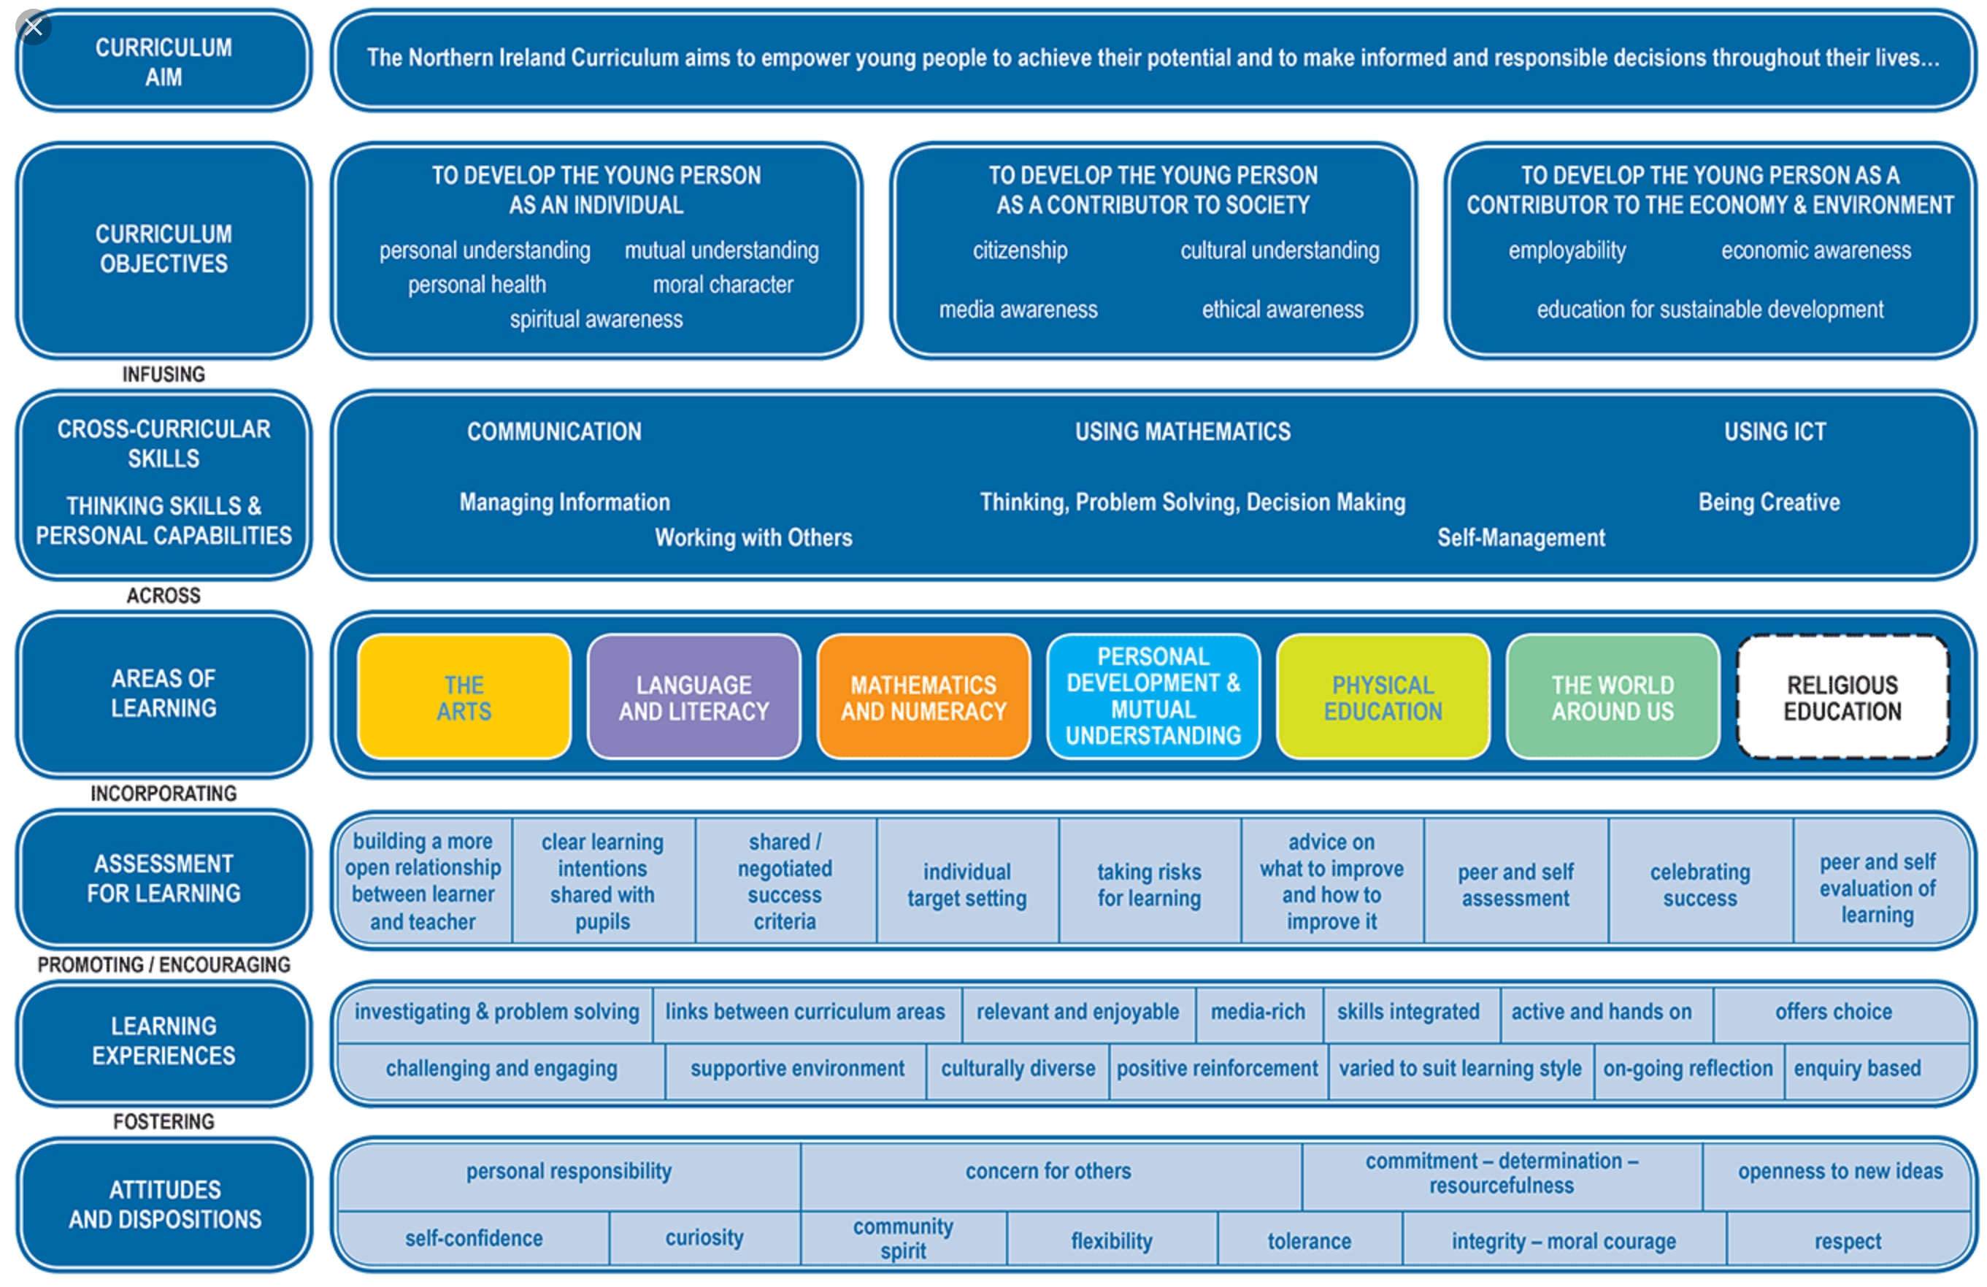

Slide 7
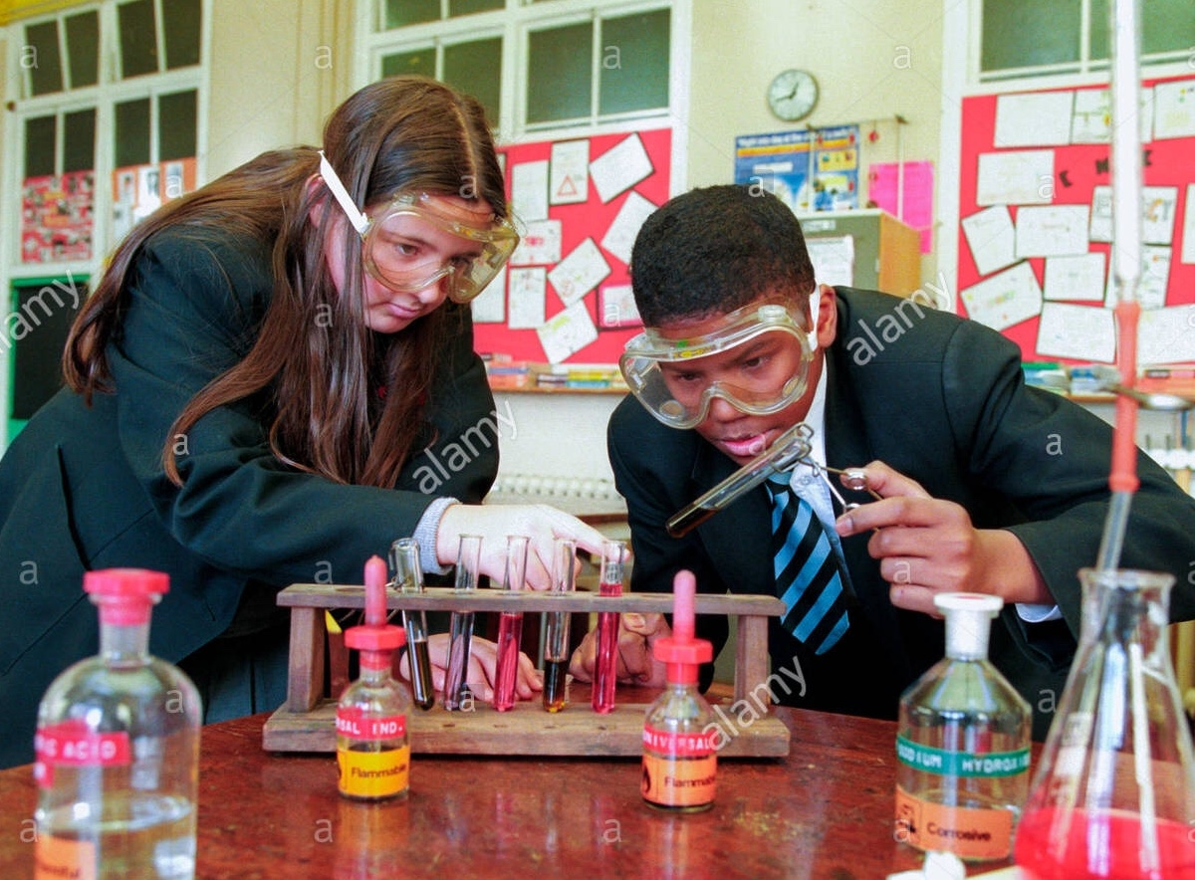
Secondary Education
Secondary / Grammar schools
Curriculum
Assessment - GCSE / AS/ A LEVEL
Budget

Slide 8
Secondary Level Examinations
General Certificate in Secondary Education (GCSE)Age 16
AS Level Examinations
Advanced Level Examinations (A Level) Age 18
Vocational Courses and Examinations.

Slide 9
Third Level Education
Further Education Colleges
Apprenticeships
University
College Fees are paid by students for most Third Level Courses.

